Slide 1
Traffic Anomaly Detection
EURECOM - Student Project, Spring 2021
Students: NOTTARIS, Matteo - MICHEL, Maxime - ŠKRABEC, Bernat
Supervision: JAMEL, Mohamed, Prof. DUGELAY, Jean-Luc

Slide 2
Outline
Problem statement, context and motivation
Data description
Previous work and state of the art
Explored approaches and experiments
Final strategy
Results
Possible improvements
Conclusions

Slide 3
Problem Statement, Context and Motivation
The delay between an accident and the response team reaction creates traffic issues and sometimes costs lives
Nowadays video surveillance system are established in a large majority of public areas, including highways
Our goal :
Use those traffic videos and several state of the art computer vision techniques to create an efficient anomaly detection system for traffic monitoring.

Slide 4
Data Source - AIC21 Track4 Dataset
Time-synchronized videos from traffic cameras
100 training and 150 test videos, ~15 min each
410p feeds at 30 fps
Anomalies, time-stamps (st-et) for the videos:
Car crashes
Stalled vehicles
14 GB of data total

Slide 5
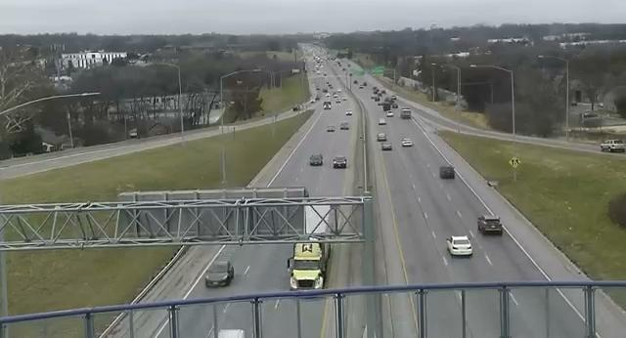
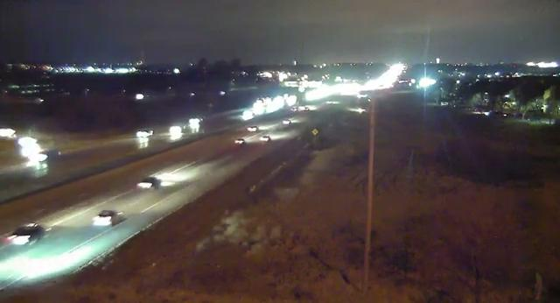
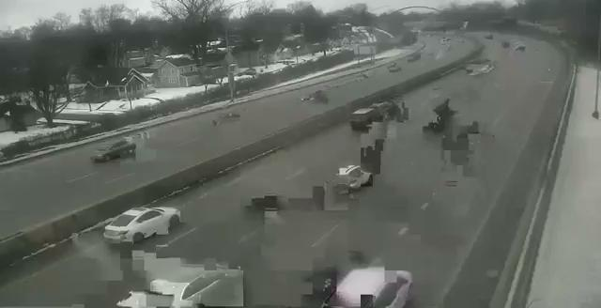
Challenging data
Cars too far away
Bad resolution
Vibrations/Defaults

Slide 6
State of the art
4 approaches:
Analysing each vehicle to focus on the accident [Kyu Beom Lee, 2019]
Detecting changes in the environment [Nejdet Dogru, 2016]
Predicting the accident [Honglei Ren, 2018]
Unsupervised Learning [JiaYi Wei, 2018]

Slide 7
Explored approaches
Car tracking
High level semantics - Object recognition
Detect the cars using object detection
Better accuracy and less false positives
Much more challenging
Low level semantics - Optical Flow
Reduce the feature space to tracks of moving points
Increased false positive rate
Anomaly detection
Comparing a learned prediction with reality
Deviation from prediction defined as anomalous behaviour

Slide 8
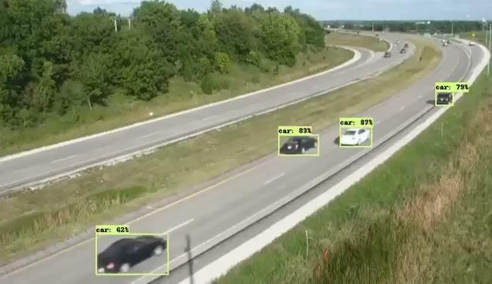
Car Detection and Tracking : EfficientDet
Description :
DL detection algorithm [Tan 2020] (Google)
Good accuracy on clear images
Can detect both people and cars/trucks
Issues :
Doesn’t detect cars that are far away
Problem of consistency
Requires good hardware to run

Slide 9
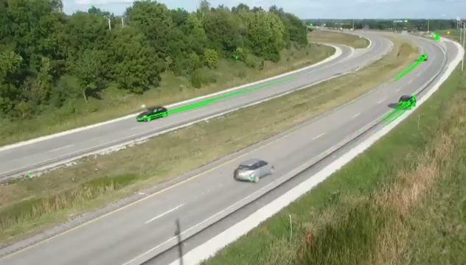
Car Detection and Tracking : Optical Flow (LK)
Description :
Corner detection
Optical flow [B. D. Lucas and T. Kanade (1981)] on corners
Discard bad points
Max length of track
Issues :
Stopped cars aren’t detected
Multiple tracks per car
Shadows and other objects are sometimes detected
During night, the headlights confuse the results
Assumes a static camera

Slide 10
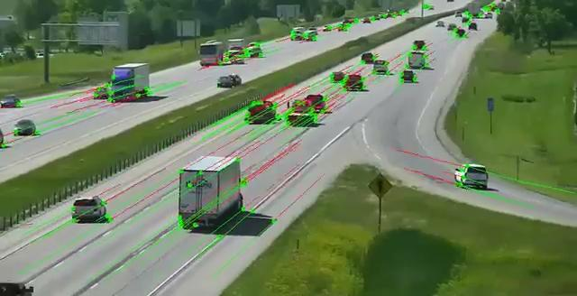
Trajectory prediction
Objective : Predict future positions of vehicles to compare and see if there are anomalies
How : Linear Model / LSTM
Linear Regression :
Promising but we need more complexity (curves …)

Slide 11
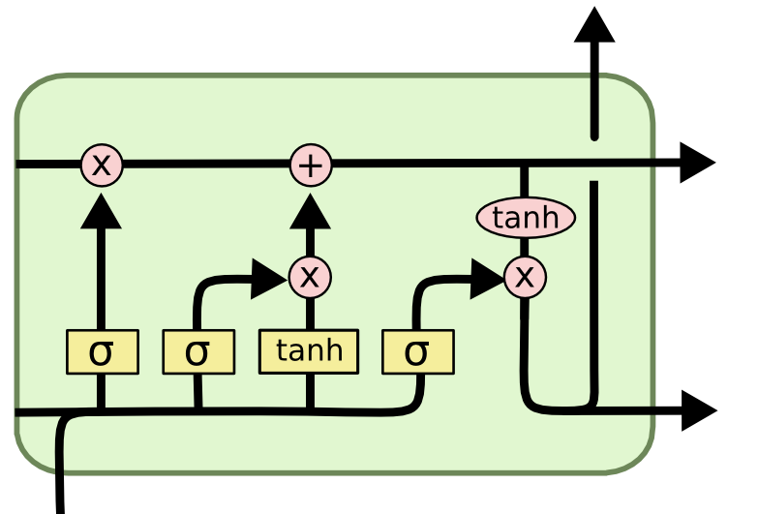
Trajectory Prediction - LSTM
X [N, 20, 2]
y [N, 10, 2]
LSTM BLOCK
[N, 64]
Long Short-Term Memory - [Hochreiter 1997]
RNN very well suited for sequence modeling
Our input are sequences of 2D points that constitute a track. Given some points, we want to predict the next ones
FC LAYER
[N, 128]
RELU
FLATTEN
FC LAYER
[N, 32]
RELU
FC LAYER
ŷ [N, 20]
y [N, 20]
MAE LOSS
LSTM Block
Our model architecture

Slide 12
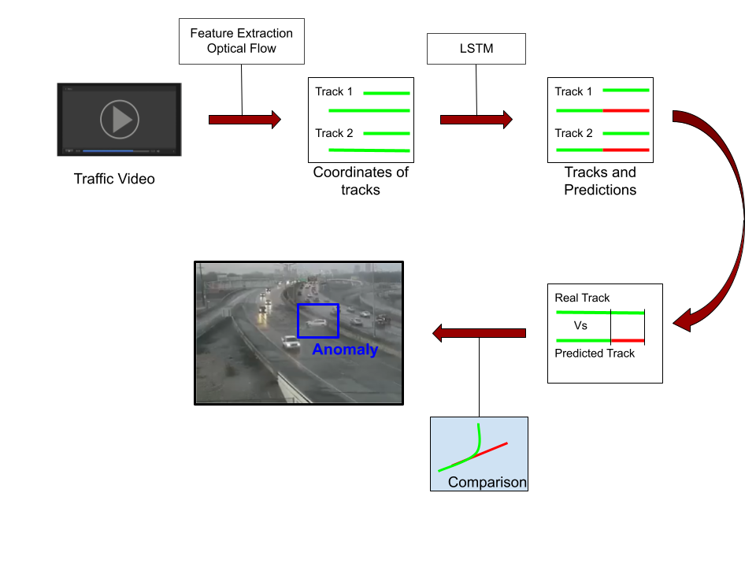
Final strategy - Pipeline

Slide 13
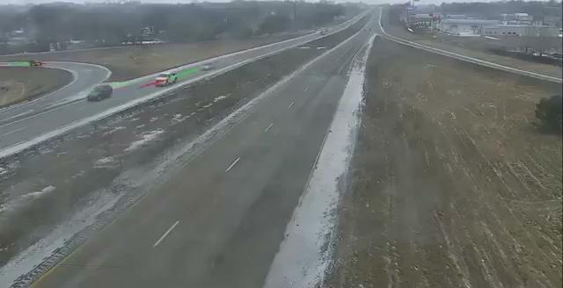

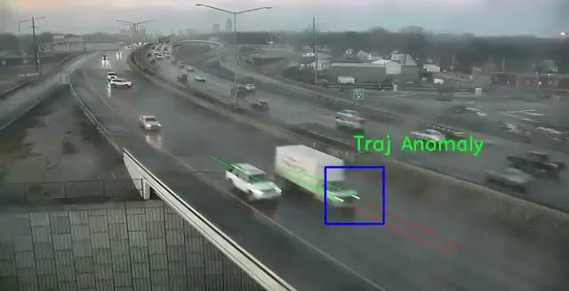
Results
Success
Failure
Reasons of failure :
Video Freezing
Very blurry images
Light reflections

Slide 14
Disclaimer and possible improvements
Our approach is far from perfect
It requires an ideal environment
Limited noise, static camera, etc.
It assumes we have access to at least 2 min of nominal recording
We need to tune the LSTM to the setting
But it’s the best we could do given the constraints
An ensemble approach could mitigate the fragile requirements
Different models for each task
Image-based models for vehicle re-identification
Object detection to detect people, fire, etc.
More and varied data could allow us to have a more general model
No need to tune to a particular environment

Slide 15
Conclusions
We have delved into a very challenging problem
We researched the state of the art and studied multiple tools and techniques
Optical Flow
Object Tracking
Sequence Modeling
etc.
We have shown a simple, example solution, with many caveats
Given our experience and tools, the best we could do
The whole experience has been very formative
We learned by doing
Even if the end result is not perfect, we take home very useful knowledge

Slide 16
Thank you for your attention
?
We’ll be happy to address any questions you may have
?

