Slide 1
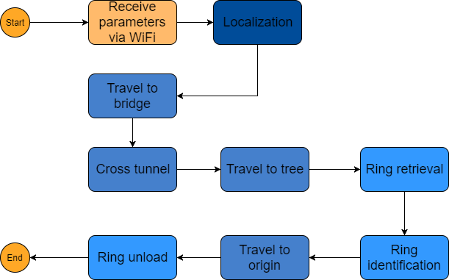
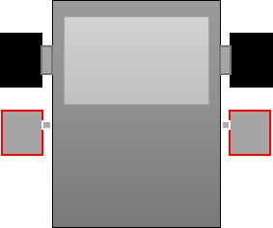
Preliminary Design
Localization design
Travelling design
Ring retrieval design
Modifications and improvements
1. Software architecture design and class diagram design
2. Reuse of code from Lab4 and improvement of the overall localization
3. Implementation of travelling with correction
4. Reuse of code from Lab5 for color detection and implementation of the claws’ control system
5. Modifications of software architecture and improvement of localization, line detection and travelling
Position Correction:
Software tasks:
1. A sensor detects a line.
2. Turn until the other sensor detects a line.
3. Stop motors. Orientation is corrected.

