Slide 1

Course 1
First steps with
Expyriment
João Cardoso – contact email: joaostefani@hotmail.com

Slide 2
What Expyriment does
A Python library for cognitive and neuroscientific experiments
Creates visual and auditory stimuli
Reads responses and communicates with devices
Supports experimental structure, timing, and data files
Open source, cross-platform, and designed for readable experimental scripts

Slide 3
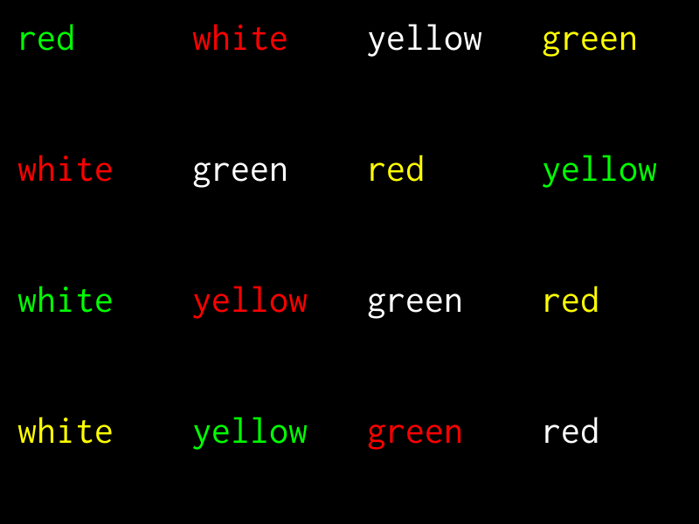
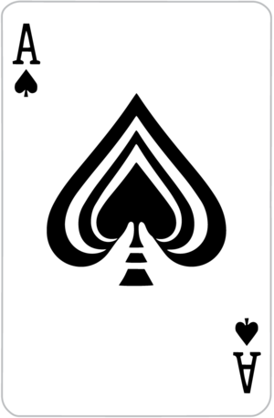
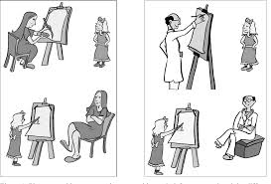
Where to find help
Official documentation
Beginner tutorial
Example stash
docs.expyriment.org
Tutorial page in the official docs
GitHub: expyriment/expyriment-stash
Stroop task
Sentence-picture matching
Card game

Slide 4


Slide 5
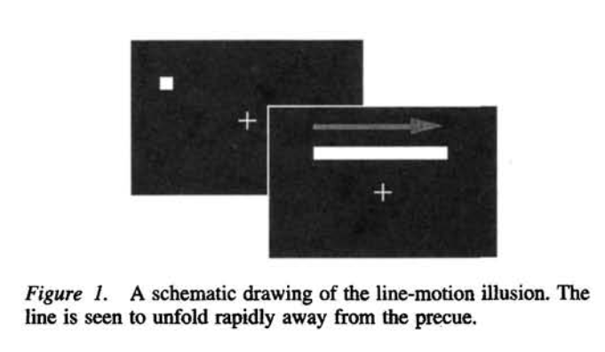
Illusory line motion: a short history
A cue appears near one end…
Hikosaka, Miyauchi & Shimojo
Use the illusion to probe spatial attention.
1993
2004–05
Jancke et al.; Rangan et al.
Measure and model wave-like population activity in early visual cortex.
…then the complete line appears at once (Downing & Treisman, 1997).

Slide 8
What the illusion lets us study
The screen says:
SPATIAL ATTENTION
STATIC LINE
Does te stimulus change when information becomes available?
SUBJECTIVE TIME
Perception says:
Why can simultaneous line pixels feel temporally ordered?
MOTION
APPARENT MOTION
How does vision interpolate between discrete states?
CORTICAL DYNAMICS
Can population activity resemble real motion without retinal motion?

