Slide 2
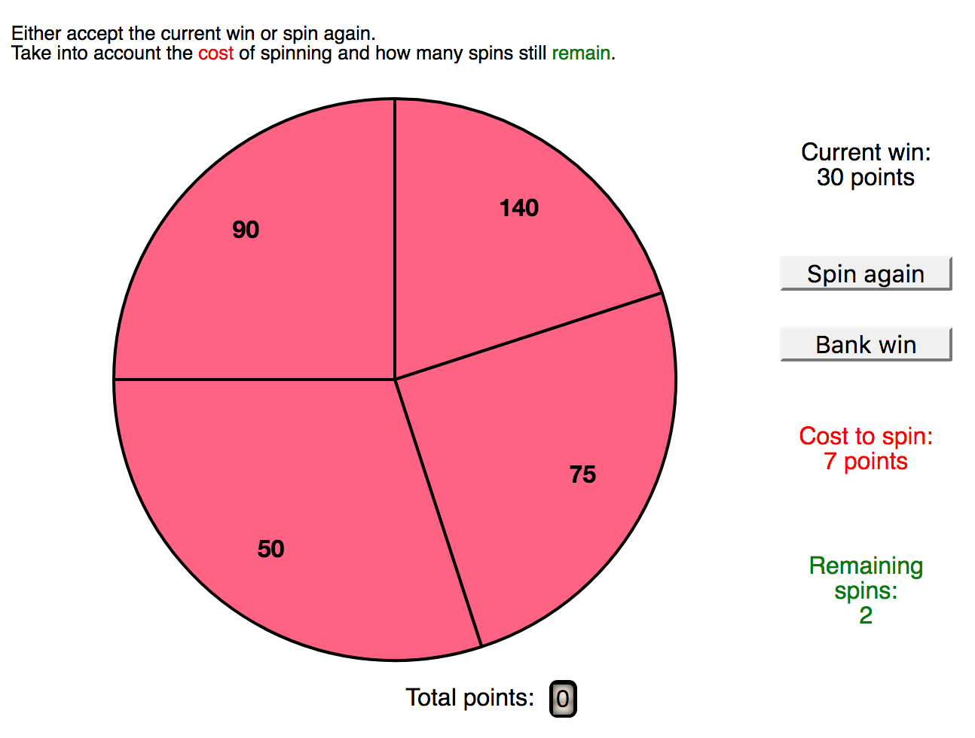

Slide 5
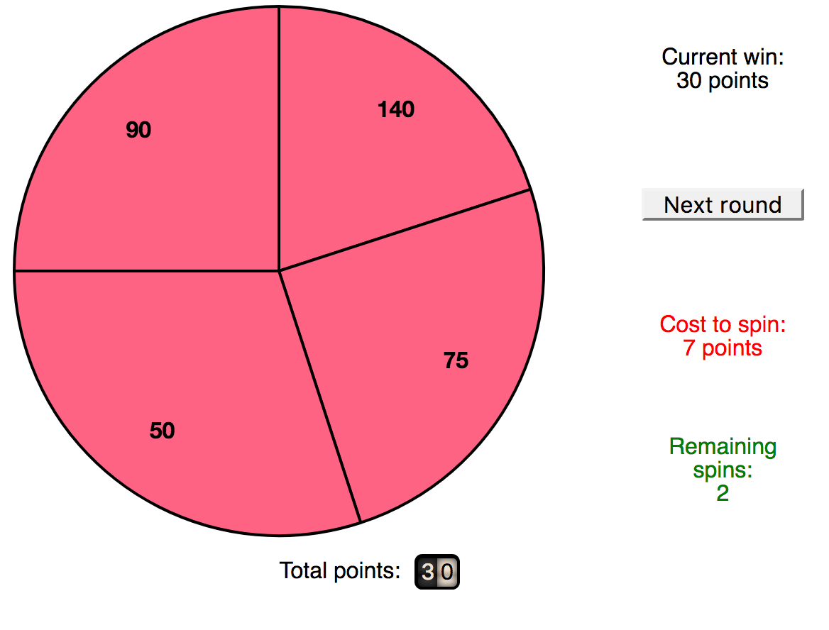

Slide 6
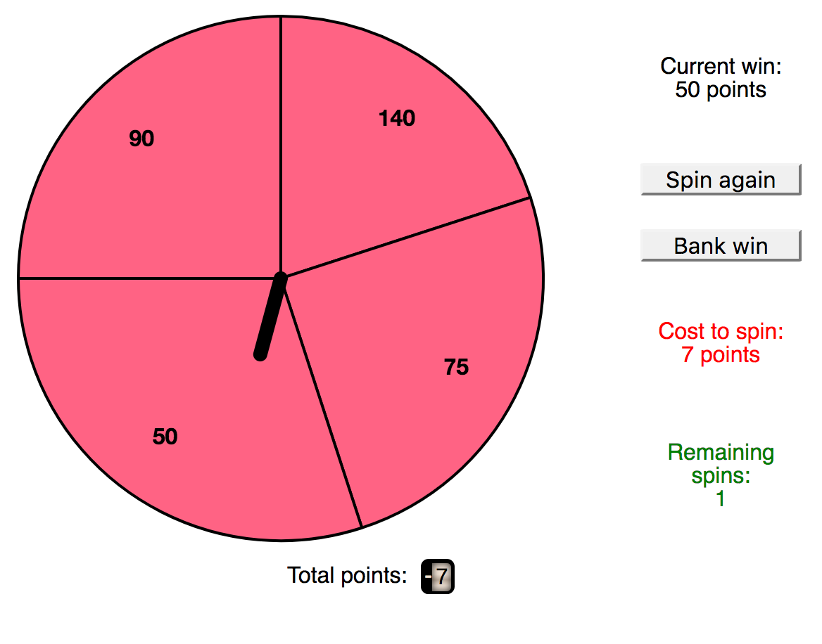

Slide 8
Notes:
Note here: there is already a ‘current win’ before your first spin

