Slide 1
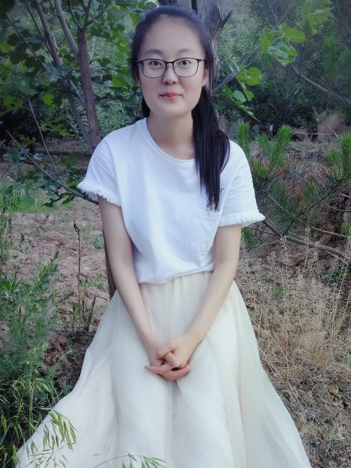
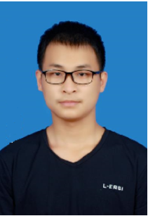

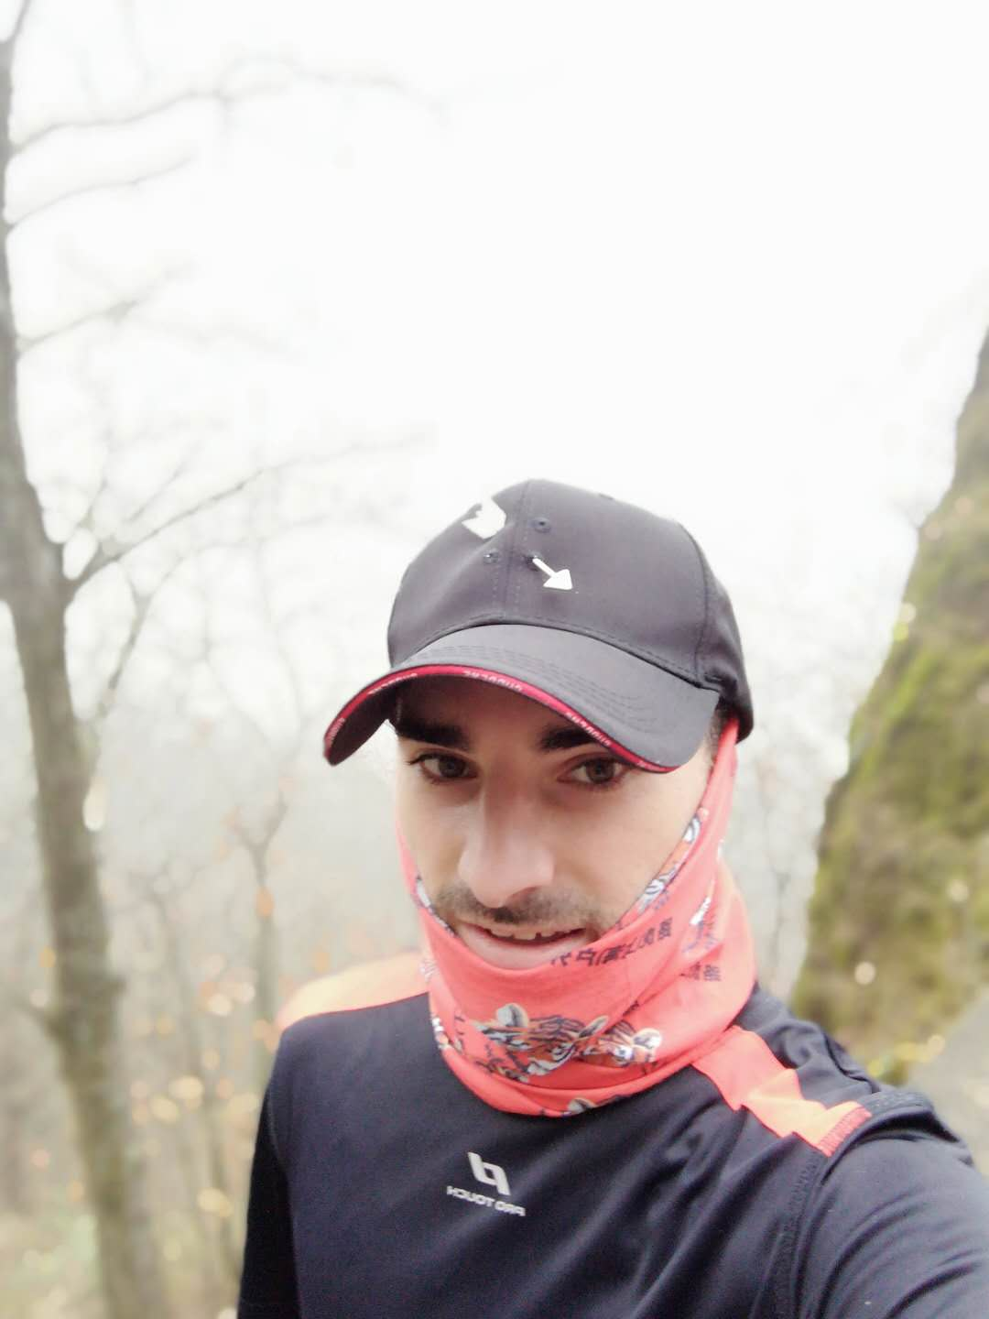
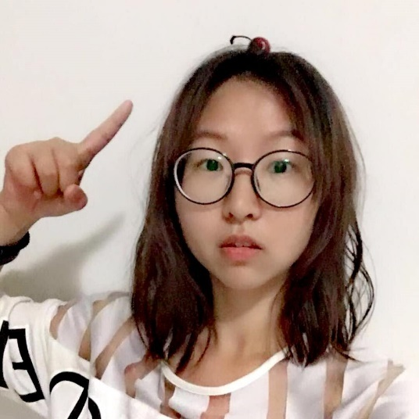
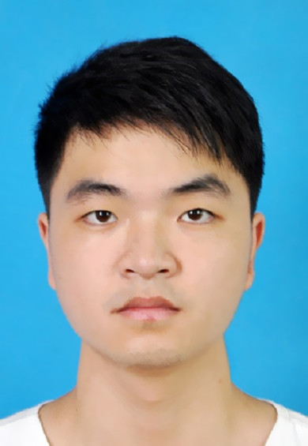
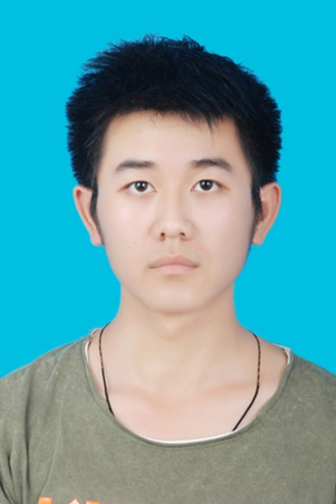
何银梅
吴熠伟 Vivien
张莹佳 Anastasia
Maxime Giliberto
李源 Sophie
童江魏
Programming
Data analysis
Website
Programming
Data analysis
PPT
LOGO design
Project management
Business
analysis
APP
Business model
Every presentation
Data analysis
Business analysis
Programming
Data analysis
Website
APP,WEBSITE
CP
程仁德 Noah

Slide 2
TOO BORING TODAY!
;(
AH!
JUST WANT TO HAVE FUN
I CAN ASK IGO FOR HELP

Slide 3
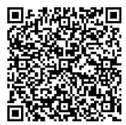

IGO
爱GO ❤ I GO!
TAKE OUT OF MOBILE
AND OPEN THIS APP
XD
Notes:
二维码换过了！

Slide 4
PAIN POINT
SOMETHING
NEW
GET IDEAS

Slide 5
COMPERASION
INNOVATION
BASED ON THE DATA
OUR NEEDS
ANALYSE
ADD TO THE DATA
BUSINESS PLAN
MACHINE LEARNING
CREATE UN APP
CREATE OUR SITE
...
FEEDBACKS
EXECUTION
OPTIMIZE

Slide 6
MISSION
VISION
At iGo, we believe that every Shanghainese deserves to be in a better mood. Igo allows Shanghainese users to enjoy new experiences according to their attempts of the moment
Change Shanghainese bad mood people into a good one with an activity they never did.

Slide 7

Suppliers
Customer
Money
Data
Notes:
INTRODUCTION

Slide 8
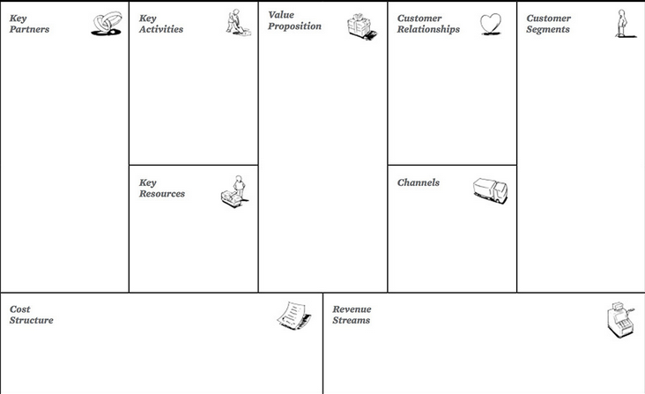
-Suggest
customized
activities
one by one
-Resolve the
customer's
boring time
-Give chance
to try
something new
by the APP's
automatic
recommendation
based on
database
-Design a series
of activities
-The website
of iGO
-Sina microblog
-Facebook
-Twitter
-E-mail
-People who has
not enough time/
exprience to plan
-People who just
want to have fun
-People who are
limited by
time/money
such as:
-Undergraduates
-Employees
-Parents
-Organizers of
clubs/events
-Mobike
-Dianping
-Suppliers
ex.
-Resto
-Bar
-Café
-Maker space
-Etc.
-Database of
mobike
-Database of
Dianping
-Suppliers
-iGo App
-iGo Mini
Programme on
Wechat
-Human ressource
-Software development
-Server maintenance
-Marketing
-3% commissions
-Page view fees
-Product recommendation fees
Notes:
此处有网页图片

Slide 9
B
MOST FREQUENT
C
A
B
D

Slide 10
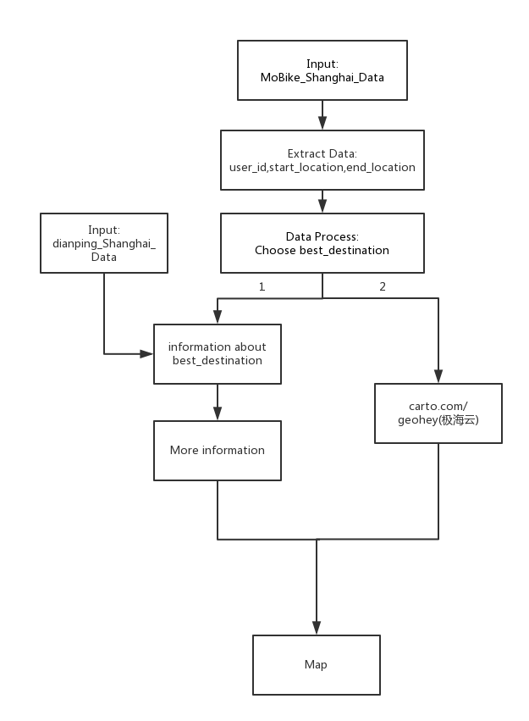

Slide 11
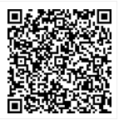
DISPLAY THE APP

Slide 12
Thank U
PRESENTED BY SWISS ARMY KNIFE
Notes:
code

