Slide 1

Impact of Transmission Type on Car Features and Market Dynamics
An in-depth analysis of car features from 1990 to 2017
Maxime Junca-Quintero
Student number: 22107517

Slide 2
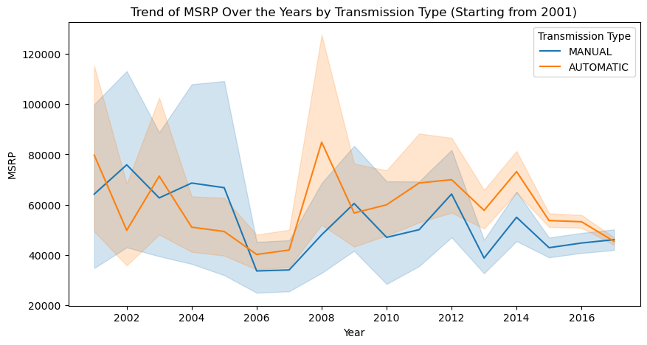
Manufacturer Suggested Retail Price Trend Analysis
MSRP for manual cars fluctuated with a notable peak in 2005, suggesting a temporary increase in value or market demand.
Automatic cars generally priced higher, with significant volatility around 2008, possibly linked to economic factors or tech advancements.
Post-2008, both transmission types show parallel trends, indicating market-wide influences on car pricing.
The overall trend implies industry response to economic conditions, with a shared pattern for both manual and automatic transmissions.

Slide 3
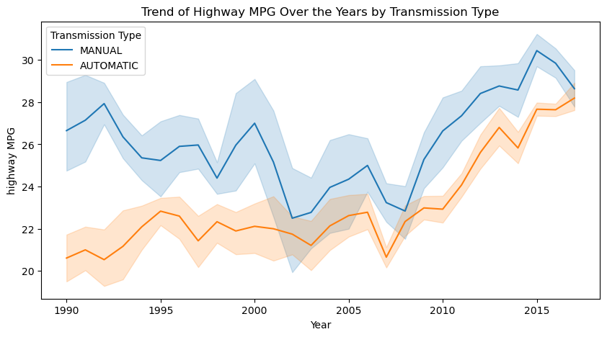
MPG Trend Analysis
Manual transmission shows consistent improvement in highway MPG over time, indicating advancements in efficiency.
Automatic vehicles exhibit a steeper increase in MPG post-2000, potentially reflecting significant technological enhancements.
Both transmission types reveal an overall positive trend in fuel economy, with narrowing efficiency gaps in recent years.
The converging MPG values since 2010 suggest market shifts towards more fuel-efficient automatic transmissions.

Slide 4
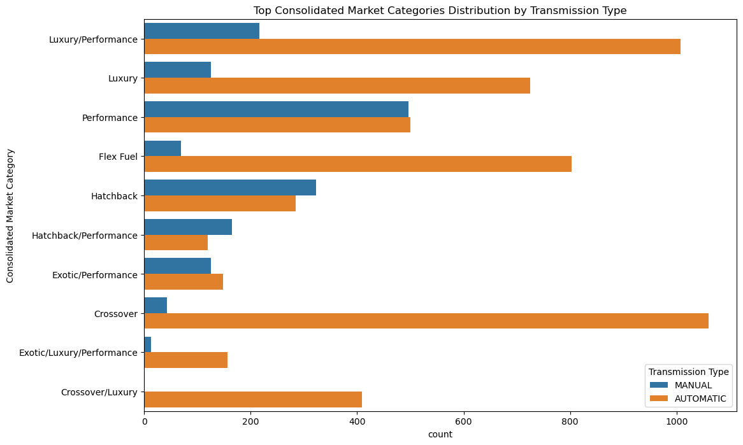
Market Category Influence
Automatic transmissions dominate in luxury/performance categories, indicating a preference for convenience in high-end vehicles.
Manual transmissions show a stronger presence in the performance category, suggesting enthusiast-driven choices favoring control.
The crossover category leans towards automatics, reflecting the general consumer trend for everyday driving comfort.

Slide 5
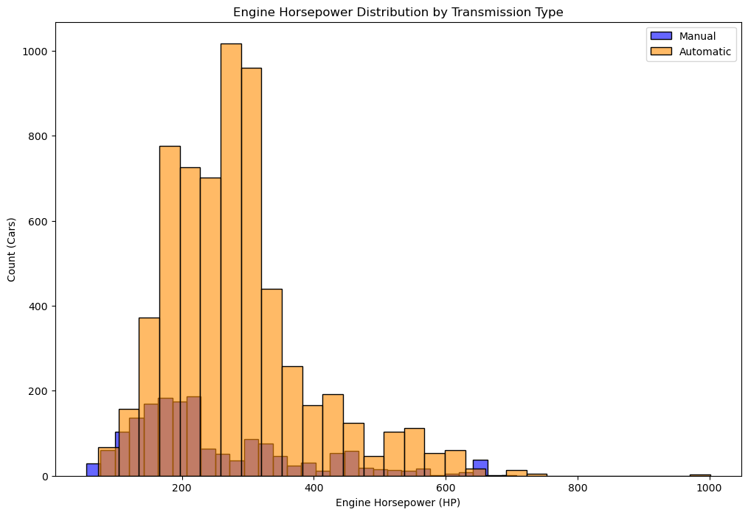
Engine Horsepower Analysis
Majority of cars with manual transmission cluster under 200 HP, aligning with standard consumer models.
Automatic transmissions are more prevalent across a wider range of engine horsepower, especially dominating above 400 HP.
High horsepower extremes (>600 HP) are exclusively automatic, suggesting a market trend towards powerful, yet user-friendly vehicles.

Slide 6
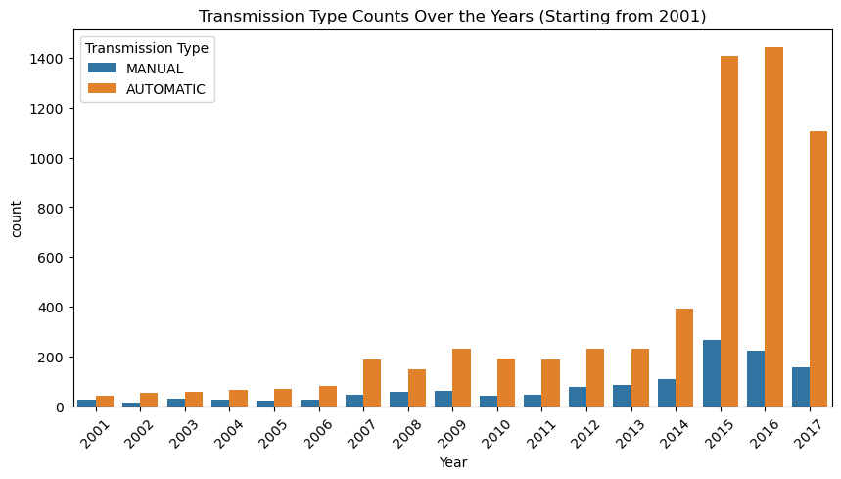
Yearly Distribution of Transmission Type
Manual transmission counts have steadily decreased since 2001, reflecting a shift in consumer preference or manufacturing trends.
Automatic transmissions have seen a marked increase, dominating the market particularly from 2013 onward.
A significant rise in automatic vehicles post-2012 suggests innovations in automatic technology or changes in driving habits, like autonomous cars or robottic transmissions.
The data indicates a strong market trend towards automatics in recent years, possibly due to their convenience and improved efficiency.

Slide 7
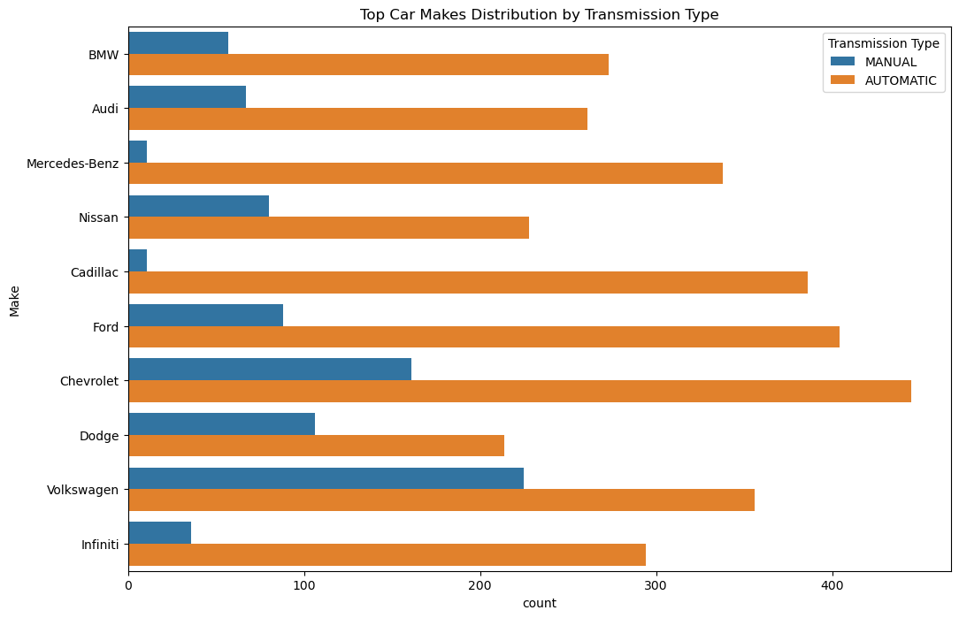
Popularity and Constructor Relationship
Luxury brands like BMW, Audi, and Mercedes-Benz have a balanced mix of manual and automatic, reflecting diverse consumer preferences.
Mass-market brands like Nissan, Ford, and Chevrolet show a clear preference for automatic transmissions, likely due to broader appeal.
Overall, automatic transmissions are more common across all contructors, suggesting a shift in market demand towards this transmission type.

Slide 8
Conclusions
Transmission vs. MSRP: Manual's peak in 2005; Automatics generally higher-priced with volatility in 2008. Post-2008, trends align, reflecting market-wide influences.
Fuel Efficiency: Manual shows steady MPG improvements. Automatics see significant MPG gains post-2000, with efficiency gaps narrowing recently.
Market Category Influence: Automatics favored in luxury/performance; Manuals in performance for control. Crossovers lean automatic for comfort.
Engine Horsepower Trends: Manuals mostly <200 HP; Automatics span wider HP range, dominating >400 HP, indicating a shift towards powerful, user-friendly vehicles.
Implications: Trend towards automatics in high-end and performance sectors; Manufacturers adapting with advanced automatic technologies.

Slide 9
Methodology
Dataset
"Car Features Dataset (1990-2017)." Data provided encompasses a comprehensive overview of car features including model, year, engine, and other properties along with MSRP. Dataset contains 11,915 rows across 16 columns.
Python Libraries
Pandas
Matplotlib
Seaborn
Software and Tools
Jupyter Notebook

