Slide 1
Site Corte
July 24 2021

Slide 2
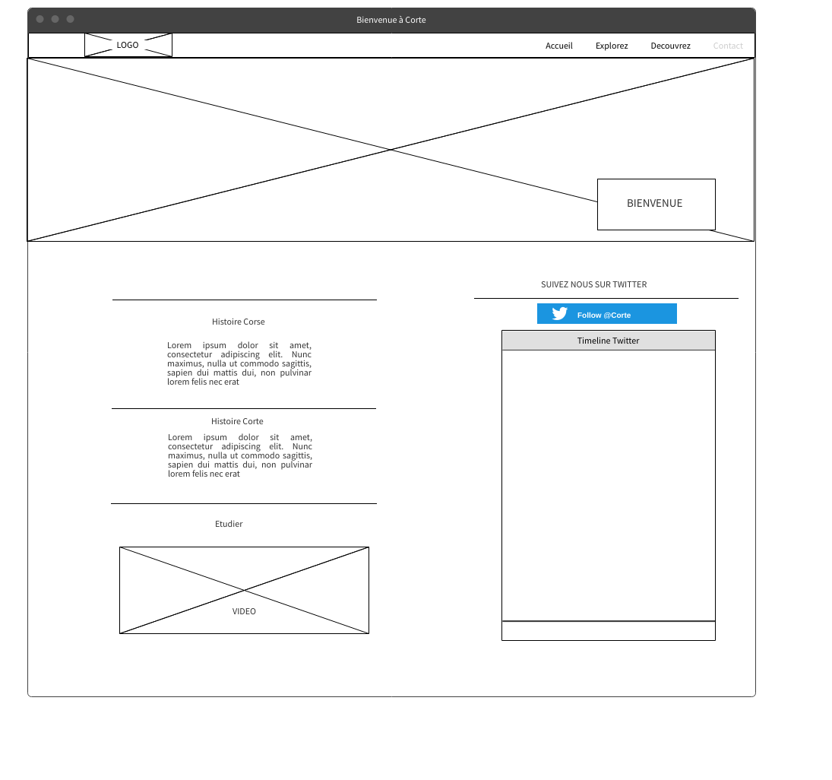

Slide 3
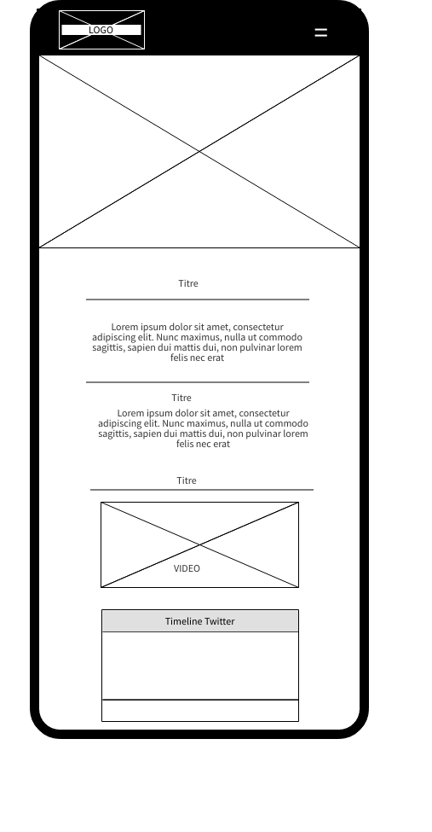

Slide 4
