Slide 1
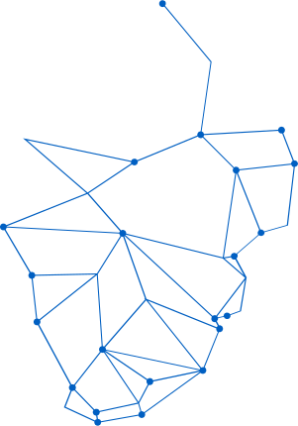
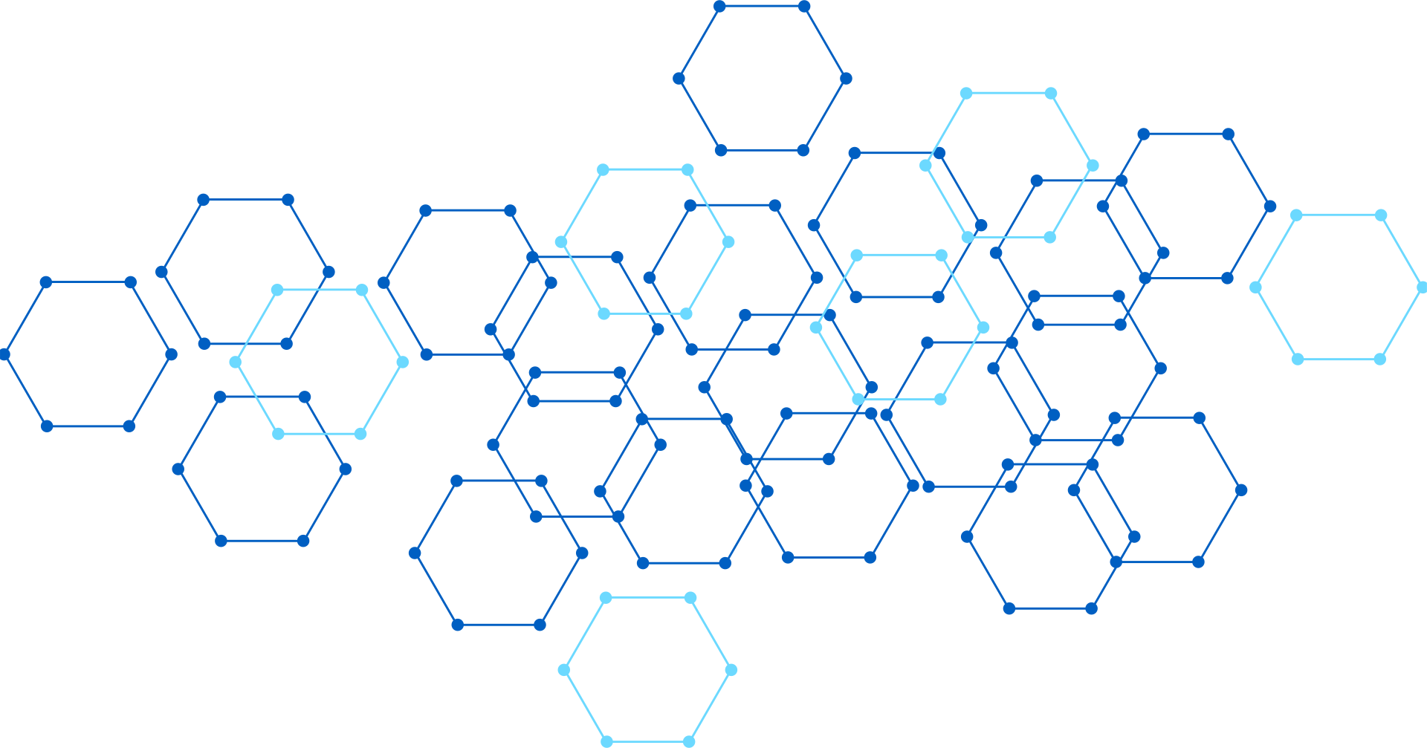
FUSIONFEST BACKEND & FRONTEND ARCHITECTURE
How the Go Server and Flutter Mobile App Work Together

Slide 2

PROJECT OVERVIEW
Backend Repository
MaximeLeBesnerais/FusionFest-Server
Go API server with chi router and PostgreSQL database for all core services.
Frontend Repository
MaximeLeBesnerais/fusion_fest
Flutter mobile app with Dart SDK, Riverpod state management, and offline-first architecture.
Purpose
Backend serves the REST API and static admin UI. Frontend provides the mobile experience for festival attendees with offline support.

Slide 3
BACKEND ARCHITECTURE
Tech Stack: Go 1.25 with go-chi/chi/v5 HTTP router for lightweight, composable routing. PostgreSQL database via jackc/pgx/v5 driver for robust data persistence. Email OTP authentication with mock or Resend provider integration. Static web UI served directly from the Go server.
Key Features: User management with email OTP verification flow. Points system with event ledger for tracking all point transactions. QR code scanning for check-ins and interactions. Trivia questions with timed rotation windows. Hype voting system. Referral system with activation logic. Rewards wallet with token-based redemption. Rate limiting and HMAC authentication.

Slide 4
FRONTEND ARCHITECTURE
Tech Stack: Flutter with Dart SDK ^3.11.3, Riverpod for state management, GoRouter for navigation, Dio for HTTP requests, flutter_secure_storage for credentials, mobile_scanner for QR codes, connectivity_plus for offline detection, shared_preferences for offline queue.
Key Features: Email OTP onboarding flow, HMAC request signing for secure API calls, QR code scanner integration, Trivia participation, Hype voting, Leaderboard display, Rewards wallet with QR redemption, Referral code sharing, Offline queue with automatic sync on reconnection.

Slide 5
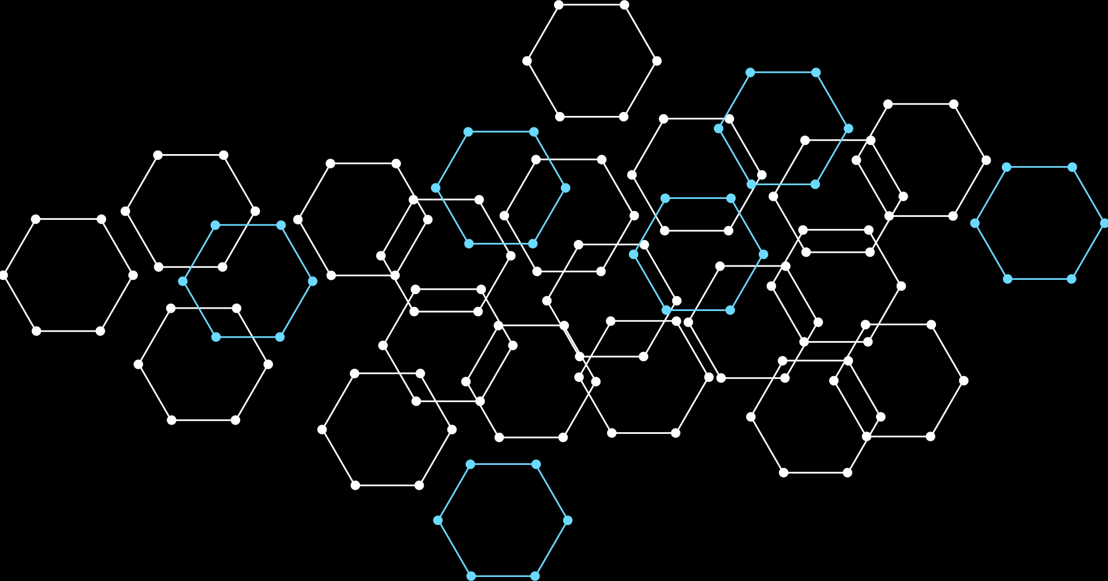



AUTHENTICATION FLOW
Steps 1-3: User enters email → Server sends OTP via Resend/mock → User verifies OTP code → Server validates and creates user record in database.
Steps 4-6: Server generates unique device_id and secret_key → Returns credentials to mobile app → App stores securely via flutter_secure_storage.
Steps 7-8: HMAC signature format: METHOD|path|timestamp → Headers: X-Device-ID, X-Timestamp, X-Signature (HMAC-SHA256 of message with secret_key).

Slide 6



QR SCAN FLOW
Scan: Mobile app uses mobile_scanner to capture QR codes. Camera activates, detects QR pattern, extracts the qrId from the code data for API submission.
Validate: POST /qr/{qrId}/scan with HMAC auth headers (X-Device-ID, X-Timestamp, X-Signature). Server validates festival window, QR active status, and prevents duplicate scans.
Record: Server records scan in qr_scans table and creates point_events entry. Mobile receives response and displays success confirmation or error message to user.

Slide 7



TRIVIA FLOW
Fetch: App calls GET /trivia/current to retrieve the currently active trivia question. Server returns question text, options, and time window for the active question.
Answer: User selects response and app sends POST /trivia/answer with question ID and selected option. Request includes HMAC authentication headers for validation.
Validate: Server checks question status, verifies user hasn't answered, confirms festival is active. Records trivia_answers entry and awards points if correct. Returns result to mobile.

Slide 8
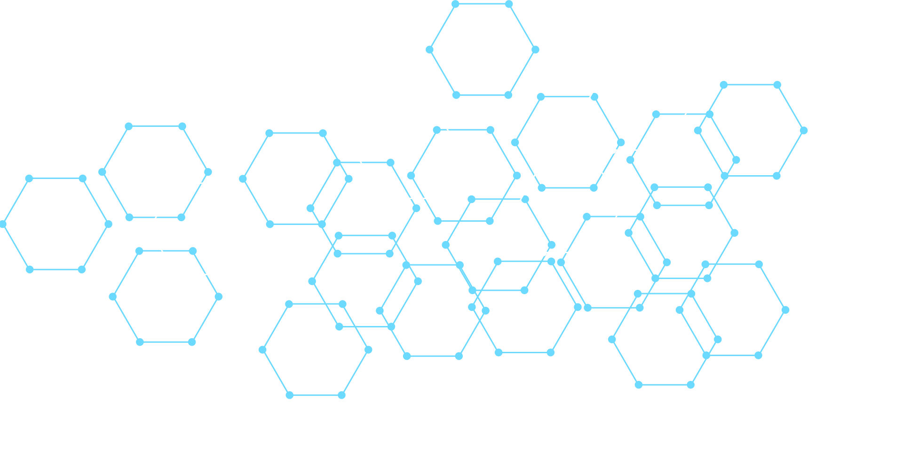
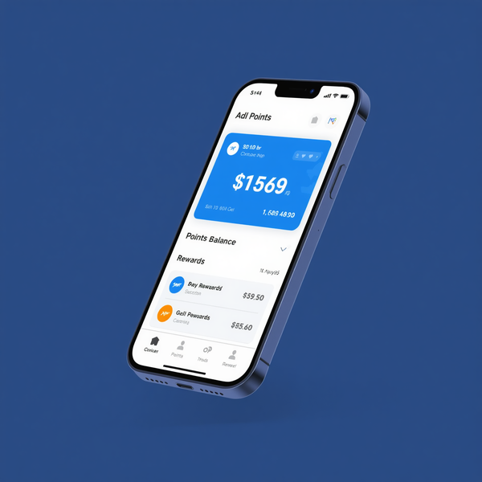

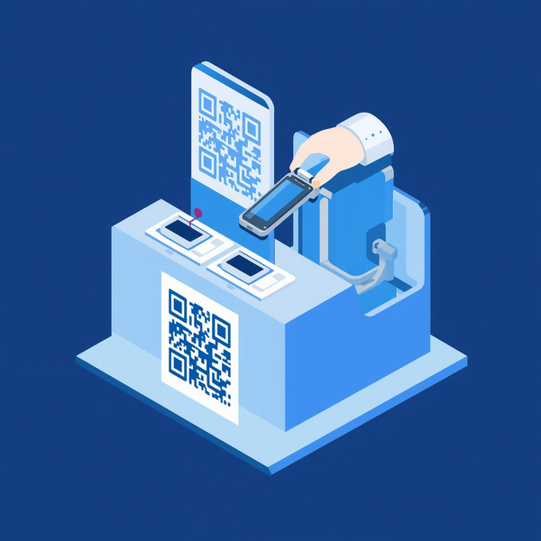
REWARDS FLOW
Wallet: GET /rewards/wallet returns user's current points balance, leaderboard rank, and available rewards catalog. Mobile displays wallet UI with claimable items based on point thresholds.
Claim: POST /rewards/claim validates points, stock availability, and no active claims. Server creates reward_claims record with unique redeem token. Mobile generates QR: fusionfest://redeem/{token}
Redeem: Staff scans user's QR code and calls POST /staff/rewards/redeem with token. Server validates token, marks claim as redeemed with timestamp. User receives confirmation of successful redemption.

Slide 9



OFFLINE SYNC FLOW
Queue: Actions stored in SharedPreferences (max 100 entries) when device is offline. Each action includes timestamp, type, and payload for later processing.
Detect: connectivity_plus package monitors network status changes. Automatically triggers sync when connection is restored.
Sync: SyncService calls POST /points/sync with queued events. Server validates, mobile clears synced entries, invalidates points and leaderboard cache.

Slide 10
API CONTRACT & CONFIGURATION
API Route Mapping
• PointsService → /points, /leaderboard
• QRService → /qr/{id}/scan
• TriviaService → /trivia/current, /trivia/answer
Additional Services
• HypeService → /hype/*
• WalletService → /rewards/wallet
• ReferralService → /referral/*
• IdentityService → /identity/*
Configuration Alignment
Mobile uses AppConfig.baseUrl set at build time via --dart-define flag. Server must be publicly accessible at matching URL for all API calls.

Slide 11


DATABASE SCHEMA HIGHLIGHTS
Core Tables: users (verified accounts), pending_users (OTP verification queue), point_events (immutable ledger tracking all point transactions with event types and timestamps)
Feature Tables: qr_codes & qr_scans (double-scan prevention), trivia_questions & trivia_answers (rotation windows), hype_sets & hype_votes (one vote per user constraint)
Rewards Tables: referrals & referral_pending (activation logic), rewards & reward_claims (token-based redemption), events (general activity logging for auditing)

Slide 12

RATE LIMITING
Global IP Limit: 60 requests/min
User Routes: 30 requests/min per X-Device-ID
Applies to all authenticated endpoints
Specific POST Limits:
• /points/sync - stricter throttling
• /qr/{id}/scan - prevent spam scanning
• /trivia/answer - one answer per window
• /hype/vote - single vote enforcement
• /rewards/claim - controlled redemption rate

Slide 13

REFERRAL SYSTEM
Generate Referral Code
POST /referral/generate returns referral_code + install_url. Users share the link with friends. New users sign up with the code, creating a referral_pending entry that activates on their first participation event.
Referral Rewards
+100 points for the referrer when their referral activates. +25 points for the referred user as a welcome bonus. +250 bonus points awarded when a user reaches 3 successful referrals.

Slide 14



DEPLOYMENT & APK DISTRIBUTION
Build: GitHub Actions compiles APK with --dart-define=API_BASE_URL configuration, embedding the production server endpoint directly into the Flutter application binary.
Publish: Compiled APK is deployed to VPS filesystem, making it available for direct download without app store dependencies or review processes.
Distribute: Server exposes GET /downloads/fusionfest-android-latest.apk for APK retrieval and GET /downloads/version.json for version checking and update notifications.

Slide 15

SYSTEM ARCHITECTURE
fusion_fest Flutter App → Dio HTTP with HMAC Headers → FusionFest-Server (Go + chi + PostgreSQL) → PostgreSQL Database. Server also serves Static Web UI and APK Downloads. Core integration: Mobile app signs all requests with HMAC-SHA256, server validates and processes against PostgreSQL.

Slide 16
THANK YOU
Questions? Let's discuss the architecture!

