Slide 1
NORTHWIND LABS · RENEWABLE FLEET INTELLIGENCE
Northwind Labs
Investor briefing · FY2025 results and the road to 3,000 connected sites
WIND
SOLAR
STORAGE

Slide 2
AGENDA
What we will cover
01
The business
Who we are, what we operate, and the market we serve
02
The numbers
FY2025 revenue, growth and unit economics
03
The product
Northwind Pulse — platform tour and roadmap
04
Why now
The outlook for 2026 and how to work with us

Slide 3
THE BUSINESS
Northwind Labs at a glance
1,284
4.1 GW
14
212
turbines & arrays monitored
capacity under management
markets across EU & North America
people in Oslo, Berlin & Chicago
Founded 2016 · Independent power producers, utilities and O&M providers run their fleets on Northwind Pulse.

Slide 4
THE BUSINESS
What we do
One data layer for mixed renewable fleets
SCADA, sensor and grid data ingested every 10 seconds
Why operators switch
Anomaly detection flags underperformance weeks before failure
Fleets on Northwind Pulse recover an average of 3.8% of lost production in the first year — mostly from faults that legacy monitoring never surfaced.
Production forecasts tuned per site, per turbine model
Compliance and availability reporting generated automatically

Slide 5
THE BUSINESS
A market that keeps compounding
€9.2B by 2028
61% still on legacy
2.4× data growth
Renewable asset-management software spend, growing ~14% per year as fleets age and digitize.
Most fleets above 50 MW run on fragmented SCADA exports and spreadsheets — our replacement wedge.
Sensor density per MW has more than doubled since 2021 — operators need tooling built for this volume.
Sources: company analysis of public tender data and customer interviews, Q1 2026.

Slide 6
THE BUSINESS
Who we serve
Three segments, one platform
Independent power producers — portfolio-wide performance
Anchor customers
Utilities — regulated reporting and grid compliance
Meridian Renewables, Kaskade Energy, Bluefjord Vind, Helios Grid Partners and 38 other operators across 14 markets.
O&M providers — white-label monitoring for their clients
Average contract: €212K ARR across 3.2 sites

Slide 7
THE NUMBERS
FY2025 scoreboard
€18.4M
118%
71%
87
ARR, up 42% YoY
net revenue retention
gross margin
fleet customers, +19 in FY25
Audited figures, fiscal year ending December 2025.

Slide 8
Quarterly revenue by segment (€K)
Quarter
Wind
Solar
Storage
Total
Q1 FY25
2,140
980
310
3,430
Q2 FY25
2,460
1,150
420
4,030
Q3 FY25
2,720
1,390
560
4,670
Q4 FY25
3,050
1,620
740
5,410
FY25 total
10,370
5,140
2,030
17,540
FY24 total
7,610
3,420
1,180
12,210

Slide 9
THE NUMBERS
Quality of the growth
What sits behind the numbers
Storage segment grew 72% — fastest-growing line
Unit economics
Expansion revenue drove 58% of net new ARR
Average contract €212K ARR · 71% gross margin · 13-month CAC payback. Every cohort since 2021 has turned contribution-positive within 18 months.
Logo churn held at 4.1%, all sub-€50K accounts
CAC payback steady at 13 months

Slide 10
THE NUMBERS
Four years of compounding
€18.4M
€12.9M
€8.6M
€5.2M
FY22
FY23
FY24
FY25
Annual recurring revenue, year-end. FY25 mix: 59% wind · 29% solar · 12% storage.

Slide 11
THE PRODUCT
Northwind Pulse — three layers
Pulse Edge
Pulse Cloud
Pulse API
On-site collectors that normalize SCADA, vibration and met-mast feeds — even over intermittent links.
Fleet analytics: anomaly detection, production forecasting and automated availability reporting.
Every metric, alert and forecast over a versioned API — feeds trading desks, ERP and BI stacks.
Deployed at 1,284 sites; median time from contract to live data is 11 days.

Slide 12
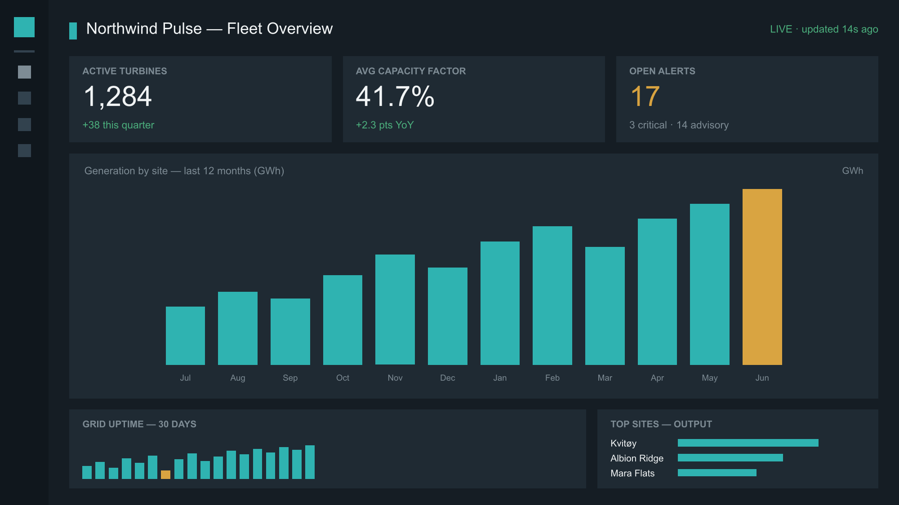
THE PRODUCT
Inside the operations view
Northwind Pulse fleet overview — live generation, alerts and uptime across a 1,284-asset portfolio.

Slide 13
THE PRODUCT
Roadmap to 2027
H2 2026
Q4 2026
H1 2027
H2 2027
Storage dispatch
Fleet copilot
Grid services
3,000 sites
Battery charge/discharge optimization against day-ahead prices.
→
Natural-language queries over live and historical fleet data.
→
Automated bidding into balancing and capacity markets.
→
Self-serve onboarding for fleets under 20 MW.
Shipped on a 6-week release train; every feature above is already in private preview with anchor customers.

Slide 14
OUTLOOK
Why now
The window is open
Fleet repowering wave starts 2026 — monitoring gets rebuilt
The plan
Grid codes tighten: automated reporting becomes mandatory
Series B of €24M funds the storage launch, US expansion and the self-serve tier — targeting €30M ARR by end of 2027.
Storage attach rate on new solar passed 40% in 2025
Our storage product line is 18 months ahead of the pack

Slide 15
NORTHWIND LABS
Let's put your fleet on Pulse
30-minute demo with your own portfolio data — no slides, just the product.
hello@northwindlabs.io · northwindlabs.io · Oslo · Berlin · Chicago

