Slide 1
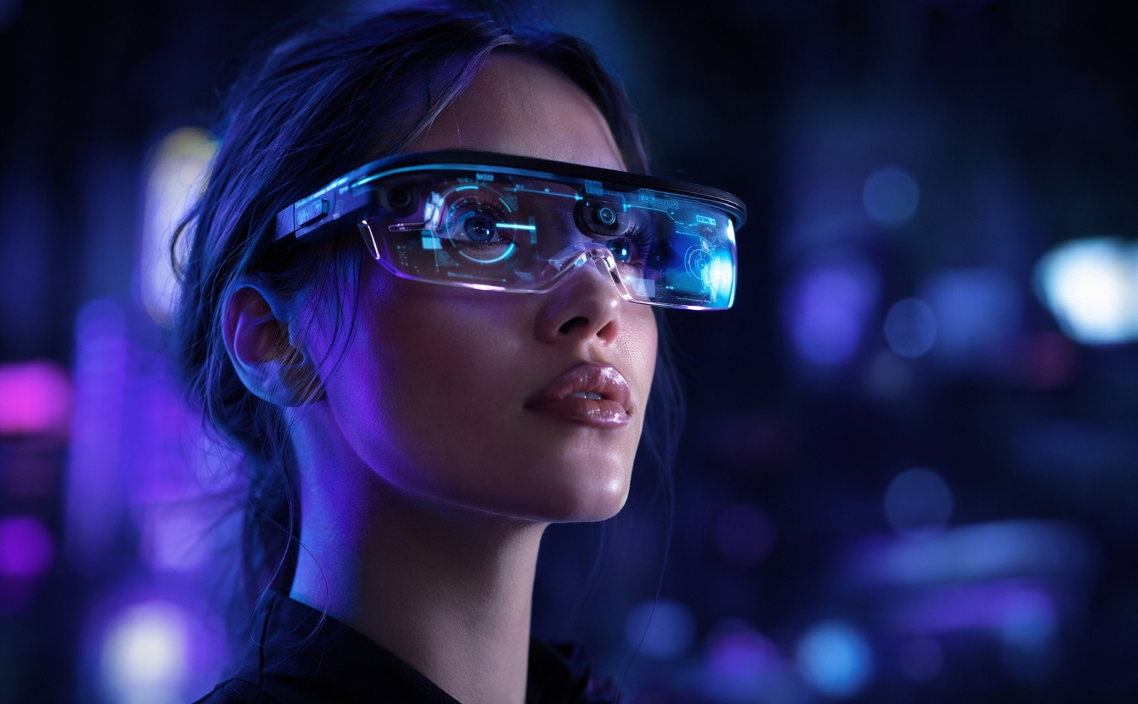
A E T H E R L I N K
GLASS
Shareholder Overview — Connected Eyewear Platform
Early sales, product roadmap, and the path to scale · FY2026
Fictional company · All figures illustrative · Strictly private & confidential

Slide 2
SHAREHOLDER OVERVIEW
Today's Agenda
Why connected eyewear, why now
Scenarios, customers & social proof
01
04
AetherLink One — product & platform
Business model & revenue plan
02
05
Early sales traction & unit economics
Roadmap, team & the ask
03
06
AetherLink Inc. — Shareholder Overview · Fictional figures for discussion only

Slide 3
O U R V I S I O N
Information should meet your eyes — not steal your attention.
AetherLink Glass puts navigation, translation, capture and communication into a featherweight frame people actually wear all day.

Slide 4
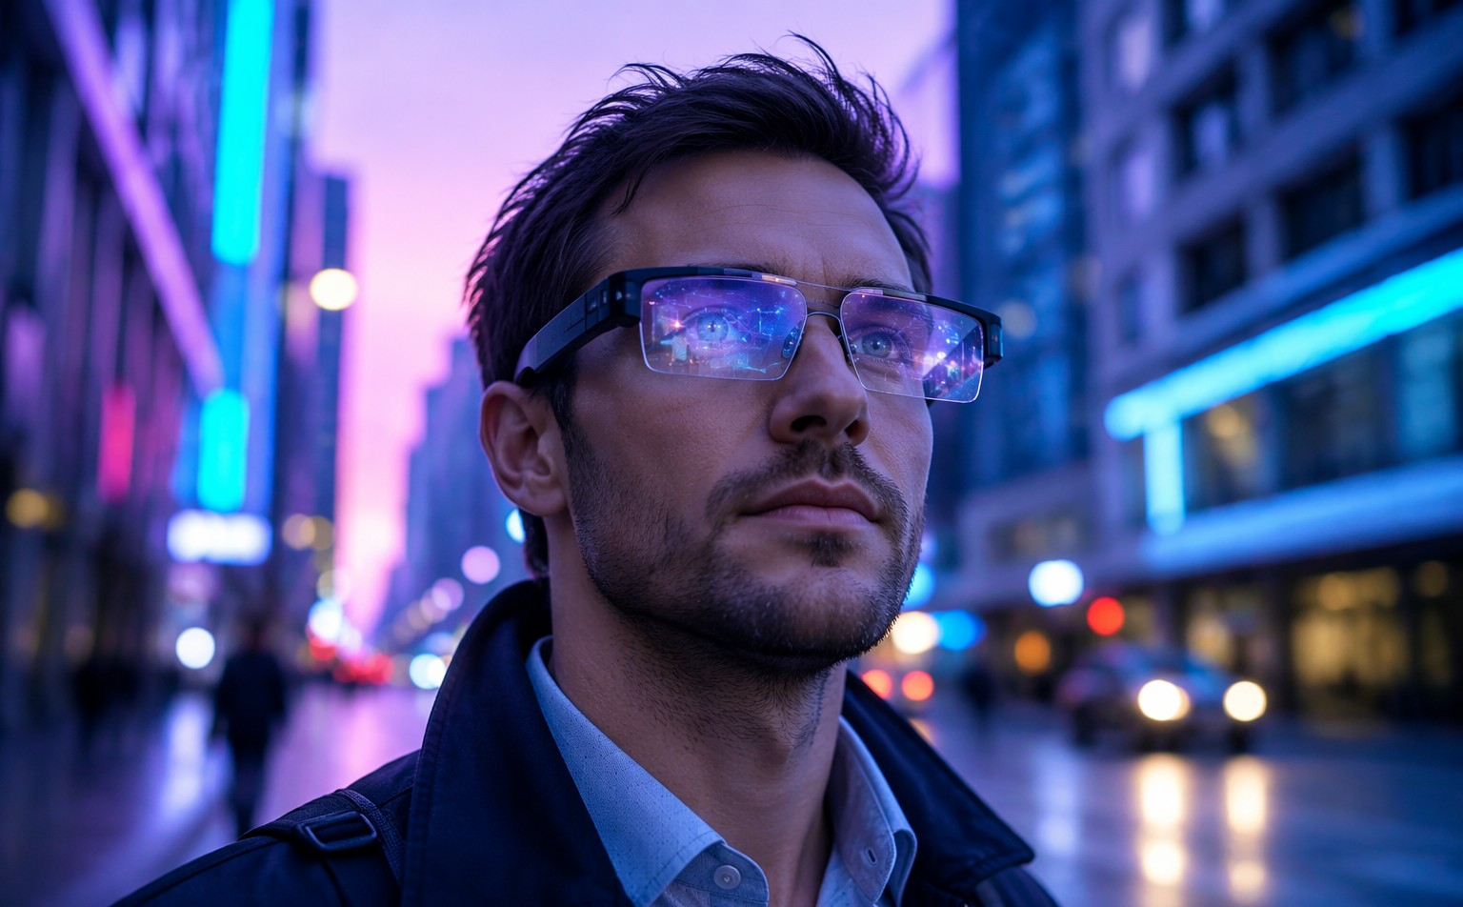
THE PROBLEM
Screens Own Our Attention
7+ hours of daily screen time — eyes down, world missed
Phones interrupt flow: 96 pickups per day on average
Navigation, translation and capture all demand a free hand and a fast glance
Existing headsets are too heavy, too odd, too expensive for daily wear
AetherLink Inc. — Shareholder Overview · Fictional figures for discussion only

Slide 5
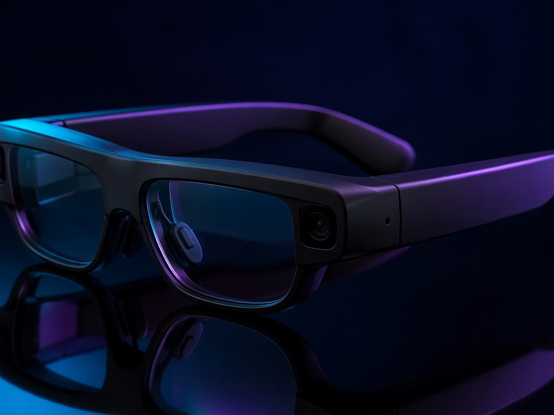
THE PRODUCT
Meet AetherLink One
38 g — lighter than most sunglasses
Binocular micro-LED waveguides, 2,000 nits, daylight readable
All-day battery with 15-minute fast top-up
On-device AI for translation, capture and glanceable navigation
$499 LAUNCH
IP54
RX READY
AetherLink Inc. — Shareholder Overview · Fictional figures for discussion only

Slide 6
PLATFORM
Three Things It Does Brilliantly
GLANCE
UNDERSTAND
REMEMBER
Navigation & alerts float at the edge of vision — arrivals, turns, gates, without breaking stride.
Live translation and captions rendered in-frame, on-device, in 27 languages.
First-person capture and instant recall: 'what was that restaurant from March?'
One frame, one AI companion — three superpowers you use every hour.
AetherLink Inc. — Shareholder Overview · Fictional figures for discussion only

Slide 7
EXPERIENCE
From Box to First Glance in Minutes
1
2
3
4
PAIR
FIT
GLANCE
GO
Phone or standalone eSIM setup
Auto IPD calibration, RX snap-ins
Choose your micro-apps
All-day wear, nightly dock
Mediated by AetherOS — our glance-first operating layer that decides what deserves your attention, and what never interrupts.
AetherLink Inc. — Shareholder Overview · Fictional figures for discussion only

Slide 8
MARKET
A Category Crossing Into the Mainstream
$34B
142M
68%
global smart-eyewear TAM by 2030, 24% CAGR
units shipped annually by 2030 (industry consensus)
of early adopters cite navigation & translation as killer apps
Our wedge: style-first frames at a mainstream price — the segment competitors abandoned chasing enterprise.
AetherLink Inc. — Shareholder Overview · Fictional figures for discussion only

Slide 9
EARLY SALES
First Two Quarters Beat the Plan
115k
units in FY2026 plan — 3.9× our first-year forecast set at seed
41%
of Q2 orders came from referrals and creator waitlists — zero paid acquisition
AetherLink Inc. — Shareholder Overview · Fictional figures for discussion only

Slide 10
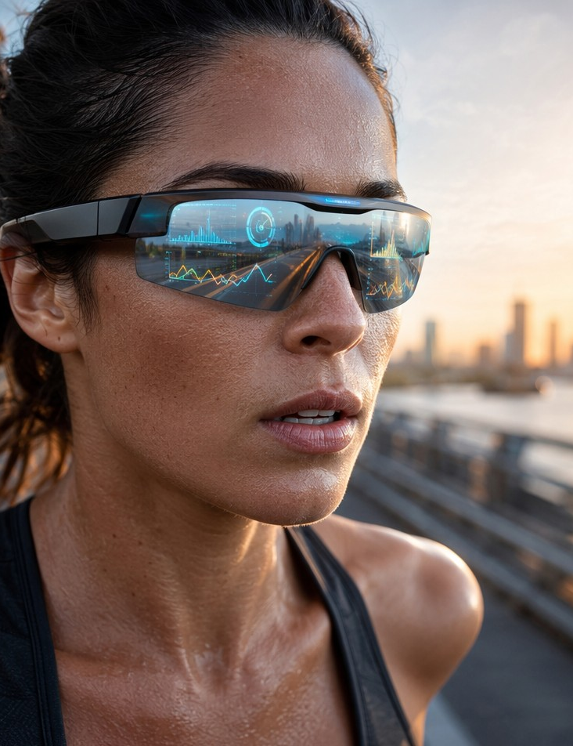
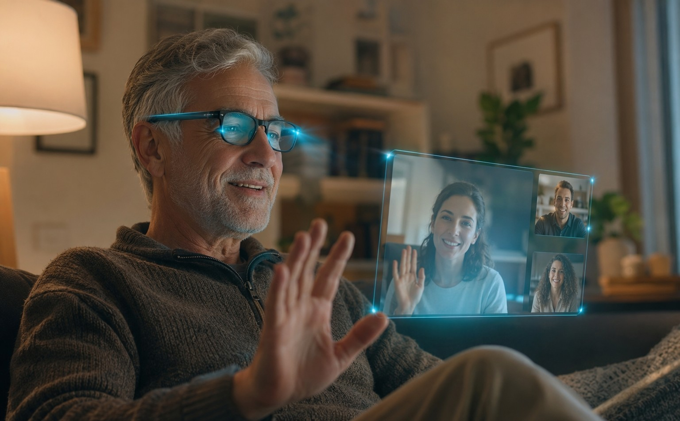
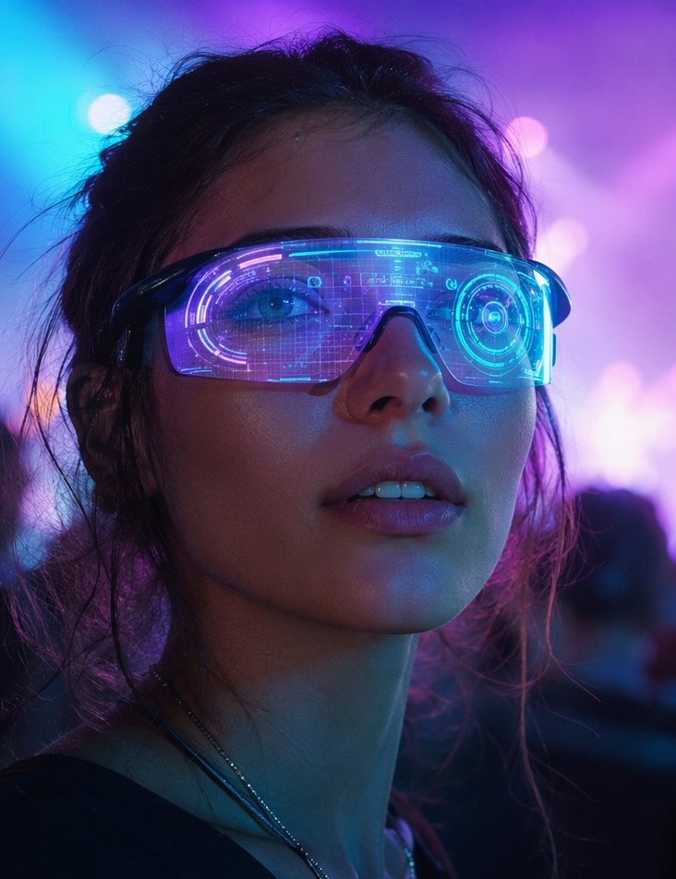
IN THE WILD
One Frame, Four Everyday Lives
COMMUTE
TRAIN
CONNECT
EXPERIENCE
Glanceable turns, no phone-out moments
Pace and heart-rate in view, hands free
Calls and captions that feel face-to-face
Capture the moment without leaving it
AetherLink Inc. — Shareholder Overview · Fictional figures for discussion only

Slide 11
“
I stopped taking my phone out on walks. Directions, messages, photos — it all just floats there when I need it, and disappears when I don't.
MARA J. — BETA PILOT #0417, LISBON
Waitlist NPS 71 · 4.8/5 comfort rating after 30 days
AetherLink Inc. — Shareholder Overview · Fictional figures for discussion only

Slide 12
BUSINESS MODEL
Hardware Margin + Companion Services
AETHERLINK ONE
AETHER+
AETHER CARE
$499
$9/mo
$79/yr
Hardware, 38% blended gross margin at current volume
Cloud recall, advanced translation packs, priority AI — 31% attach
Accidental-damage cover & lens refresh — 44% attach
Blended FY2027 revenue target: $86M — 71% hardware, 29% recurring services.
AetherLink Inc. — Shareholder Overview · Fictional figures for discussion only

Slide 13
ROADMAP
Eight Quarters, Three Generations
Q3 FY26
Q3 FY27
ONE
TWO
Retail launch, 2 colors
2× battery, binocular SLAM
Q1 FY27
Q2 FY28
ONE S
TWO PRO
Sport frame, HR sensing
Developer edition + SDK 2.0
SDK ships with every generation — 1,900 developers already building glance-apps.
AetherLink Inc. — Shareholder Overview · Fictional figures for discussion only

Slide 14
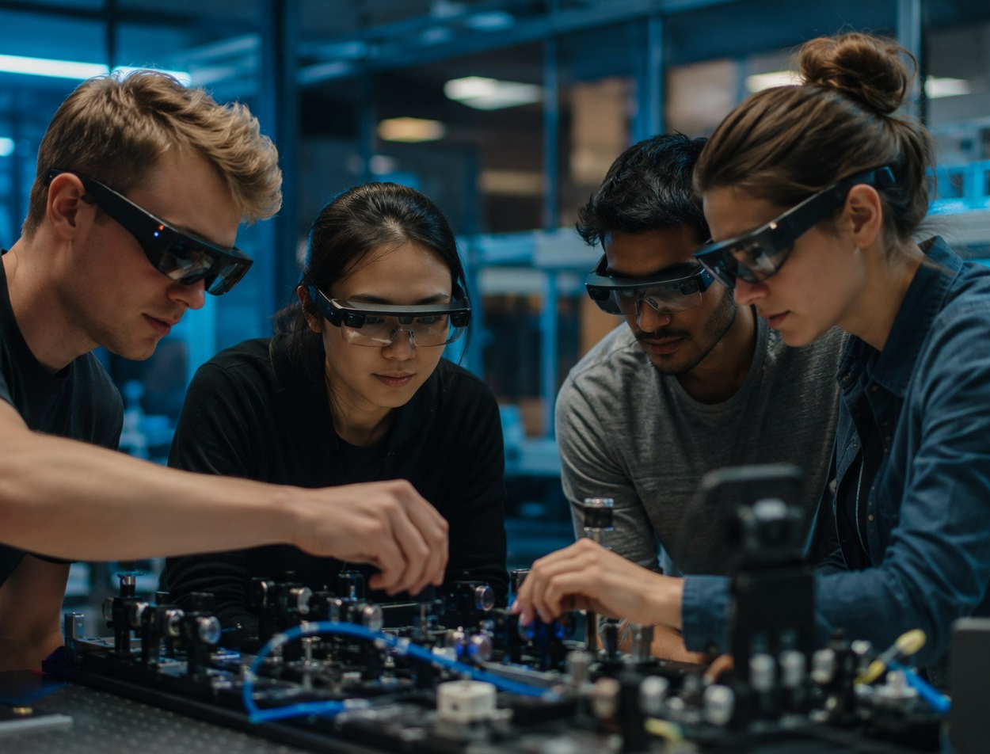
TEAM
Built by People Who Ship Optics
CEO — ex-wearables lead, shipped 4 optical consumer products
CTO — computational-imaging PhD, 31 patents in waveguide display
VP Design — award-winning frame studio, fashion-first industrial design
68 people across optics, AI, retail and supply chain
2 DESIGN AWARDS
31 PATENTS
AetherLink Inc. — Shareholder Overview · Fictional figures for discussion only

Slide 15
T H E A S K
$40M Series B
To take AetherLink One to retail scale, fund Generation Two, and grow the developer platform.
55%
30%
15%
Manufacturing & retail
Gen-2 R&D
Platform & team
A E T H E R L I N K — hello@aetherlink.example
Fictional company · All figures illustrative · Strictly private & confidential

