Slide 1
.NET 9 · C# 12 · MIT
{
}
OfficeEditor
Programmatic Office documents — without hand-writing OpenXML.
Create, edit and render DOCX, PPTX and XLSX via JSON/YAML instructions or fluent C# APIs.
DOCX
PPTX
XLSX

Slide 2
The problem
Office automation is fragmented
One programmable workflow
Each format has its own low-level API
OfficeEditor unifies creation, editing and rendering across DOCX, PPTX and XLSX — one instruction model, one layout engine, two emitters.
Generation, editing and rendering live in separate tools
Template automation gets fragile at scale
Preview and final output use unrelated layout engines

Slide 3
END TO END
Template + data → finished documents
Inputs
officeeditor merge
Outputs
template.pptx · data.json
→
detect · replace · render
→
report.pptx · report.pdf
The same instruction model drives DOCX, PPTX and XLSX.

Slide 4
Core capabilities
Create
Edit
Export
Decks from declarative JSON. Documents from instruction sets.
Smart text/image replacement. Variables, mail merge, template logic.
PPTX → PDF / PNG / SVG. Thumbnails and brand profiles.

Slide 5


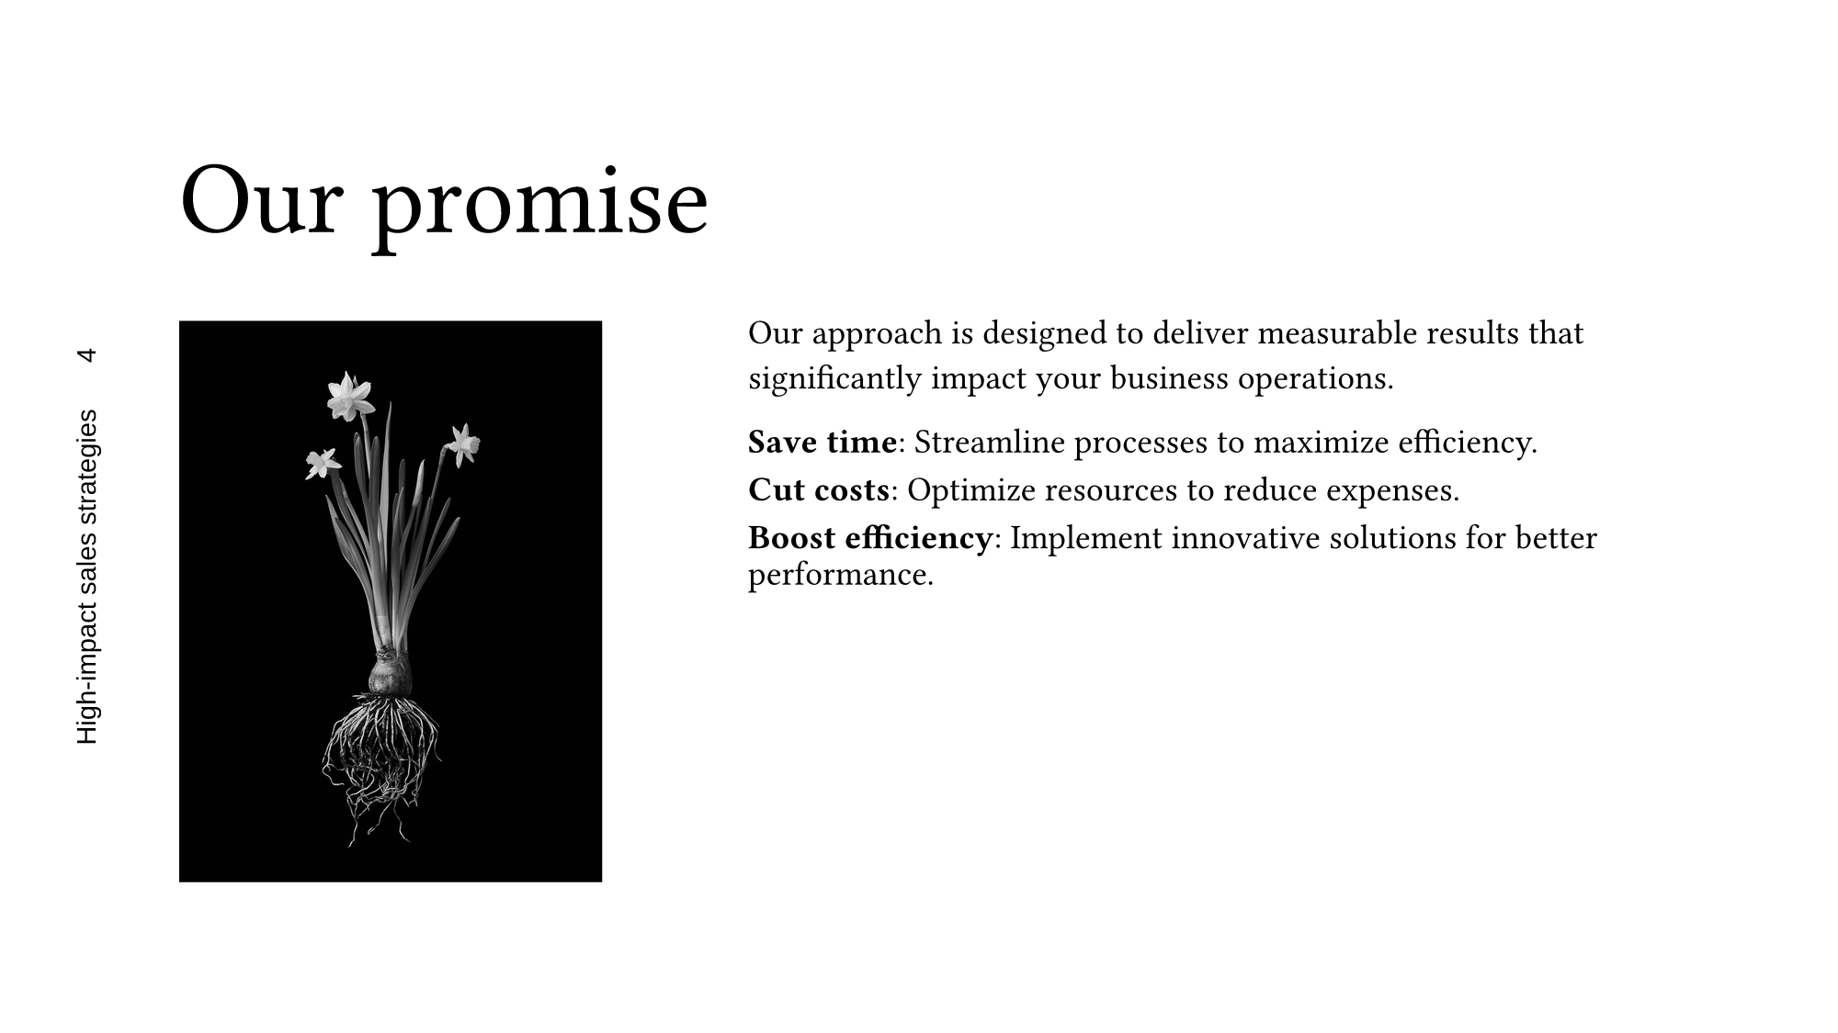

PROOF
Rendered by OfficeEditor
Real PPTX file → Typst pipeline → PNG. Source: pres-pro (16 slides).

Slide 6
ARCHITECTURE
Layout once, emit twice
JSON / YAML
→
Parse & validate
→
Expand: archetypes → components → primitives
→
Resolved layout tree — single C# pass
↓
OOXML emitter
Typst emitter
native .pptx / .docx / .xlsx
PDF · PNG · SVG preview
Deterministic preview from the same resolved layout — no second layout engine.

Slide 7
What works where
Capability
PPTX
DOCX
XLSX
Create from scratch
✓
✓
✓
Edit existing documents
✓
✓
✓
Variables & mail merge
✓
✓
✓
Template logic (if/each)
✓
✓
✓
Instruction sets
✓
✓
—
Markdown import
—
✓
—
Declarative JSON generation
✓
—
—
Typst preview & PDF/PNG/SVG
✓
—
—

Slide 8

VISUAL FIDELITY
PowerPoint vs OfficeEditor — side by side
Geometry and positioning come from the shared layout pass — residual differences are mostly font metrics and rasterization.
PowerPoint render — pres-pro slide 1
OfficeEditor Typst render — RMSE 14.03%
Average RMSE: 17.29% (pres-pro, 16 slides) — a coarse regression signal, not pixel parity.

Slide 9
FOR DEVELOPERS
Four ways in
CLI
Fluent C# API
officeeditor merge template.pptx data.json out.pptx
builder.MergeVariables(data); builder.ExportToPdf();
ASP.NET Core + MCP
Web client
deck_generate · deck_render_slide · deck_anatomize
Vite + Tailwind browser deck editor

Slide 10
Positioning
The niche
Built on the Open XML SDK
Fully programmatic — no Office installation needed
Not a replacement. OfficeEditor adds higher-level instructions, reusable layout, template logic and deterministic preview on top of native OOXML.
One abstraction across three formats
Preview and delivery share one layout engine
MIT-licensed, in-memory APIs for services

Slide 11
Status & roadmap
Works today
Next
v0.1.0 — developed & tested on macOS
NuGet packages + dotnet tool
Create, edit, merge across 3 formats
Windows verification (pure managed code)
PPTX → PDF / PNG / SVG via TypstBridge
Richer chart & SmartArt rendering
1,218 tests green, visual-diff suite
Stable v1 generation schema
v0.1.0
MIT
macOS · Linux

Slide 12
OPEN SOURCE · MIT
Try it
dotnet run --project OfficeEditor.Cli -- create demo.pptx --title "Hello"
github.com/maximeleb/OfficeEditor
{
}

