Slide 1
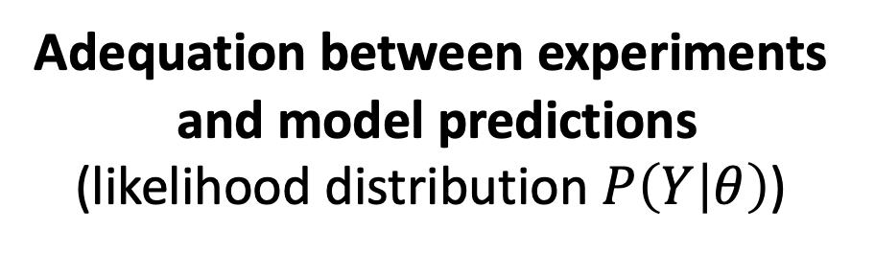
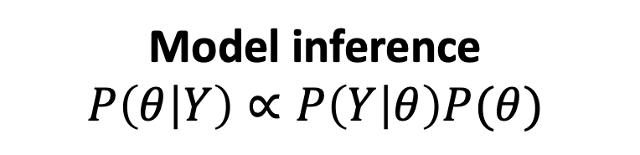
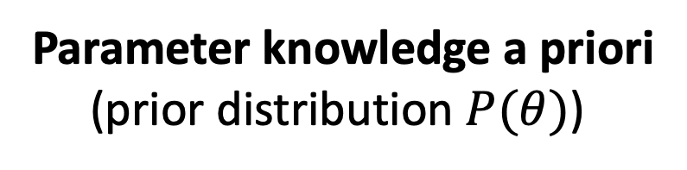

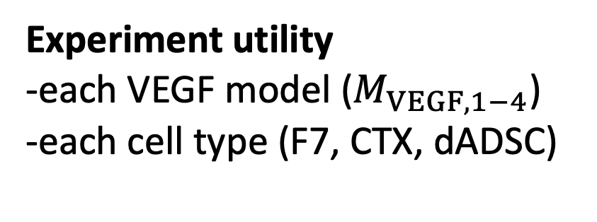
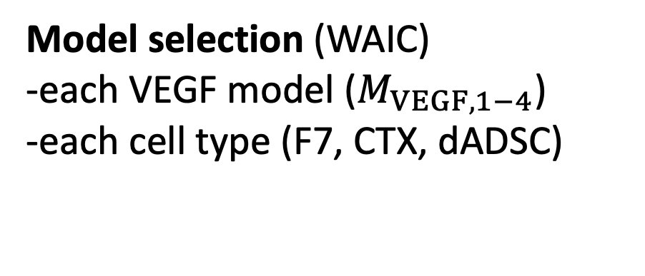
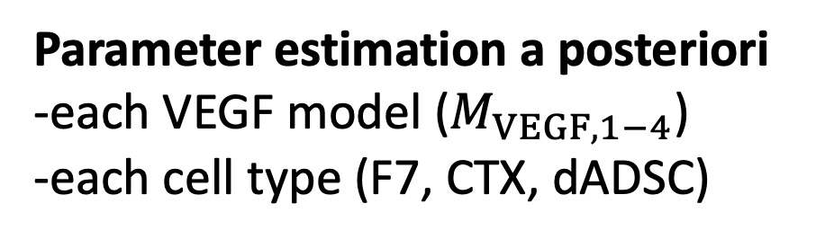
Candidate VEGF model
($M_{VEGF,1−4}$)
Parameter estimation a posteriori
-each VEGF model ($M_{VEGF,1−4}$)
-each cell type (F7, CTX, dADSC)
Requires parameter estimation
Parameter knowledge a priori
(prior distribution $P(θ)$)
In silico
experiment
Model inference
$$P\left(θ | Y\right)∝P\left(Y | θ\right)P(θ)$$
Model selection (WAIC)
-each VEGF model ($M_{VEGF,1−4}$)
-each cell type (F7, CTX, dADSC)
Adequation between experiments
and model predictions
(likelihood distribution $P\left(Y | θ\right)$)
Experiment utility
-each VEGF model ($M_{VEGF,1−4}$)
-each cell type (F7, CTX, dADSC)
Provides uncertain data
In vitro experiment
Cell type (F7, CTX, dADSC)
Specie (oxygen, glucose, VEGF, cell density)
Improves experimental design

