Slide 1
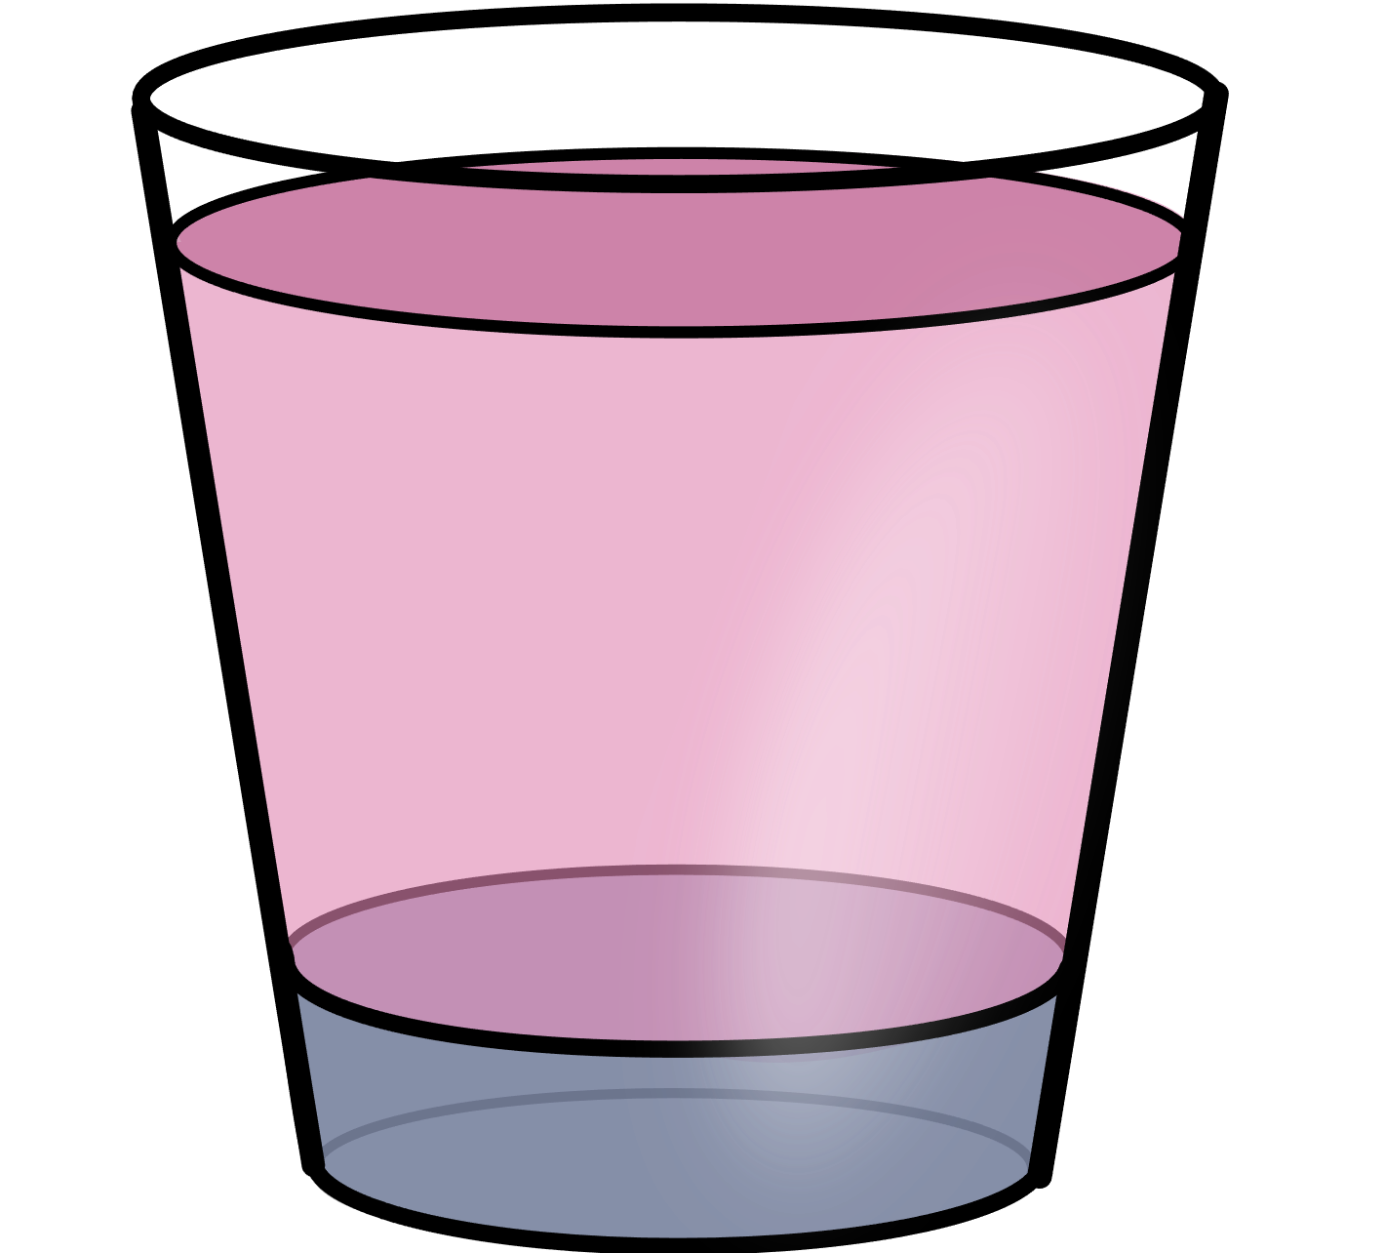
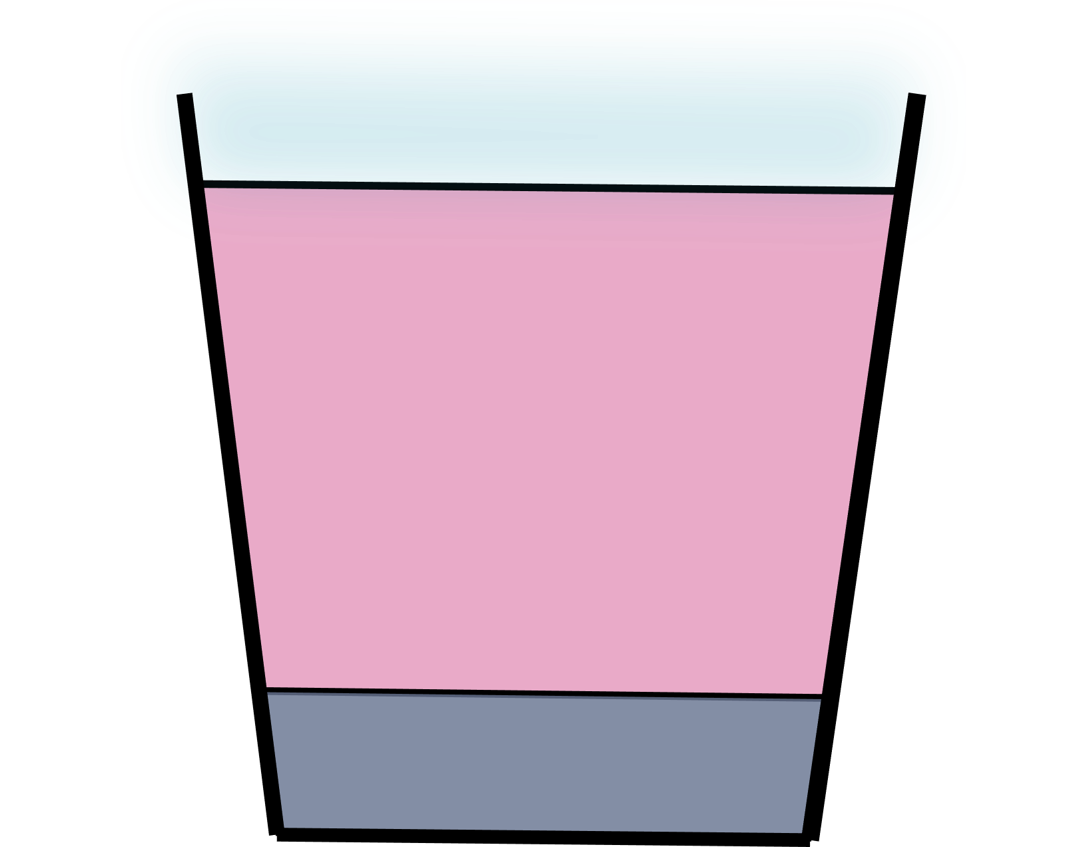

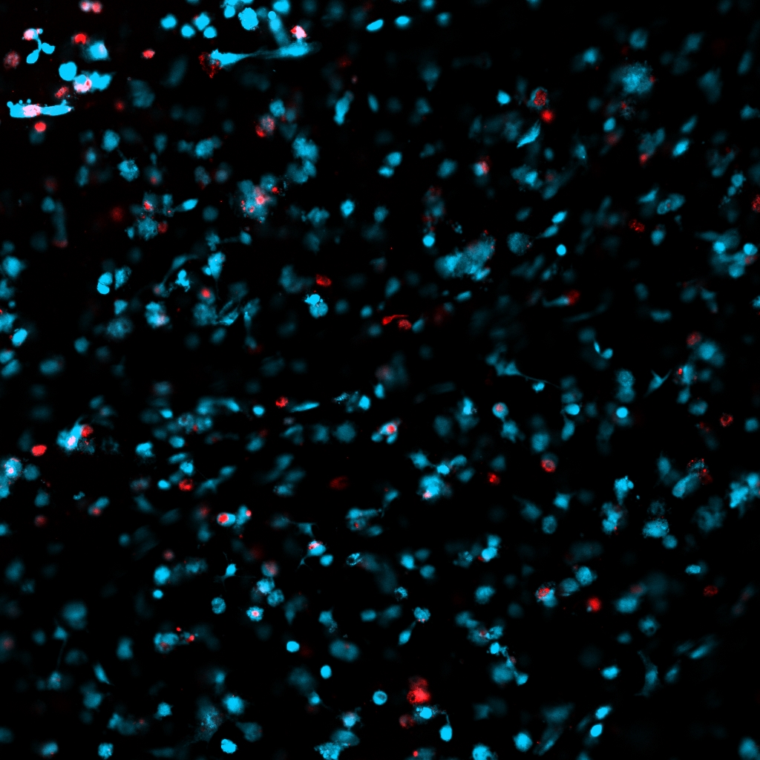








a)
$$R_{t}$$
b)
c)
Symmetry Axis
Air/Media
Interface
$$r$$
$$R_{a/m}$$
Well wall
$$z$$
$$L_{m}$$
Rotational Symmetry
Homogenization
$$R_{g/m}$$
Media/Gel
Interface
$$L_{g}$$
$$R_{b}$$
Culture media
d)
Cell-seeded collagen gel
Live cells
Dead cells
100µm

