Slide 1

CASA0017 / GROUP PROJECT PITCH
Mind the Dock
A Live Map of London's Cycle Hire
404 Group Not Found
Yifei Gong, Jiahan Xie, Zeyu Cheng,
Jialing Zhao and Shamima Akhtar
UCL CASA Connected Environments MSc
Notes:
Suggested time: 20 seconds.
We are 404 Group Not Found. Our project, Mind the Dock, helps people check Santander Cycles stations before they leave. We combine live availability with an availability history and historical cycling collision information. Today we will explain the problem, the data, the proposed website and our delivery plan.
Sources: project title and members supplied in the group proposal. Cover photograph reused from the user-supplied 模板1.pptx, ppt/media/image1.png. That template credits Hippopx for its photographs.
Pending: insert the confirmed presentation date.

Slide 2
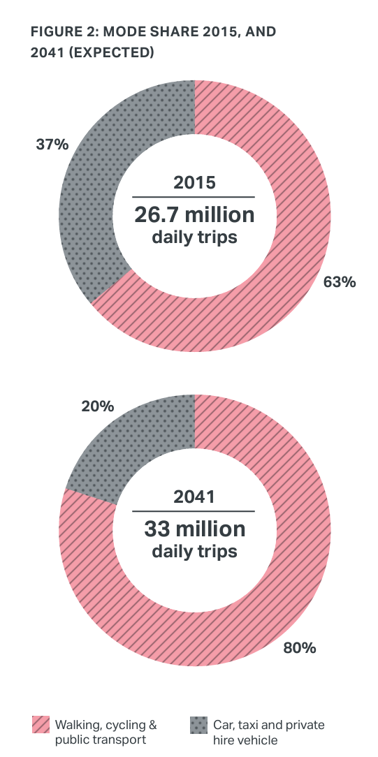
1. Background and Research
LONDON POLICY
UCL Research
TfL aims for 80% of trips by active or public transport modes by 2041.
2016 · MASTER’S THESIS
Demand dynamics and inter-modal connectivity in London bike sharing
Nilufer Sari Aslam
Fluctuating demand and station imbalance motivate our Find / Return modes.
Mayor's Transport Strategy
Analysis of Demand Dynamics and Inter-modal Connectivity in London Bicycle Sharing System - UCL Discovery
2022 · PHD THESIS
Bicycle Sharing Systems: Fast and Slow Urban Mobility Dynamics
James Todd
Bike sharing varies across time scales: motivation for our Daily Flow replay.
Bicycle Sharing Systems: Fast and Slow Urban Mobility Dynamics - UCL Discovery
MIND THE DOCK • UCL CASA0017 • 404 GROUP NOT FOUND
02

Slide 3
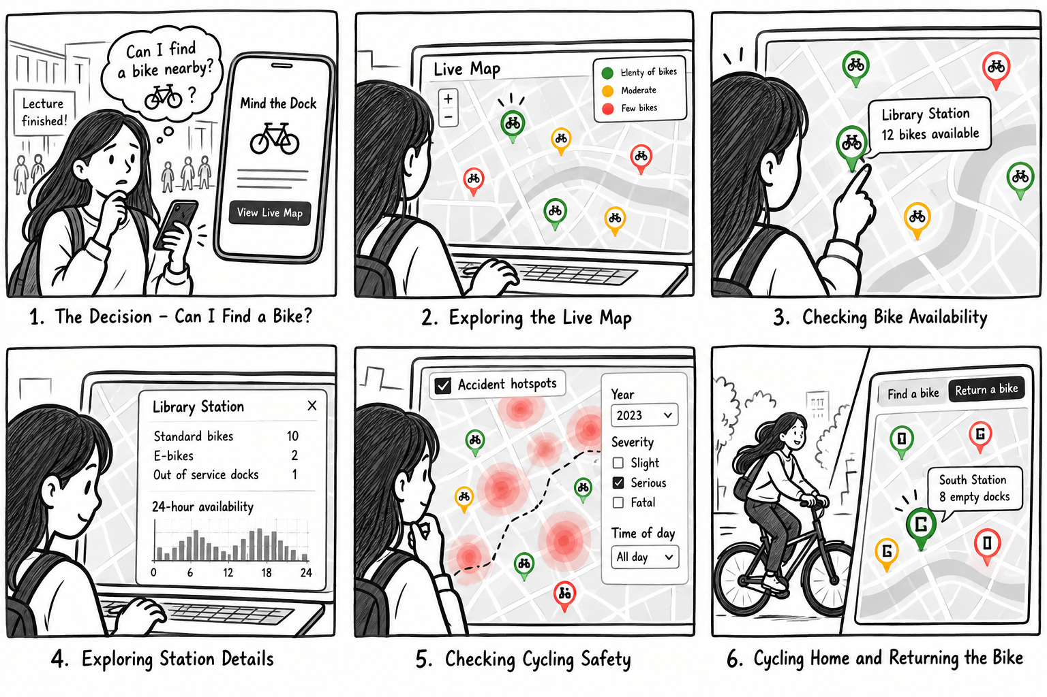
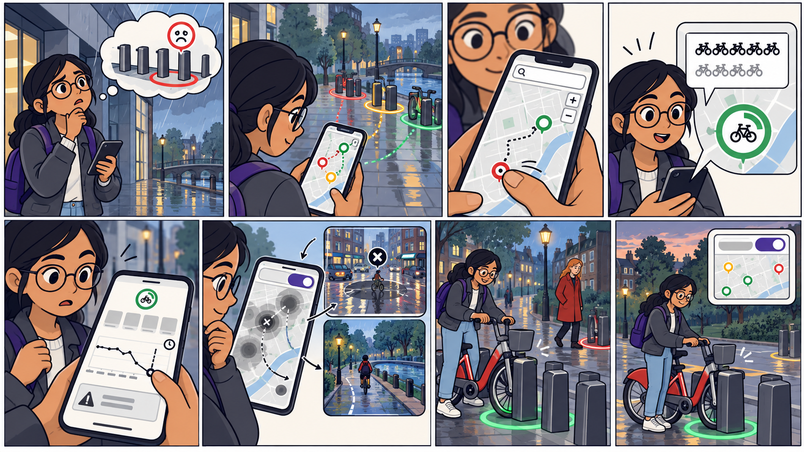
Storyboard: from uncertainty to informed choice
Scenario A: finding a bike after a lecture
Scenario B: avoiding an unreliable return dock
Discover → inspect station → check safety → borrow → return
Review availability → compare stations → choose return option
MIND THE DOCK • UCL CASA0017 • 404 GROUP NOT FOUND
03

Slide 4
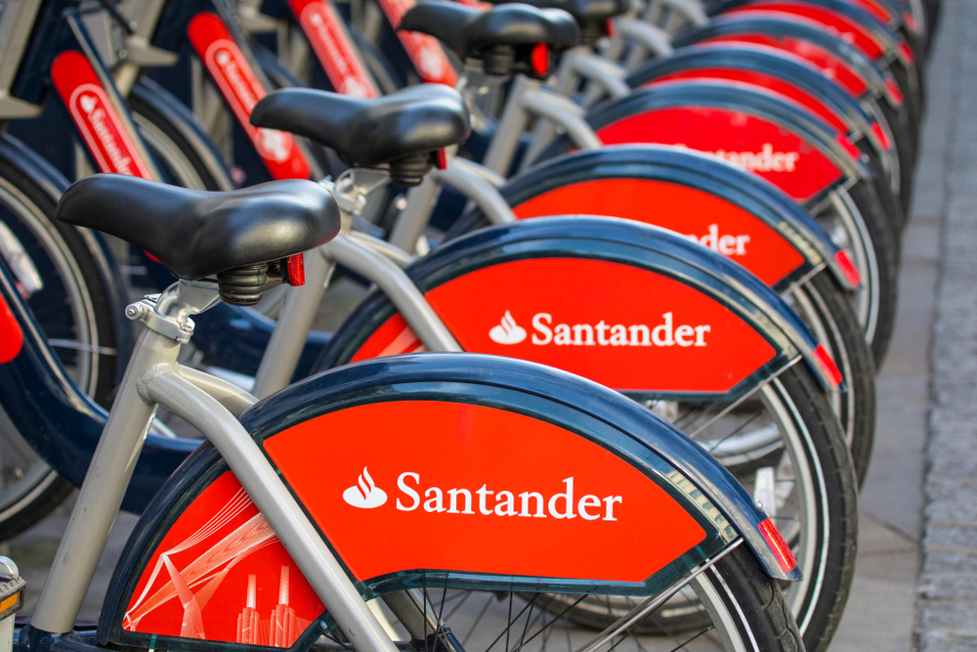
2. What problem are we trying to solve?
Convenience
Help users quickly locate available bikes and empty docking spaces nearby, reducing unnecessary walking and waiting.
Reliability
Combine live availability with historical trends to help users plan journeys and make informed decisions.
Safety Awareness
Visualise historical cycling collisions to help users understand potential safety concerns around docking stations.
MIND THE DOCK • UCL CASA0017 • 404 GROUP NOT FOUND
04

Slide 5
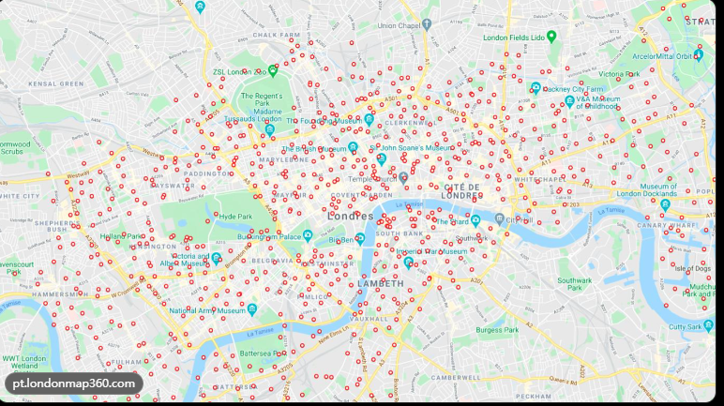
3. What will the website look like?
Home
Live Map
Daily Flow
Contact Us
Log in and Register
Availability and historical context
Visualized data
Sources, team and email
Planned interactions
Find / return
Colour markers by bike count
or empty docks.
Station details
Click for standard bikes, e-bikes
and a 24-hour history chart.
Collision filters
Explore historical records
by year, severity and time.
Map layout reference supplied by the team. Interface and availability colours are proposed.
MIND THE DOCK • UCL CASA0017 • 404 GROUP NOT FOUND
05

Slide 6
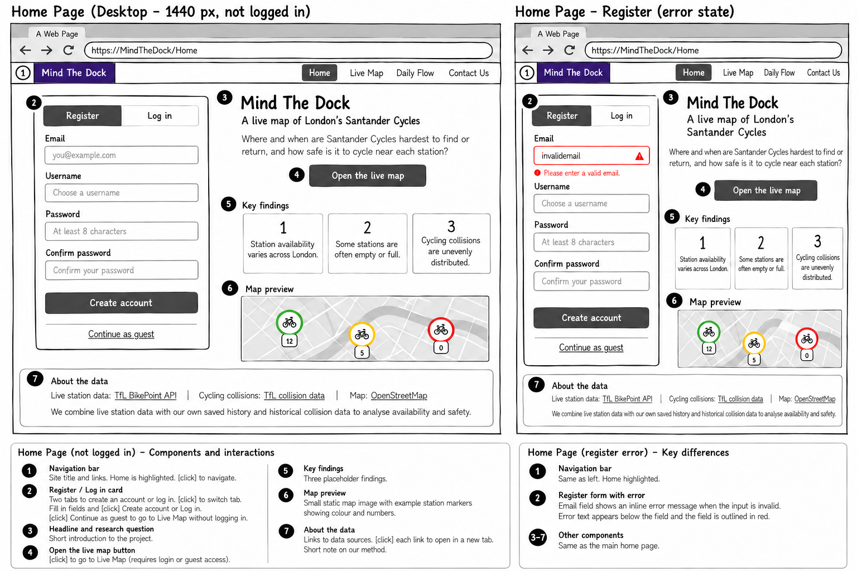
Wireframe: Home - log in and register
MIND THE DOCK • UCL CASA0017 • 404 GROUP NOT FOUND
06

Slide 7
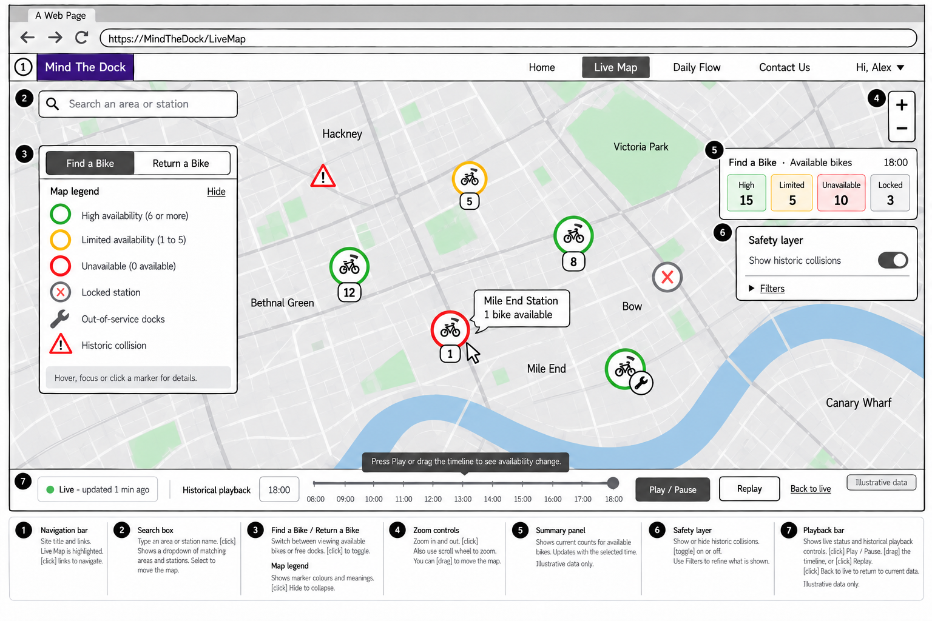
Wireframe: Live Map - find/return a bike
MIND THE DOCK • UCL CASA0017 • 404 GROUP NOT FOUND
07

Slide 8
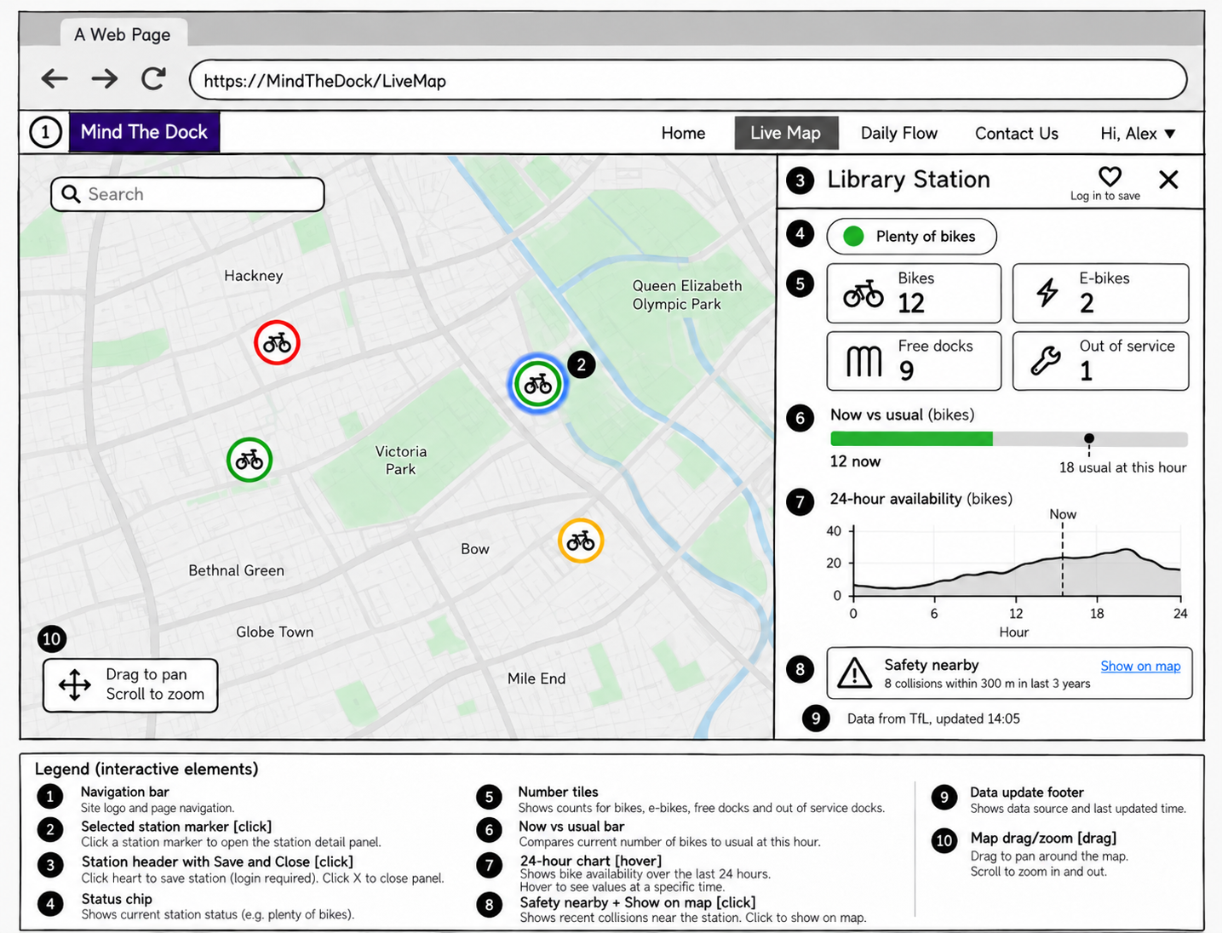
Wireframe: Live Map - library station
MIND THE DOCK • UCL CASA0017 • 404 GROUP NOT FOUND
08

Slide 9
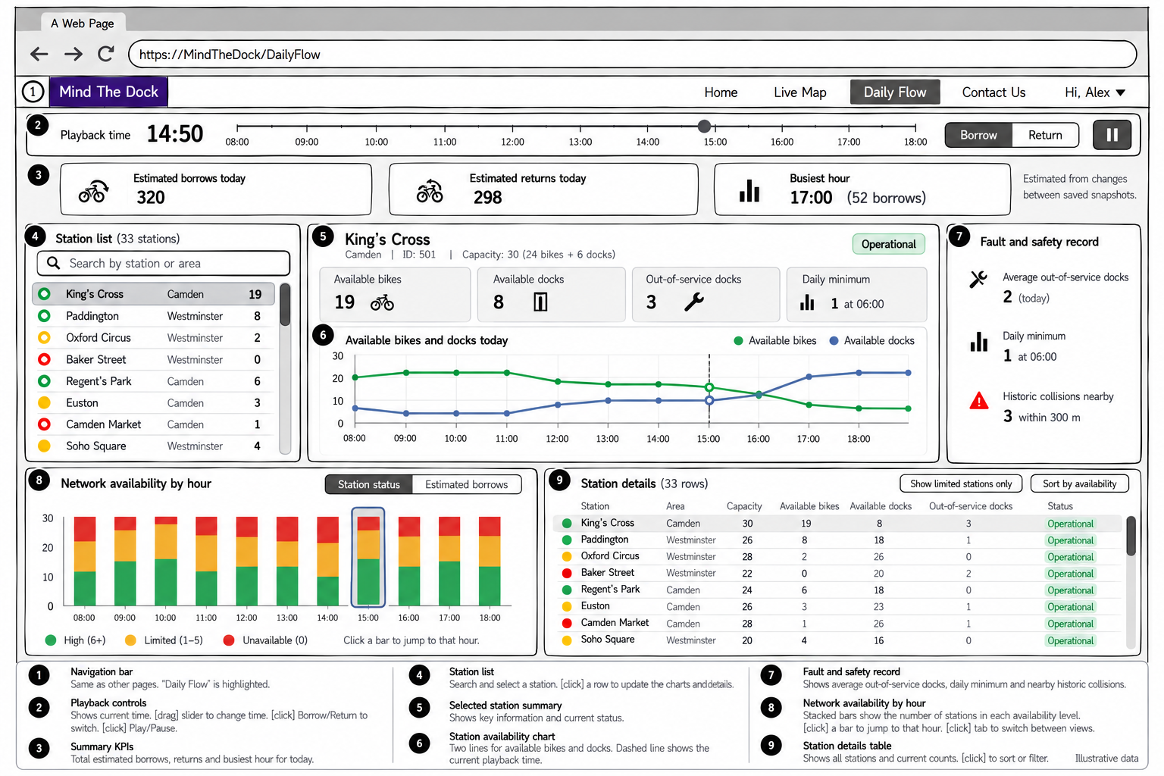
Wireframe: Daily Flow - Visualized data
MIND THE DOCK • UCL CASA0017 • 404 GROUP NOT FOUND
09

Slide 10
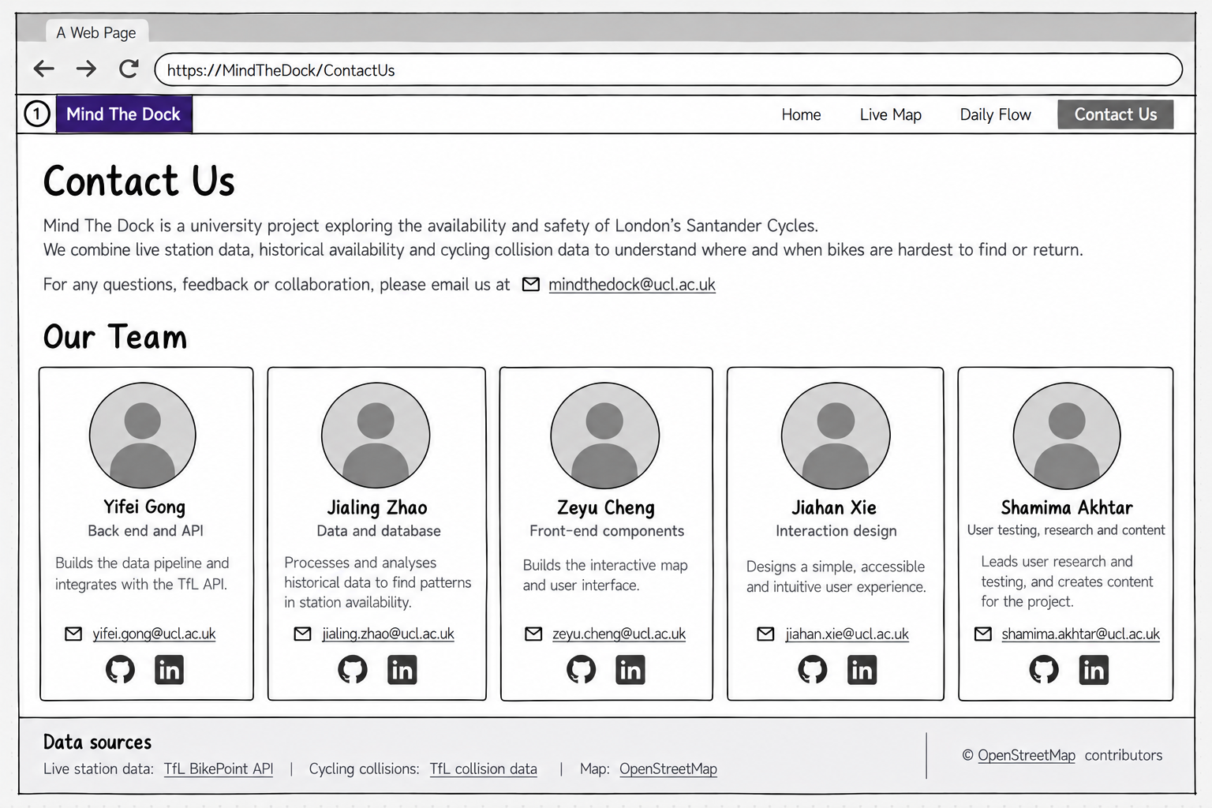
Wireframe: Contact Us - Team Members
MIND THE DOCK • UCL CASA0017 • 404 GROUP NOT FOUND
10

Slide 11
4. What data will we use?
Dataset | What we will collect | What it will show
TfL BikePoint API | Station locations Bikes and empty docks | Where users can borrow or return a bike
 | Repeated station observations Target: every 5 minutes | 24-hour availability Difficult stations and times
Cycling collisions | Location, date and severity | Historical collision patterns around docking stations
Planned architecture
Node.js collects data. MySQL stores snapshots. Express serves JSON.
Python handles analysis. Leaflet and Chart.js display the results.
Database: london_bike_pulse. Schema and query screenshots follow in the appendix.
MIND THE DOCK • UCL CASA0017 • 404 GROUP NOT FOUND
11

Slide 12
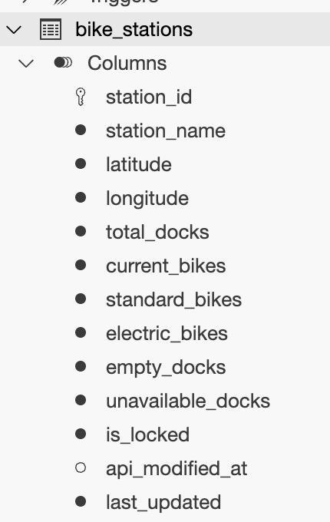
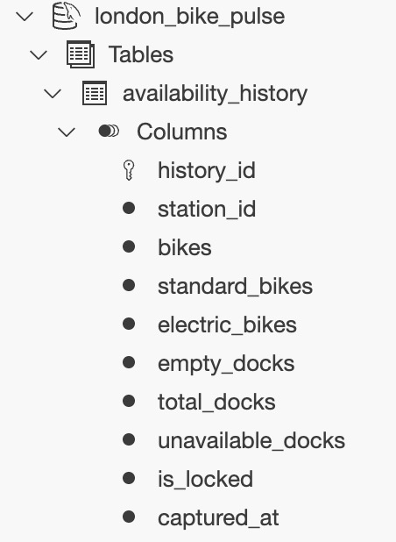
Database: station status and history
bike_stations
availability_history
Latest station state and update times
Snapshots for the availability chart
APPENDIX Team-provided database schema screenshots
12
Notes:
Appendix for questions.
The database name visible in the supplied screenshot is london_bike_pulse. bike_stations holds station_id, station_name, latitude, longitude, total_docks, current_bikes, standard_bikes, electric_bikes, empty_docks, unavailable_docks, is_locked, api_modified_at and last_updated. availability_history holds history_id, station_id, bikes, standard_bikes, electric_bikes, empty_docks, total_docks, unavailable_docks, is_locked and captured_at.
The repeated station_id supports the intended logical link between current state and history. The screenshots do not show database types, declared foreign keys, indexes, row counts or the running collection schedule. Those details require confirmation. api_modified_at and local update/collection times should retain their different meanings.
Sources: user-supplied codex-clipboard-59faf56f-c1b6-41bc-8732-9b98fd0acdc8.jpg and codex-clipboard-6adf05a7-e3f9-4946-ad38-8e9cbea84e93.jpg, received 17 October 2026. Both original images are embedded in full without cropping field rows. This appendix need not be presented during the timed pitch.

Slide 13
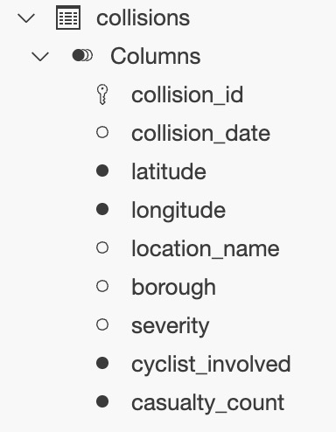
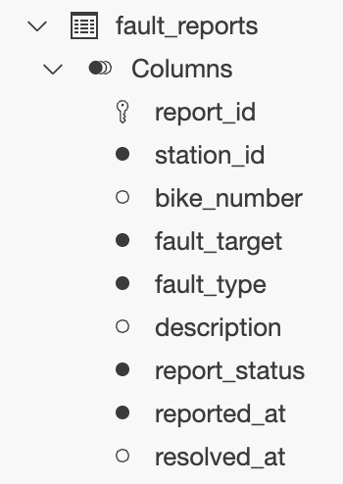
Database: collisions and fault reports
collisions
fault_reports
Recorded collisions and cycling involvement
Fields for a possible reporting feature
APPENDIX Collision data source and reporting workflow remain to be confirmed
13
Notes:
Appendix for questions.
collisions includes collision_id, collision_date, latitude, longitude, location_name, borough, severity, cyclist_involved and casualty_count. The location fields support spatial comparison around stations. No station_id is visible in this table. A time-of-day field is not visible, so the team should check the underlying type of collision_date and the source data before promising hour-based collision filters. The screenshot alone does not establish the dataset source, years, record population or severity definitions.
fault_reports includes report_id, station_id, bike_number, fault_target, fault_type, description, report_status, reported_at and resolved_at. It shows a data structure for reports, but a working form, moderation process and resolution workflow are not demonstrated. Treat reporting as a possible extension until scope is confirmed. A user-entered bike number would not be a TfL individual-bike condition feed.
Sources: user-supplied codex-clipboard-350b251f-5599-4baa-ac11-0435b873205c.jpg and codex-clipboard-02db3e4e-4b0a-4759-88d9-e7d85966b5a3.jpg, received 17 October 2026. Both images are embedded in full without cropping field rows. This appendix need not be presented during the timed pitch.

Slide 14
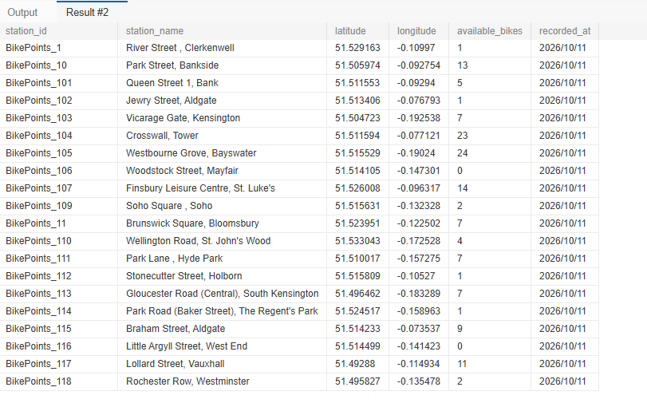
Database query: sample station records
APPENDIX Query sample dated 11 October 2026. Counts belong to this sample.
14
Notes:
Appendix for questions.
The supplied query output shows station IDs, names, coordinates, available_bikes and recorded_at. For example, the displayed sample includes River Street, Clerkenwell; Park Street, Bankside; and Queen Street 1, Bank. The visible recorded_at date is 2026/10/11. These counts describe the supplied output and should not be described as current availability. No total station count, collection reliability or production readiness can be inferred from this partial query output.
The query column labels available_bikes and recorded_at differ from current_bikes and last_updated in the supplied bike_stations schema. They may be SQL aliases or come from a different query or schema version. Confirm the query before mapping these names to the API contract.
Source: user-supplied codex-clipboard-5268c16c-0585-4283-95d0-9b7e31be5c73.png, received 17 October 2026. The full original screenshot and all its visible rows remain embedded. This appendix need not be presented during the timed pitch.

Slide 15
5. What makes Mind the Dock different?
1 Temporal exploration
Daily Flow visualises how station conditions change, rather than showing only the latest counts.
2 Two-sided availability
“Find a bike” and “Return a bike” solve different problems with context-aware legends.
3 Evidence-informed safety
Historic collision filters offer environmental context, with clear uncertainty labels.
4 Explainable station insight
Compare now versus usual, inspect faults and show data timestamp and source.
MIND THE DOCK • UCL CASA0017 • 404 GROUP NOT FOUND
15

Slide 16
6. Who will do what, and when?
Team responsibilities
Proposed milestones
Yifei Gong
Express API, collection, deployment
18-21 Oct
Collection and database
Jialing Zhao
MySQL setup and Python analysis
22-28 Oct
Live map and station panel
Zeyu Cheng
Leaflet map, station panel and charts
29 Oct-3 Nov
Analysis and collision layer
Jiahan Xie
Wireframes, CSS and interactive interface
4-12 Nov
User tests and report
Shamima Akhtar
UX Design, Research and Testing
13-15 Nov
Final checks and submission
Everyone documents their work, commits regularly and reviews the team’s changes.
MIND THE DOCK • UCL CASA0017 • 404 GROUP NOT FOUND
16

Slide 17
CASA0017 / GROUP PROJECT PITCH
THANKS
404 Group Not Found
Yifei Gong, Jiahan Xie, Zeyu Cheng,
Jialing Zhao and Shamima Akhtar
UCL CASA Connected Environments MSc
Notes:
Suggested time: 20 seconds.
We are 404 Group Not Found. Our project, Mind the Dock, helps people check Santander Cycles stations before they leave. We combine live availability with an availability history and historical cycling collision information. Today we will explain the problem, the data, the proposed website and our delivery plan.
Sources: project title and members supplied in the group proposal. Cover photograph reused from the user-supplied 模板1.pptx, ppt/media/image1.png. That template credits Hippopx for its photographs.
Pending: insert the confirmed presentation date.

