Slide 1


Data Analysis Lead - DemoDay #71
Analyzing
the Flu Incidence
Maxime FERRE
Isabelle COLSON
Iryna VOROBIOVA
Group #dal-ft-08, groupe en distanciel

Slide 2


Summary
Context
Introducing Dataset
ETL & Data Visualization Flow
Tableau dashboard
Conclusions

Slide 3

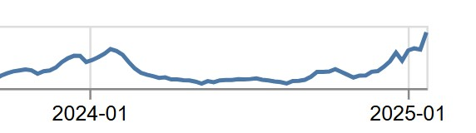
Context : 2025
The seasonal flu epidemic at the beginning of 2025 is at a high level of intensity.
The vaccination campaign has been extended until February 28, 2025

Slide 4

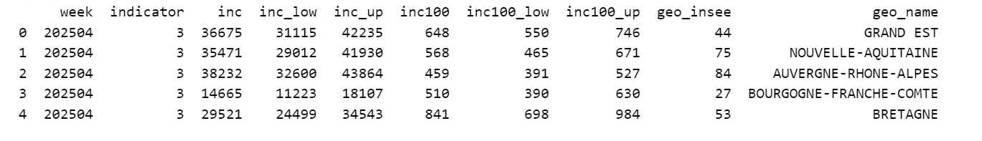
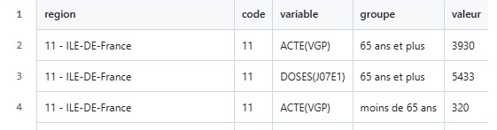

Introducing Dataset
4797 rows x 10 columns
“Flu Data 01.2018 - 01.2025”
53 rows x 5 columns “Flu Vaccination 2024-2025”

Slide 5





ETL & Data Visualization Flow

Slide 6
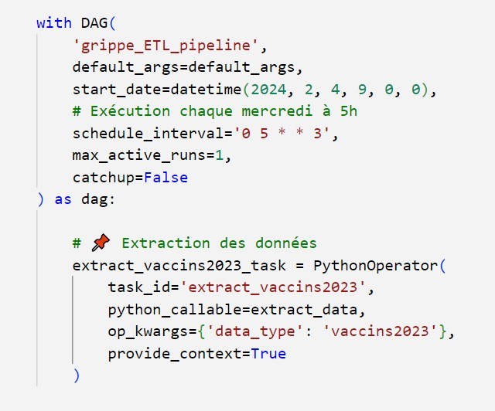
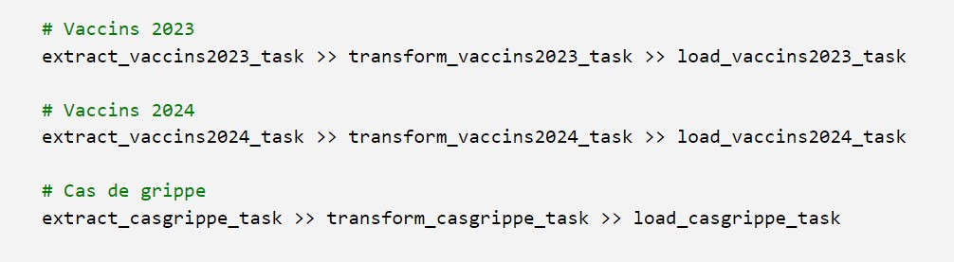
Le DAG s’exécute
tous les mercredis de chaque semaine.
Le code qui permet l’automatisation du pipeline est écrit en Python.
Les différentes tâches sont :
Extraction des données
Transformation (Cleaning)
Loading (chargement dans une base de données)

Slide 7
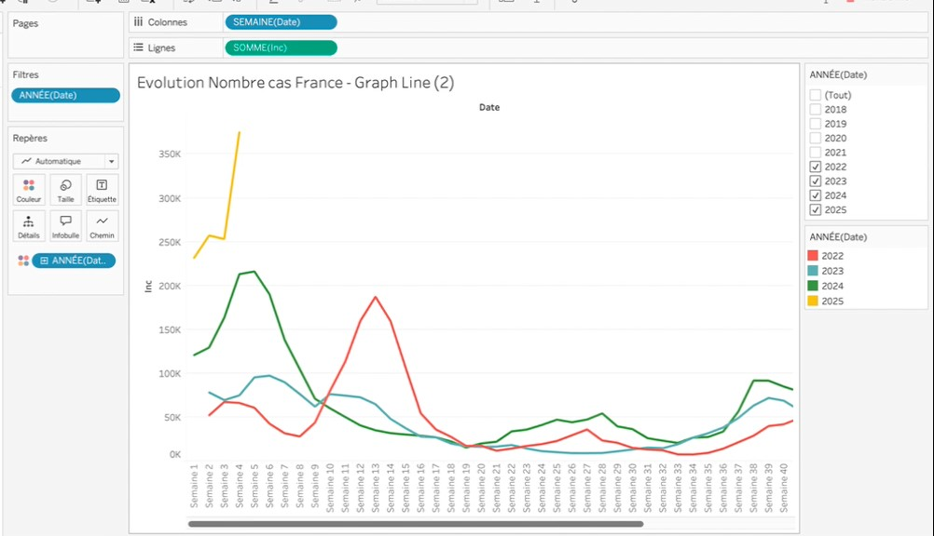
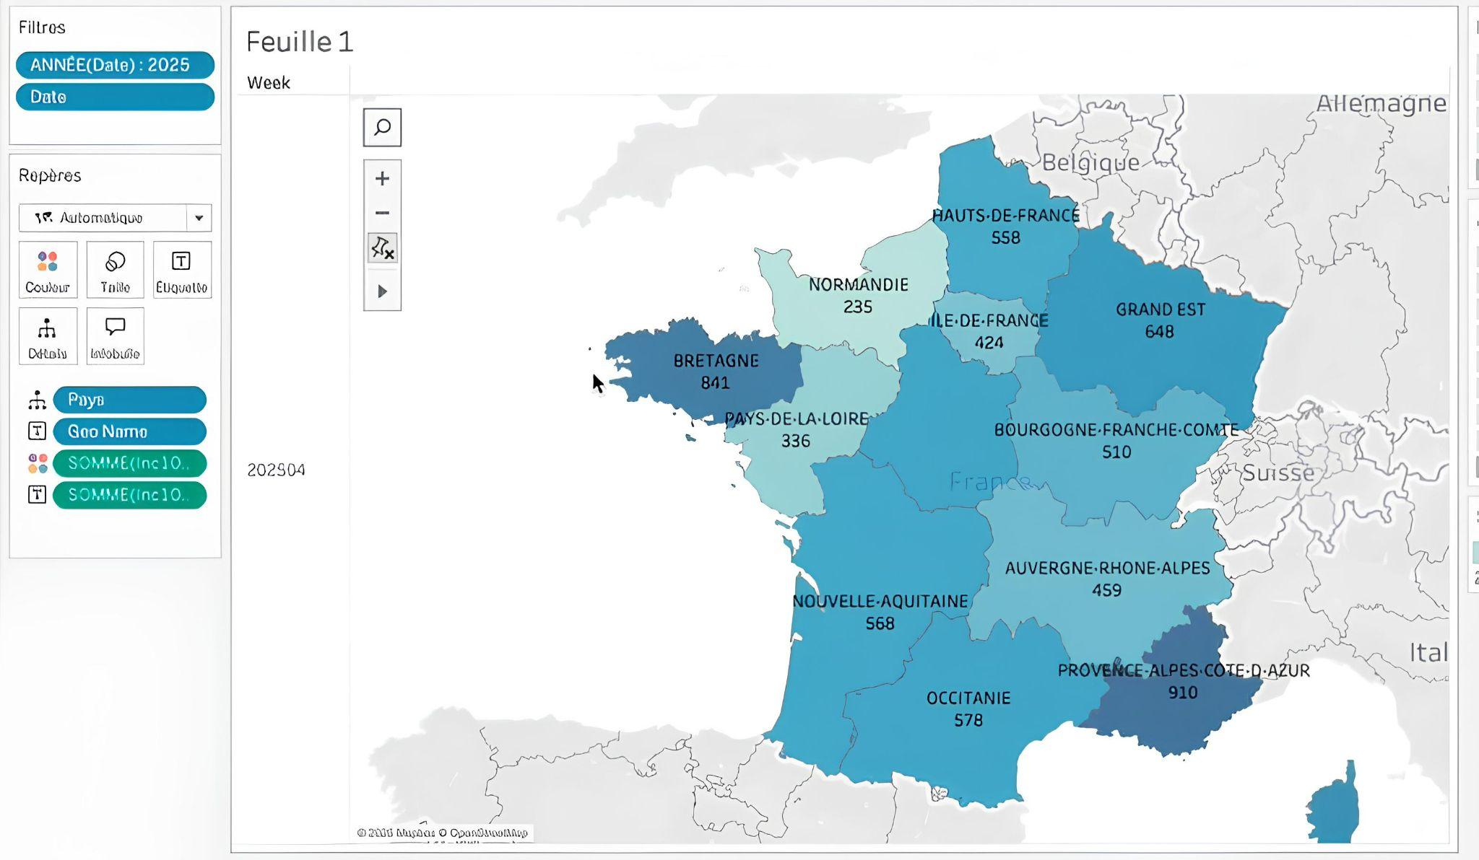
Tableau dashboard
https://public.tableau.com/app/profile/maxime.ferre/viz/Dashboard_Jedha_Grippe/Histoire1?publish=yes

Slide 8
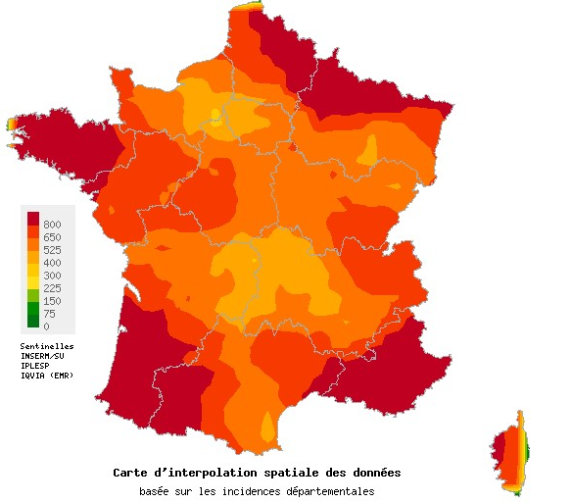
Conclusions
Key Findings
The flu epidemic remains active with high incidence among in 2025
Most affected regions: Brittany, Grand Est, and Provence-Alpes-Côte d'Azur
Analysis Improvement
Acute respiratory infections in the 4th week of 2025
Look for a dataset with more detailed age segmentation
Combine infection and hospitalization data to determine epidemic impact
Analyze flu-related deaths
Expand the vaccination analysis

Slide 9
Thank you
for your attention!

Slide 10
Any questions?

