Slide 1

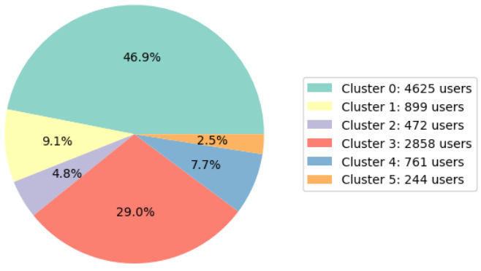
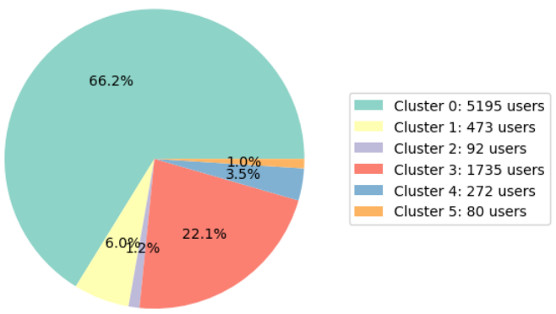
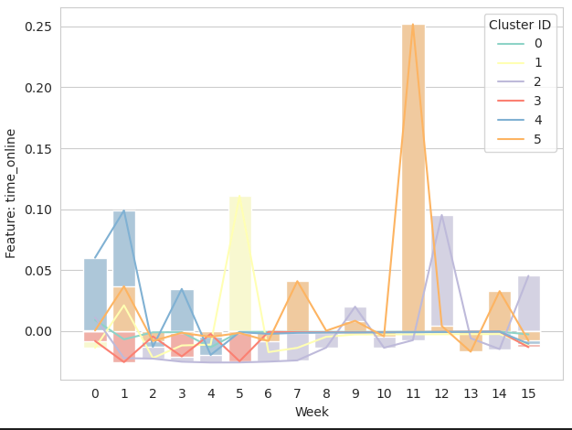
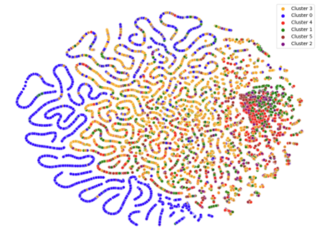
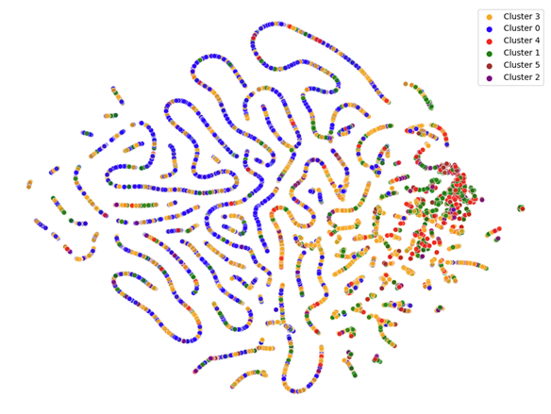
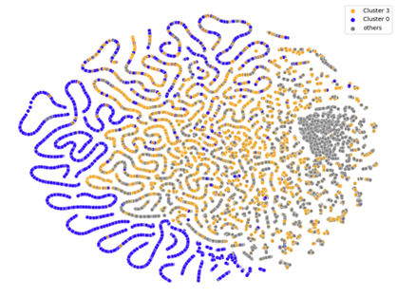
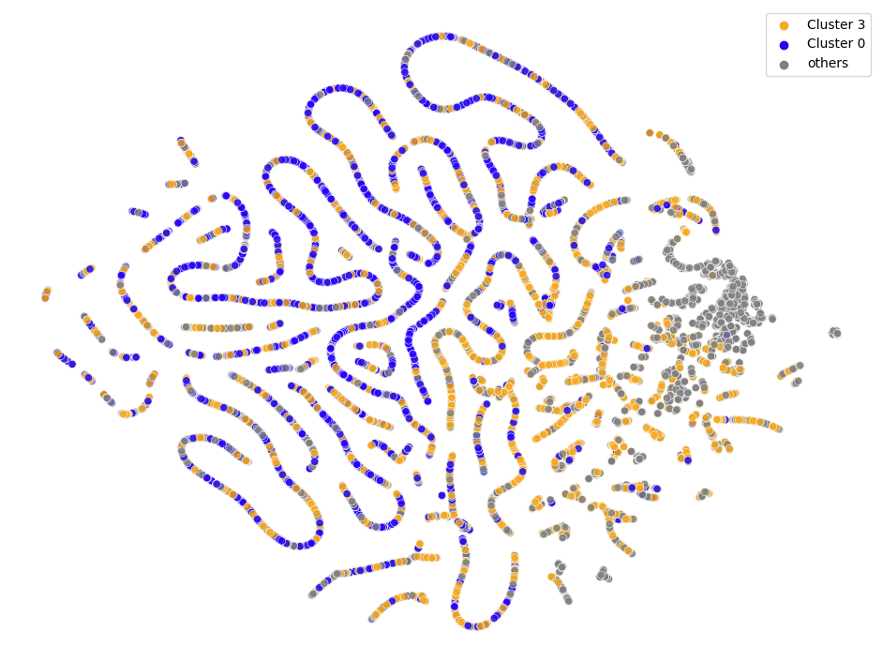
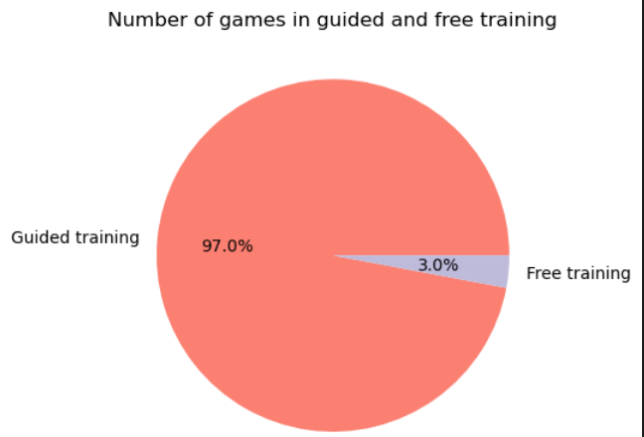
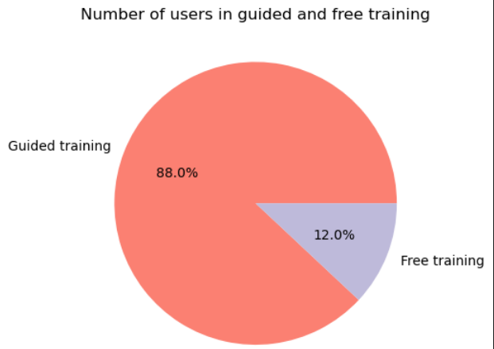

Exploring Learning Profiles:
Time Series Clustering Guided vs. Free Training
On the Challenges of Identifying Learning Types in Calcularis
Tobias Oberdörfer, Maxime Lelièvre, Violeta Vicente Cantero
Machine Learning for Behavioral Data (MLBD) Course, EPFL 2023
1. INTRODUCTION + RESEARCH QUESTION
3. RESULTS
Purpose: Identifying types of learners in guided versus free training.
Method: Multivariate K-Means time series clustering.
Research question: Can time series clustering be used to identify types of learners and categorize them into different student profiles allowing for a comparison between guided and free training?
Key takeaway: The identified clusters were largely overlapping, suggesting the used features may not be sufficient. While the current approach may not have been successful, a working pipeline for future research to build upon was created.
Figure 2. Left: Guided training with 9859 users sample and a silhouette score of 0.184
Right: Free training with 7847 users sample and a silhouette score of 0.386
SoftDTW cluster centroids show different types of learners:
Cluster zero clusters users that do not work much across all 16 weeks.
In clusters three and four users seem to stop working after only a few weeks.
Clusters two and five seem to work more between weeks 10 and 15 instead of more initially.
2. METHODOLOGY
Model Architecture
Dataset
Preprocessing
Clustering
Evaluation
Figure 3. Plot of the online time
feature cluster centroids for 16 weeks.
Training mode filter
Choosing of K
(mod. Silhouette Score^{[2]})
Histograms
Subsampling & outlier removal
TS DTW KMeans
TS KShapes
tSNE
PCA
Figure 4a. Guided training
Figure 4b.
Free training
TimeSeries (TS)
feature engineering^{[1]}
TS SoftDTW^{[3]} KMeans
PCA + tSNE
Figure 4. t-SNE plots of our clusters for different types of learners.
Middle: visualization of all six clusters; Outsides: visualization combining overlapping clusters.
Engineered features
time_online
events_done
subtasks_done
Nb_of_different_games
correct
attempts_diff
Strategies to cope with the exponential computational cost of the models & metrics:
Subsampling of the guided training dataset to train the model on 10 000 users only.
Subsampling silhouette score averaged over multiple different runs.
Removing all outliers based on three standard deviations from the mean.
4. CONCLUSION
The used features for time series clustering may not be sufficient for identifying different types of learners.
However, the study provides a usable pipeline to rerun the clustering approach with additional features in the future.
Although identified clusters overlap, some broad patterns in student learning were still recognizable, suggesting that further exploration and feature refinement may lead to better differentiation.
REFERENCES
[1] P. Mejia-Domenzain et al., “Identifying and comparing multi-dimensional student profiles across flipped classrooms,” in Artificial Intelligence in Education: 23rd International Conference, AIED 2022, Durham, UK, Proceedings, Part I. Berlin, Heidelberg: Springer-Verlag, 2022, p. 90–102. [Online].
[2] R. Tavenard et al., “Tslearn, a machine learning toolkit for time series data,” Journal of Machine Learning Research, vol. 21, no. 118, pp. 1–6, 2020. [Online].
[3] M. Cuturi and M. Blondel, “Soft-DTW: A Differentiable Loss Function for Time-Series,” in Proceedings of the 34th International Conference on Machine Learning - Volume 70, ser. ICML’17. JMLR.org, 2017, p. 894–903.
Figure 1. Guided training vs free training: games and user number comparison.

