Slide 1
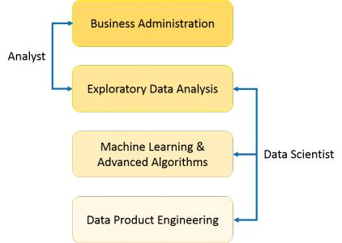
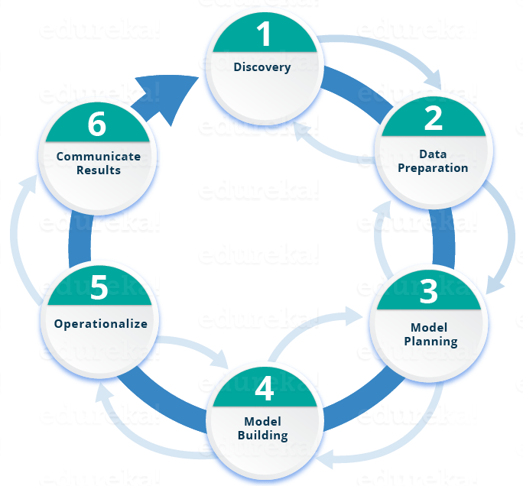
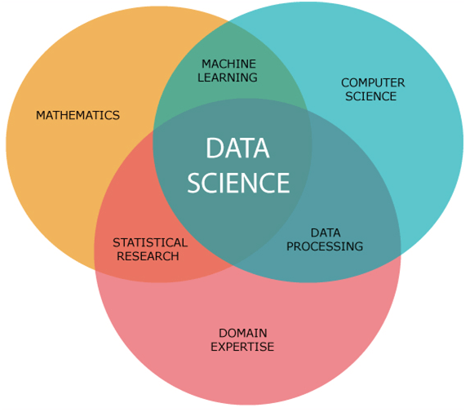
Data science
Data → knowledge
Difference between analyst and data scientist
Lifecycle of Data Science
What is Data Science?

