Slide 1
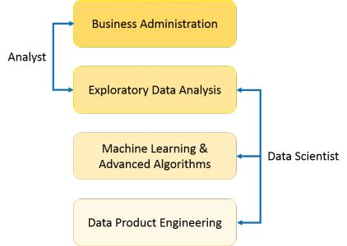
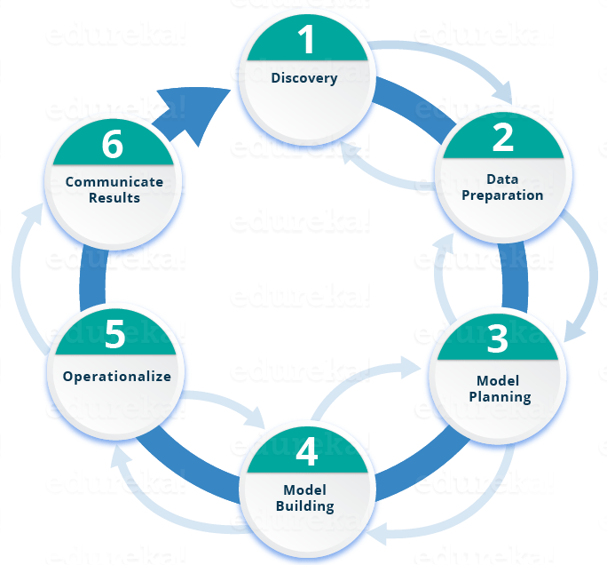
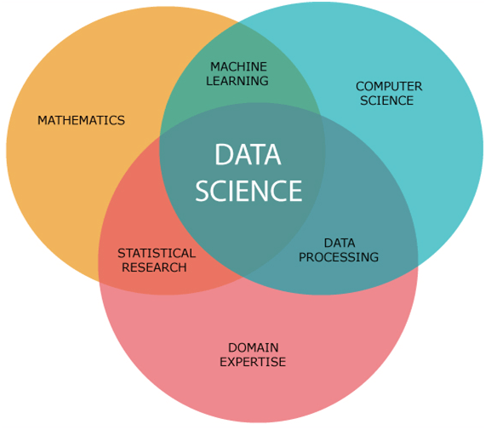
Data science
Data → knowledge
Difference between analyst and data scientist
Lifecycle of Data Science
What is Data Science?

Slide 2

DATA SCIENCE: Looking back
DATA SCIENCE
BUSINESS Intelligence
Data → Information
Real-time if possible
Focus on Future
Makes the questions
Information → Knowledge & Decisions
In Data Warehouses
Focus on Present & Past
Answers questions

