Slide 1


Slide 2

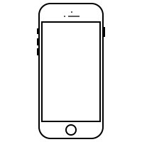
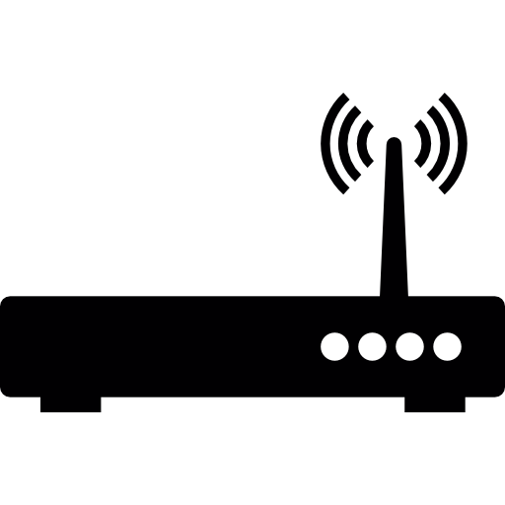


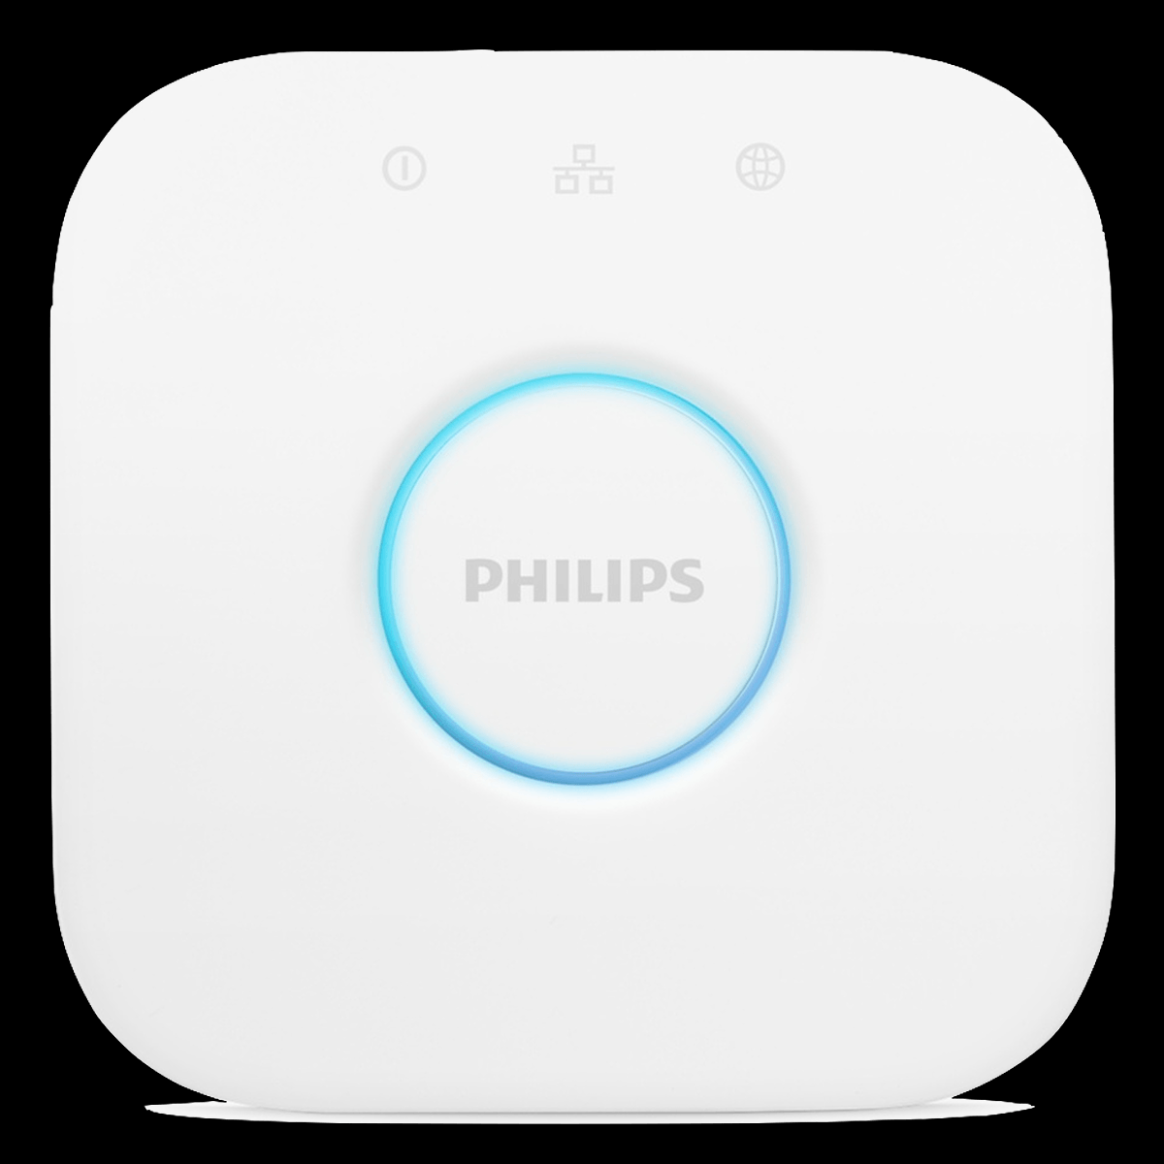

Architecture
Router
RPi
(incl. Softsensors:
Daylight
Daytim)
Devices
Hue Bridge
Hue Lamps

Slide 3


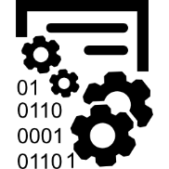
Approach
Collect Data
Learn Model
Smart Light Control

Slide 4
Data Table
Smart-phone | iPad | Kindle | PC | Week-day | Day-light | Daytime | Lamp
C | C | C | C | 1 | False | Early_Morning | True
C | C | D | C | 1 | True | Early_Morning | True
…
D | D | C | C | 1 | True | Early_Afternoon | False
D | D | C | C | 1 | True | Early_Afternoon | False
…
C | D | D | C | 1 | False | Evening | True
C | C | C | C | 1 | False | Evening | True
C = Connected
D = Disconnected

Slide 5
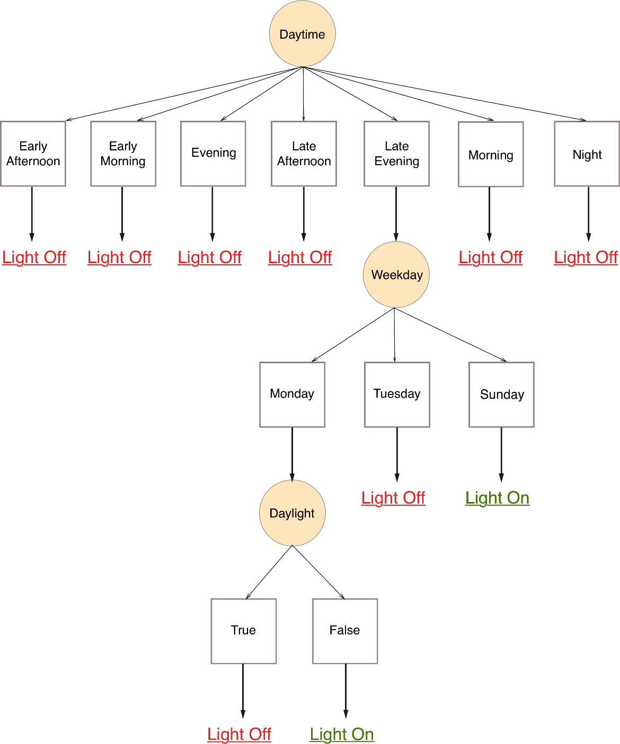
Decision Tree

Slide 6
Thanks for coming!
I hope you guys enjoyed it!

