Slide 1
Max Dean / B00759381
COM498 Algorithms & Data Structures
Assignment 1

Slide 2
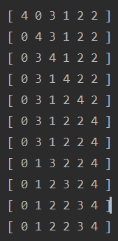
Bubble Sort Overview
Bubble sort is an algorithm that sequentially compares items in a list to its neighbor and possibly swaps them depending on weather they are already in the appropriate order or not.
After comparing / swapping elements, i.e. 1 and 2; then 2 and 3 will be compared / swapped.
This may not leave the array in order after one pass, so the process is repeated until all elements are in order. Hence, the reason for the bottom two rows of the example being identical.
Here we can see ‘4’ at the beginning of the array switch places with each iteration.

Slide 3
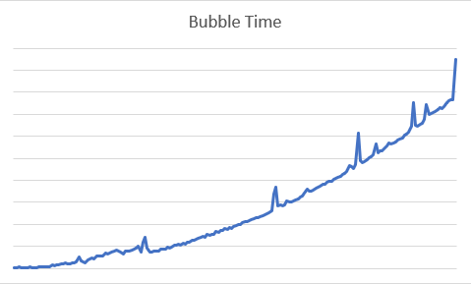
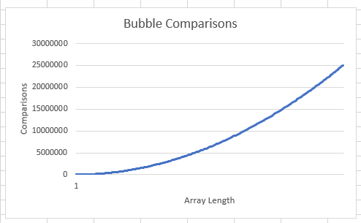
Bubble Sort Performance
The table below shows how the algorithm performs in worst, average and best-case scenarios.
To do this I generated an array in of length 100, with values 1-100 in descending order, then in random order and finally in ascending order.
Ascending and descending order will return the same number of swaps regardless of how many times the algorithm is run. However different random order arrays will require different numbers of swaps, so I ran this 100 times to get an average…
This shows the comparisons for potential swaps against array size from an implementation of the bubble sort algorithm.
The test script for this implementation of the bubble sort algorithm passed arrays of random integers (limited to positive number less than array length) from 25 to 1000.
Each array was 25 elements longer than the previous.
The results show that the number of comparisons needed to order an array rise exponentially with the array length.
Therefore, the bubble sort algorithm is said to have an average case efficiency of O(n^2).
Case | Average Swaps
Reverse Order | 1000
Random | 2428
Ordered | 0
This graph show the time elapsed between the algorithm being initiated and completion against array size, where the upper horizontal line represents 0.1 seconds.
The appears to be about five anomalies in this case but the graph seems to take a constant rise / run otherwise.
These anomalies may have been caused by other processes being run on the computer at the same time.
Case | Big Oh
Worst | O(n^2)
Average | O(n^2)
Best | O(n)

Slide 4
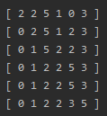
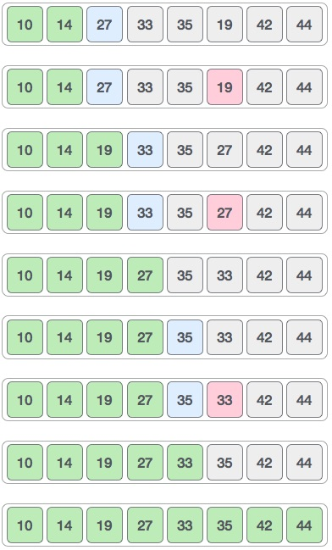
Selection Sort Overview
Selection Sort is an algorithm used to order an unordered list. It does this by iterating over the list and selecting the smallest element and the swapping it to the start or end of the list depending on weather the final product should be in ascending or descending order.
With each pass over the list the search area gets smaller by 1 as the smallest item found in the previous pass is now in its final position.
In the first iteration of this array, the smallest element ‘0’ has been found and placed at the beginning of the array.
This graphic (right) shows the process described. Where green cells are sorted / in the correct position. And red is the smallest in the search area.

Slide 5
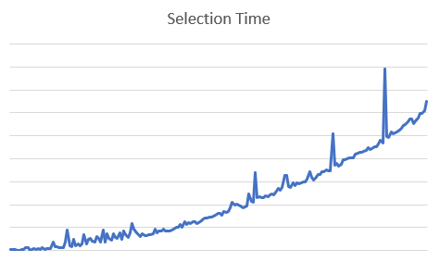
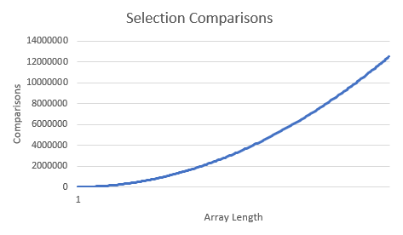
Selection Sort Performance
The graph below demonstrates the number of comparisons required to sort an unordered array, against array length (up to 5000 in intervals of 25).
This graph shows that the number of comparisons is rising exponentially with the array length. This is why selection Sort is said to be O(n^2) regardless of the order the array is in.
Selection sort lends itself to being written in a recursive form. This was not implemented however in this case.
The table below shows the average number of swaps a selection sort takes to order an unordered list.
Reverse order and Ordered return the same results constantly, however random order was repeated 100 times to obtain an average.
Case | Average Swaps
Reverse Order | 100
Random | 91
Ordered | 0
The graph above shows average completion time for the algorithm on an arrays of length 25-5000 in intervals of 25.
The highest point on the graph seems to be an anomaly but for reference, it is near 0.0016 seconds. Possibly caused by other process being run at the same time.
This matric also shows a curved result line indicating exponential growth, like the results of the comparisons test.
Each time was obtained from an average over 10 iterations of the test.
Case | Big Oh
Worst | O(n^2)
Average | O(n^2)
Best | O(n^2)

Slide 6
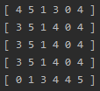
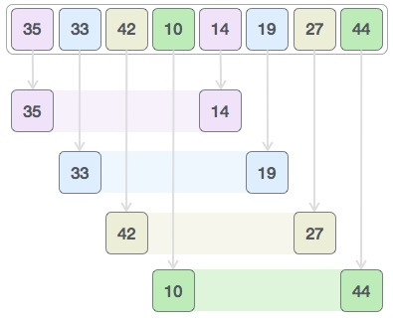
Shell Sort Overview
Shell Sort is a more complex operation than Bubble and Selection, however it is more efficient.
There are variations but a common method is to take the length of the array divided by 2. This is used as an interval.
This interval is used to index elements in the array, so that pairs can be made which are interval part in the array; then these are compared and ordered according to the weather the list is to be ascending or descending.
The interval is halved with each iteration so that the sort area is smaller with each pass.
In this example the initial length is 6 so the first interval is 3; hence why element 1 and element 1 + interval are compared and in this case swapped.
This graphic (right) shows how the first pass of an unordered list would be compared. Here, pink blue and yellow would be swapped to put the list in ascending order. The next pass would have an interval of 2.

Slide 7
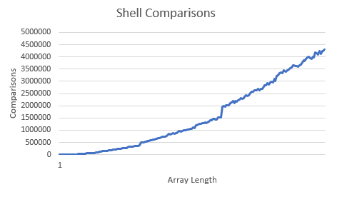
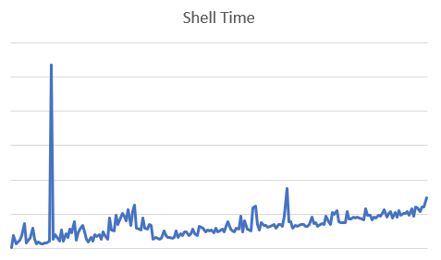
Shell Sort Performance
The line graph, left, shows the shows number of comparisons required to order an unordered array with a shell sort algorithm.
The line on the graph indicates that the number of comparisons rises in relation to array length.
For this reason, the shell sort algorithm is said to have an average case of O(n^1.5), meaning average case is still exponential.
The table below shows the average swaps for worst, average and best-case scenario of an array of length X being sort with a shell sort algorithm.
The next table below shows how this relays into ‘Big Oh’ notation.
Case | Average Swaps
Reverse Order | 2000
Random | 1995
Ordered | 0
This line graph (right) shows the time required to complete a shell sort of a randomly ordered array.
The end value on this graph at array length of 5000, has a completion time is 0.00003 seconds.
This line is rising exponentially just like the on the comparisons graph but it is very feint because of how well the algorithm performs, especially with this size of data set.
Case | Big Oh
Worst | O(n^2)
Average | O(n^1.5)
Best | O(n)

Slide 8
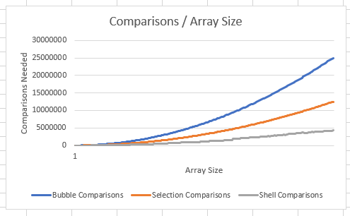
Computations
As another performance metric, I have also computed the number of swaps each algorithm made to order the arrays. This can bee seen on the table (left).
I have included min, max and average number of swaps required by each algorithm to order an array which is; ordered, in reverse order, and in random order.
Of course the ordered and reverse ordered arrays yield the same results for every iteration, so the average, min and max are the same in these rows.
I have also included the ‘Big Oh’ notation that is assumed for each of these.
Algorithm | Order | Big Oh | Average Swaps | Min Swaps | Max Swaps
Bubble Sort | Reverse | O(n^2) | 1000 | 1000 | 1000
 | Random | O(n^2) | 2428 | 2033 | 2696
 | Ordered | O(n) | 0 | 0 | 0
Selection Sort | Reverse | O(n^2) | 100 | 100 | 100
 | Random | O(n^2) | 91 | 85 | 97
 | Ordered | O(n^2) | 0 | 0 | 0
Shell Sort | Reverse | O(n^2) | 2000 | 2000 | 2000
 | Random | O(n^1.5) | 1995 | 1515 | 2435
 | Ordered | O(n) | 0 | 0 | 0
In the testing of these algorithms, the number of comparisons made with each iteration of an array was considered.
This line graph shows the number integer comparisons made against array length, where the biggest array is 5000 randomly generated integers (with a limit also of 5000).
These are the key comparisons of each algorithm where one integer is compared in size to another; and if the left most element being compared is greater than the right, they are swapped.
Each algorithm makes a number of other comparisons as well. For example, each iteration of an loop, for, while or do-while requires a comparison of some sort.

Slide 9
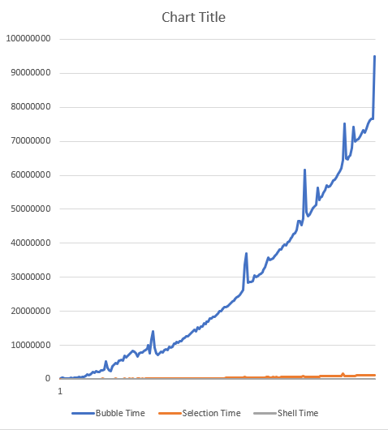
Completion Time
I used completion time as the main metric for comparing these sort algorithms.
The clear winner of this comparison is the shell sort algorithm, followed closely by the selection sort.
The bubble sort algorithm is, by many orders of magnitude, the least efficient. With these randomly generated dataset of data sets, bubble sort averaged ~5x10^5 more time elapsed between start and finish of the sort.
A limitation of the performance measurement is that the computer the algorithms where run on many have had other systems process’ running at the same time, which cause extra time to elapse in this period due to concurrent processing.
This experiment may have benefited from the use of a threading library, which could be used to ensure processor time. This would also reduce the anomalies seen on the time / array size charts seen throughout this presentation.

Slide 10
Overall Evaluation / Conclusion
Through the performance tests run in this experiment, I believe it is clear that the most efficient algorithm tested is the Shell Sort. It achieves the fastest average times to sort an unordered array of integers and while also doing the least amount of computation to get to that point.
When applying these algorithms to a real world problem they should all be considered as they each have an advantage, i.e. although bubble sort was the slowest overall, it only needs on pass over the dataset to validate if the array is already in order.
A potential 4th performance metric that could yield different result could be an investigation of which algorithm uses the most system memory during its operation.

Slide 11
References
Data Structure and Algorithms – Shell Sort, TutorialsPoint, viewed 03/11/2019. Available at: https://www.tutorialspoint.com/data_structures_algorithms/shell_sort_algorithm.htm
Data Structure and Algorithms Selection Sort, TutorialsPoint, viewed 03/11/2019. Available at: https://www.tutorialspoint.com/data_structures_algorithms/selection_sort_algorithm.htm
Solomon Bothwell, 2017, Sorting Algorithms and Big-O Analysis, Medium.com, viewed 02/11/2019. Available at: https://medium.com/@ssbothwell/sorting-algorithms-and-big-o-analysis-332ce7b8e3a1
Time Complexities of all Sorting Algorithms, geeksforgeeks.com, viewed on 02/11/2019. Available at: https://www.geeksforgeeks.org/time-complexities-of-all-sorting-algorithms/
The Efficiency of Algorithms, viewed on 01/11/2019. Available at: https://learning.ulster.ac.uk/bbcswebdav/pid-4961834-dt-content-rid-16733496_1/courses/73748_1920/Session%20B%20Part%20II%20Extended.pdf
COM498 Algorithms & Data Structures, viewed on 01/11/2019. Available at: https://learning.ulster.ac.uk/bbcswebdav/pid-4955107-dt-content-rid-16618696_1/courses/73748_1920/Session%20C%20Part%20I%281%29.pdf

