Slide 1
Using Terraform to define infrastructure as code
Maximilian Hanussek
High Performance and Cloud Computing Group
Zentrum für Datenverarbeitung
Applied Bioinformatics Group
Eberhard Karls University Tübingen
12.10.20
de.NBI cloud user meeting³
Virtual
Notes:
Welcome to the workshop on how to use the tool Terraform to define whole infrastructures like a program
My name is Max and I’m responsible for the de.NBI cloud site on the technical level in Tübingen.

Slide 2
Workshop Goals
Get a basic understanding of Terraform
Get an idea how the syntax is working
Learn what Terraform can be used for
Create a basic cluster setup (master and compute)
Notes:
Just to get an idea on what you will learn throughout this workshop
I have defined some goals what you can expect to learn in this workshop
General understanding of TF
Basic understanding of the TF syntax
Use cases for TF
Knowledge how a cluster setup looks like and how it can be built

Slide 3
Outline
Introduction
Terraform
(Virtual-)Cluster
Software Stack
Hands-On
Part1: Terraform Basics
Part2: Build more complex infrastructures
Part3: Basic virtual cluster deployment
Part4: VALET
Notes:
In the next 2 hours I will explain you in short what is
Cluster and how can we make it virtual
What do we need for that (softwarestack)
What is terraform and how can it help us with our goal of a virtual cluster
Then we go on with the hands on part using terraform to deploy a virtual cluster
And end up with an interactive UNICORE demo which can be used on top of a cluster

Slide 4
Introduction – Terraform
What is Terraform?
(Open source) Tool from HashiCorp¹
Allows you to maintain infrastructure as Code
Write configurations as functions and modules
With all benefits of it (versioning, sharing)
Provides reproducibility
¹https://www.terraform.io
Notes:
Who of you have heard of terraform?
Who of you have already used it?
Terraform is an open source tool from the company HashiCorp
Terraform allows exactly the managing of infrastructures as code
It brings a lot of modules and functions to manage your infrastructure
Further you can also versioning your code and therefore your infrastructure and share it with others which can be difficult if you think about physical installations
In the end it gives you an important part regarding the reproducibility of workflows and pipelines

Slide 5
Introduction – Terraform
Why Terraform?
Easy to install
Light weighted
Many tutorials out there
Comes with a variety of interfaces
Documentation
Makes your and our life easier
Lots of valuable features
Notes:
Key features of Terraform are: Read slide

Slide 6
Introduction - Cluster
A computer cluster is a set of loosely or tightly connected
computers that work together so that, in many respects,
they can be viewed as a single system.²
²https://en.wikipedia.org/wiki/Computer_cluster
Notes:
What is a cluster?
Wikipedia definition
Very generic but makes sense
Who of you is familiar with Cluster systems for example HPC systems?

Slide 7

Introduction - Cluster
Notes:
Physically in an HPC cluster for example you have nodes (Servers)
Connected via a Network
Master(s) and Compute(s)
And also storage and so on which is not shown here
That is the setup very basically

Slide 8
Introduction - Cluster
Use cases:
Need multiple resources of a single VM
Your workload can be parallelized
No need to handle different VMs, just a single cluster
Run whole pipelines, schedule jobs differently
Notes:
See slide

Slide 9

Introduction - Cluster
Notes:
How can we bring such a setup into the cloud?
Or emulate such an infrastructure?

Slide 10
Introduction – Softwarestack
Master node(s) (VMs)
Compute node(s) (VMs)
Network connection
(Shared Filesystem)
(Batch System/Scheduler)
(Middleware)
Notes:
First we need to know, what is the rough software stack?
We need nodes, which are represented by VMs
Then we need some network connection which we can also have in our cloud environment
The following three points in brackets are substantial for a cluster but we will not discuss these in this workshop
Of course you will need to set up a shared filesystem, so the nodes have access to a common file system
Of course you will need a Batch system and/or Scheduler that can handle and submit jobs to a node
On top of that you can set some kind of middleware like UNICORE for example to ease the access, user management and other additional features

Slide 11
Introduction – Terraform
Classical HPC cluster:
Built up machines
Configure networks
Set up shared filesystem
Configure Scheduler
Virtual cluster:
Spawn virtual machines
Configure virtual networks
Set up shared filesystem
Configure Scheduler
Use Infrastructure as a Code
Notes:
As I said compared to a classical, physical HPC cluster we just replace the servers by virtual machines
Such a virtual infrastructure can be handled a more easily as we can just reconfigure everything or start from scratch with less effort
Terraform is a tool that can help us to map a infrastructure into code

Slide 12
Introduction – Terraform
How to use Terraform?
Notes:
So far we talked about the basics and what Terraform is.
Now we want to use it which leads us to the first hands on part
If you have any problems please raise your hand and we will help you

Slide 13
Prerequisites
Internet connection
Download and install Terraform (0.13.2)
https://releases.hashicorp.com/terraform/
Have a key pair available in the OpenSSH format, if not generate one
ssh-keygen -t rsa -b 4096
Download/clone GitHub repo (git clone, wget, curl, via browser)
https://github.com/MaximilianHanussek/deNBI_cloud_terraform_2020.git
Notes:
But before we need check some prerequisites
So please grab your notebook
Who has Linux/Mac/Windows ?
Someone not already having Terraform installed and working?
Please download and install it now
Everyone has a public key available?

Slide 14
Prerequisites - Login
Dashboard Login
URL: https://denbi.uni-tuebingen.de/
Notes:
Then we can go on
Please login to the cloud dashboard under this URL so you will be able to see how your resources are behaving
You will get the credentials on the next slides

Slide 15
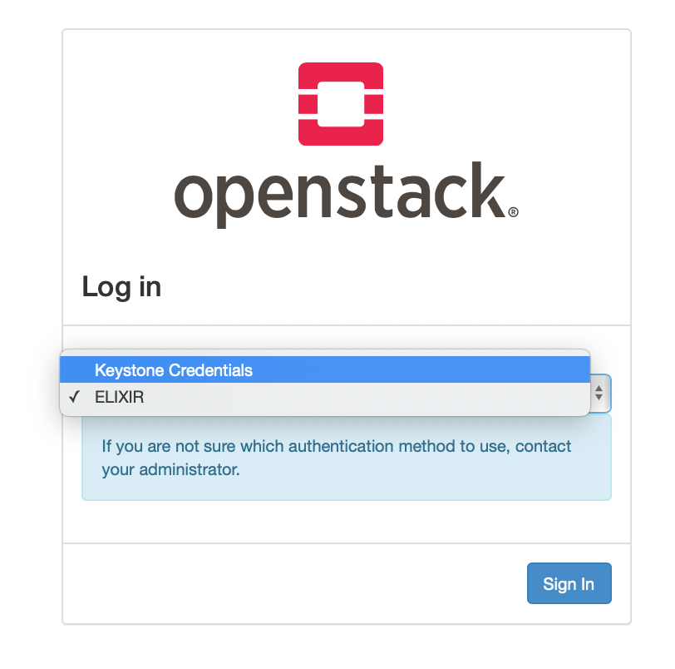
Prerequisites - Login
https://denbi.uni-tuebingen.de/
Notes:
First, choose Keystone as authentication method

Slide 16
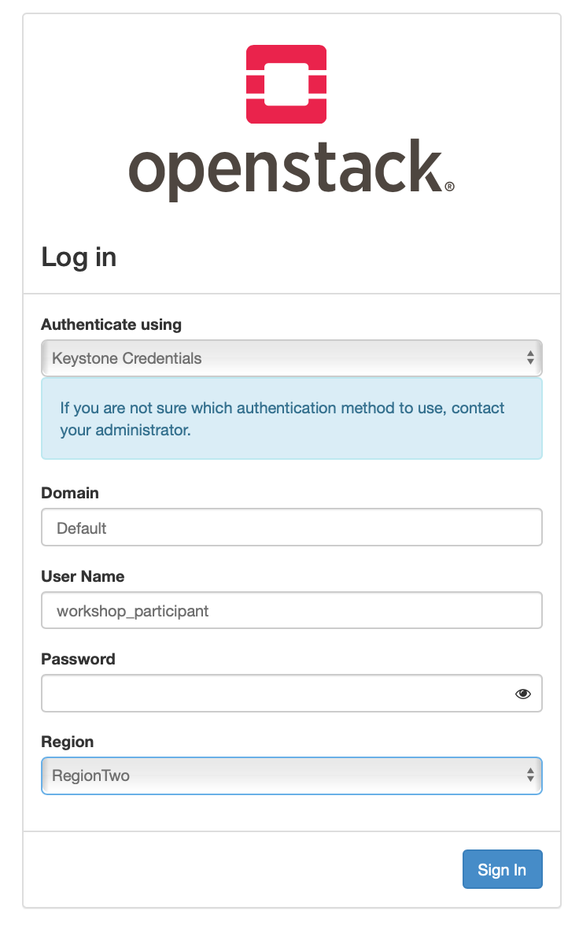
Prerequisites - Login
Notes:
- After that you will see a login screen where enter the following credentials coming on the next slide

Slide 17
Prerequisites - Login
Domain: Default
User name: workshop_participant
Password: unicorn42
Region: RegionTwo
Notes:
The credentials are the following: See slide

Slide 18
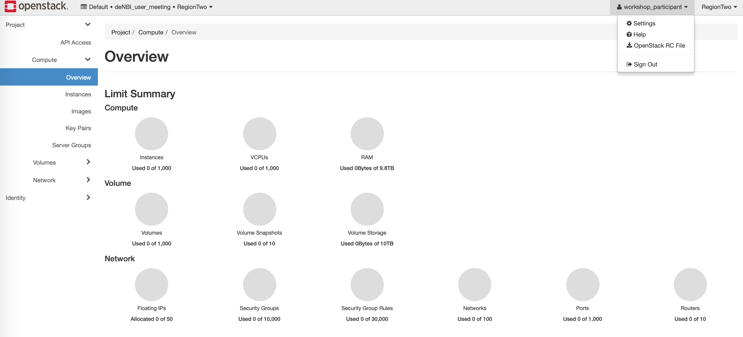
Prerequisites– RC File
Notes:
This project is specific for this workshop please do not delete anything you can see on the dashboard!
Later on you can start your own instances and changing things but for just watch, please
Further you will need the credentials of this project
Therefore, please click on the username …

Slide 19
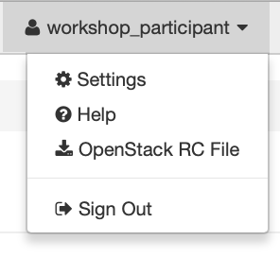
Prerequisites – RC File
Notes:
and download the OpenStack RC File
That is for now everything you need to do with this

Slide 20
Hands-On Part 1
Goal: Understand TF structure and start VM
Change into:
deNBI_cloud_terraform_workshop/terraform_workshop_part_1
See a bunch of files
providers.tf
key_pair.tf
security_group.tf
vars.tf
main.tf
versions.tf
Notes:
Now we will start with the more practical parts, the Hands-On part
Before every part you will see what the goal of this Part is
So for this part the goal is to get an idea of the TF structure, how TF works, including also the syntax and start a first VM
Everything I do now is completely included in the GitHub repo so there is no need to copy something, just watch
If you have a look in terraform_workshop_part_1 directory
You can see 6 files
All ending with .tf which is a specific file suffix and used to say terraform, hey these files are for you please use them
We will go stepwise through all the files, so you have seen whats inside of them and how they work
This split structure by resources is just a recommendation you can also write everything into one single file but this might make it easier to maintain

Slide 21
Hands-On Part 1
providers.tf
provider "openstack" {}
Notes:
The first file is not very spectacular
It just tells Terraform that we want to use the OpenStack modules and our cloud provider is based on OpenStack
You can also put your credentials in here but I would not recommend that, which we will come to later

Slide 22
Hands-On Part 1
versions.tf
terraform {
required_providers {
openstack = {
source = "terraform-providers/openstack"
}
}
required_version = ">= 0.13"
}
Notes:
The second file we will have a look on is connected to the providers file
It defines a version requirement for TF which needs to be fulfilled
Why is this important: OS is upgrading, also parts of the API, TF is upgrading
-> Important to keep everything working for given versions or down to which version it is supported

Slide 23
Hands-On Part 1
key_pair.tf
resource "openstack_compute_keypair_v2" "workshop_keypair" {
name = var.workshop-key-name
public_key = var.public-key
}
terraform key words
user chosen name
Notes:
Next we will have a look at the key_pair.tf file which offers a bit more content
In purple you can see TF keywords
In blue variables where you are free to choose a name for
We will also stick to a schema regarding the naming of the different variables
Resource variables are used with underscores
Other variables we will come later to contain hyphens and no underscores

Slide 24
Hands-On Part 1
security_group.tf
resource "openstack_networking_secgroup_v2" "terraform_workshop_sec_group" {
name = var.security-groups[0]
description = "Allow SSH access and ping request“
delete_default_rules = true
}
terraform key words
user chosen name
key word values
Notes:
We also need a security group
Again we create a resource here an “empty” security group -> delete all default rules
We give it a name (Resource + group itself)
For the name we use a variable, but access it like a list or an array (square brackets) and also a description
Further you can see also Boolean variables are available (delete default rules)

Slide 25
Hands-On Part 1
security_group.tf (outgoing connections)
resource "openstack_networking_secgroup_rule_v2" "egress_public_4" {
direction = "egress"
ethertype = "IPv4"
security_group_id = openstack_networking_secgroup_v2.terraform_workshop_sec_group.id
}
resource "openstack_networking_secgroup_rule_v2" "egress_public_6" {
direction = "egress"
ethertype = "IPv6"
security_group_id = openstack_networking_secgroup_v2.terraform_workshop_sec_group.id
}
Notes:
Now we are going to fill the security group with rules
First for the outgoing connections where we allow anything
As you can see we are using the id of the created resource using this dot notation (module, resource name, id)

Slide 26
Hands-On Part 1
security_group.tf (SSH)
resource "openstack_networking_secgroup_rule_v2" "ingress_public_4_ssh" {
direction = "ingress"
ethertype = "IPv4"
protocol = "tcp"
port_range_min = 22
port_range_max = 22
remote_ip_prefix = "0.0.0.0/0"
security_group_id = openstack_networking_secgroup_v2.terraform_workshop_sec_group.id
}
Notes:
Then we also need incoming connections, for example SSH usually on port 22
Here we specify ethertype with Ipv4, tcp as proctocol, only port 22 and the remote IP addresses, here all
Again we refer to the security group id

Slide 27
Hands-On Part 1
security_group.tf (ICMP)
resource "openstack_networking_secgroup_rule_v2" "ingress_public_4" {
direction = "ingress"
ethertype = "IPv4"
protocol = "icmp"
remote_ip_prefix = "0.0.0.0/0"
security_group_id = openstack_networking_secgroup_v2.terraform_workshop_sec_group.id
}
Notes:
At least we also add the ICMP protocol which allows us to use for example the ping command and check the connection to the VM
Just to show you that there are more network protocols than TCP

Slide 28
Hands-On Part 1
vars.tf (volume)
variable "cinder-disc-size" {
default = 10
}
variable "cinder-storage-backend" {
default = "quobyte_hdd"
}
variable "volume-name" {
default = "maxhanussek-workshop-volume"
}
Needs to be changed
Cloud site specific
Notes:
Now we have a look at the next configuration file with the name vars.tf
This file holds all the variables you have already seen before starting with var. something
The first variable just holds a number, the size we will give a cinder volume in gigabytes
The second one says which backend we want use, which might be cloud dependent
The names of the variables (BLUE) can be defined as you wish, we keep the name schema in mind and use hyphens here
The backend variable and all other variables in magenta are specific to the cloud environment (Please do not change these ones)
The green ones like the volume names need to be changed as it is not possible for some resources to have the same name
Further is it easier to distinguish the resources

Slide 29
Hands-On Part 1
vars.tf (flavor, name, image)
variable "flavors" {
type = map
default = {
"workshop-vm" = “de.NBI default"
}
}
variable "vm-name" {
default = "maxhanussek-workshop-vm"
}
variable "workshop-image" {
default = "CentOS 7.7 2020-07-07"
}
Notes:
For the flavors variable the map type is introduced which we will use a lot more later
With this type we set different default values and resolve it by its variable name, it is not necessary here but than you have already seen it
Then we need to give the VM we want to start a name (vm-name)
The last entry sets the name of the image we want to use
The image we want to use is already available, so we need the exact name in order to identify it

Slide 30
Hands-On Part 1
vars.tf (keys)
variable "workshop-key-name" {
default = "maxhanussek-keypair"
}
variable "public-key" {
default = ""
}
Notes:
Next we come to the keys
We define a name for the keypair we want to import
In order to import a key we also need a public key (in OpenSSH format) which will be entered between the empty quotation marks
In the downloaded github repo files you will find one of my public keys already entered, please delete this enter your own one

Slide 31
Hands-On Part 1
vars.tf (security-group, network)
variable "security-groups" {
default = [
"maxhanussek-sec-group"
]
}
variable "network" {
default = "denbi_uni_tuebingen_external2"
}
Notes:
As already mentioned earlier where we have defined the security group, we set here the name it will get in the end
Here you can see the list notation with the squared brackets
Terraform requires a list for this kind of information, the reason is that you can use more than one security group
And we also define the network we want to use
That should be the basic setup to start a VM

Slide 32
Hands-On Part 1
main.tf (image, volume)
data "openstack_images_image_v2" "workshop_image" {
name = var.workshop-image
most_recent = true
}
resource "openstack_blockstorage_volume_v2" "cinder_volume" {
name = var.volume-name
size = var.cinder-disc-size
volume_type = var.cinder-storage-backend
}
Notes:
So far we have set up the cloud provider we want to use, a key pair, security groups and the variables to make everything a bit easier
Now we go into the main.tf file where we setup the instance and everything else
First we need to get the id of the already existing image as not the name but the id is required by terraform
Second we create a cinder volume as you will need this probably in your daily work, for that we use our defined variables (name, disc size, backend)

Slide 33
Hands-On Part 1
main.tf (instance)
resource "openstack_compute_instance_v2" "workshop_vm" {
name = var.vm-name
flavor_name = var.flavors["workshop-vm"]
image_id = data.openstack_images_image_v2.workshop_image.id
key_pair = openstack_compute_keypair_v2.workshop_keypair.name
security_groups = var.security-groups
network {
name = var.network
}
Notes:
Now we start with the larger instance block
To create an instance, we need a new resource which we call workshop_vm
Then we make use of our defined variables and set the VM name, flavor name, the image id from before, keypair, security group and Network
The network has to be specified like this with curly brackets since version 0.12 for reasons
That part would define the instance completely but we also want to attach the cinder volume created before directly at the start of the VM

Slide 34
Hands-On Part 1
main.tf (instance)
block_device {
uuid = data.openstack_images_image_v2.workshop_image.id
source_type = "image"
destination_type = "local"
boot_index = 0
delete_on_termination = true
}
block_device {
uuid = openstack_blockstorage_volume_v2.cinder_volume.id
source_type = "volume"
destination_type = "volume"
boot_index = -1
delete_on_termination = true
}
}
Notes:
Therefore we use the blockdevice module, that can only be used/called inside of an instance’s resource block
The first block sets up a local image referring to the VM image, and should be deleted if the instance is deleted
The second block connects the cinder volume which should also be deleted with the VM
Why this has to be done like this I do not really know but that is what terraform suggests how to do it

Slide 35
Hands-On Part 1
Use Terraform
Initialize Terraform in Terraform directory
(deNBI_cloud_terraform_2020/terraform_workshop_part_1)
terraform init
Notes:
Now we should have everything to deploy a VM with an attached cinder volume
But before we have to say terraform that this workshop_part_1 directory is a terraform directory containing .tf files
So we run the terraform init command

Slide 36
Hands-On Part 1
Initializing the backend...
Initializing provider plugins...
...
* provider.openstack: version = "~> 1.31.0"
Terraform has been successfully initialized!
...
Notes:
That should give us some green output and a success message if everything is fine
You can see that terraform has loaded the openstack provider plugin we want to use

Slide 37
Hands-On Part 1
Use Terraform
Run Terraform graph
(deNBI_cloud_terraform_2020/terraform_workshop_part_1)
terraform graph | dot –Tsvg > graph.svg
Notes:
Now we can already have a look at the structure of the task we have defined trough our .tf files
In the background TF is constructing a graph of the resources and how they are connected to each other
We can use the terraform graph command and pipe the output to the dot command (need Graphviz installed)
The output will be a .svg file that shows a directed and hopefully acyclic graph
This feature is nice to find circles that are problematic

Slide 38
Hands-On Part 1
Notes:
In general our structure would look like this
As the graph is to large to show it in detail here just an overview
You can create the graph afterwards yourself and have a more detailed look at it
Even this simple ends up in a rather complex graph

Slide 39
Hands-On Part 1
Use Terraform
Run Terraform plan
(deNBI_cloud_terraform_2020/terraform_workshop_part_1)
terraform plan
Notes:
Before we really apply our terraform plan, we can start a dry run with the command terraform plan
I would recommend you that every time before you run the apply step to run the plan command to check what will happen

Slide 40
Hands-On Part 1
Error: One of 'auth_url' or 'cloud' must be specified
on providers.tf line 1, in provider "openstack":
1: provider "openstack" {}
Notes:
So what you see now should be an error which sounds a bit cryptic in the beginning
We seem to have missed something …
What we forget is to give terraform our credentials or more exact in our case to source our credentials from the downloaded rc file
Without the environment variables in that file TF does not know which cloud we want to use, where to find it, what kind permissions we and so on

Slide 41
Hands-On Part 1
Use Terraform
Source OpenStack credentials
(deNBI_cloud_terraform_2020/terraform_workshop_part_1)
source deNBI_user_meeting-openrc.sh
Password:
terraform plan
Notes:
So lets source the rc file by either changing into the directory you have stored it
Or specifying the full path to it and stay into the part 1 directory
You will need to enter a password which is the same as for the login and written here again
After the credentials are sourced, please run terraform plan again
It should succeed now and give you some output

Slide 42
Hands-On Part 1
# openstack_blockstorage_volume_v2.cinder_volume will be created
+ resource "openstack_blockstorage_volume_v2" "cinder_volume" {
+ attachment = (known after apply)
+ availability_zone = (known after apply)
+ id = (known after apply)
+ metadata = (known after apply)
+ name = "maxhanussek-workshop-volume"
+ region = (known after apply)
+ size = 10
+ volume_type = "quobyte_hdd"
}
Notes:
The output shows in detail, what will happen if we execute our plan
For example here the creation of the cinder volume with all its attributes
And many more …

Slide 43
Hands-On Part 1
Plan: 8 to add, 0 to change, 0 to destroy.
Notes:
Where you also should have look is the one of the last lines
Which resources are created (add), changed or even destroyed
Here you can check if everything behaves like expected

Slide 44
Hands-On Part 1
Use Terraform
Run Terraform apply (confirm with ‘yes’)
(deNBI_cloud_terraform_2020/terraform_workshop_part_1)
terraform apply
Apply complete! Resources: 8 added, 0 changed, 0 destroyed.
Check the Dashboard for the created resources
https://denbi.uni-tuebingen.de
Notes:
Now we really really want to deploy our VM by running terraform apply
TF plan can not reveal all failures but at last on syntax and a bit deeper levels but no failures during runtime
We now run the command and follow the output until the process is finished
Now you can check the dashboard and you will see all the created resources (VM, Volume, security group/rules, key not visible)

Slide 45
Hands-On Part 1
Use Terraform
Run Terraform destroy (confirm with ‘yes’)
(deNBI_cloud_terraform_2020/terraform_workshop_part_1)
terraform destroy
Destroy complete! Resources: 8 destroyed.
Check the Dashboard for the destroyed resources
https://denbi.uni-tuebingen.de
Notes:
That was the first part
Another nice feature if terraform is that it can clean up all the created resources completely
So if we run terraform destroy we can see how the resources are deleted
No left overs so we can start with the second part from scratch
Any questions for the first part? You can do this later all on your own and play around ☺

Slide 46
Hands-On Part 2
Use Terraform
Change to: terraform_workshop_part_2
Initialize Terraform in Terraform directory
(deNBI_cloud_terraform_2020/terraform_workshop_part_2)
terraform init
Notes:
You can now change to the directory with the second part
First we directly initialize the directory with terraform init

Slide 47
Hands-On Part 2
Use Terraform
Goal: Start multiple (similar) VMs
Add new variable to end of vars.tf
variable "node-count" {
default = 3
}
Notes:
Goal of this part is to not just start a single VM, you could do this simply by hand, we want to start multiple (similar) VMs at once
We are just adding a new variable to our vars.tf file we call node-count
And we set a value of three, so as we want 3 VMs

Slide 48
Hands-On Part 2
Use Terraform
Change parts of main.tf (Volume resource)
resource "openstack_blockstorage_volume_v2" "cinder_volume" {
count = var.node-count
name = "${var.volume-name}-${count.index}"
size = var.cinder-disc-size
volume_type = var.cinder-storage-backend
}
Notes:
Now we change to the main file and make some changes
First we will need 3 Volumes
We add the provided count variable and assign it the number we have just defined (3)
Further we want to have the name related to the number of the index and access the index of the counter by the dot syntax
We here use the “old” TF syntax with the $ sign and the quotation marks as otherwise it would not work

Slide 49
Hands-On Part 2
Use Terraform
Change parts of main.tf ( Instance resource)
resource "openstack_compute_instance_v2" "workshop_vm" {
count = var.node-count
name = "${var.vm-name}-${count.index}"
flavor_name = var.flavors["workshop-vm"]
image_id = data.openstack_images_image_v2.workshop_image.id
key_pair = openstack_compute_keypair_v2.workshop_keypair.name
security_groups = var.security-groups
network {
name = var.network
}
Notes:
As we want to start multiple VMs we also need to implement the count module variable for the instance resource
Same procedure as for the volume section, define count variable and name

Slide 50
Hands-On Part 2
Use Terraform
Change parts of main.tf ( Block device)
block_device {
uuid = element(openstack_blockstorage_volume_v2.cinder_volume.*.id, count.index)
source_type = "volume"
destination_type = "volume"
boot_index = -1
delete_on_termination = true
}
}
Notes:
For the attachment of the volumes we need to get the uuid of a created volume we defined the resource above
As we want to attach to the corresponding volume to the corresponding VM we need to iterate over the volumes
To do this we use the element function and the star indicating something similar like a wild card
The wild card (*) will be replaced with the current count index value (1,2 or 3)
This comes from the count variable we defined for the instance resource
With the definition of the count module variable we defined something like a loop, how you would use in other programing languages

Slide 51
Hands-On Part 2
Use Terraform
Change to: terraform_workshop_part_2
Run terraform plan & terraform apply
(deNBI_cloud_terraform_2020/terraform_workshop_part_2)
terraform plan
terraform apply
Notes:
As before we run terraform plan to check if everything looks good
We now can see that multiple resources will be created (VMs and Volumes)
Now we run terraform apply and should see how multiple VMs are created with just a single TF call
In the Dashboard you can now see the created resources, but as we have chosen an internal network these VMs are not directly accessible. Reason is that other users also need public IP addresses ☺

Slide 52
Hands-On Part 2
Use Terraform
Changed network variable in vars.tf
variable "network" {
default = "denbi_uni_tuebingen_internal"
}
Notes:
We also changed the used network to an internal network to save some public IP addresses
The addresses assigned to the VMs make them not directly accessible but we are not working with them so that is fine for this use case
We will use the internal network in the next Part in a more useful way

Slide 53

Hands-On Part 2
terraform.tfstate
Have a look at terraform.tfstate file
Holds all information about the infrastructure
!!! Holds also your credentials
!!! Holds also keys
Be careful if you share these file (Git, …)
Notes:
Now we want to have a deeper look at the Terraform data structure (terraform.tfstate file)
You will find it in the terraform directory (initialized)
If we open it (cat, vim) in the current state, where everything is deployed, you will see all the information TFholds about the created resources
But be careful, it also holds your credentials and also keys
So if you share your TF files or have it in a Git repo be sure that you exclude these kind of files from sharing !!!
This data structure can be seen as a template, terraform is checking against

Slide 54
Hands-On Part 2
Use Terraform
Change the infrastructure
Open vars.tf file
variable "node-count" {
default = 3
}
variable "node-count" {
default = 4
}
Notes:
Now we want to see what is happening if we make changes to the infrastructure on the TF file level
For this purpose we change the node count variable in the vars.tf file from 3 to 4

Slide 55
Hands-On Part 2
terraform plan
Plan: 2 to add, 0 to change, 0 to destroy.
terraform apply
Apply complete! Resources: 2 added, 0 changed, 0 destroyed.
Notes:
If we run TF plan we can see that 2 “things” will be added
If we run terraform apply we can see what happens …
What happens is that TF checks the current deployment status via the state files
It finds out that there should be one more node and one more volume
It deploys all the missing things and integrates it into the existing infrastrutcure data (state file)
We can also see the new resources in the Dashboard

Slide 56
Hands-On Part 2
Use Terraform
Change the infrastructure again
Open vars.tf file
variable "node-count" {
default = 4
}
variable "node-count" {
default = 2
}
Notes:
Now we want to see what is happening if we make other changes
For this purpose we change the node count variable again from 4 to 2
As before run terraform plan to check if everything looks good
And afterwards terraform apply
In the Dashboard you can now see that the VMs are deleted automatically

Slide 57
Hands-On Part 2
terraform plan
Plan: 0 to add, 0 to change, 4 to destroy.
terraform apply
Apply complete! Resources: 0 added, 0 changed, 4 destroyed.
Notes:
If we run TF plan we can see that 4 “things” will be destroyed
Again we run terraform apply wand e can see what happens …
Again TF checks the current deployment status via the state file
It finds out that there should be just 2 nodes and 2 volumes instead of 4
TF therefore destroys the unnecessary things and updates the existing infrastrutcure data (state file)
We can also see that the resources are now gone in the Dashboard

Slide 58
Hands-On Part 2
Use Terraform
Change the infrastructure by accident
Go to the dashboard and delete a VM
(Please take one of your own ones!)
terraform plan
terraform apply
Notes:
What happens if me make changes to the infrastructure from outside just deleting a VM
We go to the web interface and just delete a VM
Again we run TF plan and see what happens
And TF apply to perform the actions
In the Dashboard you can now see that the VM deleted by accident is restarted

Slide 59
Hands-On Part 2
terraform plan
Plan: 2 to add, 0 to change, 0 to destroy.
terraform apply
Apply complete! Resources: 2 added, 0 changed, 0 destroyed.
Notes:
If we run TF plan we can see that 2 “things” will be added
Which are the VM and the attached volume we just deleted via the dashboard
With TF apply we can restore the resources to the last correct state

Slide 60
Hands-On Part 2
Use Terraform
Changing the infrastructure through
Variable changes (remove or add)
Handling of deletions from outside
Terraform makes it easy to recover from unwanted changes or scaling up and down the infrastructure
Notes:
What have learned
We can change the infrastructure and TF will track the changes and update the infrastructure
It does not matter if the changes come from inside (TF files) or from outside (GUI)
Gives us some benefits (Arrow)

Slide 61
Hands-On Part 2
Use Terraform
Run terraform destroy
terraform destroy
Check terraform.tfstate again
{
"version": 4,
"terraform_version": "0.13.2",
"serial": 183,
"lineage": "8c08c491-29cd-9f7a-b79c-5f607a59374d",
"outputs": {},
"resources": []
}
Notes:
So now we clean up everything again and destroy the resources
Running terraform destroy
Now we can check the terraform state file again and see that it contains nearly nothing anymore as no infrastructure is left

Slide 62
Hands-On Part 3
Use Terraform
Change to: terraform_workshop_part_3
Initialize Terraform in Terraform directory
(deNBI_cloud_terraform_2020/terraform_workshop_part_3)
terraform init
Notes:
Now we come to part 3
We change into the part directory and run terraform init

Slide 63
Hands-On Part 3
Use Terraform
Goal: Build a cluster structure
Cluster setup:
3 VMs (1 Master node, 2 Compute nodes)
3 Volumes
2 different networks
2 different flavors
2 different images
Notes:
Goal of this part is to not just start a single VM, you could do this simply by hand, we want to start multiple (similar) VMs at once
We are just adding a new variable to our vars.tf file we call node-count
And we set a value of three, so as we want 3 VMs

Slide 64
Hands-On Part 3
vars.tf
variable "volume-name" {
type = map
default = {
"master" = "maxhanussek-workshop-volume-master"
"compute"= "maxhanussek-workshop-volume-compute"
}
}
variable "vm-name" {
type = map
default = {
"master" = "maxhanussek-workshop-vm-master"
"compute"= "maxhanussek-workshop-vm-compute"
}
}
Notes:
As mentioned before we will now make use of the map type as we have 2 kind of resources
Master and compute
We will use the map type for every resource we need to or want adapt regarding the usage (master or compute)
We can represent this with the following syntax for example with the volume-name and the vm name

Slide 65
Hands-On Part 3
vars.tf
variable “flavors" {
type = map
default = {
"master" = “de.NBI small"
"compute"= “de.NBI default"
}
}
variable “workshop-image" {
type = map
default = {
"master" = " CentOS 7.7 2020-07-07"
"compute"= " CentOS 7.8 2020-07-07"
}
}
Notes:
More interesting is that we can choose different flavors for the master node or the compute nodes.
Usually the compute nodes are doing the work and need larger resources that the master node
It is also possible to use different images for the different kind of VMs if necessary
For example if pre defined images are used for master and compute nodes.

Slide 66
Hands-On Part 3
vars.tf
variable “network" {
type = map
default = {
"master" = “denbi_uni_tuebingen_external2"
"compute"= “denbi_uni_tuebingen_internal"
}
}
variable “private-key-path" {
default = “/path/to/private/key“
}
variable "internal-key-name" {
default = "maxhanussek-internal-key"
}
Notes:
The same can be done for the network as usually the compute nodes do not need a public IP as they do not need to be a accessible directly.
So we also define two different networks (external -> master, internal compute)
Further we define a variable that holds the path to the private key
We will need this for some upcoming things

Slide 67
Hands-On Part 3
key_pair.tf
resource "tls_private_key" "internal_connection_key" {
algorithm = "RSA"
rsa_bits = 4096
}
resource "openstack_compute_keypair_v2" "internal_connection_key_openstack" {
name = var.internal-key-name
public_key = tls_private_key.internal_connection_key.public_key_openssh
}
Notes:
As we want to construct a cluster environment where the master node is accessible but the compute nodes are not
we need to connect to the compute nodes via the masternode
But we need an SSH key for that as VMs are per Default only accessible via the public/private key mechanism
Therefore we need to place a private key inside of the master VM.
As private keys should always be kept private and local we do not use the same key as the master VM
Instead we create a new keypair using the tls module brought by TF
First the private key is created -> RSA and 4096 bits
Then we create a new resource holding the public key we can get from the created private key from before

Slide 68
Hands-On Part 3
main.tf
data "openstack_images_image_v2" "workshop_image_master" {
name = var.workshop-image["master"]
most_recent = true
}
data "openstack_images_image_v2" "workshop_image_compute" {
name = var.workshop-image["compute"]
most_recent = true
}
Notes:
We now use our added map entries from the variable file
To separate Master and Compute Resources, here to get id of the used images
The map entries are accessed as a list with this square bracket notation you might know from other programming languages
The same needs to be done with the volume resources (which will be skipped) and the instance resources we are having a look at now

Slide 69
Hands-On Part 3
main.tf
resource "openstack_compute_instance_v2" "workshop_vm_master" {
name = var.vm-name["master"]
flavor_name = var.flavors["master"]
image_id = data.openstack_images_image_v2.workshop_image_master.id
key_pair = openstack_compute_keypair_v2.workshop_keypair.name
security_groups = var.security-groups
network {
name = var.network["compute"]
}
network {
name = var.network["master"]
access_network = true
}
Notes:
Again we are making use of our map values, here for the master instance (name, flavor)
For the networks we are now adding two
First the internal network so the master node can get access to the compute nodes and vice versa
And the public network, which we will also set as the access network, otherwise OpenStack might chose the wrong one
Or more precise that is dependent on used VM operating system

Slide 70
Hands-On Part 3
main.tf (provisioner)
provisioner "file" {
content = tls_private_key.internal_connection_key.private_key_pem
destination = "~/.ssh/connection_key.pem"
connection {
type = "ssh"
private_key = file(var.private-key-path)
user = "centos"
timeout = "5m"
host = self.access_ip_v4
}
}
Notes:
Further we need to bring the currently generated private key as a file on the master node in order to access the compute VMs
As this key is assigned to them
What we are doing is we will use the provisioner module, which has various possibilities how to interact with deployed resources
Here we are using the file submodule and write the private key to a file and send it to the master VM
In order to do we need to tell TF where our private key for the master VM is -> Just a simple SSH command in the background
And also we need to tell which IP should be used -> self.access_ip_v4
As we do not know the IP in beforehand we need to refer to the one when the VM is deployed

Slide 71
Hands-On Part 3
main.tf (provisioner)
provisioner "file" {
source = "hello_world.txt"
destination = "/home/centos/hello_world.txt"
connection {
type = "ssh"
private_key = file(var.private-key-path)
user = "centos"
timeout = "5m"
host = self.access_ip_v4
}
}
Notes:
Of course it is also possible to transfer any wanted file to a resource here a hello_world test file
You just need to set the source path and where it should be placed inside of the VM with the destination path
The connection part is always the same
Why is this useful?
This useful if you need to do run any post deployment settings with more complex scripts directly executed on a resource

Slide 72
Hands-On Part 3
main.tf (provisioner)
provisioner "remote-exec" {
script = "set_internal_private_key_permissions.sh"
connection {
type = "ssh"
private_key = file(var.private-key-path)
user = "centos"
timeout = "5m"
host = self.access_ip_v4
}
}
Notes:
An other sub module of the provisioner module is the remote-exec module
This allows you to execute a script stored locally on a remote resource in this case our master node
It just needs the path to the script and the usual connection details
Here we have copied a private key to the master node but the permissions need to be set to 600 so the key can be used
Some of you might have seen such an error or warning message
The Shell script we are using for this can be found in the terraform_part_3 directory so you can have a look at it

Slide 73
Hands-On Part 3
main.tf
provisioner "remote-exec" {
script = "mount_cinder_volumes.sh"
connection {
type = "ssh"
private_key = file(var.private-key-path)
user = "centos"
timeout = "5m"
host = self.access_ip_v4
}
}
Notes:
A usefull application example of this is for example the automated mount of the attached cinder volume on the master instance
You find the necessary script again in the terraform_workshop_part_3 directory
Again we just remotely execute the script, all in all a handy module
You just need to understand that this is only working if the resource, here a VM is directly accessible via SSH
If not like our compute nodes you need to do anything indirectly via the master node

Slide 74
Hands-On Part 3
Use Terraform
Change to: terraform_workshop_part_3
Run terraform plan and terraform apply
(deNBI_cloud_terraform_2020/terraform_workshop_part_3)
terraform plan
terraform apply
Notes:
Again we execute terraform plan and afterwards terraform apply
We can now see that the resources are deployed but afterwards we see some output of the provisioner module
Lets check, if the hello_world.txt file is there and the volume is mounted
And in order to not waste resources we will destroy it again

Slide 75
Hands-On Part 3
Use Terraform
Make use of the map module
Let TF create “one time” keys for you
Provisioner module can be used for post mods
Terraform makes it more convenient to deploy more complex infrastructures in an automated way and also be able to handle it.
Notes:
What have learned in Part 3
We created a basic cluster infrastructure consisting of 1 master node and 2 compute nodes
Connected via an internal network
Further we have used the tls module of TF and the provisioner module to make some modifications after the deployment

Slide 76




Hands-On Part 3
Congratulations we have deployed
a virtual cluster infrastructure

Slide 77
Hands-On Part 4
Use Terraform
Goal: Build an advanced virtual cluster (VALET)
Features:
Batch System (PBS TORQUE)
Middleware UNICORE (incl. Workflow engine)
Monitoring system (Zabbix)
Add and remove nodes without downtime
Automated load based scaling available
https://github.com/MaximilianHanussek/VALET
Notes:
Now some advertisement of my own work, some of you might have already used it, like Peter Ebert we heard from before
Over the last couple of months I have implemented a fully automated deployment of a virtual cluster
Of course it comes with a batch system and a shared file system
But also adds some more things like UNICORE as middleware to get a more convenient access to the resources
Also including the UNICORE workflow engine
With Zabbix you get your own monitoring system to monitor the cluster
Further it is possible to add and remove nodes to and from the cluster to scale the resources
This can also be done in an automated way based on the measured load of the cluster
If you are interested in such a virtual cluster have look on my github repo or just talk to me or write me mail
IF TIME, live demo of VALET

