Slide 1

Spring Boot Unit Testing

Slide 2

Table of Contents
Spring Boot
Java UnitTests (JUnit5)
Mocks

Slide 3
Spring Boot
Open Source Java Framework
Web Server
Inversion of Control (IoC)
Dependency Injection
Uses many Annotations
Notes:
Framework
Programmer fills gaps
Framework manages Input by calling the created functions and classes

Slide 4
IoC
Class Instances are created by Spring
Spring manages Control Flow
Notes:
Spring instanciates our Classes (based on Annotations)
Class that require (depend on) other classes are created via depency injection
User input and how to respond is managed by the framework
Spring Boot comes with many config classes
These can be replaced by custom classes

Slide 5
Dependency Injection
B – Class with Constuctor
  public B(A a)
Spring Instaciates the A and B class
First A is created, then A is passed to the B Constructor
Notes:
Spring can create Objects which require other Objects
This ensures that you can work on the same class instance of a class not created by you
Be aware of cyclic class dependencies

Slide 6
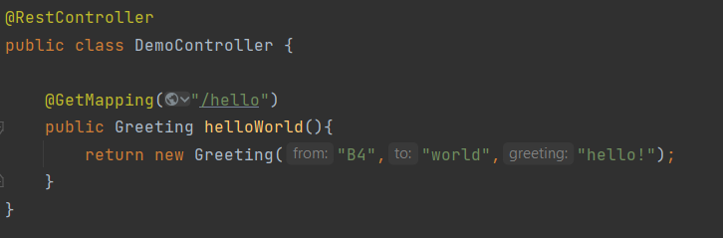
Spring Rest Controller – Example
Notes:
@RestController tells Spring to:
create an Instance on StartUp
parse Objects returned by methods called via http-requests to JSON
@GetMapping(„/hello“)
handle get-requests on „hello“ with this method
Greeting is a class containing just 3 String fields

Slide 7
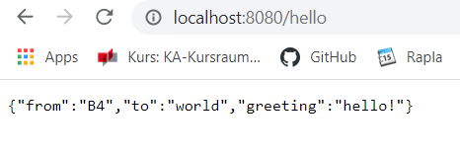
Spring Rest Controller – Example
Accessible at „localhost:8080/hello“
Greeting is just a basic Objects with 3 fields
Returns JSON Object
Notes:
Example Response

Slide 8
JUnit 5
Testing Framework for Java
Improves quality
Uses Annotations
Easy to use

Slide 9
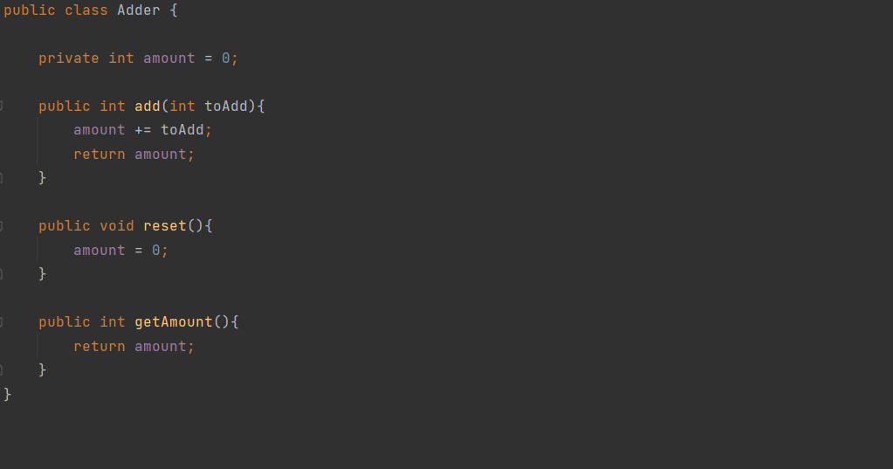
Adder Class
Notes:
Basic Example class
Basic Adder Class
You can add Numbers
And you can reset

Slide 10
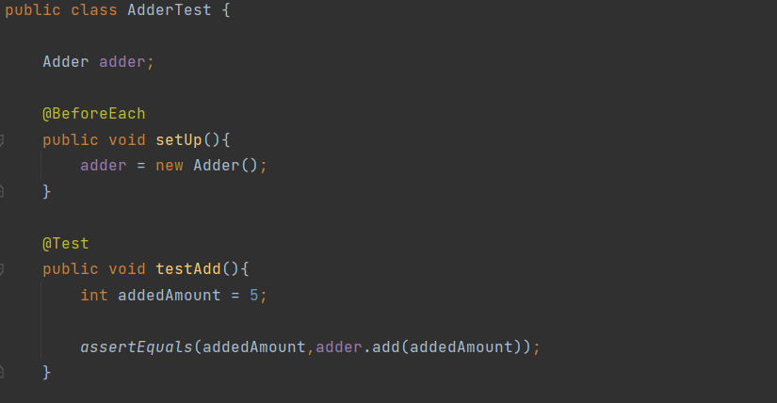
AdderTest
Notes:
Exmaple Test Class
When creating a Test-Class you should think about the different use Cases of the Class
Testing all Methods is ideal, i would advise skipping getters/setters
One „missing“ Test in this exmaple -
can you spot it?

Slide 11
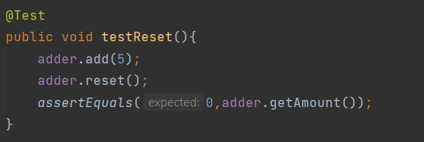
AdderTest – missing Test
Notes:
you can use multiple Assertions
you can assert that Exception X is thrown
Other Annotaions include
@AfterEach
@BeforeAll
@AfterAll

Slide 12
Spring Boot Tests - Problems
Slow Tests due to Spring Context startup
Hard to test without Context due to IoC and Dependency Injection
Notes:
Spring Boot Context can take 10+ seconds to start
=> Pain if you have > 3 Tests Classes each requiering a new Context
=> Usually a Test Class for almost every Class containing logic
=> You can‘t use Dependency Injection so you have to create all required classes yourself (and reslove the dependencies)

Slide 13
Solution: Mocks
No/ minimal Spring Context required
=> less/ no Overhead
Mockito allows to create Mock classes
Mocks can greatly reduce SetUp Overhead
Notes:
Mock – fake Object with custom Behaviour
Reduces Time for Tests to run => no Context

Slide 14
Mockito
Open source library
Enables the Creation of Mock Objects with custom behaviour
Annotations to reduce Biolerplate Code
Notes:
Creates Classes on RunTime

Slide 15
End of Theory
Repo: github.com/MaximilianLincks/JUnit5Demo
Notes:
All Code Snippets in the GitHub Repo
In src/main/java/com/example/demo/slides and
src/main/test/com/example/demo/slides

