Slide 1
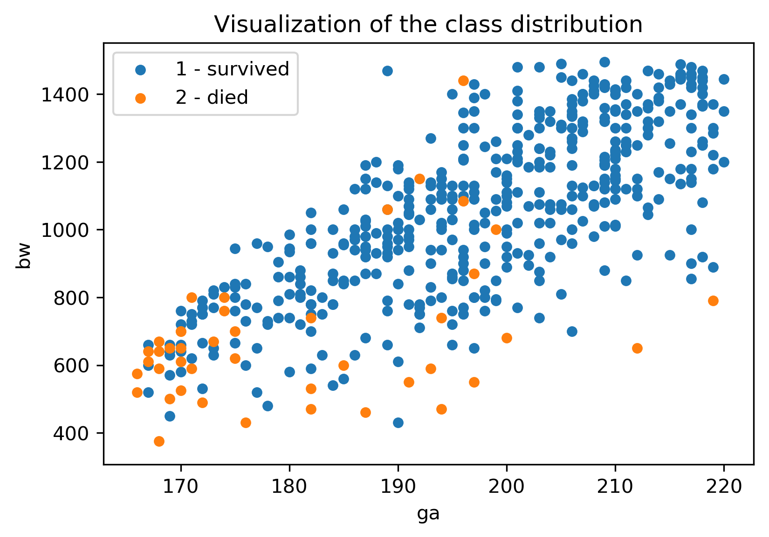
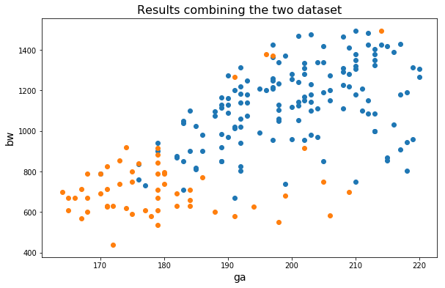
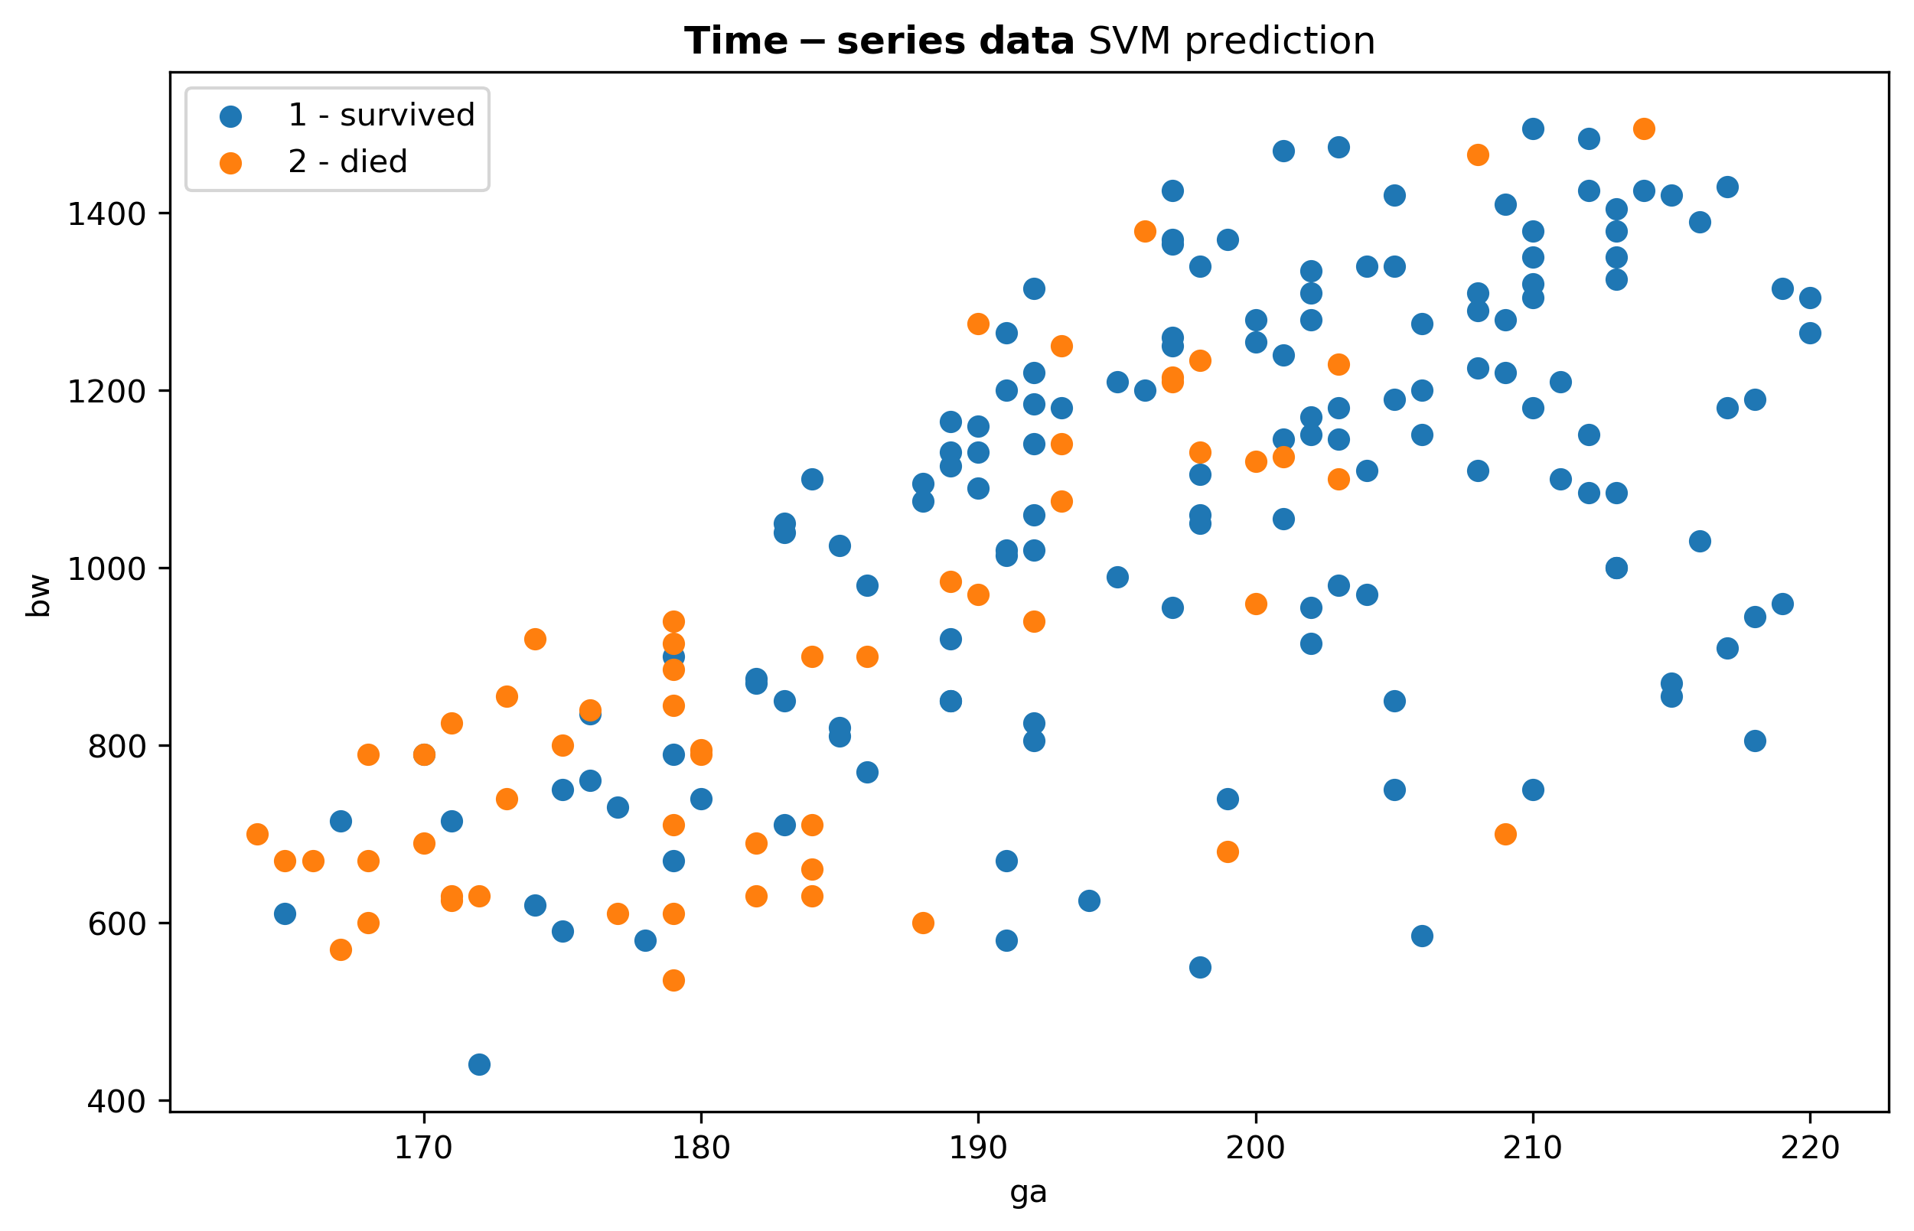
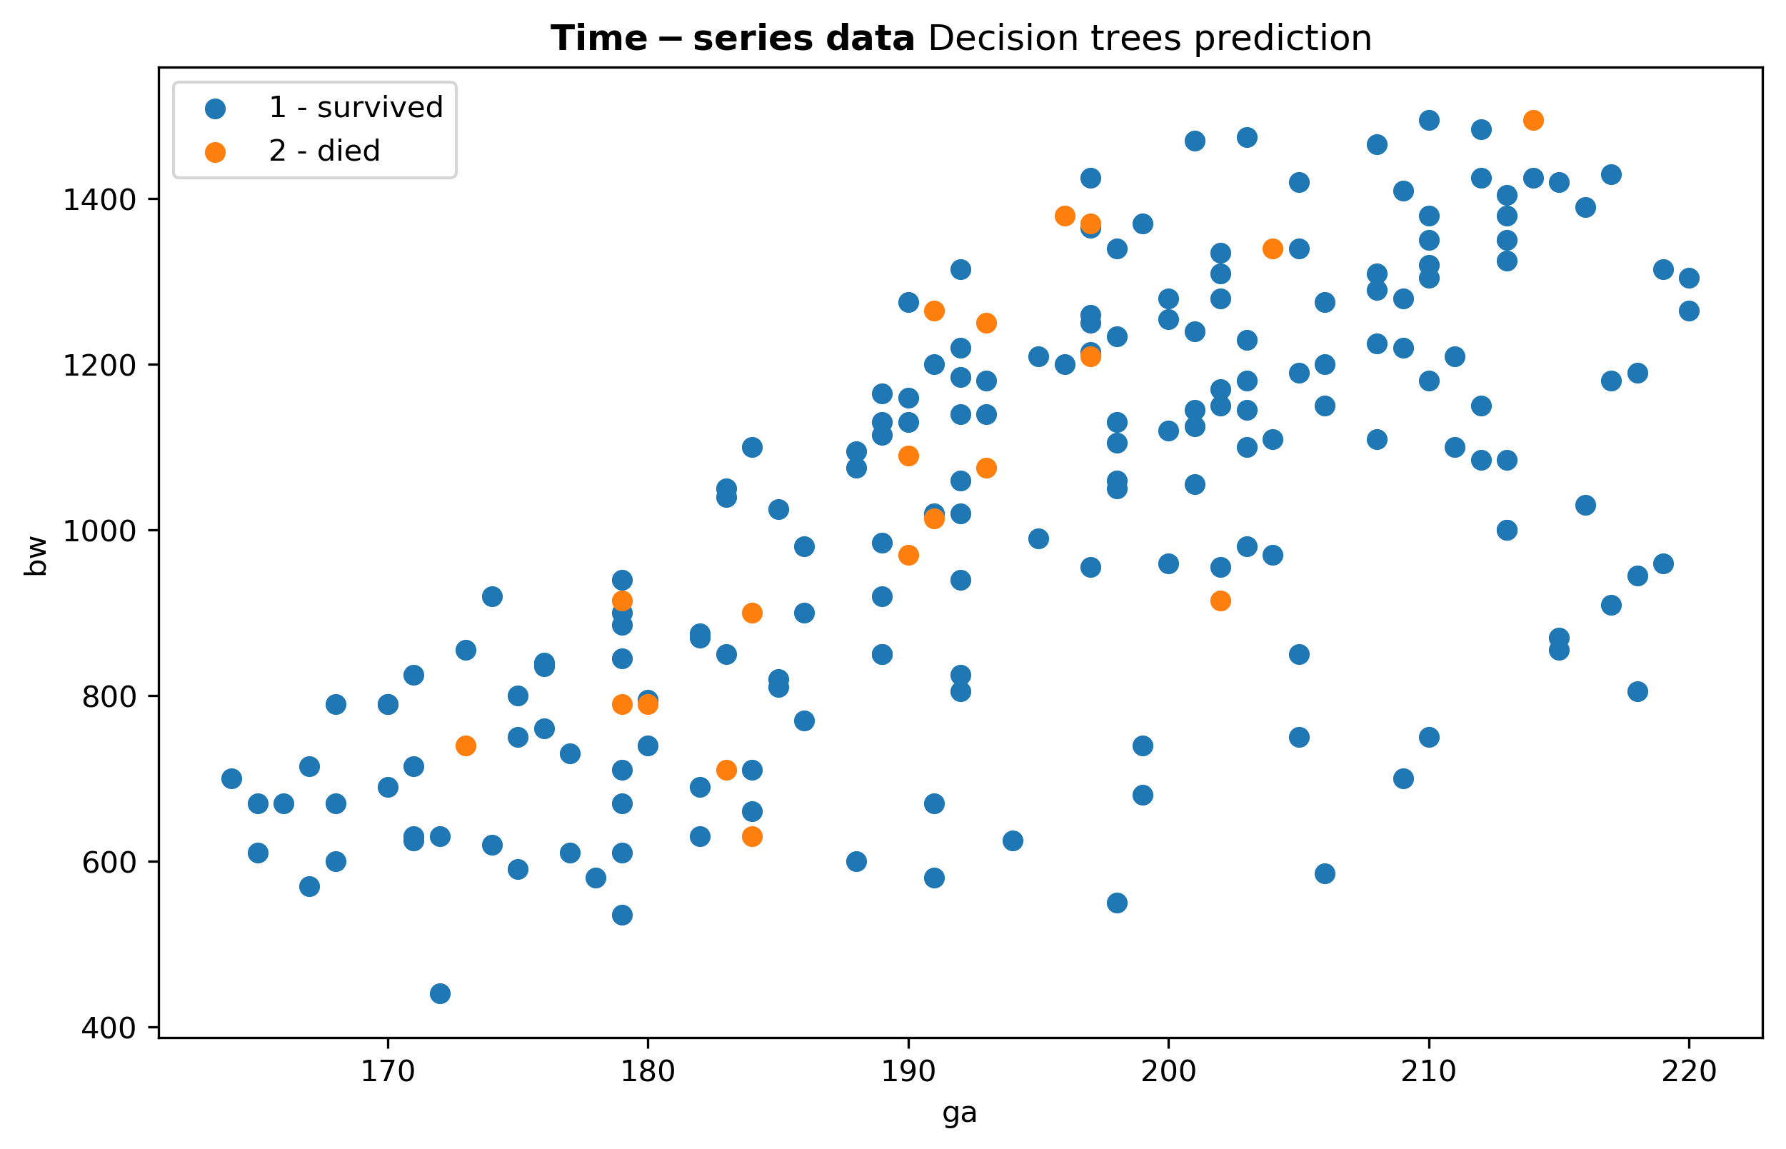
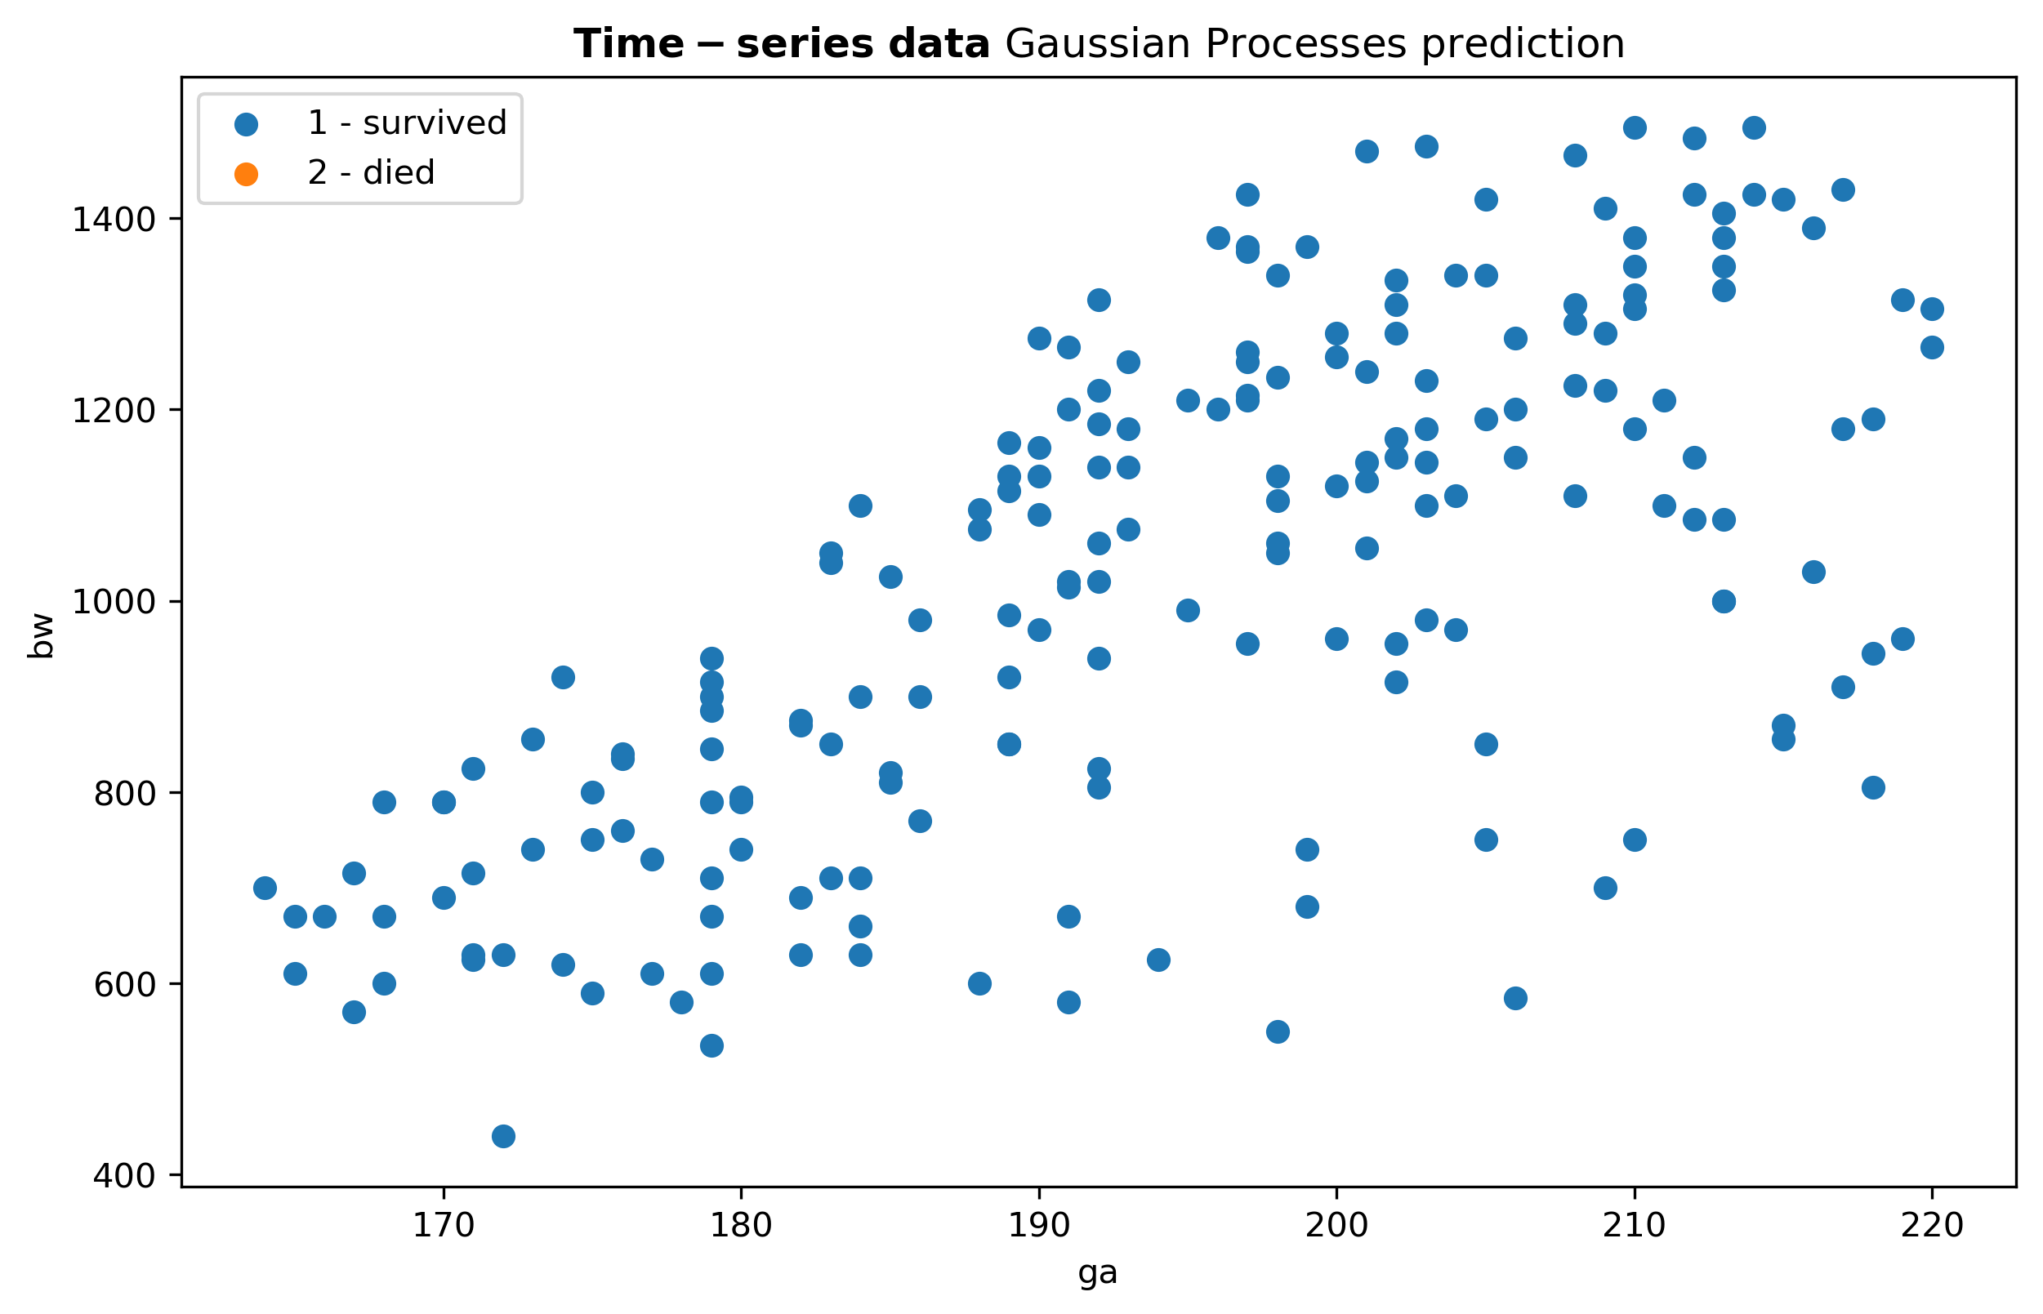
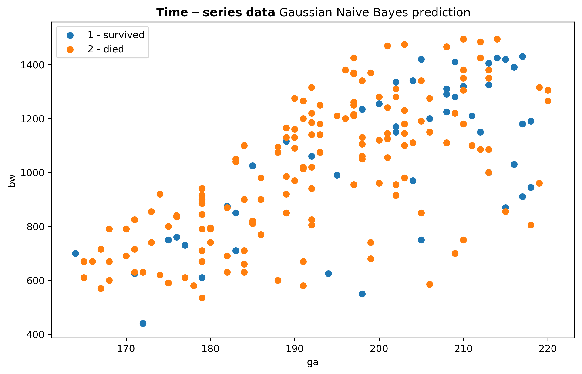
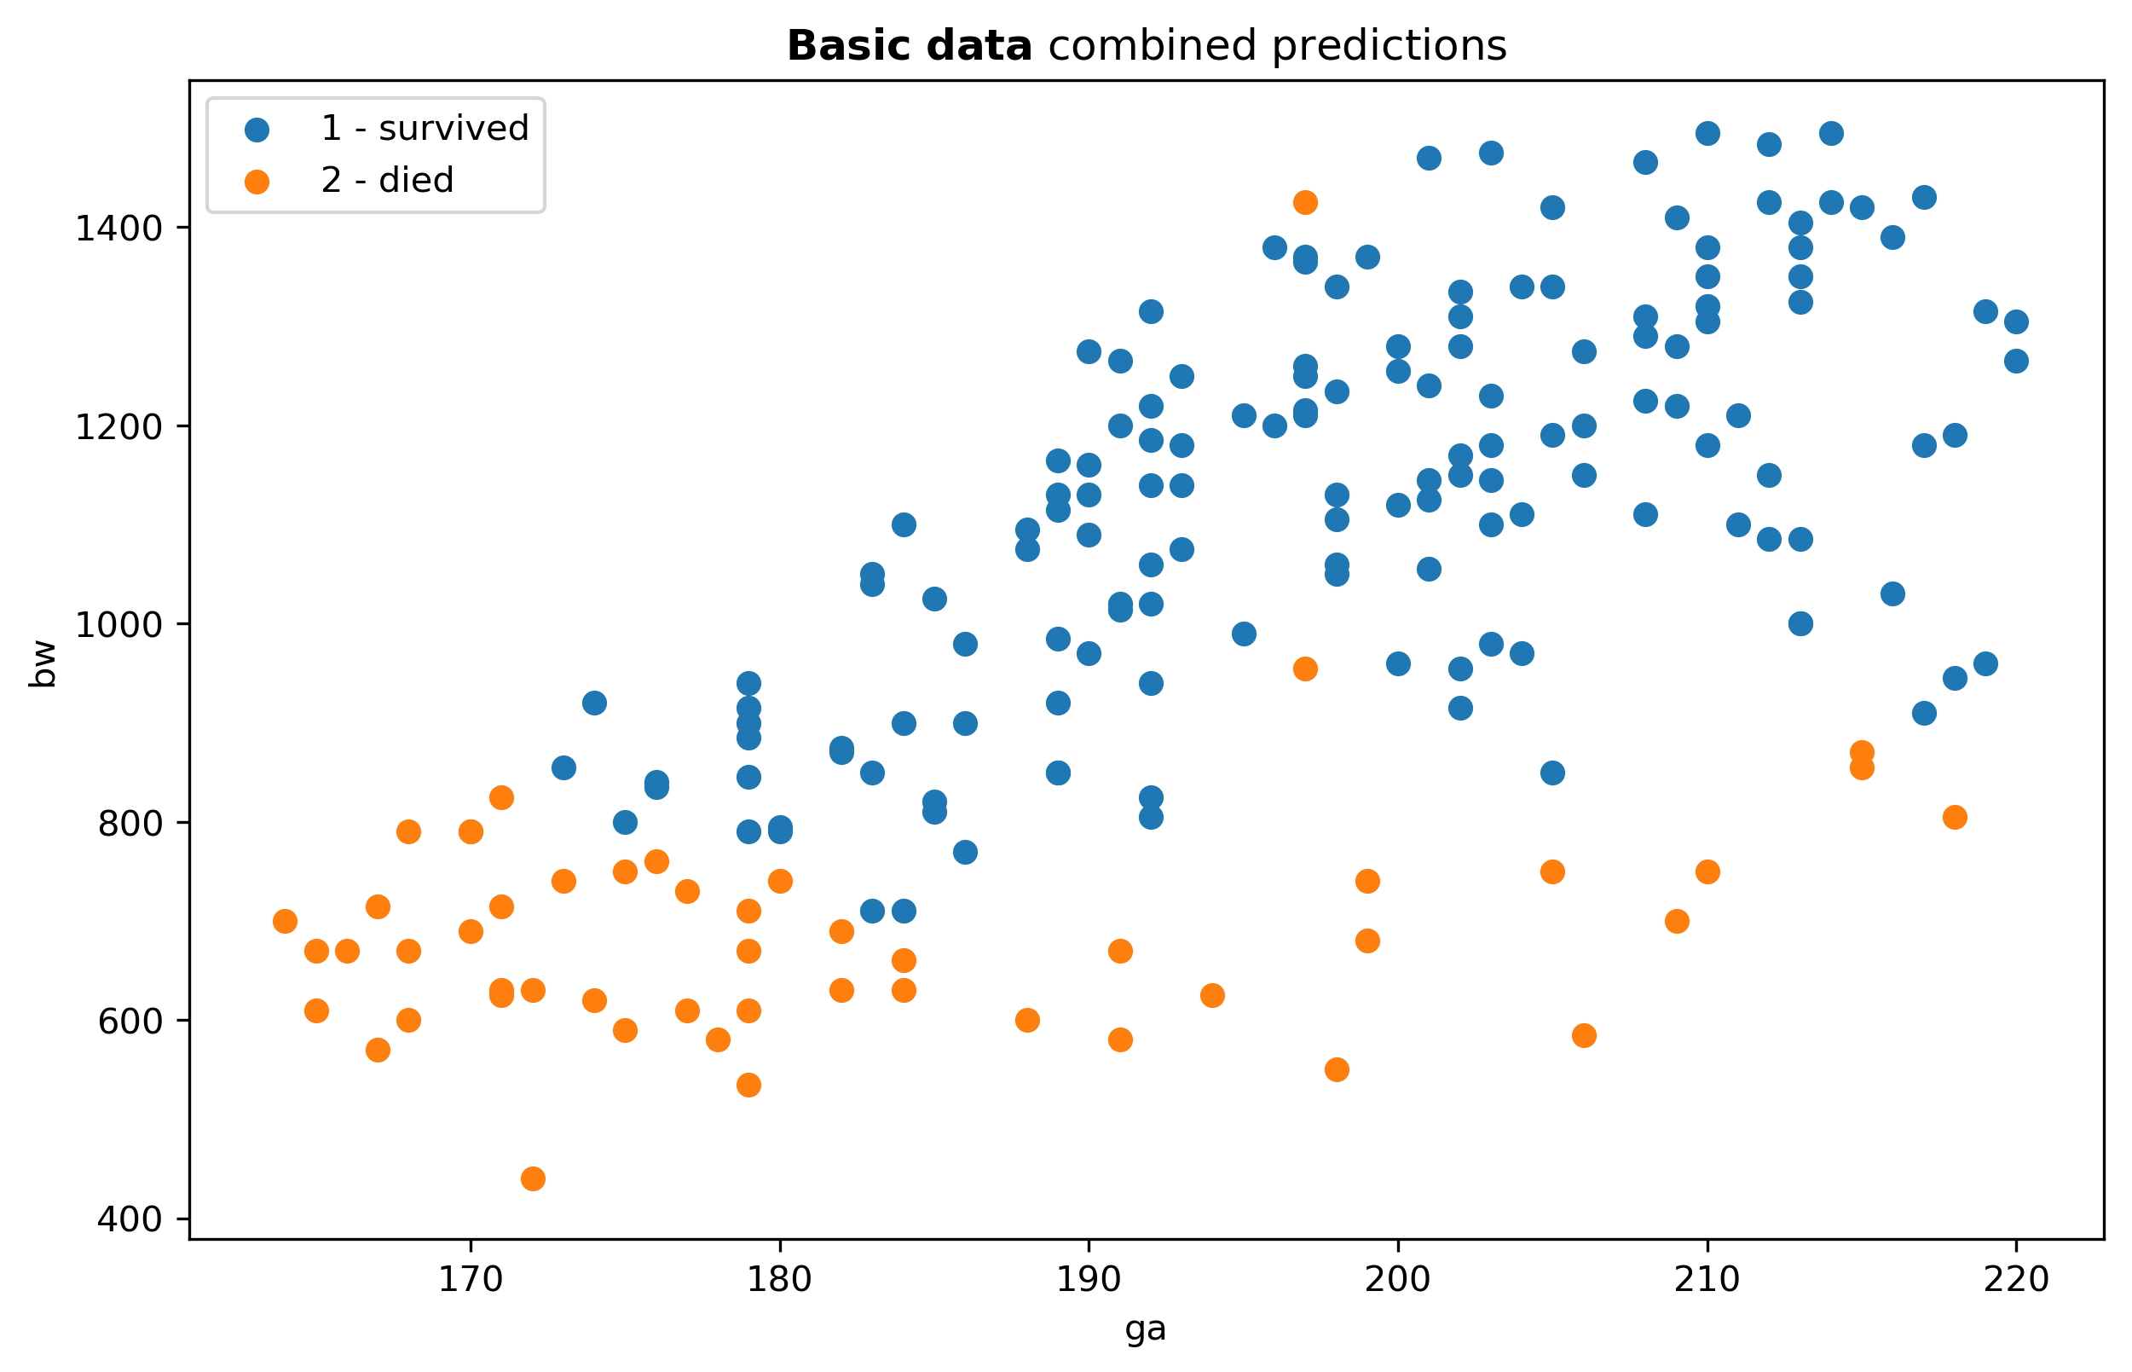
Machine learning in neonatal intensive care
Basic data
Time-series data
Combined data
Training set
Use different classifiers:
Logistic Regression
Decision Trees
Support Vector Machine
Gaussian Naive Bayes
Gaussian Processes
Combined prediction:
Extract statistical features from the time-series data:
mean and variance
Slope and intercept of linear regression
Use same classifiers as for basic data
➔ mapping back prediction in the basic data space
Predictors do not discover specific pattern
Combining basic data with time-series data
Again, a mixture of classifiers can help to make more safe decision
one prediction
Maximilian Proll
Michele Vantini
AALTO University
Computer Science Department

