Slide 1
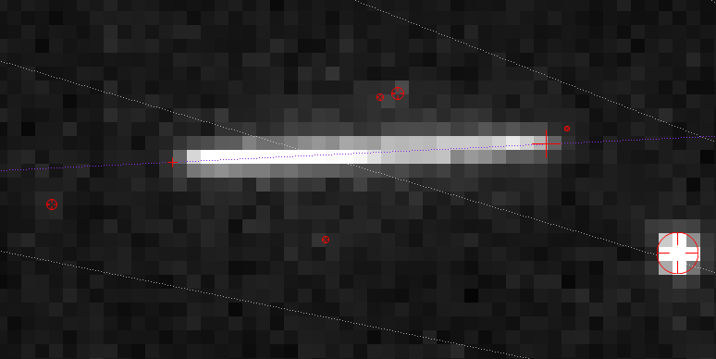

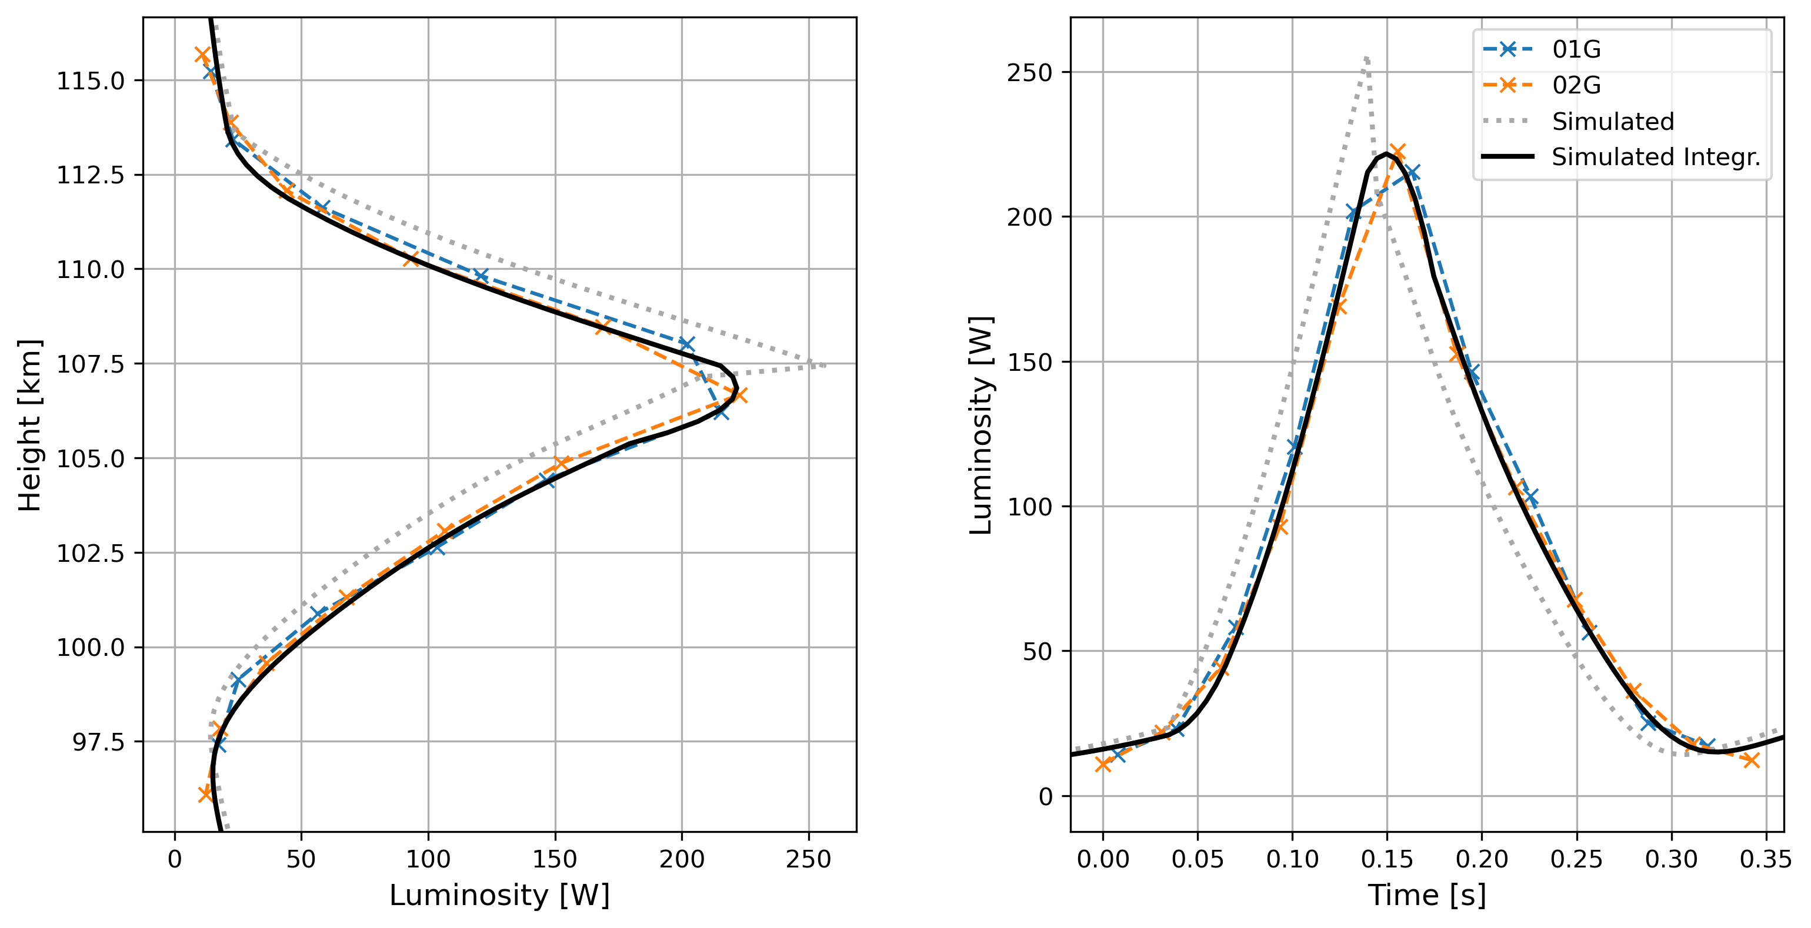
02G
Simulated
0.03125 s
0.005 s
Simulated Integr.

