Slide 1
Detecting
Social Group Mentions
In Parliamentary Speeches
Using LLMs
Max Weiland
Konstanz, 18.11.2025

Slide 2

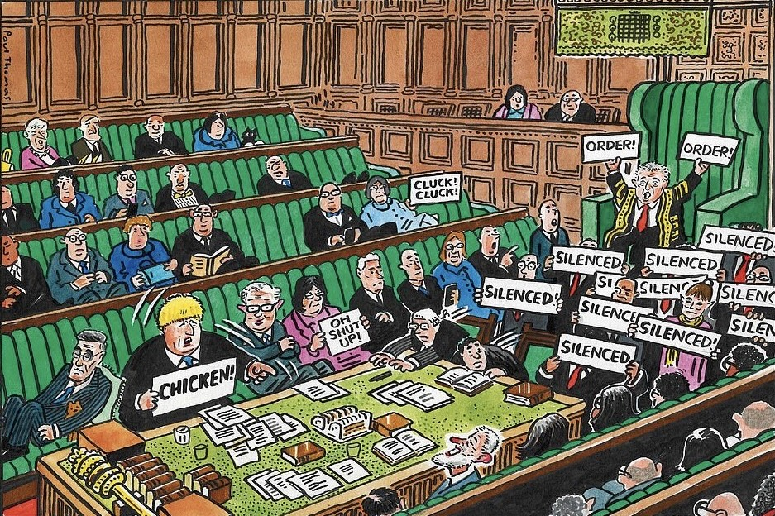
Motivation
Politics is about the representation of the interests of social groups
Politicians regularly talk about and appeal to these groups
To mobilize them, signal responsiveness, make them feel represented and to win votes
Develop automated pipeline to classify these group appeals in political text
Manual content analysis vs. dictionary vs. LLMs
Apply best method to parliamentary speeches in the UK House of Commons and analyze how group appeals are used as electoral strategy

Slide 3
Research Questions
Methodological
Which classification method most effectively identifies social group appeals in parliamentary speeches?
Substantive
How do British parties and MPs strategically use social group appeals in their parliamentary rhetoric to gain electoral support?

Slide 4
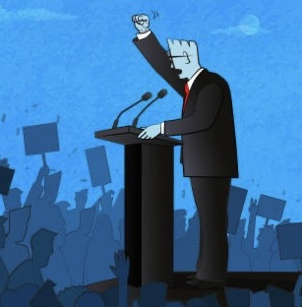
Illustrative Examples
‘I am glad to say that the Conservatives will be standing up for working people.’
‘This Government offers tax cuts to millionaires and porridge and food banks to low-paid workers.’
‚At what point will the Government put the needs of vulnerable children before private profit?‘
‚What plans does the Government have to help older people who live on small incomes for which they have saved all their lives to build up?‘
‚That means thousands of young people being helped to achieve their full potential.‘ Note: All examples taken from parliamentary speeches delivered in UK parliament between 2010 and 2019

Slide 5
How Group-Based Rhetoric Works
Individuals categorize themselves as belonging to various social groups, have positive feelings towards these in-groups and may have negative feelings against certain out-groups (Tajfel and Turner 1979)
Talking about certain groups allows politicians to show which groups are important to them (Conover 1988)
People inherently rely on social categorization when making political decisions (Kinder and Kam 2010) and may use this identity as shortcut in complex decision-making scenarios (Thau 2019)
Group references can influence peoples’ evaluations of political candidates (Robison et al. 2021)
Class voting reacts to the appeals made by political parties (Thau 2021)

Slide 6
Related Work - Detecting Group Mentions
Manual hand-coding of party manifestos in Britain, Austria and the Netherlands (Thau 2019, 2021; Horn et al. 2021, Howe et al. 2022, Huber 2022, Dolinsky 2023)
Group appeals prevalent over time, but became more diversified
Application of a dictionary to detect group mentions in Tweets (Riethmüller and Franzmann 2025, Horne et al. 2025)
Sentiment towards group classified by BERT model
Challenger parties use more symbolic rhetoric and are more negative
Using a finetuned BERT model to detect group mentions in party manifestos (Licht and Sczepanski 2025, Horne et al. 2025)
Sentences containing group mentions are more emotional
Their frequency is dependent on policy topic

Slide 7
Supervised Learning for Detection
Two classification tasks: Classification of social group mentions as Named Entity Recognition (BIO tagging) and classification of stance towards the mentioned group (positive/supportive, neutral, negative/critical)
For both tasks compare best performing BERT model, a finetuned (PEFT) generative LLM, a closed-source generative LLM (few-shot prompted) and a dictionary baseline
Training set
Manual annotation of 5000 sentences from UK parliamentary speeches provided in ParlSpeech V2 dataset (Rauh and Schwalbach 2020) prefiltered with a dictionary (Horne et al. 2025)
Data augmentations via synonym replacement based on GloVe embeddings and generative paraphrases
Hyperparameter tuning on a validation set, cross-validation as final evaluation

Slide 8
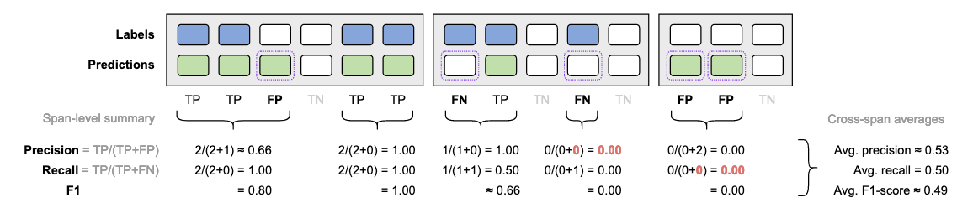
Evaluation of NER
Seqeval (Nakayama 2018) Prediction only counts as TP if the entire span is correct
Cross-Span Averages (Licht and Sczepanski 2025) Less strict than seqeval by rewarding partial matches To avoid division by zero, assigns full FP and FN recall and precision of 0.00
Sentence-Level Count prediction as correct if at least one word of a mention in sentence correctly predicted

Slide 9
Unsupervised Learning for Categorization
It is hard to think of all potential social groups that might be mentioned by politicians
Prior studies first manually identified and then grouped mentions into meaningful categories by hand (Thau 2019)
Apply clustering method (e.g. DBSCAN) to the pooled embeddings of the mention spans
Find a reasonable number of clusters and qualitatively assign a label to these clusters

Slide 10
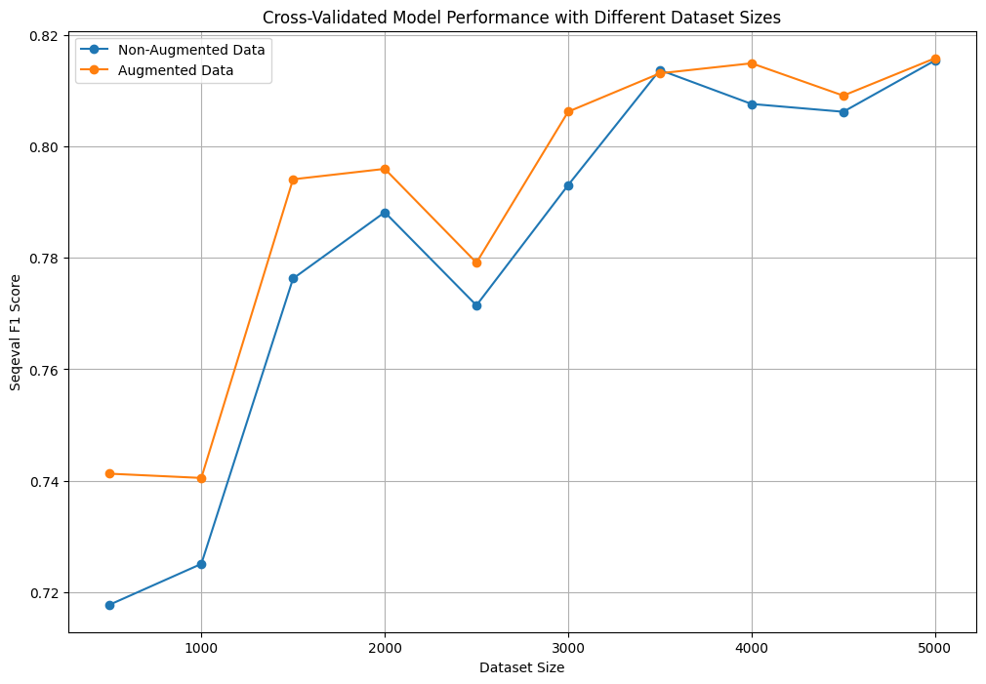
Data Augmentation

Slide 11
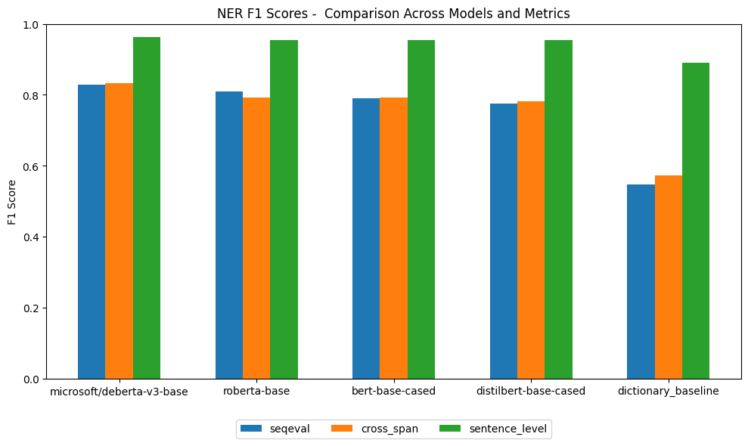
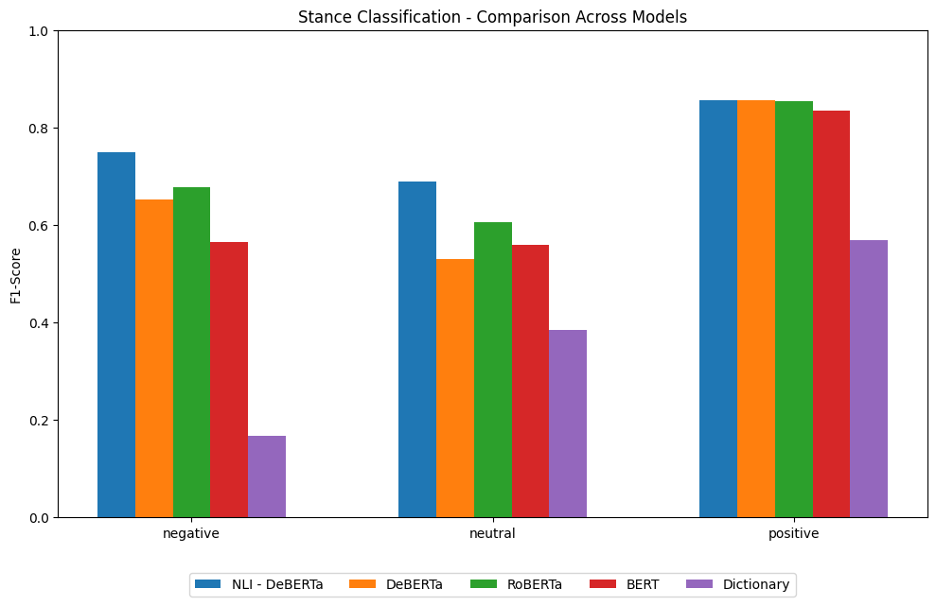
First Results

Slide 12
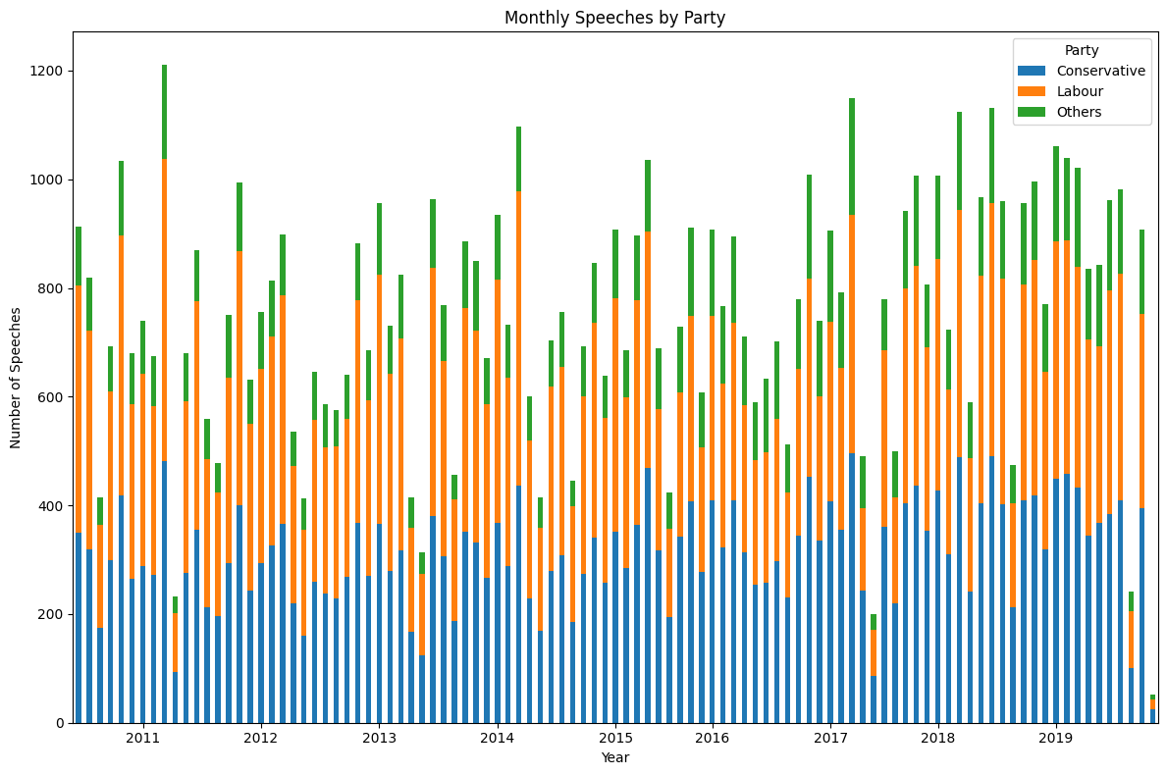
Empirical Application
Parliamentary questions in UK House of Commons between 2010 and 2019
Focus on UK allows comparison with previous studies (Thau 2019, 2021)
Single-member districts increase importance of individual name recognition (Proksch and Slapin, 2015)
In candidate-centered systems, the incentive to cultivate a personal vote leads to greater responsiveness to constituents (Cain et al., 1987)

Slide 13
Hypotheses
H1a: All legislators are more likely to use group appeals as an election approaches.
H1b: This effect is more pronounced among electorally vulnerable legislators.
H2: Legislators from opposition parties are more likely to make use of negative group appeals.
H3a: Labour MPs are more likely to use positive group appeals towards young people, whereas Conservative MPs are more likely to positively appeal to elderly people.
H3b: Legislators’ constituency demographics reinforce these party differences.

Slide 14
Statistical Method
Reduce the dataset to questions asked to Ministers and the PM
Aggregate from sentence to speech level encoding if the speech contains positive/negative appeal towards each group found during clustering
Run separate multilevel logistic regressions predicting the presence of the respective appeal type
Test for party-level (party, government status), MP-level (margin of victory, constituency demographics) variables as well as their interaction (party x constituency demographics)

Slide 15
Limitations, Challenges and Open Questions
No differentiation between policy and group appeals
Results would be more reliable if multiple people annotated data
Multilevel models vs. clustered standard errors
Parliamentary speeches less structured and targeted at the electorate than party manifestos
Time- and resource-intensive to develop a ”best-effort” approach for each individual method
Unclear how well clustering works
Clusters containing “mixed” groups
Noisier than directly classify into pre-existing categories

Slide 16
References
Cain, B., Ferejohn, J., & Fiorina, M. (1987). The personal vote: Constituency service and electoral independence. Harvard University Press.
Conover, P. J. (1988). The Role of Social Groups in Political Thinking. British Journal of Political Science, 18(1), 51–76.
Dolinsky, A. O. (2023). Parties’ group appeals across time, countries, and communication channels—examining appeals to social groups via the parties’ group appeals dataset. Party Politics, 29 (6), 1130–1146.
Horn, A., Kevins, A., Jensen, C., & van Kersbergen, K. (2021). Political parties and social groups: New perspectives and data on group and policy appeals. Party Politics, 27(5), 983–995.
Horne, W., Dolinsky, A. O., & Huber, L. M. (2025). Using llms to detect group appeals in parties’ election manifestos1.
Howe, P. J., Szöcsik, E., & Zuber, C. I. (2022). Nationalism, Class, and Status: How Nationalists Use Policy Offers and Group Appeals to Attract a New Electorate. Comparative Political Studies, 55(5), 832–868.
Huber, L. M. (2022). Beyond Policy: The Use of Social Group Appeals in Party Communication. Political Communication, 39(3), 293–310.
Licht, H., & Sczepanski, R. (2025). Detecting Group Mentions in Political Rhetoric A Supervised Learning Approach. British Journal of Political Science, 55, e119.
Kinder, D. R., & Kam, C. D. (2010). Us Against Them: Ethnocentric Foundations of American Opinion. University of Chicago Press.
Nakayama, H. (2018). seqeval: A Python framework for sequence labeling evaluation.
Proksch, S.-O., & Slapin, J. B. (2015). The Politics of Parliamentary Debate. Cambridge University Press.

Slide 17
References
Rauh, C., & Schwalbach, J. (2020). The parlspeech v2 data set: Full-text corpora of 6.3 million parliamentary speeches in the key legislative chambers of nine representative democracies. Harvard Dataverse, 1 (1).
Robison, J., Stubager, R., Thau, M., & Tilley, J. (2021). Does Class-Based Campaigning Work? How Working Class Appeals Attract and Polarize Voters. Comparative Political Studies, 54(5), 723–752.
Riethmüller, F., & Franzmann, S. T. (2024). Supply-side dynamics of parties’ group appeals: How dominance affects the choice between symbolic and policy-based appeals. Party Politics, 13540688251339624.
Tajfel, H., & Turner, J. C. (1979). An integrative theory of intergroup conflict. Organizational Identity: A Reader, 56(65), 9780203505984–16.
Thau, M. (2019). How political parties use group-based appeals: Evidence from britain 1964–2015. Political Studies, 67 (1), 63–82.
Thau, M. (2021). The Social Divisions of Politics: How Parties’ Group-Based Appeals Influence Social Group Differences in Vote Choice. The Journal of Politics, 83(2), 675–688.

