Slide 1
Replication:
Party Communication
During and After
Election Campaigns
Max Weiland
Konstanz, 15.07.25

Slide 2
1. Research Question
How does party communication change during election campaigns?
Previous Research:
Politicians strategically apply emotive language during election campaigns (Kosmidis et al. 2019)
Negativity during campaigns linked to increased affective polarization (Marchal 2022)
Poor economic performance makes everyone speak more negatively (Crabtree 2020)
Analysis:
How does communication change between non-election campaign and campaign times?
How did German parties’ sentiment change during the 2025 Bundestag campaign?
Analyze individual politicians’ communication on social media, sentiment analysis on Bluesky posts

Slide 3
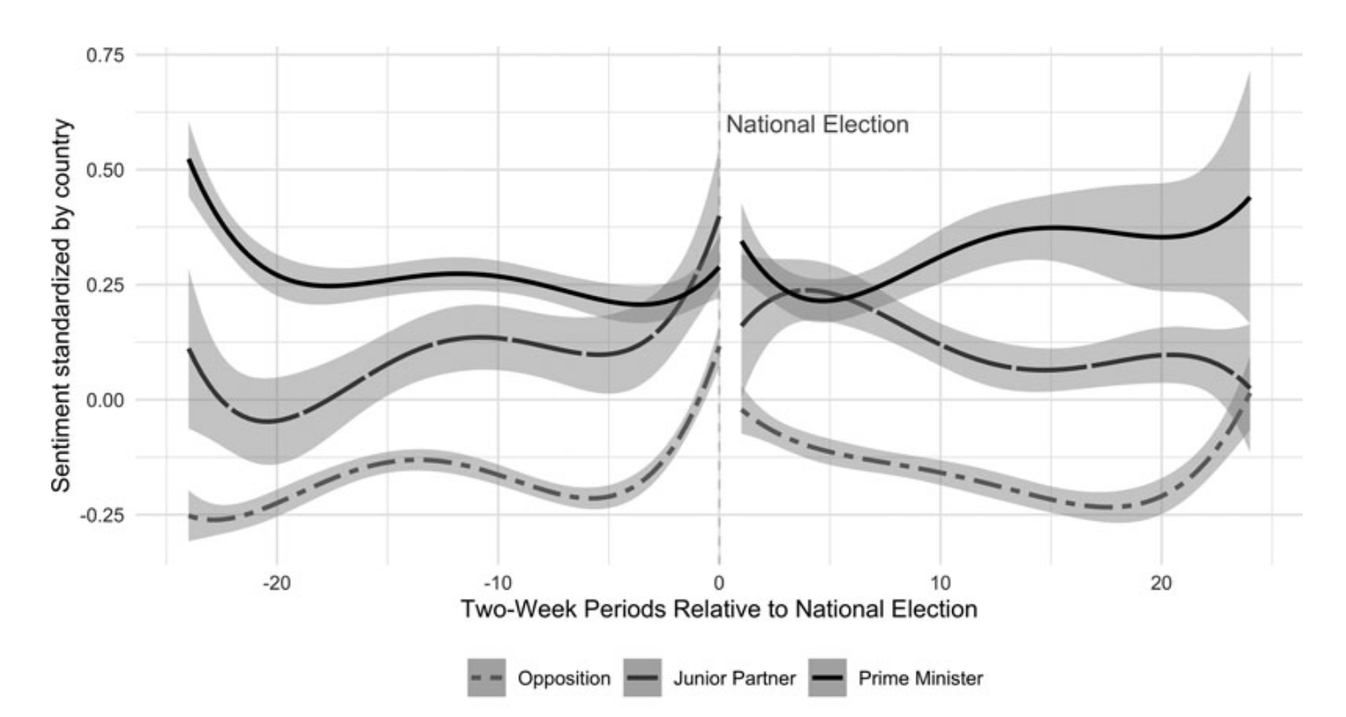
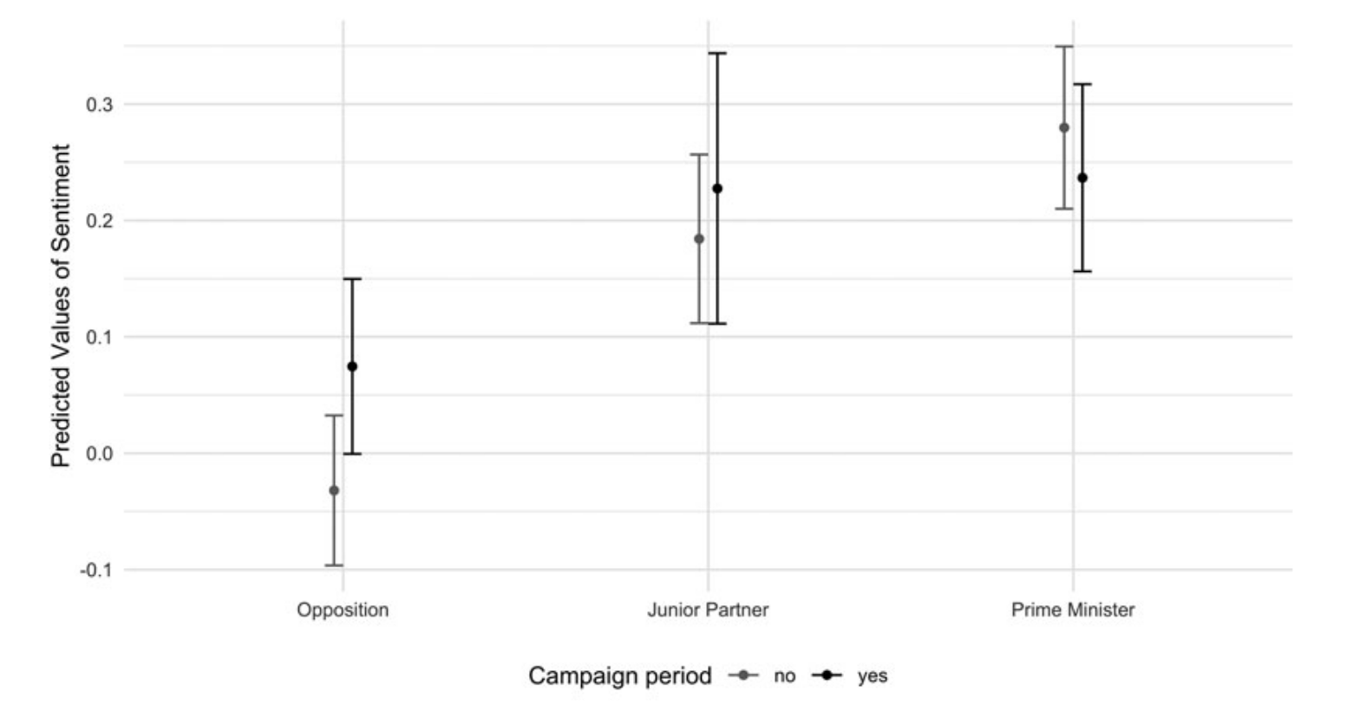
2. The Original Paper
Modulation of Democracy: Partisan Communication During and After Election Campaigns (Silva et al. 2024)
Analyze all tweets by every member of a national parliament in the EU 27 between February 2018 and February 2020
Apply a dictionary-based sentiment analysis
Findings:
Generally, government parties communicate more positively than the opposition
This gap narrows during election campaigns. The effect holds even for Euroskeptic and extreme parties
Parties trailing in the polls communicate more negatively

Slide 4
3. Replication
Test if the authors’ findings can be applied to the 2025 German Bundestag campaign
Hypotheses: H1: Government parties communicate more positively than opposition parties. H2: Opposition parties are more positive during campaign than non-campaign times. H3: Governing parties are more negative during campaign than non-campaign times.
Collected 17,173 posts of German MPs having a Bluesky account from June 2024 until June 2025
Remove period of caretaker government directly after election
Apply a BERT-based sentiment classifier to classify MPs sentiment (in one-week intervals)
Run a multilevel model grouped at politician and party level

Slide 5
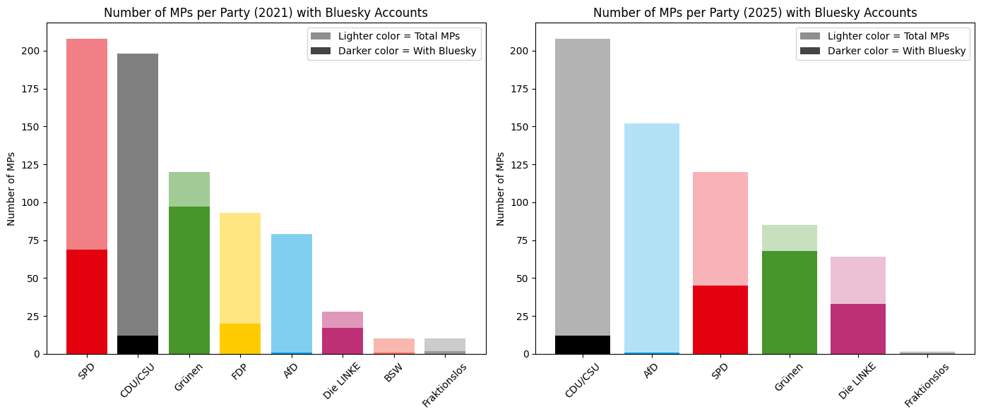
4. Limitations and Open Questions
Proportion of Bluesky accounts within a party is very unequally distributed across parties
What single politician posts might not be representative of party’s main line
Bundestag campaign did not start as planned, but because of dissolution of the parliament
Focus better on single parties for which I have a reasonable amount of data?

Slide 6
References
Crabtree, C., Golder, M., Gschwend, T., & Indriđason, I. H. (2020). It is not only what you say, it is also how you say it: The strategic use of campaign sentiment. The Journal of Politics, 82(3), 1044-1060. Marchal, N. (2022). “Be nice or leave me alone”: An intergroup perspective on affective polarization in online political discussions. Communication Research, 49(3), 376-398. Kosmidis, S., Hobolt, S. B., Molloy, E., & Whitefield, S. (2019). Party competition and emotive rhetoric. Comparative Political Studies, 52(6), 811-837.
Silva, B. C., Schürmann, L., & Proksch, S. O. (2024). Modulation of democracy: Partisan communication during and after election campaigns. British Journal of Political Science, 54(2), 339-354.

