Slide 1

COMP 472 assignment 3
Maximilien Fathi (21313371) Zihan Zhou (40024056)

Slide 2

1. Introduction
We will look at:
Analysis of datasets provided for the assignment
Analysis of the vocabularies used for the Naïve Bayes models
Analysis of performances for each model and dataset
Conclusion on chosen best model

Slide 3

2.0 analysis of datasets

Slide 4
2.1 Analysis of datasets
Training dataset
Testing dataset

Slide 5

3.0 analysis of vocabularies

Slide 6
3.1 analysis of vocabulary
Vocabulary size for each model
Some key notes
Slight time difference for training
  0.0209 sec for NB-BOW-OV
  0.0147 sec for NB-BOW-FV
Better accuracies when filtering
Removal of stop words (bonus)

Slide 7

4.0 analysis of performances

Slide 8
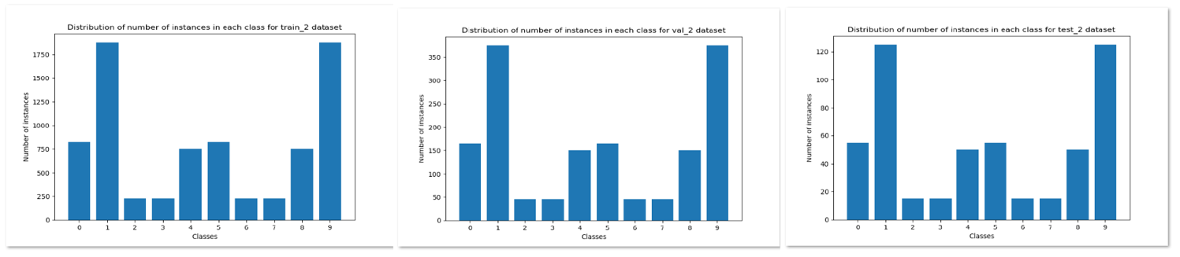
2.2 Analysis of dataset 2
Imbalanced dataset
  Accuracy => Not an appropriate metric
  Relatively larger gap between macro-average F1 and weighted-average F1
  Affects values of certain hyper-parameters when trying to tune them

Slide 9
3.1 GNB MODEL PERFORMANCE
Dataset 1
Dataset 2
Accuracy | 0.69
Macro-average F1 | 0.68
Weighted-average F1 | 0.69
Accuracy | 0.67
Macro-average F1 | 0.60
Weighted-average F1 | 0.68
Similar and decent performances for both
Quick runtime for both

Slide 10
3.2 base-dt MODEL PERFORMANCE
Dataset 1
Dataset 2
Accuracy | 0.42
Macro-average F1 | 0.40
Weighted-average F1 | 0.41
Accuracy | 0.78
Macro-average F1 | 0.72
Weighted-average F1 | 0.78
Poor performance
Quick runtime
Better performance
  Less classes to consider
  More data provided
Quick runtime

Slide 11
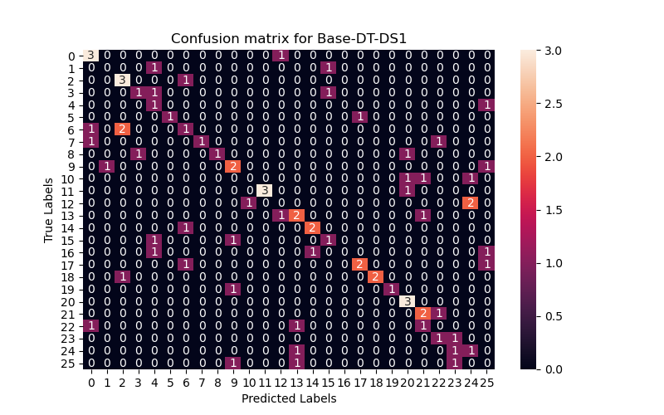
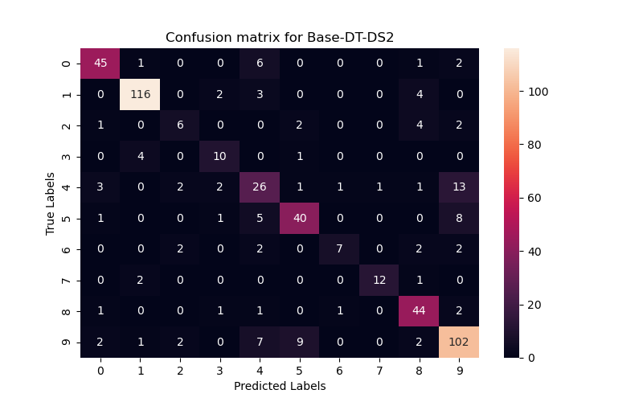
Continued …
Dataset 1
Dataset 2

Slide 12
3.3 best-dt MODEL PERFORMANCE
Dataset 1
Dataset 2
Accuracy | 0.46
Macro-average F1 | 0.43
Weighted-average F1 | 0.45
Accuracy | 0.78
Macro-average F1 | 0.71
Weighted-average F1 | 0.77
Best combination of hyper-parameters
criterion | entropy
max_depth | None
min_samples_split | 2
min_impurity_decrease | 0.0
class_weight | None
Best combination of hyper-parameters
criterion | entropy
max_depth | None
min_samples_split | 5
min_impurity_decrease | 0.0005
class_weight | balanced

Slide 13
Continued …
My observations
Tuning hyper-parameters
Slightly better performance (compared to base-dt)
Longer runtime because of grid search
Not the ideal model
Gini vs. Entropy
  Speed vs. Performance
Minimum sample split
  The lower, the better generally
Class weight
  Add more weight for imbalanced dataset
Maximum depth
  Prevents underfitting
Minimum impurity decrease
  At its lowest, any splitting is allowed

Slide 14
3.4 perceptron MODEL PERFORMANCE
Dataset 1
Dataset 2
Accuracy | 0.78
Macro-average F1 | 0.76
Weighted-average F1 | 0.77
Accuracy | 0.84
Macro-average F1 | 0.79
Weighted-average F1 | 0.83
Best performance so far for DS1
Quick runtime
Best performance so far for DS2
  Less classes to consider
Quick runtime
Dataset is more imbalanced
  Weighted-average F1 > Macro-average F1

Slide 15
3.5 base-mlp MODEL PERFORMANCE
Dataset 1
Dataset 2
Accuracy | 0.42
Macro-average F1 | 0.31
Weighted-average F1 | 0.35
Accuracy | 0.83
Macro-average F1 | 0.77
Weighted-average F1 | 0.82
Worst performance so far!
  Low number of iterations (200)
  Never converges
  Still have back propagation errors
  Gets better with a lot more iterations
Took longer than previous models
Good performance (similar to perceptron)
  Less classes to consider
Took longer than previous models

Slide 16
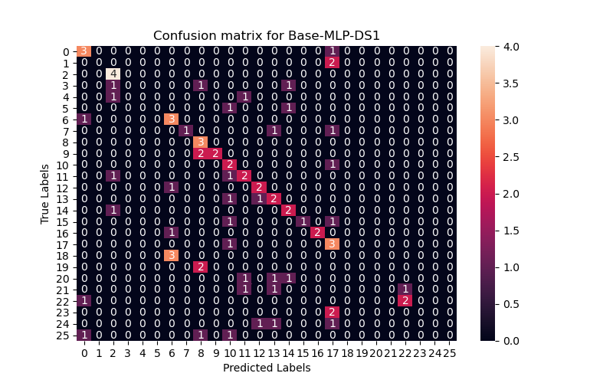
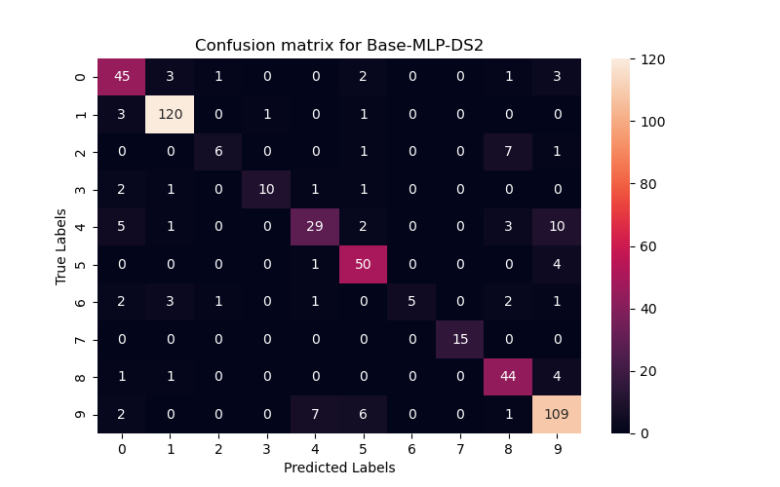
Continued …
Dataset 1
Dataset 2

Slide 17
3.6 best-mlp MODEL PERFORMANCE
Dataset 1
Dataset 2
Accuracy | 0.88
Macro-average F1 | 0.87
Weighted-average F1 | 0.87
Accuracy | 0.91
Macro-average F1 | 0.88
Weighted-average F1 | 0.91
Best combination of hyper-parameters
activation | logistic
hidden_layer_sizes | (200,)
solver | (adam)
Best combination of hyper-parameters
activation | tanh
hidden_layer_sizes | (200,)
solver | adam

Slide 18
Continued …
My observations
Tuning hyper-parameters
Highest performance so far
Never converges at 200 iterations
Very Long runtime
Network architecture matters!
  Too few neurons => Underfitting (worse performance with 5 neurons for example)
  Too many neurons => Overfitting and large runtime
Increasing number of iterations (bonus)
  Slightly increases performance (already high)
  Allows for full convergence
  Runtime is even longer than previously

Slide 19

4. conclusion
Best-MLP is the most performant model for both datasets.
It is also the slowest!

Slide 20

thank you!
Any questions?

