Slide 1

ePet
Emotion based speech controlled

Slide 2

Sometimes you need
a companion!

Slide 3
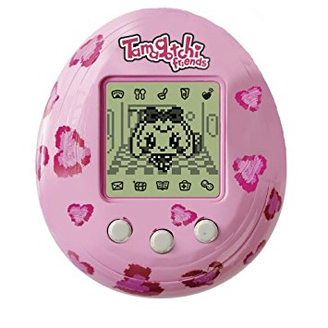
Tamagotchi
in the 90‘s

Slide 4
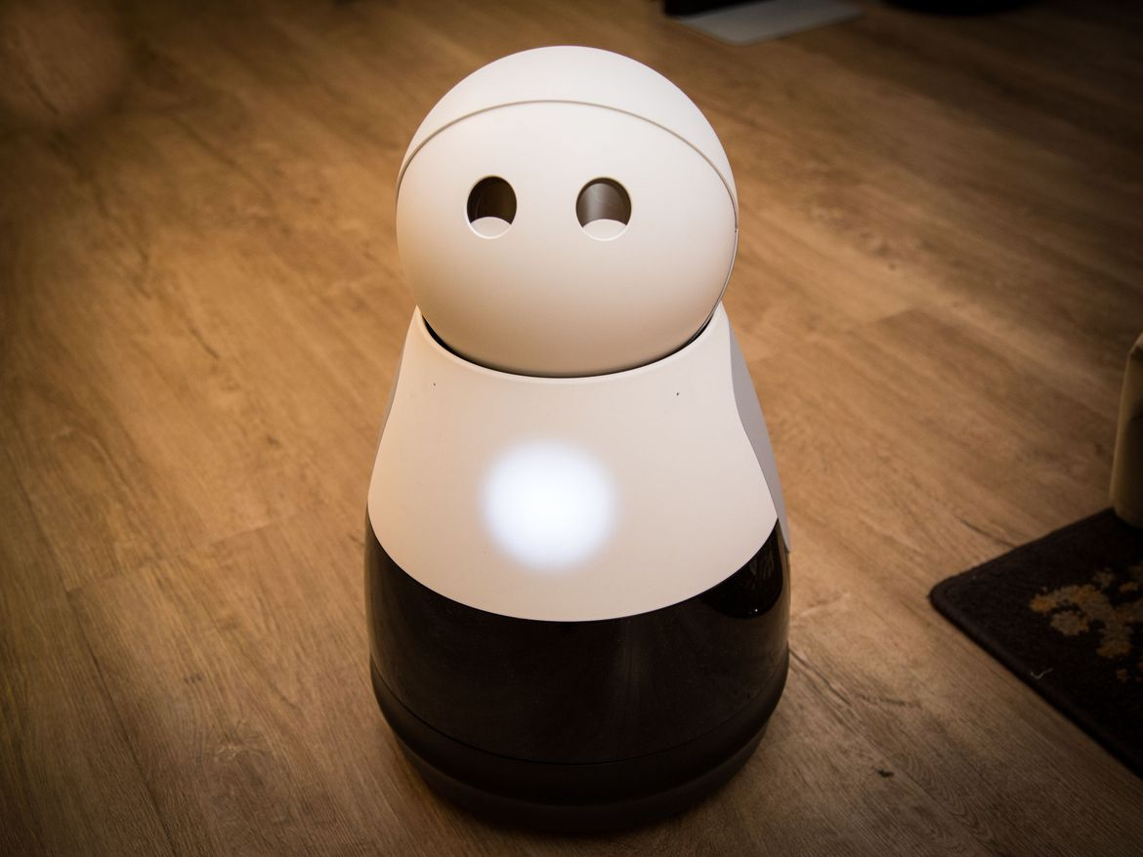
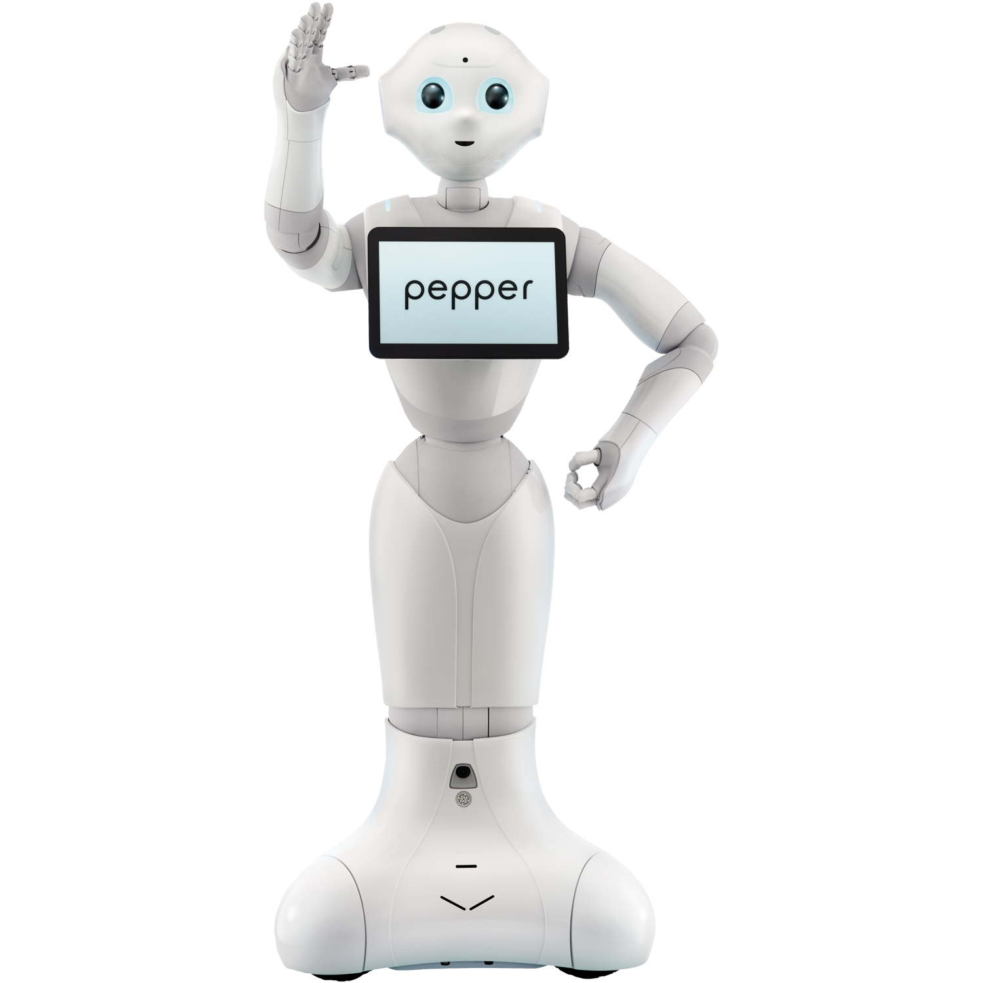


Slide 5

Motivation
Hack your own solution and connect the
gadgets
dots

Slide 6
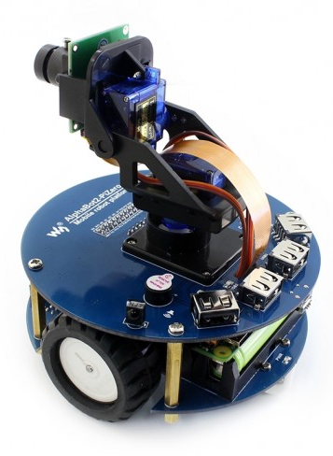
ePet - Magic Sauce!
Emotions Hungry, happy, fitness…
Games Fetch the ball!
Movement and LED feedback Based on current state of emotions
Speech controlled Via Alexa & Amazon Echo Plus
Remote control Through App GUI

Slide 7






How ePet works
ePet

Slide 8

How ePet works
ePet

Slide 9

How ePet works
ePet
Spring Boot

Slide 10
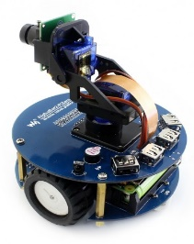

Fetch the ball
Detect the ePet via camera
Driving robot to selected position
Make it happy!

Slide 11






Technologies
Websockets
Raspberry Pi 3
Altemista Cloud
AlphaBot 2
Java
Python
Bosch IoT Cloud
Ionic
Spring Framework

Slide 12

ePet thanks you for your attention

