Slide 1
GROCERY WEB APPLICATION
Done by
Logesh. D (211521205076)
Vignesh. B.J (211521205182)
Maximus. R (211521205083)
Gajabosekumar. S (211521205039)

Slide 2
GROCERY WEB APPLICATION
ABSTRACT
Efficient online grocery shopping is a crucial aspect of modern e-commerce systems. We propose a web-based application for seamless grocery shopping and management using a user-centric design and robust backend functionalities.
Done by
Our approach aims to provide an intuitive interface for customers to browse and purchase products, while enabling sellers and administrators to efficiently manage inventory and orders.
Logesh. D
Vignesh. B.J
Maximus. R
Gajabosekumar. S
Used Technologies: HTML, CSS, JavaScript

Slide 3
GROCERY WEB APPLICATION
INTRODUCTION
Importance of Online Grocery Shopping Systems
Online grocery shopping systems play a vital role in modern e-commerce, offering customers convenience, time-saving, and personalized services.
Done by
Key Component
Logesh. D
Vignesh. B.J
Maximus. R
Gajabosekumar. S
A user-friendly interface, robust backend functionalities, and efficient order management are crucial components of online grocery shopping systems.

Slide 4
GROCERY WEB APPLICATION
INTRODUCTION
Challenges with Traditional Methods
Traditional approaches to online grocery shopping often involve cumbersome interfaces, limited product offerings, and inefficient order fulfillment, leading to customer dissatisfaction and loyalty issues.
Done by
Emergence of Modern Technologies
Logesh. D
Vignesh. B.J
Maximus. R
Gajabosekumar. S
Modern web development technologies and design principles have enabled the creation of seamless and intuitive online shopping experiences, revolutionizing the way people shop.

Slide 5
GROCERY WEB APPLICATION
INTRODUCTION
Proposed Methodology
This project proposes a comprehensive Grocery Web App, leveraging user-centric design and robust backend functionalities to provide customers with a hassle-free online shopping experience.
Done by
Objectives
Logesh. D
Vignesh. B.J
Maximus. R
Gajabosekumar. S
The aim is to develop a robust and efficient online grocery shopping system, facilitating a seamless and enjoyable experience for customers, while enabling users and administrators to efficiently manage inventory and orders.

Slide 6
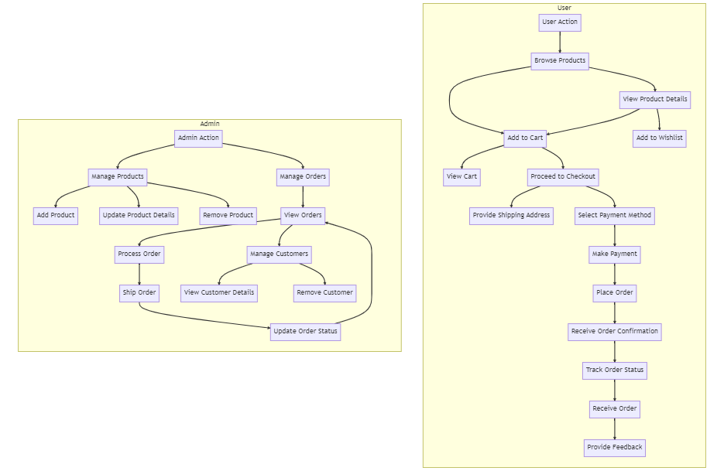
GROCERY WEB APPLICATION
INTRODUCTION
Done by
Logesh. D
Vignesh. B.J
Maximus. R
Gajabosekumar. S

Slide 7
GROCERY WEB APPLICATION
EXISTING SYSTEM
Traditional online grocery shopping systems often rely on outdated interfaces, limited product offerings, and inefficient order fulfillment processes. Drawbacks include poor user experience, high cart abandonment rates, and the need for manual intervention.
Done by
Logesh. D
Vignesh. B.J
Maximus. R
Gajabosekumar. S

Slide 8
GROCERY WEB APPLICATION
EXISTING SYSTEM
Basic e-commerce platforms are employed for online grocery shopping, but they often lack personalized features and require extensive customization. This leads to complex and costly implementations. Assessing customer satisfaction traditionally may rely on subjective feedback or simplistic rating systems. Such methods may not accurately represent real-world customer needs and preferences.
Done by
Logesh. D
Vignesh. B.J
Maximus. R
Gajabosekumar. S

Slide 9
GROCERY WEB APPLICATION
PROPOSED SYSTEM
Our system leverages modern web technologies to develop an intuitive Grocery Web App for seamless online shopping. Using a responsive design framework, we ensure consistent performance across devices, catering to the needs of today's consumers. The app incorporates advanced algorithms for personalized product recommendations and secure payment gateways to protect user data and transactions.
Done by
Logesh. D
Vignesh. B.J
Maximus. R
Gajabosekumar. S

Slide 10
GROCERY WEB APPLICATION
PROPOSED SYSTEM
Our robust backend enables sellers to efficiently manage product listings, inventory, and orders, supporting scalability as the user base grows. Key features include real-time inventory updates and customizable shopping lists, enhancing shopping efficiency and reducing stockouts. This automated approach offers convenience, accuracy, and scalability, making it ideal for integration into modern e-commerce ecosystems.
Done by
Logesh. D
Vignesh. B.J
Maximus. R
Gajabosekumar. S

Slide 11
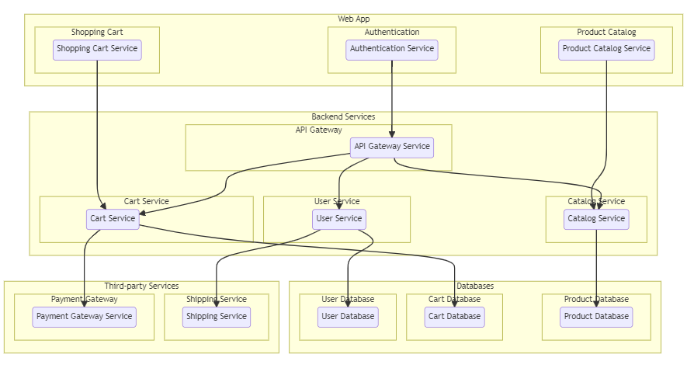
GROCERY WEB APPLICATION
SYSTEM ARCHITECTURE
Done by
Logesh. D
Vignesh. B.J
Maximus. R
Gajabosekumar. S

Slide 12
GROCERY WEB APPLICATION
CONCLUSION
Our robust backend enables sellers to efficiently manage product listings, inventory, and orders, supporting scalability as the user base grows. Key features include real-time inventory updates and customizable shopping lists, enhancing shopping efficiency and reducing stockouts. This automated approach offers convenience, accuracy, and scalability, making it ideal for integration into modern e-commerce ecosystems.
Done by
Logesh. D
Vignesh. B.J
Maximus. R
Gajabosekumar. S

Slide 13
GROCERY WEB APPLICATION
THANK YOU
TEAM LEADER & COORDINATOR
RESOURCE COLLECTION
RESEARCH
VISUALIZATION
DOCUMENTATION
MAXIMUS. R
VIGNESH. B.J
LOGESH. D
MAXIMUS. R
GAJABOSEKUMAR. S

