Slide 1
Best Match Graphs

Slide 2
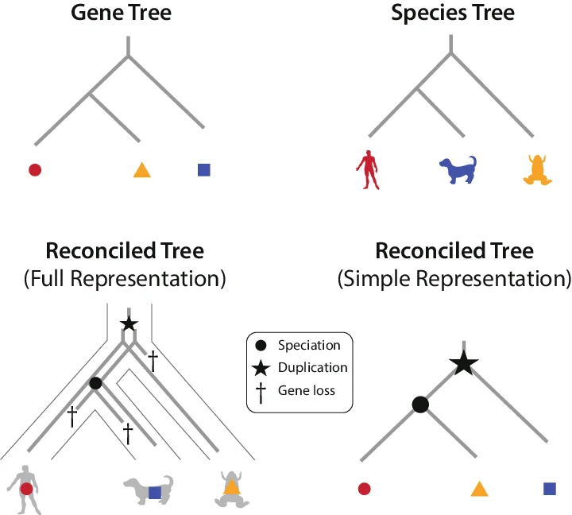
What are we even talking about?
We are looking at gene trees. A gene tree shows evolutionary relationship of a single gene (family).
They help understand phylogenetics (species tree).
Our data: sequence similarity between genes (often blast or blat scores).

Slide 3
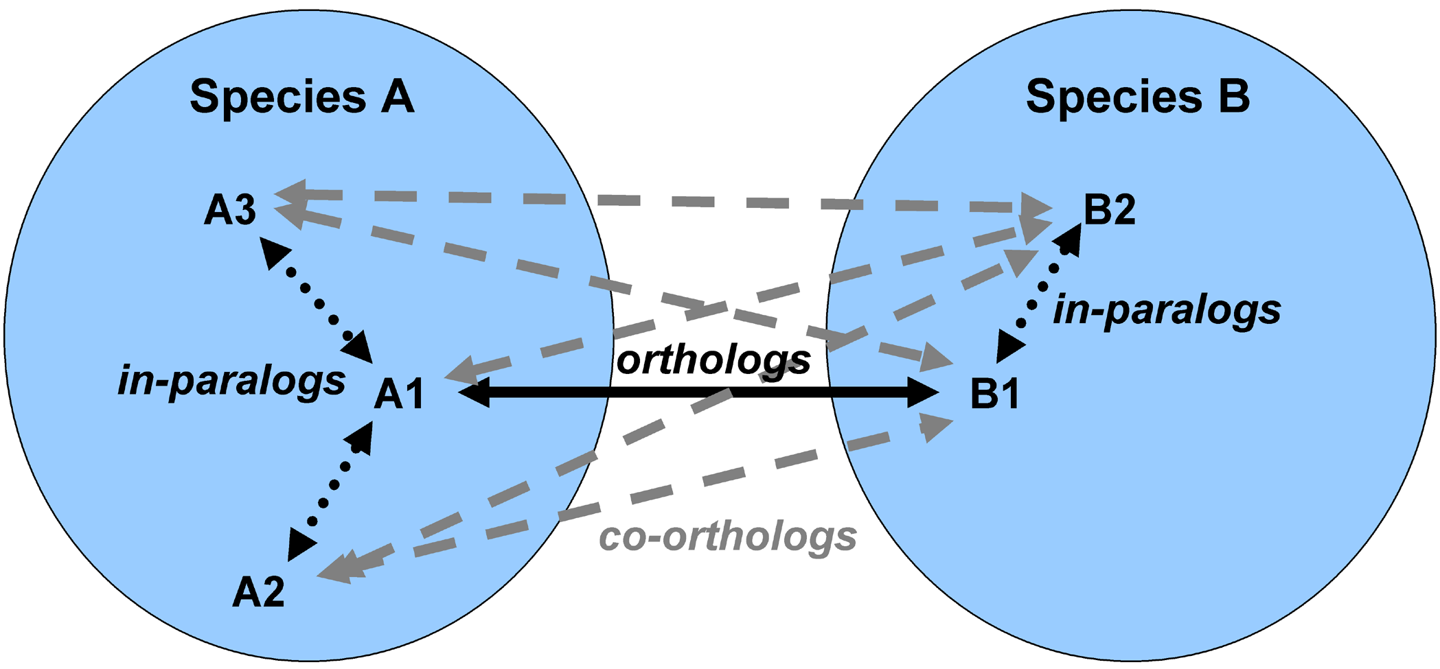
Motivation (or why should you care)
Homologue genes are
Ortholog (evolved through speciation only)
Paralogs (arose by gene duplication
Notes:
Homologous proteins share a common ancestry, and may be characterized as either orthologs (which evolve by speciation only) or paralogs (which arise by gene duplication) [1], [2]. Orthologs typically retain similar domain architecture and occupy the same functional niche following speciation, while (functionally redundant) paralogs are likely to diverge with new functions through point mutations and domain recombinations

Slide 4
Motivation (or why should you care)
Orthologs typically retain similar domain architecture and occupy the same functional niche, and are used to infer phylogenetic relationships.
Including paralogs can lead to wrong trees!

Slide 5
Why care about best match graphs?
Best matches are directly linked to orthology: Given gene A1 in species A, all its co-orthologous genes Bx in species B are closest relatives to A1.
Best match graphs arise naturally during orthology detection

Slide 6
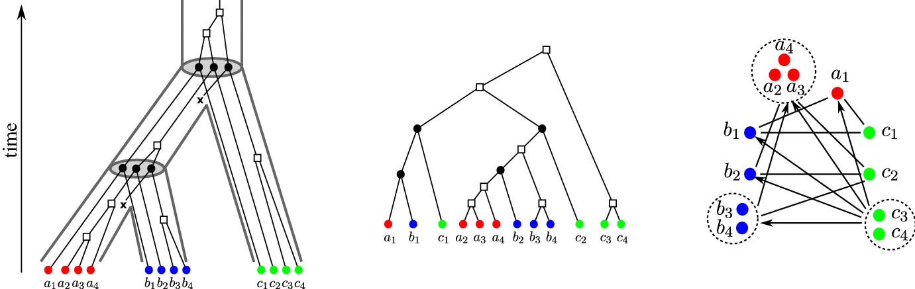
How do we get a best match graph?
We’ll start with a gene tree (right), which was generated through an evolutionary scenario (left). The tree T is leaf-colored: leaves are genes, colors are species S. The leaf set L has a surjective map.
Formally:
Best match:
Evolutionary
scenario
Gene
Tree
Notes:
An evolutionary scenario (left) consists of a gene tree whose inner vertices are marked by the event type ( for speciations, for gene duplications, and for gene loss) together with its embedding into a species tree (drawn as tube-like outline). All events are placed on a time axis. The middle panel shows the observable part of the gene tree ; it is obtained from the gene tree in the full evolutionary scenario by removing all leaves marked as loss events and suppression of all resulting degree two vertices

Slide 7
How do we get a best match graph?
Best match:
Best match graph only contains the leaf nodes!
Evolutionary
scenario
Gene
Tree
Best Match
Graph
Notes:
The r.h.s. panel shows the colored best match graph that is explained by . Directed arcs indicate the best match relation . Bi-directional best matches ( and ) are drawn as solid lines without arrow heads instead of pairs of arrows. Dotted circles collect sets of leaves that have the same in- and out-neighborhood. The corresponding arcs are shown only once

Slide 8
Aim of the paper
Normally, we don’t know the gene tree, but create best matches in order to detect orthologs. Aim: improve ortholog detection.
Question: Is it possible that this best match graph derived from a tree?
Evolutionary
scenario
Gene
Tree
Best Match
Graph
Notes:
If it didn’t derive from a tree, this indicates that we might have some paralougs in our sample, as a phylogenetic tree (ignoring duplication events) could not produce this best match graph

Slide 9
Coloured Best Match Graphs
The colored best match graph (cBMG) G(T,σ) has vertex set L and arcs xy∈ E(G) if x≠y and x→y. Each vertex x∈ L obtains color σ(x).
The rooted tree T explains the vertex-colored graph G(T,σ) if G(T,σ) is isomorphic to the cBMG of that tree.
Gene
Tree
Best Match
Graph

Slide 10
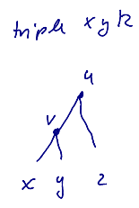
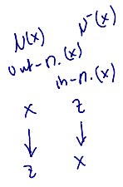
A few notations
Triple: a binary tree on three leaves.
We write xy|z
Out-neighborhood: N(x)={z|xz∈ E(G)}
In-neighborhood: N⁻(x)={z|zx∈ E(G)}

Slide 11
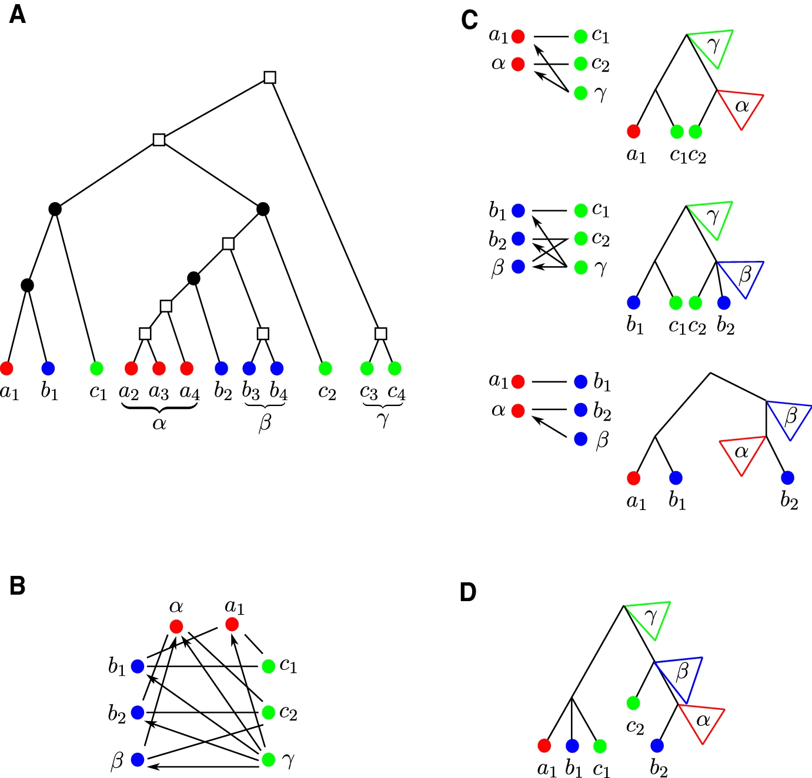
CBMGs Properties
Thinness: classes that share the same neighborhood
Two vertices x,y∈ L are in relation ⩪ if N(x)=N(y) and N⁻(x)=N⁻(y), and the out- and in-neighborhoods don’t contain vertices of the same color.
For each ⩪ class α, G[α] is edge-less.
Gene
Tree
Best Match
Graph
Notes:
Dotted circles collect sets of leaves that have the same in- and out-neighborhood.

Slide 12
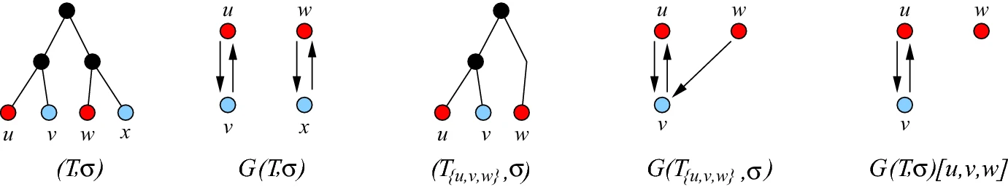
2-cBMGs
2 coloured BMGs are bipartite, since arcs in G(T,σ) connect only vertices with different colors.
A 2-cBMG is explained by restricting a subtree of T to two colors.
G is the edge-disjoint union of bipartite subgraphs corresponding to color pairs.
In order to understand when arbitrary graphs G(T,σ) are cBMGs, it is sufficient to characterize 2-cBMGs.

Slide 13
Least resolved trees
A unique “smallest” tree among all trees that explain the same 2-cBMG.
The least resolved tree is obtained by contraction of all redundant edges in an arbitrary tree (T,σ) that explains (G,σ).
An interior edge e in (T,σ) is redundant if (Te,σ) (tree without the edge) also explains G(T,σ).
2-cBMGs
Least resolved trees

