Slide 1
Objective 1a
Check whether every best match is also a weak best match: Formal Argument
$∀x∈L\left(N\right)∧τ∈σ\left(L\left(N\right)\right)∖\left\{σ\left(x\right)\right\}$
$Q\left(x,τ\right)=\min_{≼}\left\{v∈lca\left(x,y\right):σ\left(y\right)=τ\right\}$
Weak Best Matches:
$∀x,y∈L\left(N\right),σ\left(y\right)≠σ\left(x\right):lca\left(x,y\right)∩Q\left(x,σ\left(y\right)\right)≠∅$
Strict Best Matches:
$∀x,y∈L\left(N\right),σ\left(y\right)≠σ\left(x\right):lca\left(x,y\right)⊆Q\left(x,σ\left(y\right)\right)$

Slide 2
Objective 3
recommendation for further improvements/modifications
Insert heatmap here
Notes:
Insert heatmap here

Slide 3
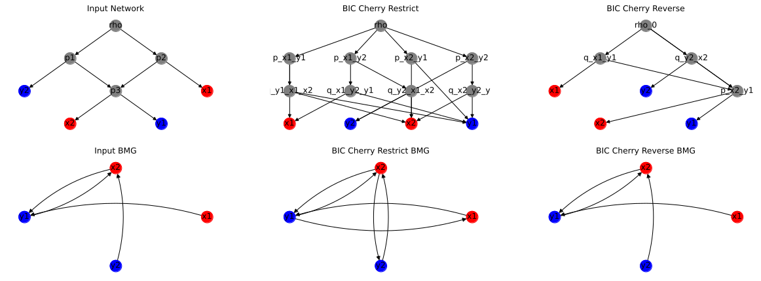
Objective 3
recommendation for further improvements/modifications

Slide 4
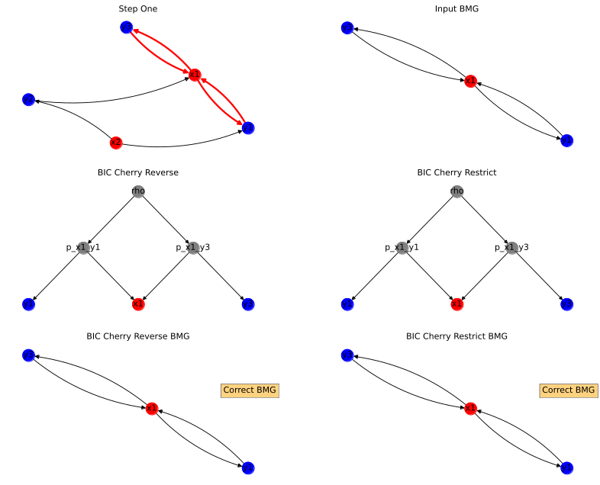
Objective 3
Reverse Bic Cherry explained

Slide 5
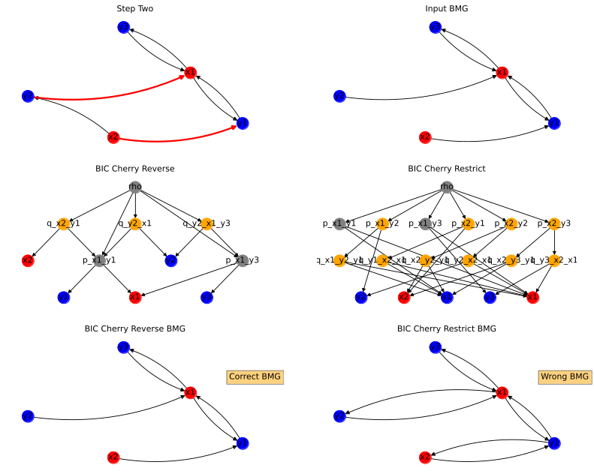
Objective 3
Reverse Bic Cherry explained

Slide 6
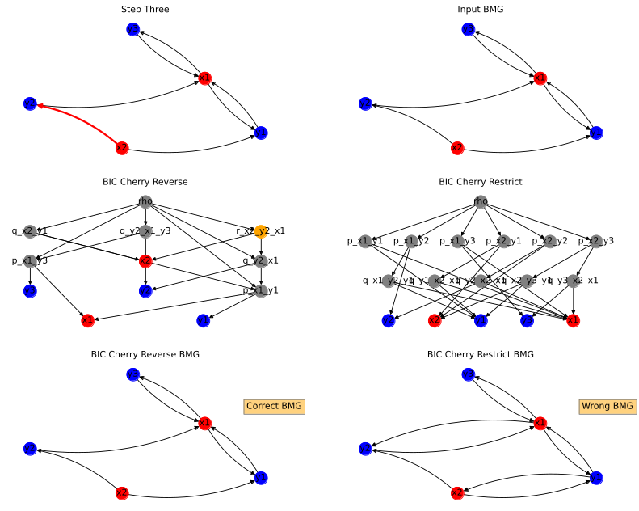
Objective 3
Reverse Bic Cherry explained

Slide 7
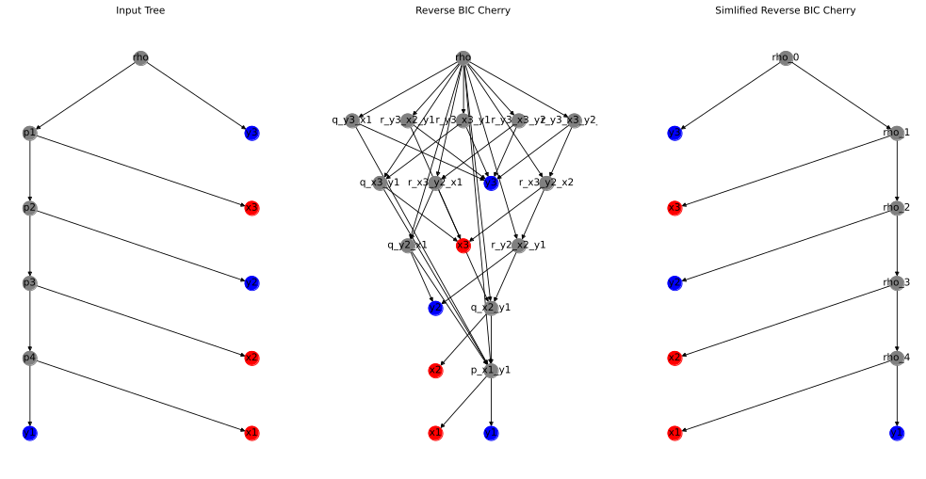
Objective 3
Reverse Bic Cherry simplified explained

Slide 8
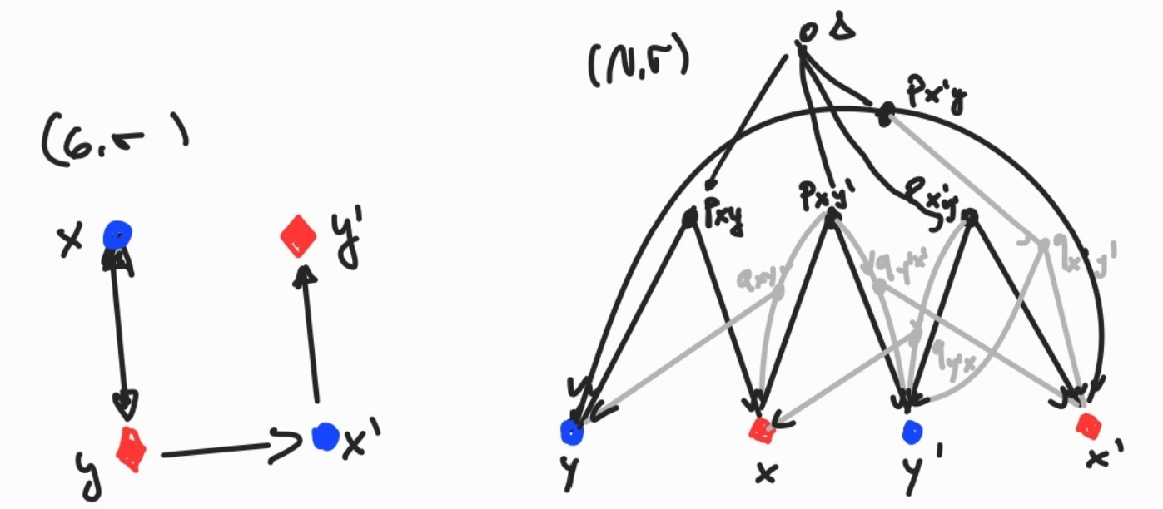
Objective 3
Non-BMGs can not be used to generate the correct networks

Slide 9
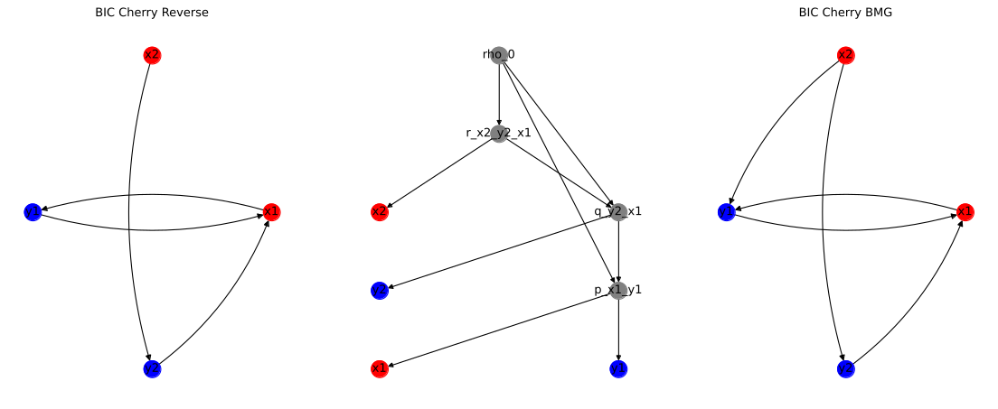
Objective 3
Non-BMGs can not be used to generate the correct networks

Slide 10
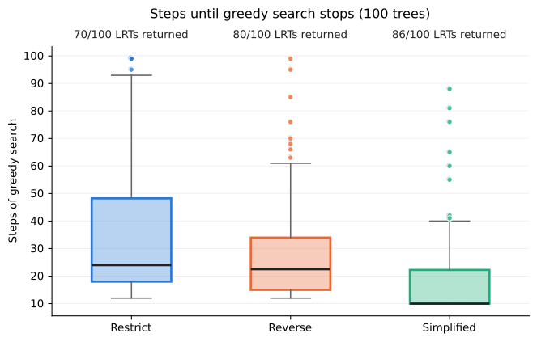
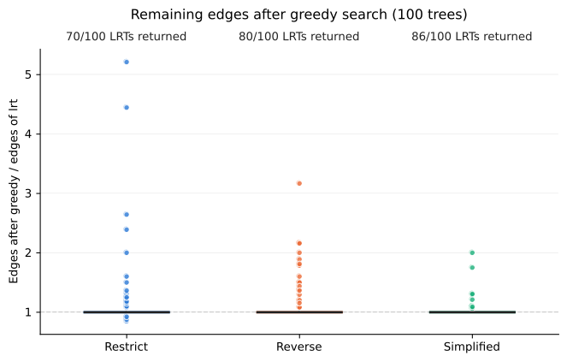
Objective 3
Performance check on Trees

Slide 11
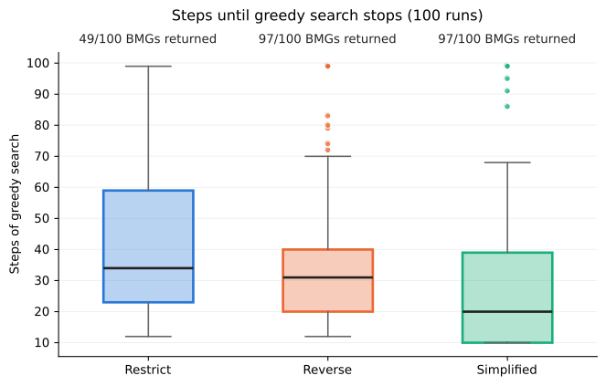
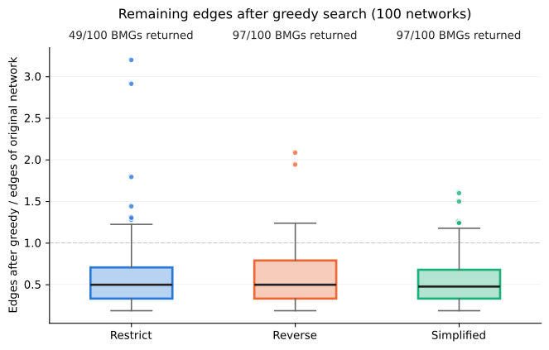
Objective 3
Performance check on Networks

