Slide 1
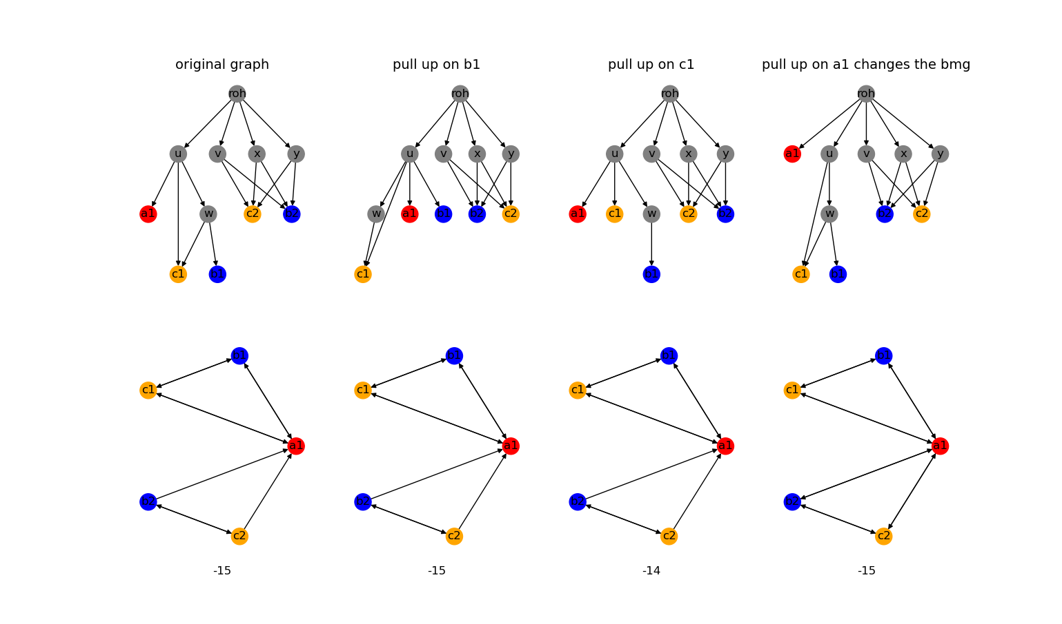
Pulling up

Slide 2
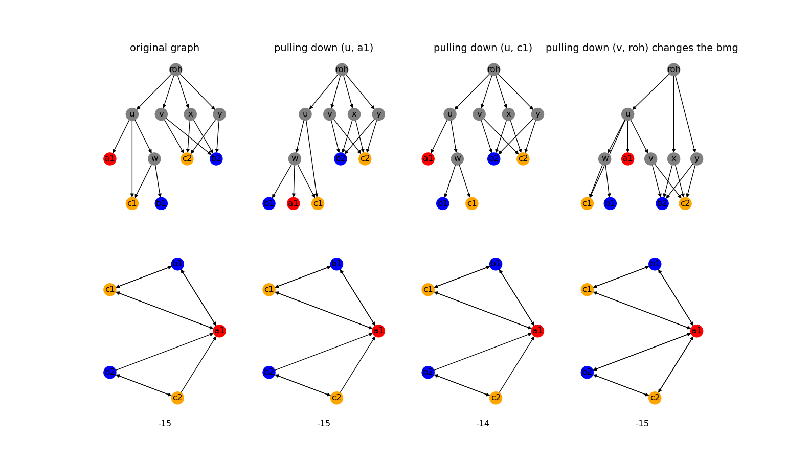
Pulling down

Slide 3
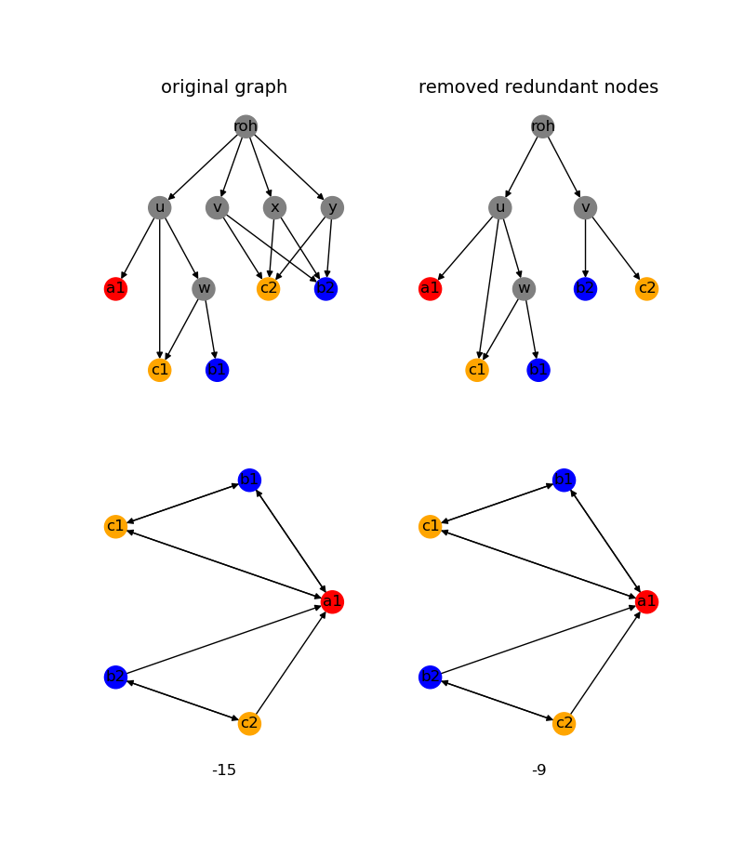
Remove redundant nodes

Slide 4
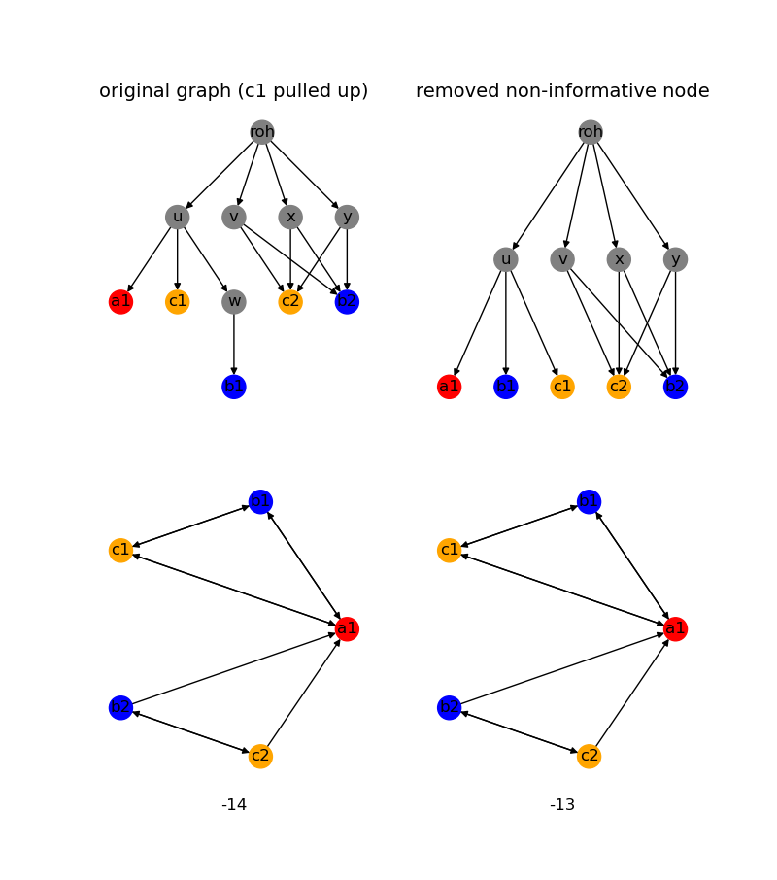
Remove non-informative nodes

Slide 5
Measuring tree likeness
Reticulation: |E| - |V| + 1
Number of edges: |E|
Effective Resistance

Slide 6
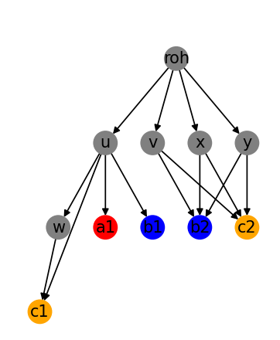
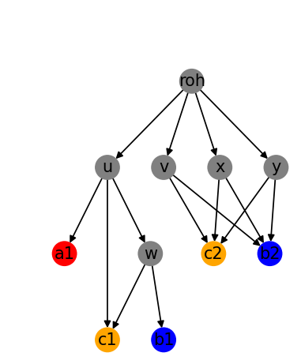
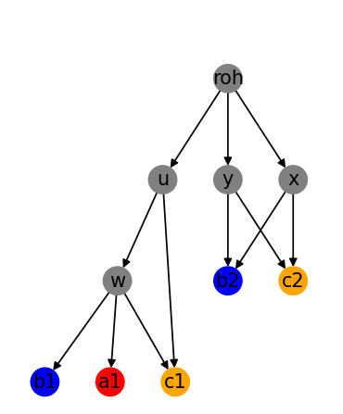
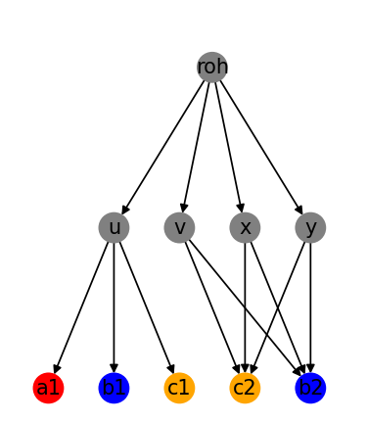
1st idea: Beam search
n editing operations
}
...
Select the best (in terms of tree likeness) m networks having the same BMG and repeat
n editing operations
n editing operations
Even with n = m = 1 on moderately sized graphs this took way too long
n editing operations

Slide 7
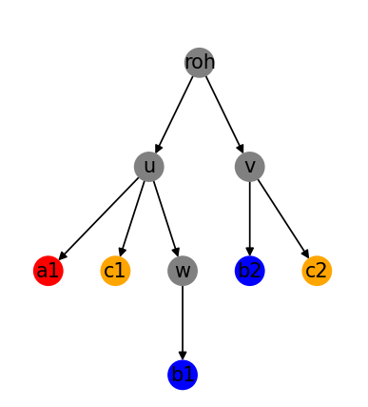
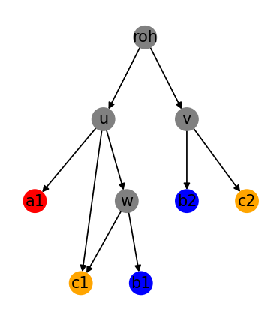
Solution: greedy search
Accept changes and repeat
Yes
Pull up or
Pull down
Is the tree likeness higher and does the BMG stay consistent?
Remove redundant nodes, remove non-informative nodes
No: revert operation and try a different operation

Slide 8
Solution: greedy search
ADD PSEUDOCODE

Slide 9
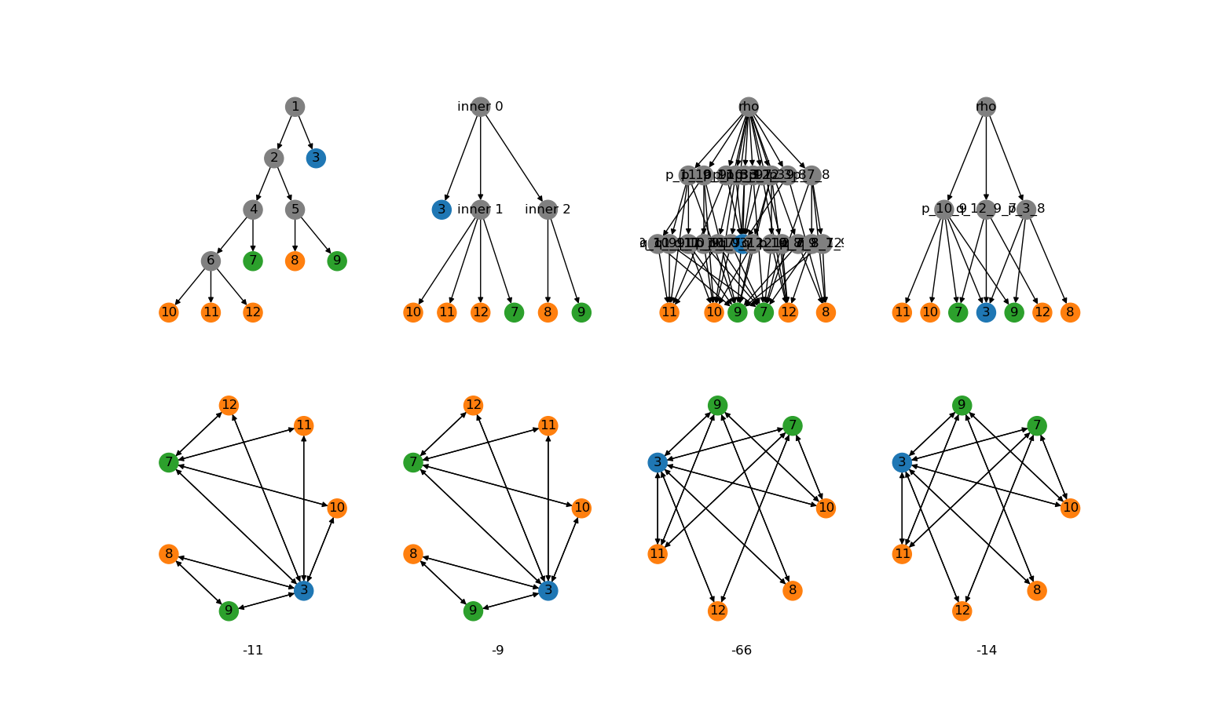
Thinness

Slide 10
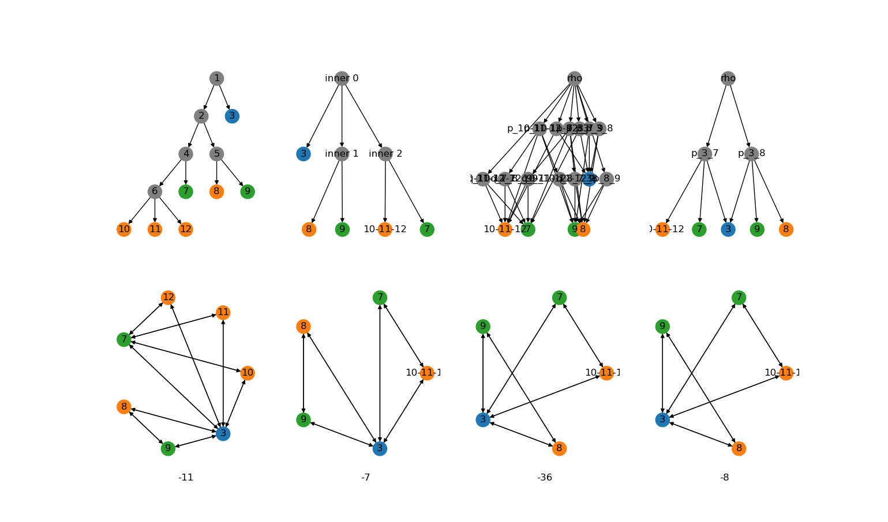
Thinness
Pick a node n
If in-degree(n) >= 2:
Pick two parents p1, p2
Pick one of their lcas
Connect n to lca
disconnect p1 from n
disconnect p2 from n
Original BMG:
Thinness classes BMG:
Thinness classes BMG:
Thinness classes BMG:

Slide 11
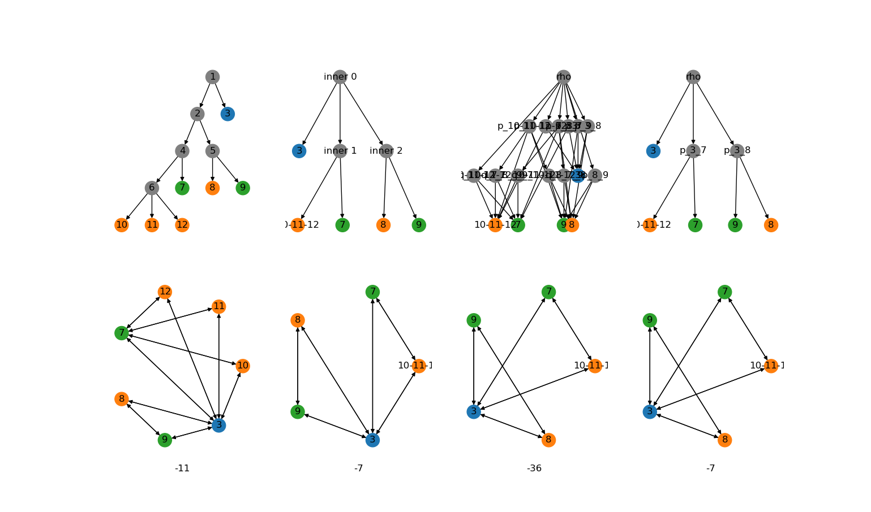
Removed diamonds

Slide 12
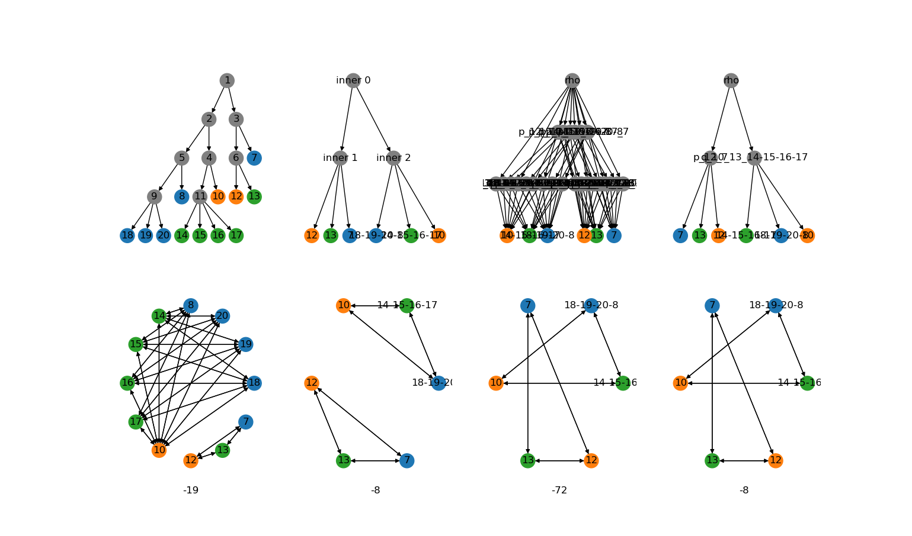
Heuristic working

