Slide 1
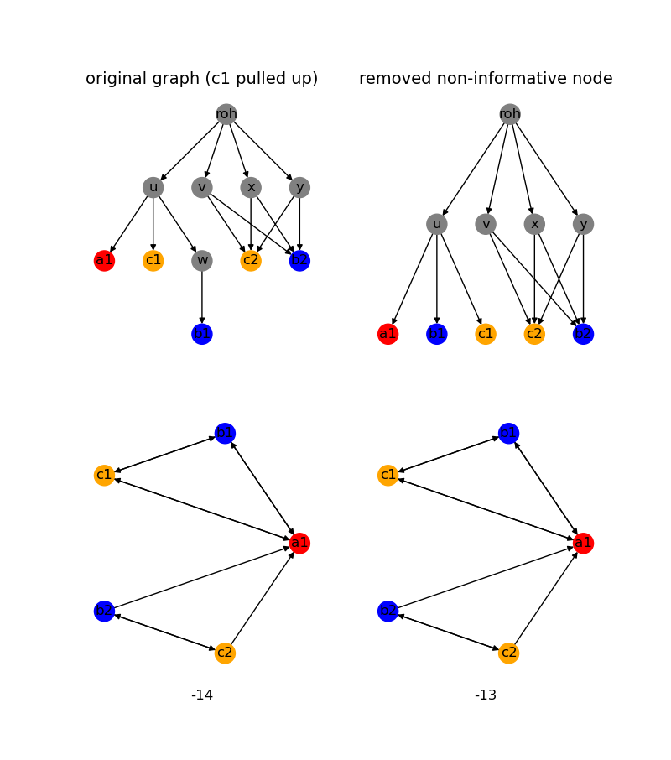
Editing operations
- Pulling up
- Pulling down
- Removing redundant nodes (nodes with the same parents and children)
- Removing non-informative nodes

Slide 2
Measuring tree likeness
Negative Reticulation: -(|E| - |V| + 1)
Negative Number of edges: -|E|
Effective Resistance

Slide 3
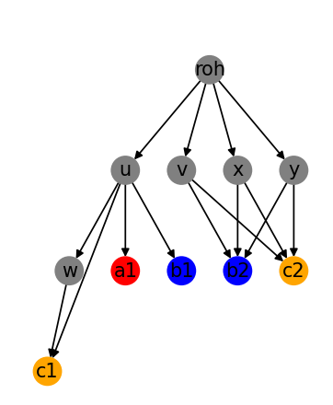
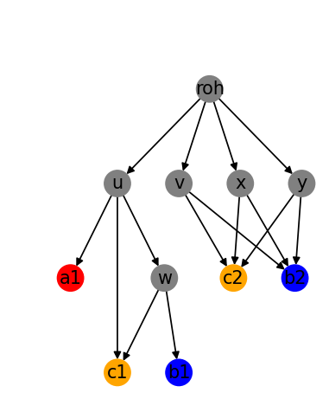
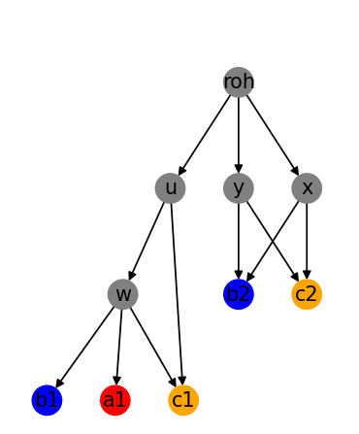
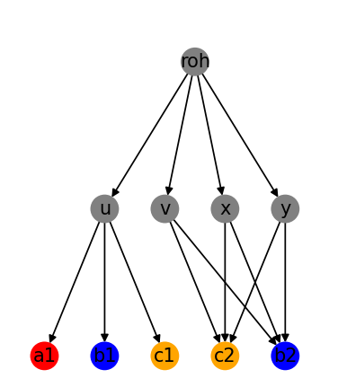
1st idea: Beam search
n editing operations
}
...
Select the best (in terms of tree likeness) m networks having the same BMG and repeat
n editing operations
n editing operations
n editing operations

Slide 4
1st idea: Beam search
n editing operations
}
...
Select the best (in terms of tree likeness) m networks having the same BMG and repeat
n editing operations
n editing operations
Even with n = m = 1 on moderately sized graphs this took way too long
n editing operations

Slide 5
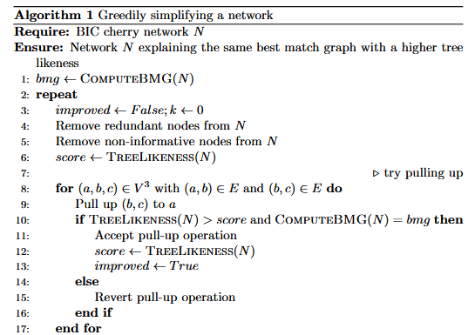
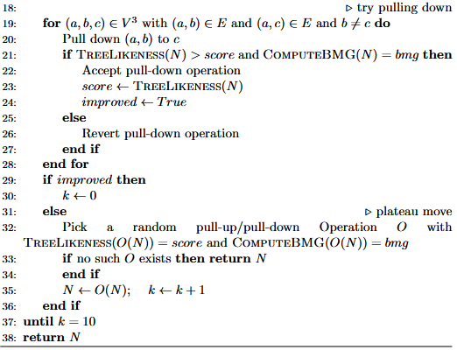
Solution: greedy search

Slide 6
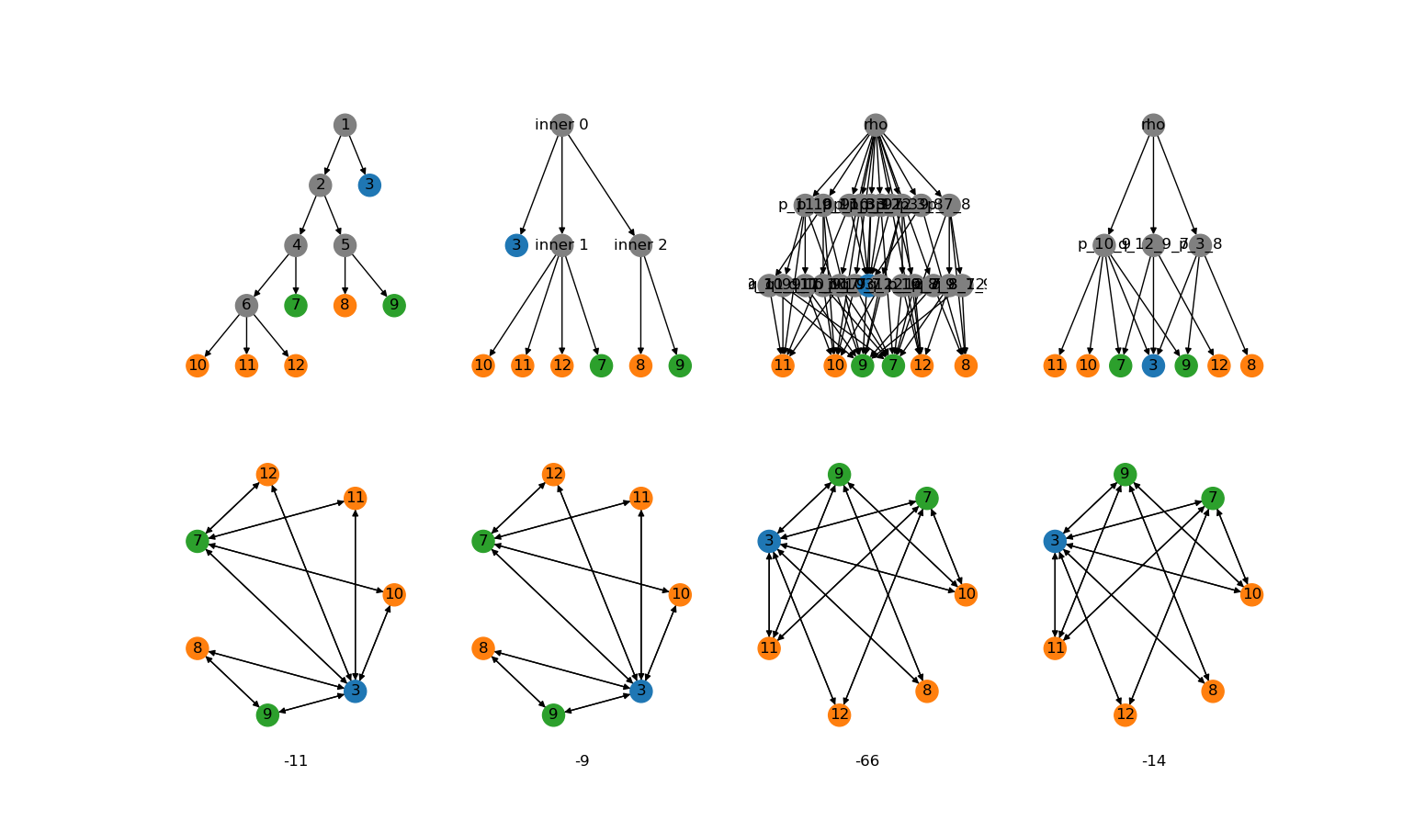
Thinness

Slide 7
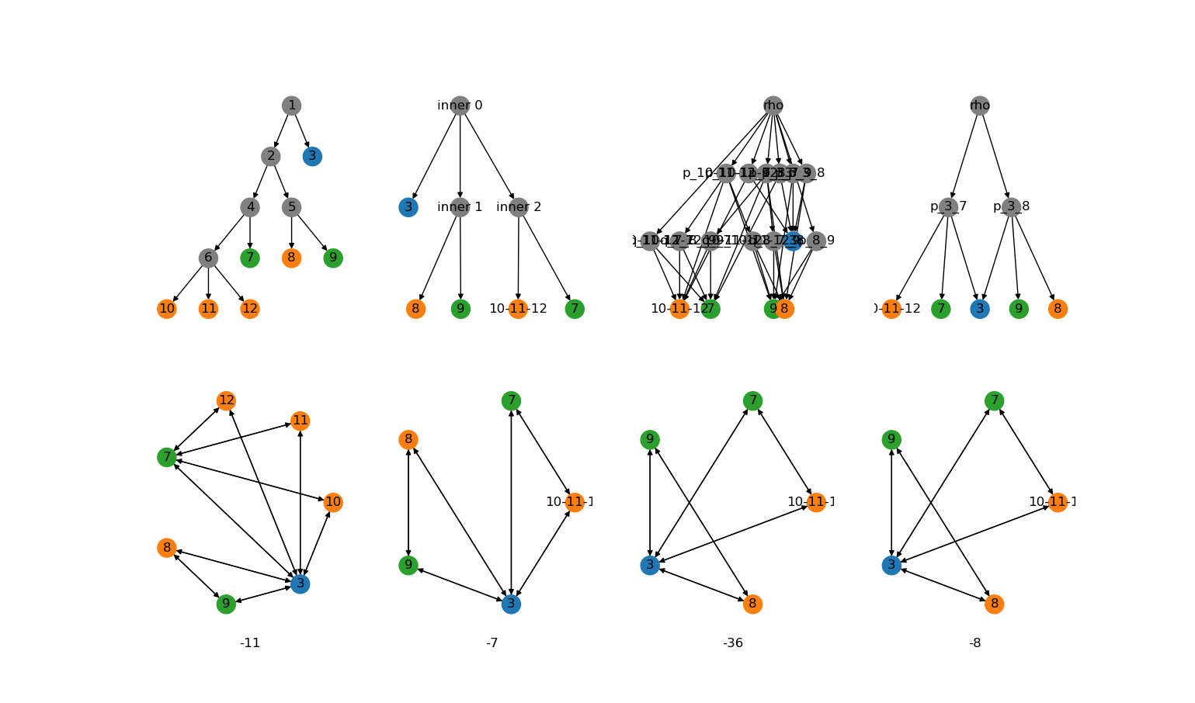
Thinness
Original BMG:
Thinness classes BMG:
Thinness classes BMG:
Thinness classes BMG:

Slide 8
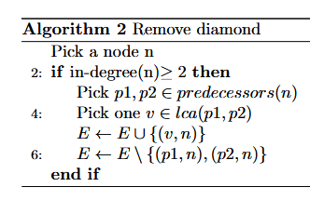
Removing diamonds
Original BMG:
Thinness classes BMG:
Thinness classes BMG:
Thinness classes BMG:

Slide 9
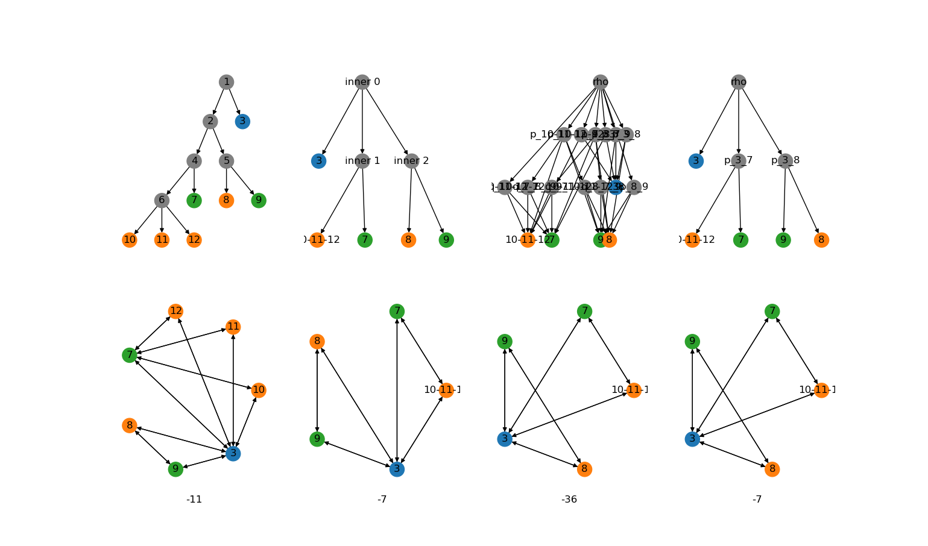
Removed diamonds

Slide 10
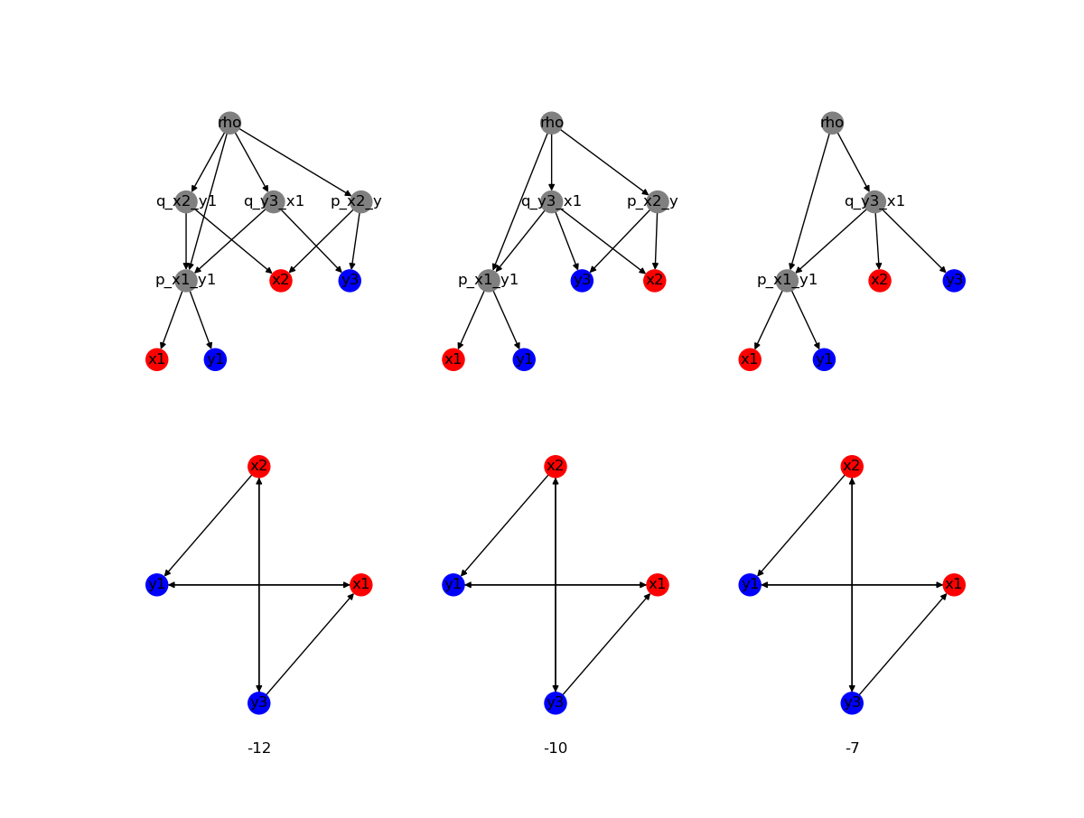
Combining nodes

Slide 11
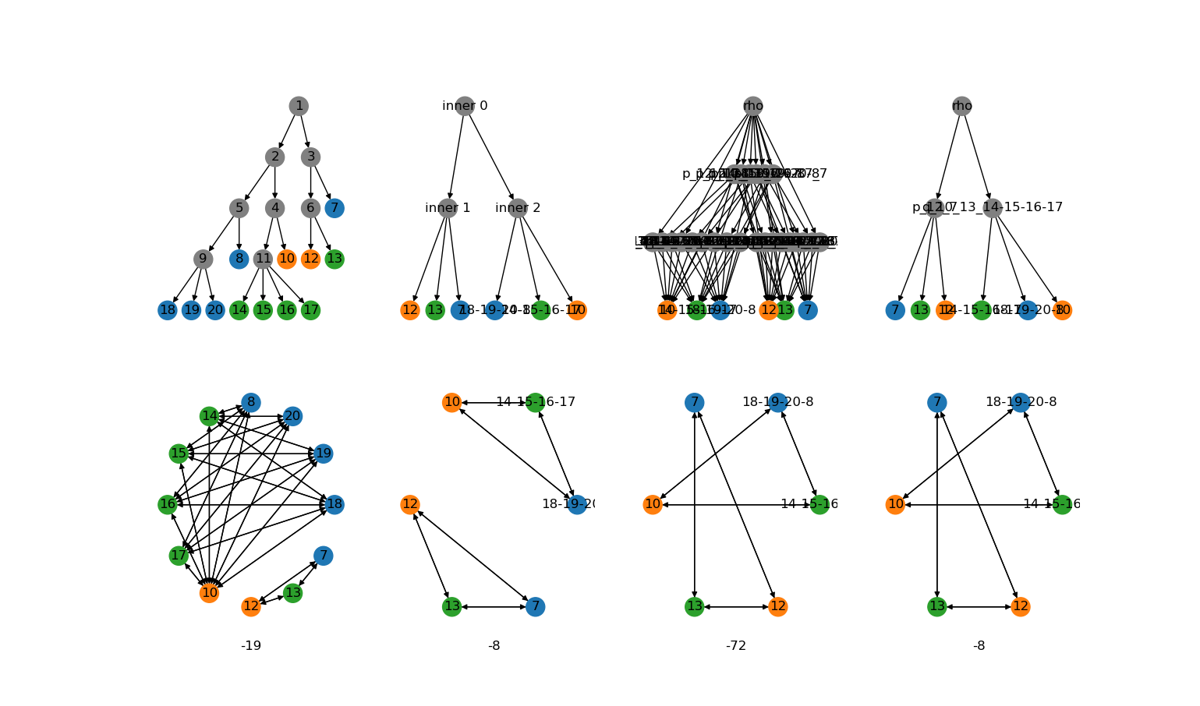
Heuristic working

Slide 12
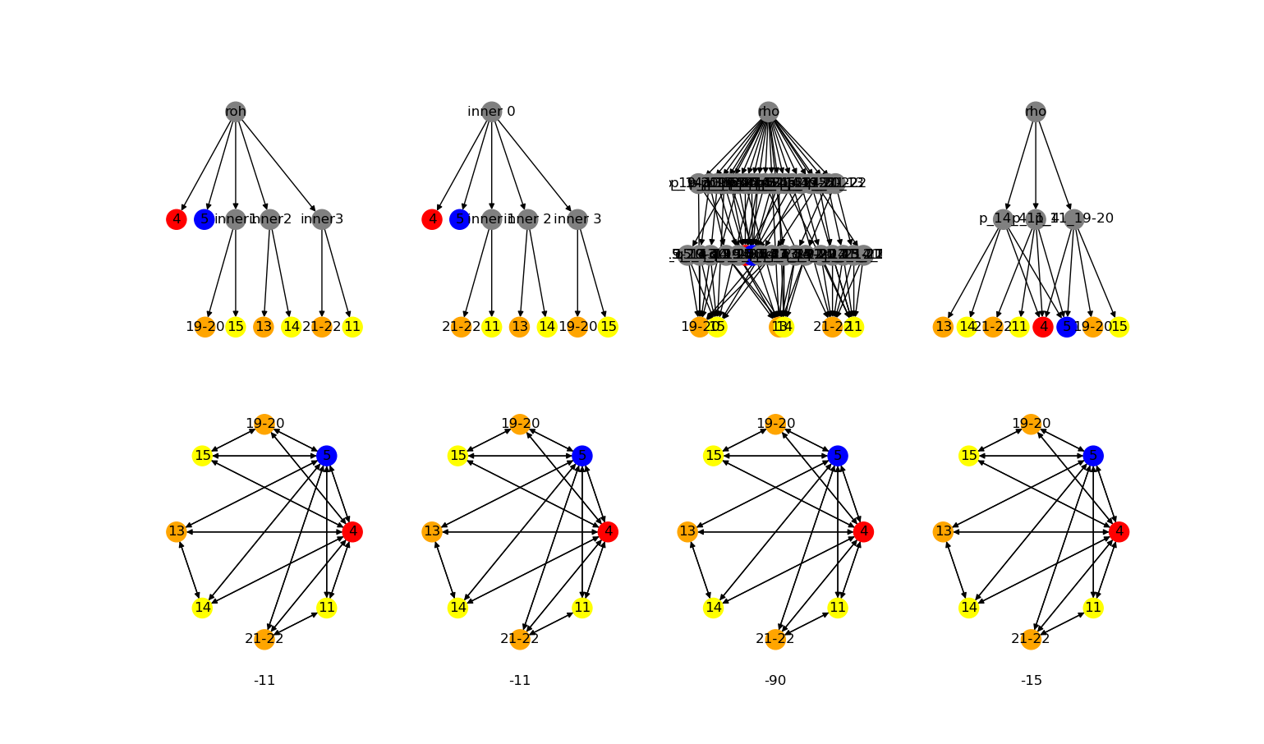
Heuristic not working
Solution: Solve Diamonds for more than two parents

Slide 13
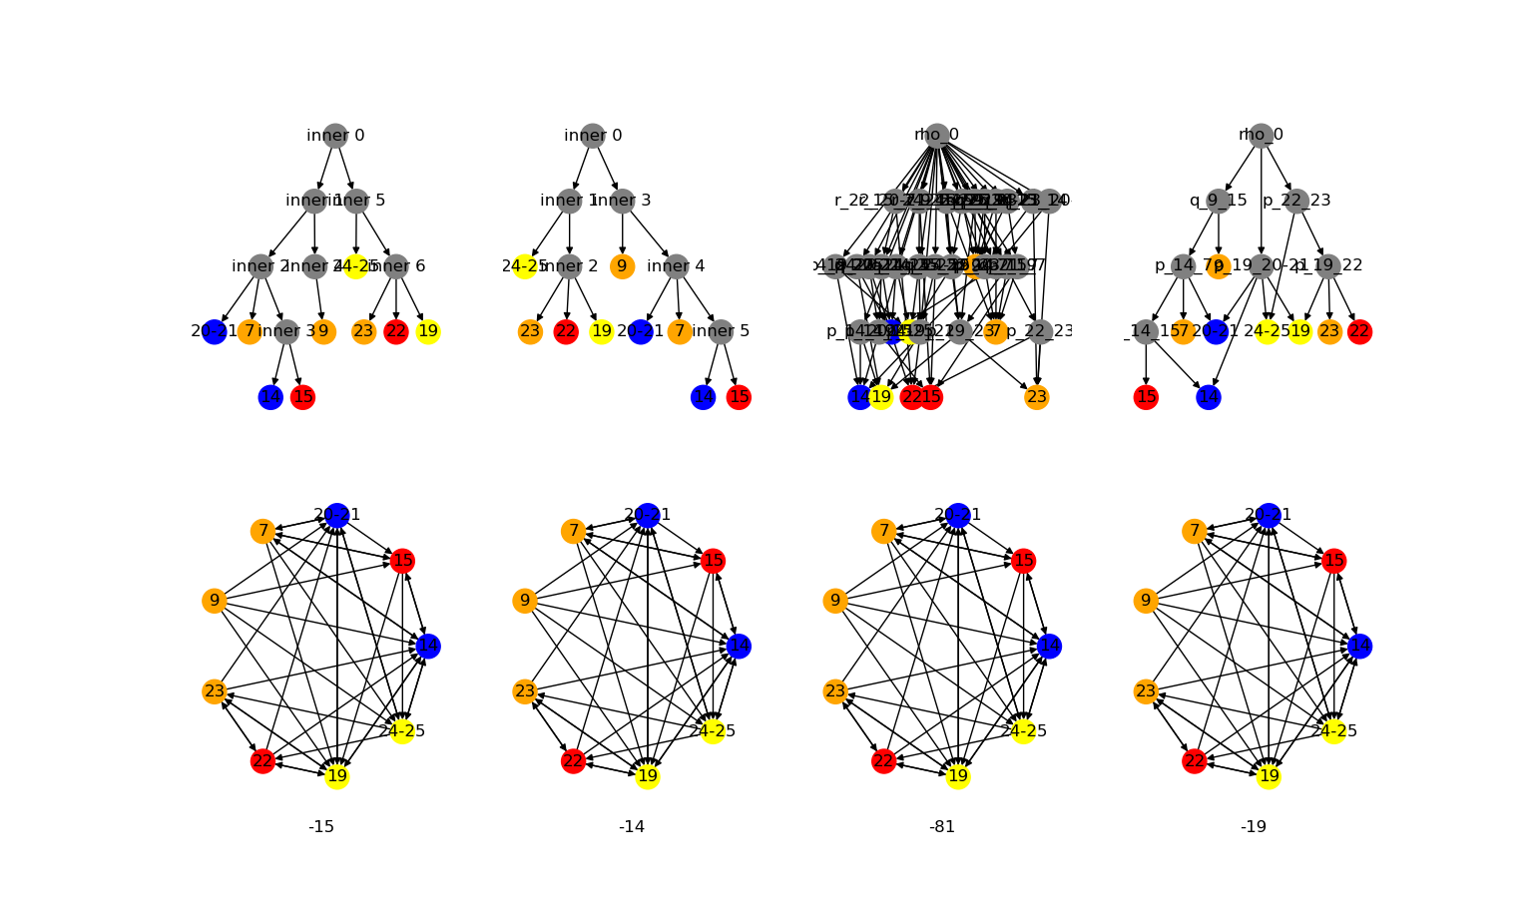
Heuristic not working
Solution: Remove nodes
General solution: Allow more than one operation at a time

Slide 14
Appendix

Slide 15
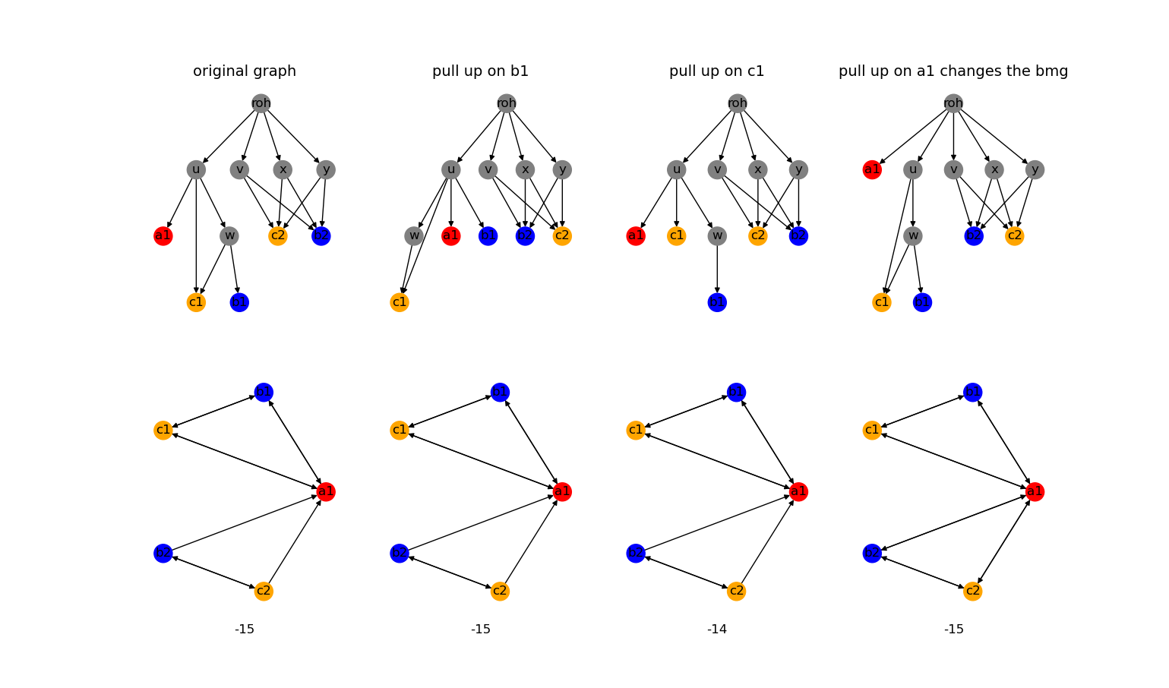
Pulling up

Slide 16
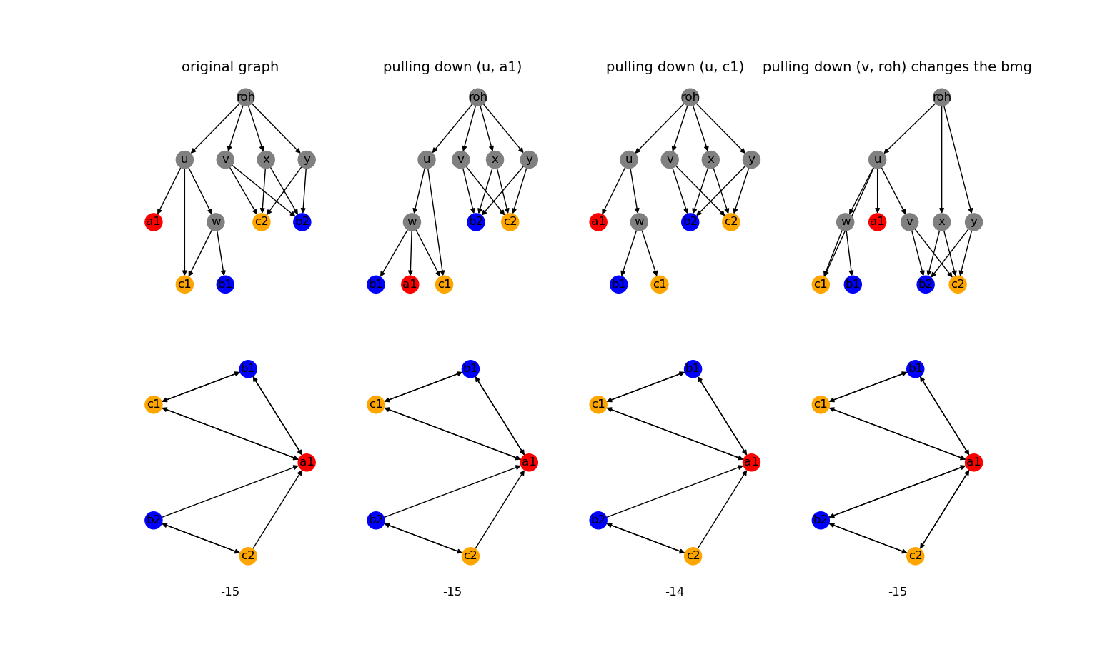
Pulling down

Slide 17
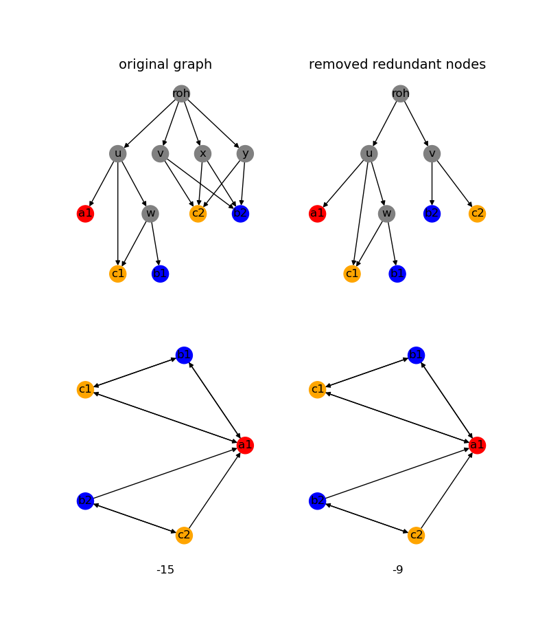
Remove redundant nodes

Slide 18
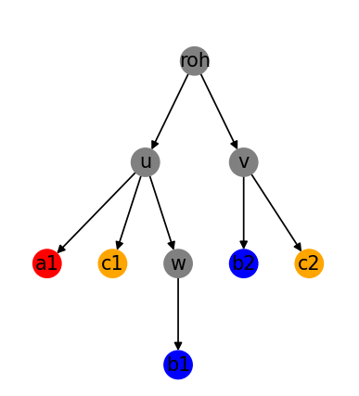
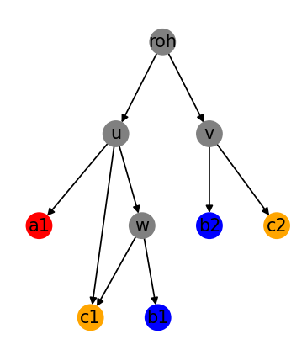
Solution: greedy search
Accept changes and repeat
Yes
Pull up or
Pull down
Is the tree likeness higher and does the BMG stay consistent?
Remove redundant nodes, remove non-informative nodes
No: revert operation and try a different operation

