Slide 1
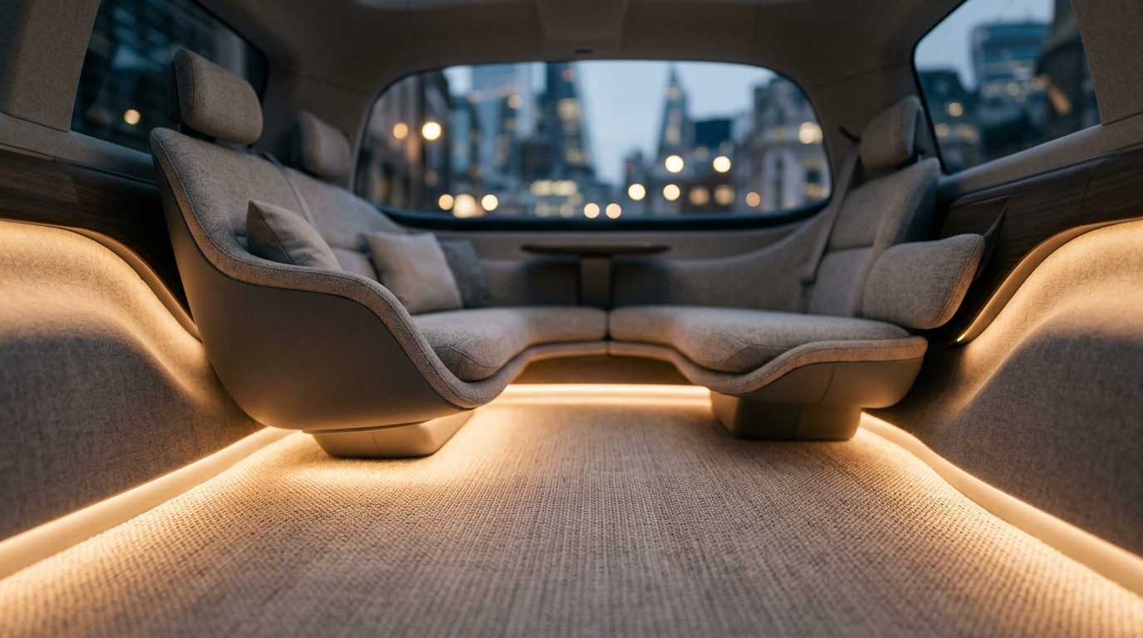
The magic carpet
A luxury floor for premium ride services - warm, quiet, designed, and it swaps in seconds
Aladdin and the Magic Carpet - Team 4 · Autoneum Challenge 2026 - Final · 2026-09-11
Notes:
We are Aladdin and the Magic Carpet. Our carpet is a floor for the premium end of the robotaxi market - the Uber Black class - and its trick is that it comes out of the car in three seconds. Let us start at the end of a working day.

Slide 2
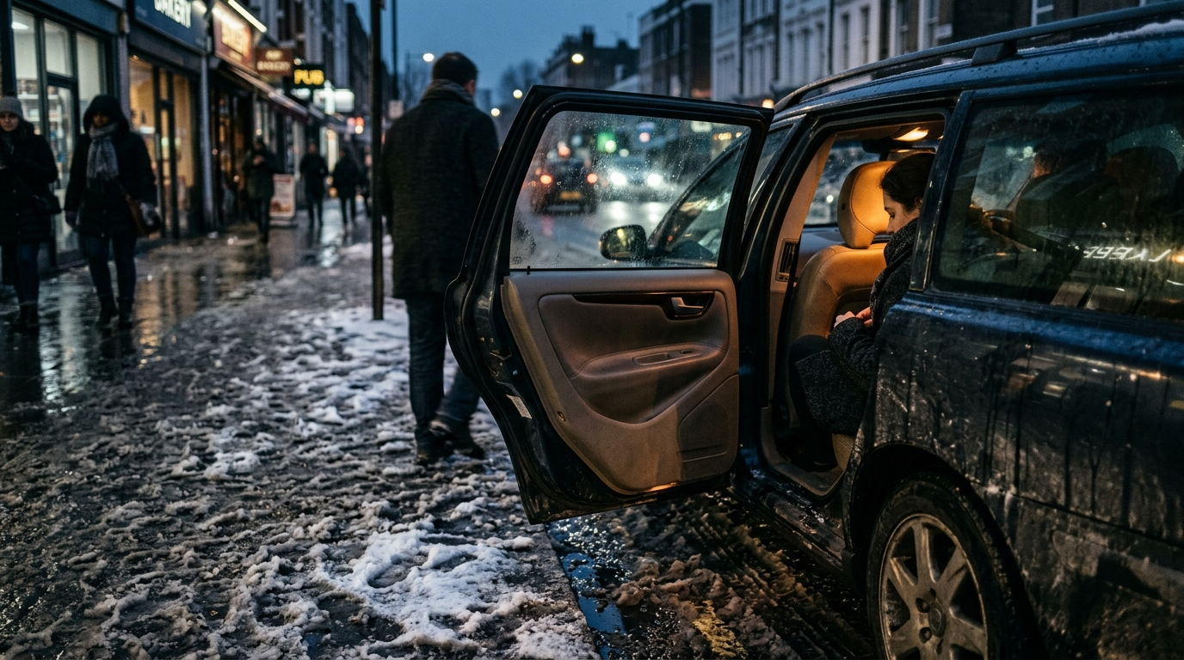
Six in the evening, slush outside: the fare steps into a cabin that is already warm underfoot
Nobody scrubbed it. The mat that earned all day just went back to the depot for a clean one.
The magic carpet
2/15
Notes:
Picture it. Winter, six in the evening, slush on the pavement. A premium robotaxi pulls up - the Uber Black of 2035. The fare opens the door and steps out of the cold onto a floor that is warm underfoot, into a cabin that is quiet, that looks like it was designed for him. This car has been working since five in the morning. Nobody has scrubbed anything. Hold that picture - we come back to it.

Slide 3
By 2035 the premium robotaxi is a luxury cabin that works sixteen hours a day
USE CASE - THE TARGET
Premium ride services
Uber Black class fleets. The fare pays for a warm, beautiful cabin - most on long journeys.
SEGMENT
C/D-segment BEV, Level 4
Europe and Switzerland. Autoneum's largest market, 46 % of revenue.
AND A BONUS
The private owner
Swaps in a cheap mat when his car works as a taxi. More on him at the end.
Source: Goldman Sachs, Robotaxis to become a $400 bn market in 2035 (Apr 2026); Autoneum FY2025 revenue release (Jan 2026)
The magic carpet
3/15
Notes:
Our customer is the premium ride service - the Uber Black class, run by big operators. That class is being built right now: Uber is putting twenty thousand Lucid Gravity, a luxury SUV, on its platform from 2026, and Waymo's own car is a seventy-thousand-dollar Jaguar. Six million robotaxis by 2035, and Europe is Autoneum's largest market. The private owner who rents his car out is a bonus of the same idea - we park him until the end.

Slide 4
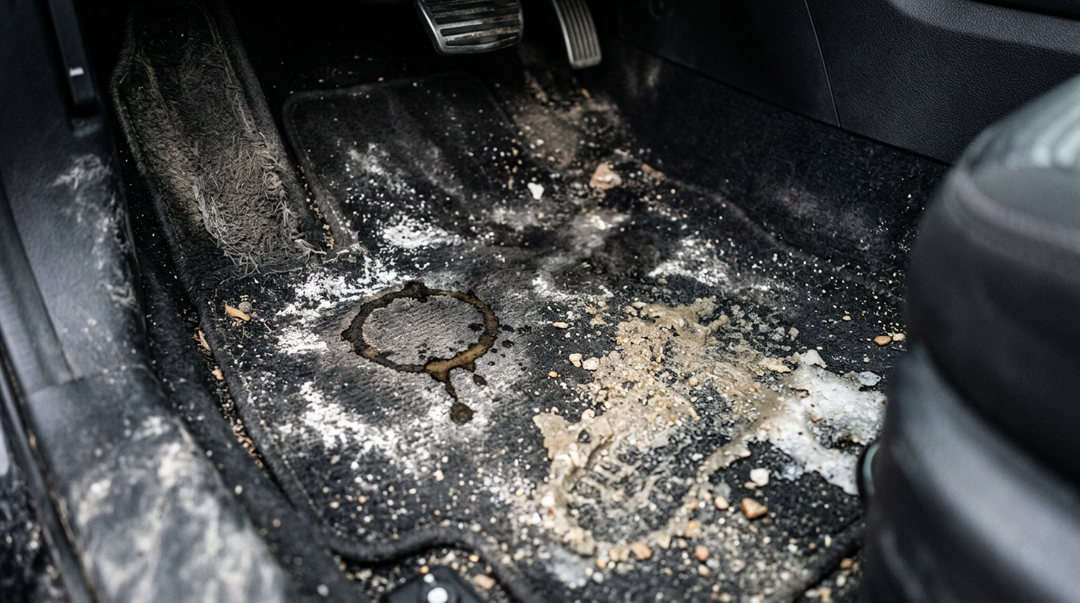
This is what twenty strangers a day leave behind
A private car carries 2-4 people a day. A Waymo does 20+ paid rides - and a premium fare rates what he sees.
Source: Waymo, ~500,000 paid rides a week on ~3,000-3,700 vehicles (TechCrunch, CNBC, Dec 2025 - Mar 2026)
The magic carpet
4/15
Notes:
Salt, sand, a coffee ring, flattened fibres. Waymo runs half a million paid rides a week on three to four thousand cars - twenty-plus rides per car per day, each one a stranger, and nobody supervises a driverless cabin. For a premium service this is not a nuisance, it is the product failing: the fare who paid extra rates what he sees when the door opens.

Slide 5
Cleaning is the one thing a robotaxi cannot do while earning
A BASIC INTERIOR CLEAN
30-60 min
heavy soiling doubles or triples it
PER CLEAN
USD 60-150
routine, up to 500 when bad
FOR THE OPERATOR
= downtime
it earns only while carrying people
Source: Consumer detailing trade estimates, 2025 (not an automotive study); press reporting on Waymo fleet handlers
The magic carpet
5/15
Notes:
Thirty to sixty minutes for a basic interior clean, two to three times that when it is bad. Detailing-trade figures, not an automotive study - we say so. But the money is not the cleaning bill, it is the hour the car spends earning nothing. For a fleet, uptime is the whole product. And the private owner has it worse: no depot, no crew, his garage on a Sunday - and his own car, that strangers have been in all week.

Slide 6
LEARNING FROM ANOTHER INDUSTRY
A luxury hotel never cleans the mattress
It changes the layer above it. Each layer has one job, and the one that touches the guest is replaced every time.
The magic carpet
6/15
Notes:
Hotels do not deep-clean a room between guests. They change the contact layer - protector, sheet, duvet cover. The expensive core underneath is protected and almost never washed, and that is why housekeeping is measured in minutes. That is the whole idea, applied to a car floor: stop cleaning the car. Change the layer that got dirty.

Slide 7
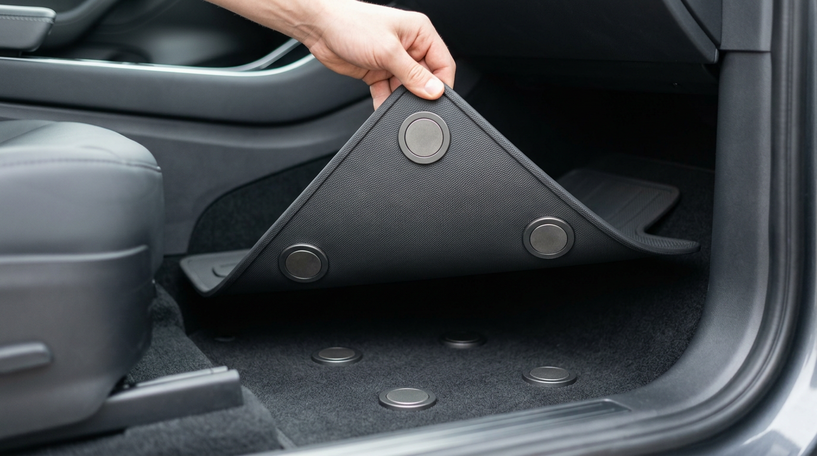
So the mat comes out at the depot, and the cleaning happens somewhere else
The mat becomes a part the depot swaps - the car never waits for a cleaner.
Wipe-clean skin, mono-material PET
No fibres to hold dirt
Magnetic dock, no visible fasteners
Out in seconds, no tools
Cleaned off the vehicle
The car goes back out, the mat is washed
The magic carpet
7/15
Notes:
This is it. Watch the corner. Four magnets hold it, they centre it, nothing is screwed or clipped, nothing corrodes. It lifts out in seconds and the cleaning happens away from the car - the car leaves the depot with a fresh mat while the dirty one is washed. For a fleet that is the difference between a car that earns and a car that waits.

Slide 8
THE HARDER PROBLEM
But a floor you can wipe is a floor you can hear
Quiet needs an open, porous surface. Clean wants a closed one. Today you pick one.
The magic carpet
8/15
Notes:
Here the idea nearly died. A quiet floor has to be open and porous so sound gets in and is absorbed. A clean floor wants to be closed, so nothing gets in - and a closed surface reflects every bit of road noise back at you. Today you choose: a carpet that absorbs and stains, or a rubber mat that wipes and is loud. In an electric robotaxi without engine noise that is worse, because road and wind are all that is left.

Slide 9
Autoneum has already solved all of it, just never in the same part
We need | Autoneum has | Where it sits
Washable floor | Washable surface flooring | Trucks (Borgers, 2023)
Wipeable yet acoustic | Alpha-Liner | Wheelhouse, outside
Absorb through a closed skin | RIMIC micro-perforation | Heatshields
Cleanability metric | Cleanability Analyzer | Internal lab
Heating layer | (Heated) Floor mats | Trucks
Source: Autoneum Challenge deck, 7 Sep 2026, slides 6-7; Autoneum product brochure 2021; Autoneum press release on Borgers, Apr 2023
The magic carpet
9/15
Notes:
Every ingredient exists inside Autoneum today. Washable surface flooring is a truck product that came in with Borgers in 2023. Alpha-Liner is a wheelhouse liner whose coating is tuned so the textile still absorbs while the surface wipes clean - our exact conflict, solved, on the outside of the car. RIMIC proves you can absorb through a closed skin. Autoneum even owns the measurement. None of these has been combined, and none has been offered in a passenger car.

Slide 10
One dock, three tiers - we build the top one, the others fall out of it
Tier 3 is the product for premium fleets. Tiers 1 and 2 are the same dock with less on it.
1 - SHORT DISTANCE
Swap and wipe
Out in seconds, cleaned off the vehicle.
2 - MEDIUM DISTANCE
Quiet and premium
Perforated skin over the absorber. And it looks designed.
3 - LONG DISTANCE
Warm
Heating tracks under the skin. Feel at home.
The magic carpet
10/15
Notes:
The product line, on the distance axis of the trend matrix we were shown - but read it from the top. Tier three is what we build for premium fleets: warm, quiet, designed. Take the heating out and you have tier two for a mid-market ride. Take the acoustics out and you have tier one for the city shuttle. One dock carries all three, so the premium product funds a platform that the volume end can buy into later. The margin is at the top; that is where we start.

Slide 11
Luxury already heats its surfaces and sells the mat as a signature
S-Class heated armrests. Rolls-Royce lambswool mats. Never on a swappable floor.
UBER X LUCID X NURO
20,000
luxury-SUV robotaxis from 2026
WAYMO'S BASE CAR
USD 70,000
a Jaguar, since 2018
RIDERS PAY
+13-40 %
Waymo over Uber, 2025-26
Source: Lucid / Uber / Nuro, Jul 2025; Waymo Blog 2018; Obi via TechCrunch, Jan 2026; Mercedes-Benz Warmth Comfort package; Rolls-Royce Boutique
The magic carpet
11/15
Notes:
Three facts that make tier three a business and not a wish. The premium robotaxi is being built: Uber is deploying twenty thousand Lucid Gravity, a luxury SUV, from 2026, and Waymo has run a seventy-thousand-dollar Jaguar since 2018. Riders pay for the experience: Obi measured Waymo thirty to forty percent above Uber in mid-2025, still thirteen percent above in early 2026. And luxury already heats surfaces - the S-Class warmth package heats armrests and door panels - and already treats the mat as a signature. We combine the two and make it swappable.

Slide 12
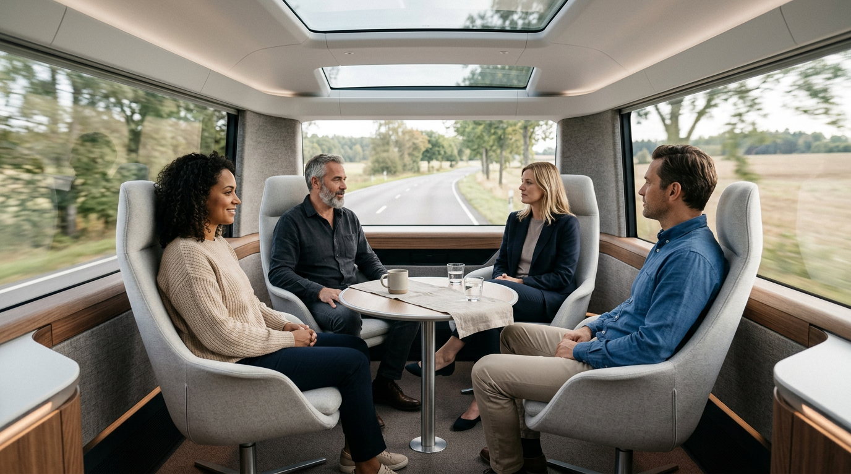
On a winter journey, warmth is the difference between arriving and charging
Around 200 W of radiant surface instead of 4,500 W of blown air. Winter otherwise costs an EV 20-40 % of its range.
Source: Applied Thermal Engineering 2024; Energy and Buildings 2026; AAA EV range test 2019 (-41 % at -7 C with heating); US DOE VTO 2024
The magic carpet
12/15
Notes:
This is where the luxury mat earns its price. Radiant surfaces give comfort at around two hundred watts where blown air needs four and a half kilowatts, and people feel neutral several degrees below the set air temperature. Winter otherwise costs an EV twenty to forty percent of its range - on a three-hour trip that is a charging stop. Be careful with the claim: it heats the person, not the cabin; the air stays for demisting. Volvo drew this journey years ago - a cabin that replaces the three-hundred-kilometre flight. Zurich to Geneva is two hundred and eighty.

Slide 13
SIX IN THE EVENING, AGAIN
Fifty warm cabins a day, and not one of them scrubbed inside the car
The luxury mat runs all week. At the depot it swaps for a clean one in seconds. That is what the fare pays for.
The magic carpet
13/15
Notes:
Now you know what you saw at the start. That cabin worked since five in the morning on a warm, quiet, designed floor - and when it came through the depot the mat came out and a clean one went in, in seconds, while the car kept moving. Fifty cabins a day like that, and not one of them scrubbed inside the car. That is what a premium fare pays for, and it is what the operator saves.

Slide 14
ONE MORE THING
The same dock lets a private owner play taxi on a cheap mat and drive home on his own
Luxury mat for himself, cheap mat for the shift. Thirty seconds between them.
The magic carpet
14/15
Notes:
And because it is a dock, the mat that goes back in does not have to be the same kind of mat. A private owner who rents his car out as a robotaxi keeps two: a cheap one that strangers stand on all week, and his own luxury one for Friday evening and the drive to the mountains. Same dock, thirty seconds. We did not design for him - he comes free with the platform.

Slide 15
What we ask the board for
— A pilot: one premium fleet, fifty docks, one winter
— Lab time on the Cleanability Analyzer and an impedance tube
— A decision to treat the dock as a platform, not the mat as a part
Sources: Autoneum challenge deck 2026, product brochure 2021, FY2025 release; Goldman Sachs 2026; Obi / TechCrunch 2026; Lucid-Uber-Nuro 2025; AAA 2019, US DOE 2024; Applied Thermal Engineering 2024, Energy and Buildings 2026. Full references in the presenter script.
Notes:
Three things. A pilot with one premium fleet - fifty docks, one winter - because the warm mat proves itself in December, not in a lab. Lab time on the instruments Autoneum already owns. And a decision about what this is: not a mat, a dock - a platform that starts at the luxury end and carries the rest of the market later. Thank you.

