Slide 1
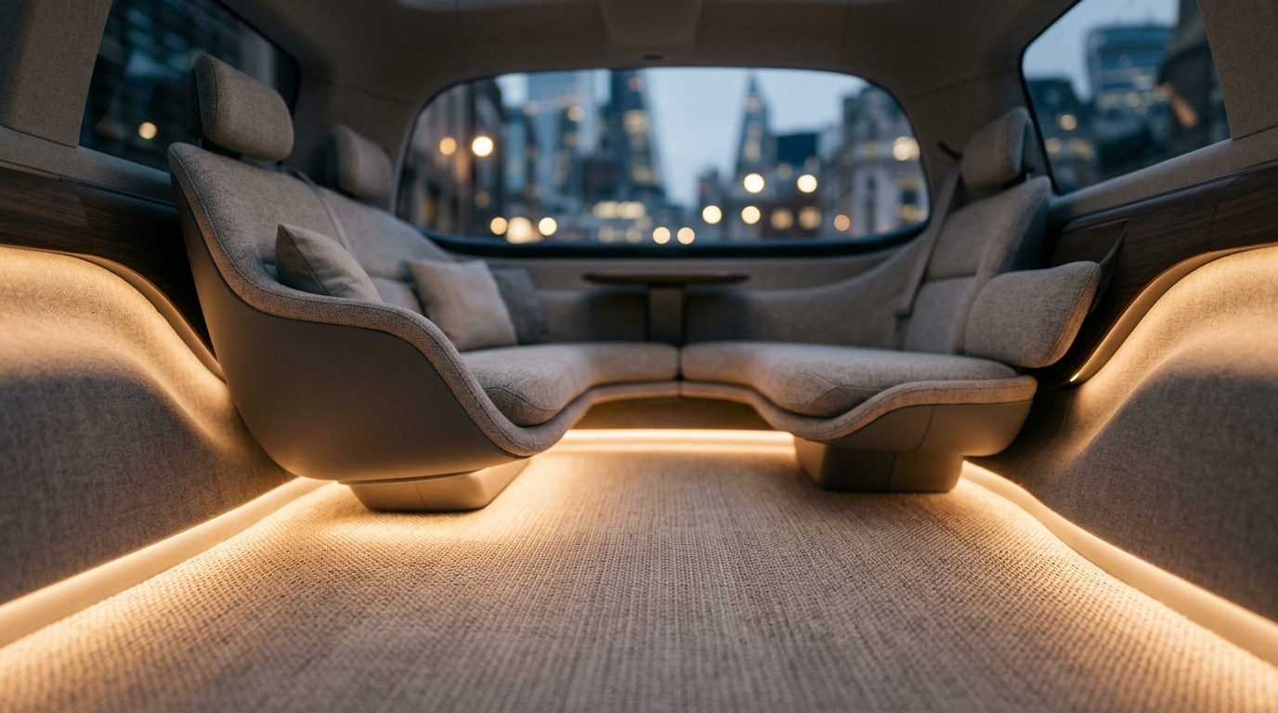
Swap, do not scrub
One dock, two mats - a cheap one for the shift, a luxury one for the journey
Aladdin and the Magic Carpet - Team 4 · Autoneum Challenge 2026 - Midterm · 2026-09-09
Notes:
We are Team 4. Our challenge is cabin comfort in a robotaxi, and we went
at the least glamorous part of it - the floor. It turns out to be the part
that decides whether a shared vehicle earns money or sits in a depot.

Slide 2
By 2035 one car serves two owners
USE CASE A
Private owner
His luxury mat. The cheap one goes in for taxi shifts.
USE CASE B
Premium ride service
Uber Black class. The fare pays for a warm, beautiful cabin - most on long journeys.
SEGMENT
C/D-segment BEV, Level 4
Europe and Switzerland, city. Autoneum's largest market, 46 % of revenue.
Source: Goldman Sachs, Robotaxis to become a $400 bn market in 2035 (Apr 2026); Autoneum FY2025 revenue release (Jan 2026)
Swap, do not scrub
2/13
Notes:
Two heroes, one cabin. The private owner: his car carries his own luxury
mat, and when it goes out to earn as a robotaxi, the cheap mat goes in.
Friday evening he swaps back and drives to the mountains - remember that
Friday evening, we come back to it. The premium ride service: the Uber
Black class, where the fare pays for arriving warm. That class is being
built right now - Uber is putting twenty thousand Lucid Gravity, a
luxury SUV, on its platform from 2026, and Waymo's own car is a seventy-
thousand-dollar Jaguar. The figures on the slide: six million robotaxis
by 2035, and Europe is Autoneum's largest market.

Slide 3
WHY NOT THE TRUCK
The truck loses its driver, so its heated mat loses its user
The whole cab interior exists because a human sleeps in it.
Swap, do not scrub
3/13
Notes:
Challenge A asks for a heated mat for the driver of an autonomous truck.
The word driver is in quotation marks on that slide, and we think that is
the answer. If the truck drives itself, the cab interior loses its reason
to exist - not just the mat, but the headliners, the side panels, the bunk
bed support. Autonomy is a trend that kills existing Autoneum products.
The right response is to follow the passenger, not the driver.

Slide 4
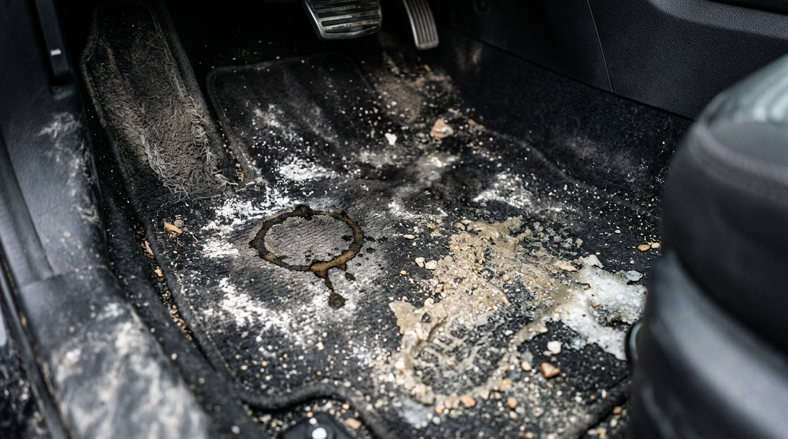
This is what twenty strangers a day leave behind
A private car carries 2-4 people a day. A Waymo does 20+ paid rides, with nobody watching.
Source: Waymo, ~500,000 paid rides a week on ~3,000-3,700 vehicles (TechCrunch, CNBC, Dec 2025 - Mar 2026)
Swap, do not scrub
4/13
Notes:
Salt, sand, a spilled coffee, flattened fibres. A private car carries two
to four people a day. Waymo runs about half a million paid rides a week on
three to four thousand vehicles - that is twenty-plus rides per car per day,
each one a stranger. And nobody supervises a driverless cabin - whoever
spills something simply gets out.
Waymo already employs dedicated fleet handlers for this, in protective
equipment, because passengers have started treating robotaxis like party
buses. This is not a 2035 problem. It is happening now.

Slide 5
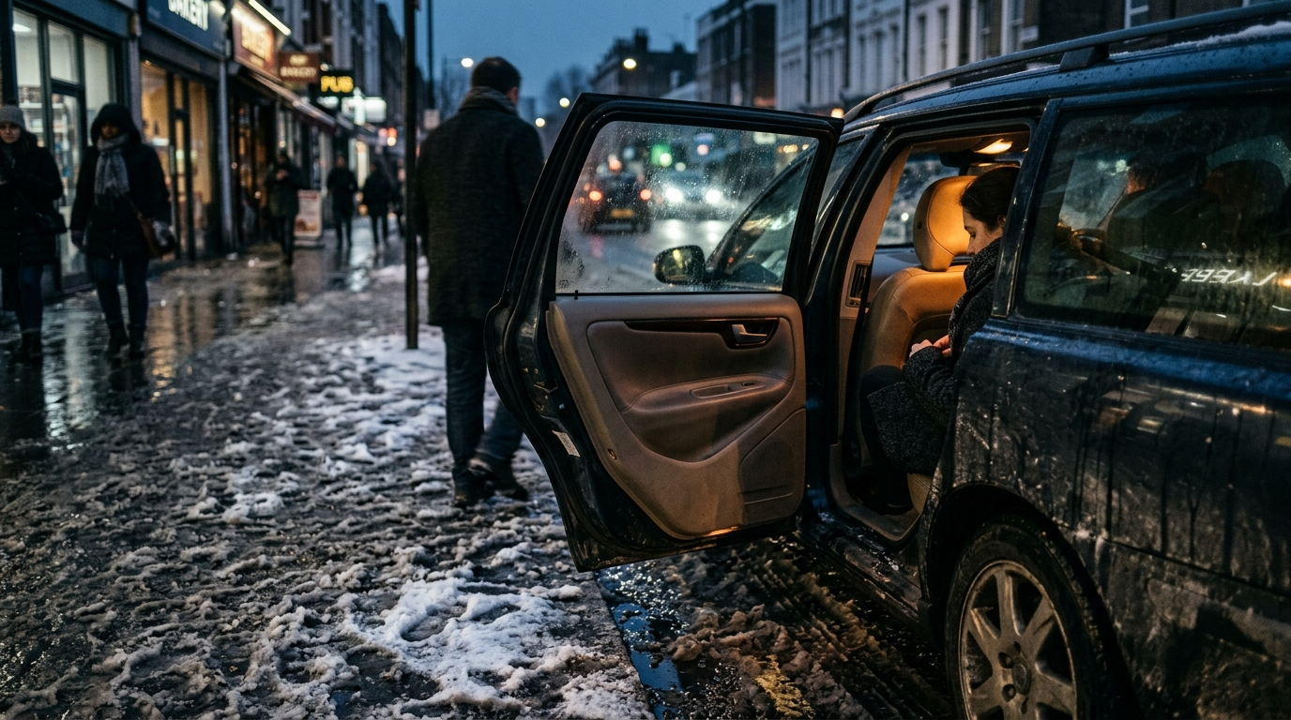
Cleaning is the one thing a robotaxi cannot do while earning
A BASIC INTERIOR CLEAN
30-60 min
heavy soiling doubles or triples it
PER CLEAN
USD 60-150
routine, up to 500 when bad
FOR THE OPERATOR
= downtime
it earns only while carrying people
Source: Consumer detailing trade estimates, 2025 (not an automotive study); press reporting on Waymo fleet handlers
Swap, do not scrub
5/13
Notes:
A basic interior clean takes thirty to sixty minutes, and heavy soiling
doubles or triples that. These are detailing-trade figures, not an
automotive study - we flag that honestly - but the direction is not in
doubt. For a fleet the money is not really the cleaning bill, it is the
hour the vehicle spends not carrying anyone. Uptime is the entire product.
And the private owner has it worse: no depot, no crew, just his garage on
a Sunday.

Slide 6
LEARNING FROM ANOTHER INDUSTRY
A luxury hotel never cleans the mattress
It cleans the layer above it. Each layer has one job, and the one that touches the guest is replaced every time.
Swap, do not scrub
6/13
Notes:
Hotels do not deep-clean a room between guests, they change the contact
layer. Mattress protector, sheet, duvet cover - each layer has one job,
and the expensive core underneath is protected and almost never washed.
Housekeeping is measured in minutes because of it. That is the whole idea
we are proposing, applied to a vehicle floor: stop cleaning the car, and
change the layer that got dirty.

Slide 7
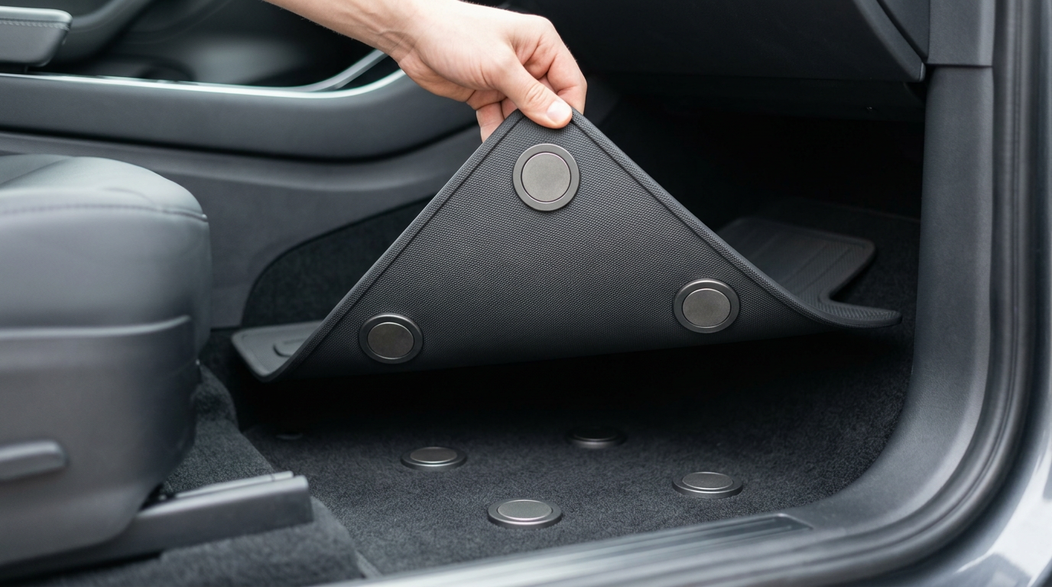
A floor that swaps in seconds and is cleaned off the vehicle
The mat becomes a part you swap - for a clean one, or for your own.
Wipe-clean skin, mono-material PET
No fibres to hold dirt
Magnetic dock, no visible fasteners
Out in seconds, no tools
Cleaned off the vehicle
The car goes back out, the panel is washed
Swap, do not scrub
7/13
Notes:
The mat becomes a part you swap instead of trim glued into the car - for
a clean one after the shift, or for the owner's own. A wipe-clean mono-
material skin, so no fibres trap salt and sand. A magnetic dock with no
visible fasteners: out in seconds, no tools, nothing exposed for road
salt to eat. And the important bit - cleaning happens away from the
vehicle. The car leaves with a fresh panel while the dirty one is
washed.

Slide 8
THE HARDER PROBLEM
A floor you can wipe is a floor that is acoustically dead
Absorption needs an open, porous surface. Cleaning wants a closed one. Today you pick one.
Swap, do not scrub
8/13
Notes:
Here is where the idea nearly died. An acoustic floor has to be open and
porous so sound can get in and be absorbed. A cleanable floor wants to be
closed so nothing gets in. Today you choose - a carpet that absorbs and
stains, or a rubber mat that wipes and is loud. In a battery-electric
robotaxi without engine noise that is worse, because road and wind noise
are all that is left.

Slide 9
Autoneum has already solved all of it, just never in the same part
We need | Autoneum has | Where it sits
Washable floor | Washable surface flooring | Trucks (Borgers, 2023)
Wipeable yet acoustic | Alpha-Liner | Wheelhouse, outside
Absorb through a closed skin | RIMIC micro-perforation | Heatshields
Cleanability metric | Cleanability Analyzer | Internal lab
Heating layer | (Heated) Floor mats | Trucks
Source: Autoneum Challenge deck, 7 Sep 2026, slides 6-7; Autoneum product brochure 2021; Autoneum press release on Borgers, Apr 2023
Swap, do not scrub
9/13
Notes:
This is the core of our research. Every ingredient exists inside Autoneum
today. Washable surface flooring is a truck product that came in with the
Borgers acquisition in 2023. Alpha-Liner is a wheelhouse liner whose
coating is tuned so the textile still absorbs sound while the surface
wipes clean - our exact conflict, already solved, just on the outside of
the car. RIMIC proves you can absorb through a closed skin. And Autoneum
even owns the measurement: the Carpet Cleanability Analyzer outputs a
cleanability index today. None of these has ever been combined, and none
has ever been offered in a passenger car.

Slide 10
One panel, three layers, every one of them in-house
Wipe-clean skin, micro-perforated
Liquid beads off, sound passes through
Absorber
Hybrid-Acoustics PET, the acoustics
Magnetic dock
No contacts, no cable, lifts out
Swap, do not scrub
10/13
Notes:
The micro-perforation is the trick, and it is Autoneum's own: RIMIC
heatshields are closed aluminium that still absorbs, because a tuned
perforation turns airborne sound into heat. We take that principle inside
and put it in a closed, hydrophobic skin over the absorber. Liquid beads
off the top. Sound goes through the holes and into the absorber below.

Slide 11
One dock, three tiers
Each tier adds to the one below. Tier 3 has two buyers - the owner, and the premium service.
1 - SHORT DISTANCE
Swap and wipe
Out in seconds, cleaned off the vehicle.
2 - MEDIUM DISTANCE
Quiet and premium
Perforated skin over the absorber. And it looks designed.
3 - LONG DISTANCE
Warm
Heating tracks under the skin. Feel at home.
Swap, do not scrub
11/13
Notes:
This is the product line, and it maps onto the distance axis of the
trend matrix we were shown. Tier one is the city shuttle: it only has to
come out fast and wipe clean. Tier two adds what a longer ride notices -
acoustics, and a surface that looks designed, because shared interiors
today look cheap for one reason: hard-wearing and premium are opposites.
Tier three adds the heating, and it has two buyers. The private owner,
for his own journeys. And the premium ride service, Uber Black class,
which runs it all week because a warm, beautiful cabin is what its fare
pays for. One dock carries all three - a platform, not three products -
and tier three is where the margin is.

Slide 12
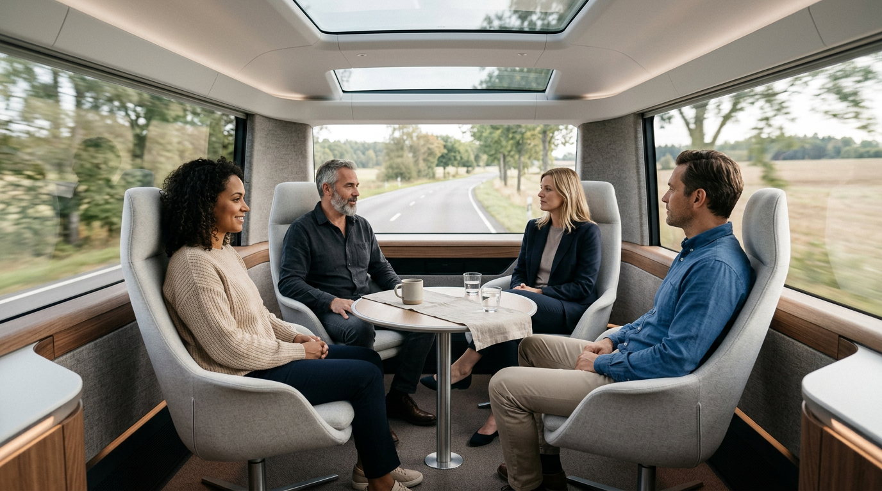
Friday evening the cheap mat comes out and his own goes in
Warm, quiet, designed - for long journeys. His own at the weekend, a premium service's all week. Around 200 W instead of 4,500; winter costs an EV 20-40 % of its range.
Source: Applied Thermal Engineering 2024; Energy and Buildings 2026; AAA EV range test 2019 (-41 % at -7 C with heating); US DOE VTO 2024
Swap, do not scrub
12/13
Notes:
The payoff of the promise from slide 2. All week strangers stood on the
cheap mat. Friday evening the owner lifts it out, drops in his own - and
the cabin is his again: warm floor, quiet ride, a surface he chose.
Three hours to the mountains, feeling at home the whole way. Luxury
already does this, just not on the floor: the S-Class warmth package
heats armrests and door panels, Rolls-Royce sells lambswool floor mats
as a signature. We combine the two and make it swappable. The premium
service runs the same mat all week, because on a long journey heating is
where the money is: around two hundred watts of radiant surface against
four and a half kilowatts of blown air, and winter otherwise costs an EV
twenty to forty percent of its range. Be careful with the claim: it
heats the person, not the cabin - the air system stays for demisting.

Slide 13
What we will prove by Friday
— Swap time - panel out, panel in, on a stopwatch
— Cleanability - our skin against a carpet, on Autoneum's index
— Absorption - through a perforated skin
Sources: Autoneum challenge deck 2026, product brochure 2021, FY2025 release, Borgers release 2023; Goldman Sachs 2026; TechCrunch and CNBC on Waymo; AAA 2019, US DOE 2024; Applied Thermal Engineering 2024, Energy and Buildings 2026. Full references in the presenter script.
Notes:
Three measurements, not three slides. The one we want on stage on Friday
is the swap - a stopwatch, a dirty panel out, a clean one in. The open
question we already know about is what the heating layer costs the
acoustics, because anything we add between the skin and the absorber is in
the sound path. Thank you.

