Slide 1

Amazon Sale Cancel Prediction
Project Presentation
Bradley Budach,
Pronob Kumar,
Tamim Ahmed
CS

Slide 2
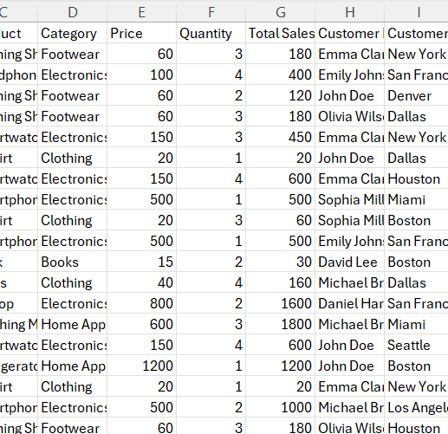
About Dataset
We worked on Amazon sales data for 2025.
We received the data from a website called “Kaggle”.
Link: https://www.kaggle.com/datasets/zahidmughal2343/amazon-sales-2025
The dataset has more than 5 Features and 100 instances

Slide 3
Data Processing
Removed the irrelevant columns like “Customer Name”.
Converted and extracted temporal features from the “Date Reworked” column
Numeric features were scaled where necessary (especially for models like XGBoost).

Slide 4
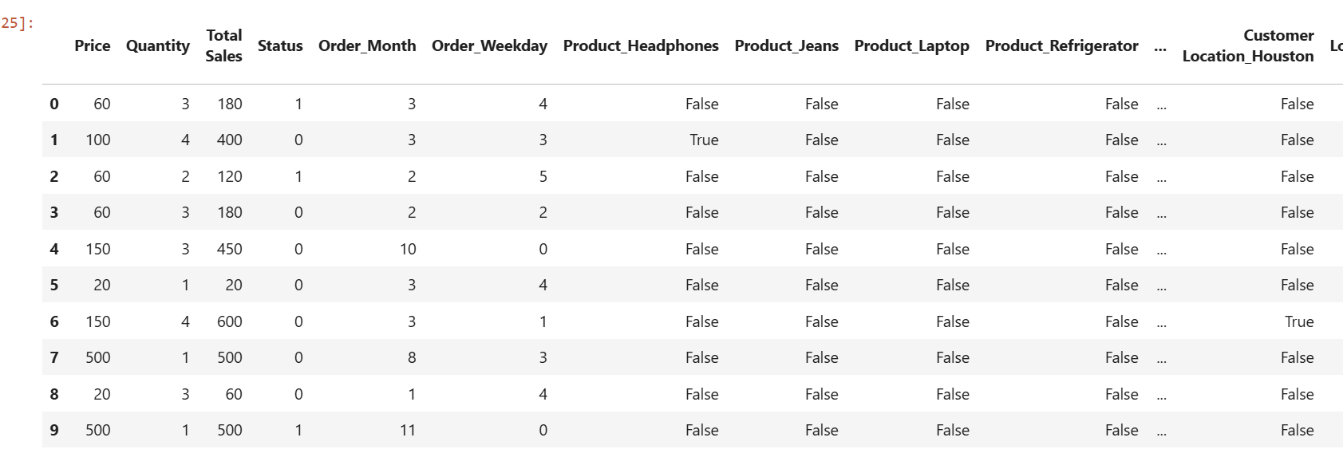
After the Data was processed:

Slide 5
Machine Learning Model
This ML task falls under Binary Classification
01
Our targeted status was 1 for cancelled and 0 for not cancelled
02
We did Binary Classification because there are only 2 answers to work with, canceled or not.
03

Slide 6
Model 1 - Random Forest Classifier
Library: Scikit-learn
Parameters: n_estimators=100
Evaluation:
Accuracy: 68%
AUROC: 0.62
Cross-Validation (5-Fold):
Mean Accuracy: 65.2%,
Mean AUC: 0.534

Slide 7
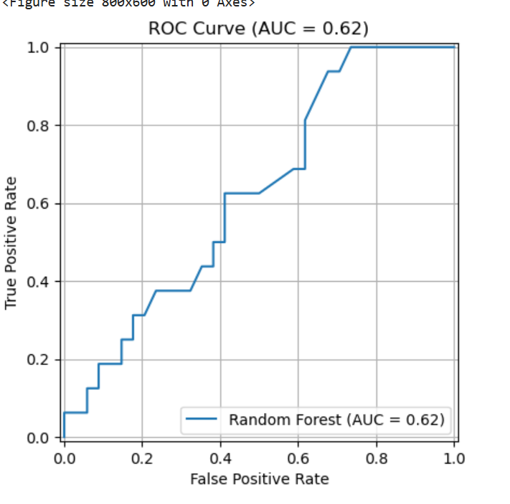

Slide 8
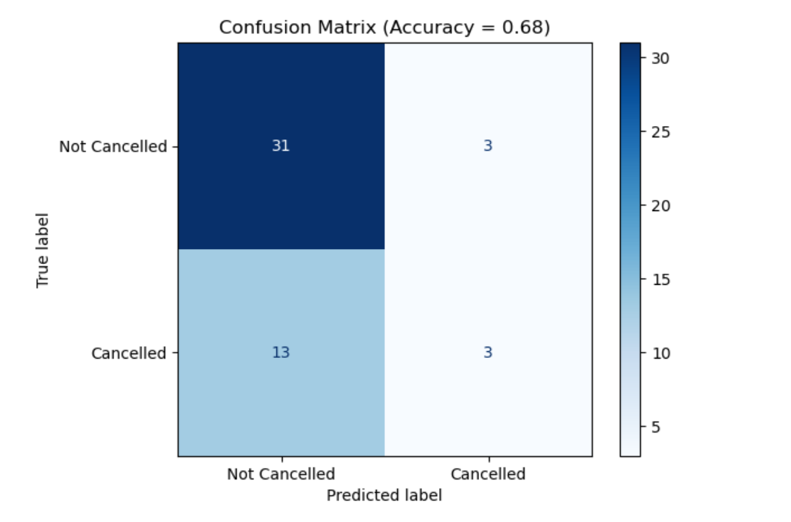

Slide 9
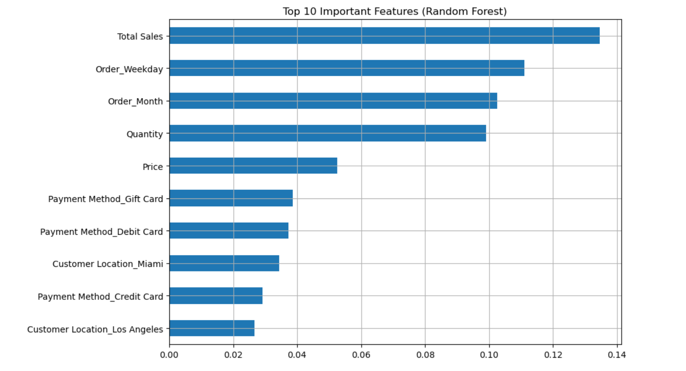

Slide 10
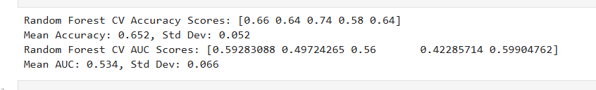
Cross Validation:

Slide 11
Model 2 - XGBoost Classifier
Library: XGBoost
Parameters: max_depth=4, n_estimators=50
Evaluation:
Accuracy: 66%
AUROC: 0.61
Cross-Validation (5-Fold):
Mean Accuracy: 63.6%
Mean AUC: 0.589

Slide 12
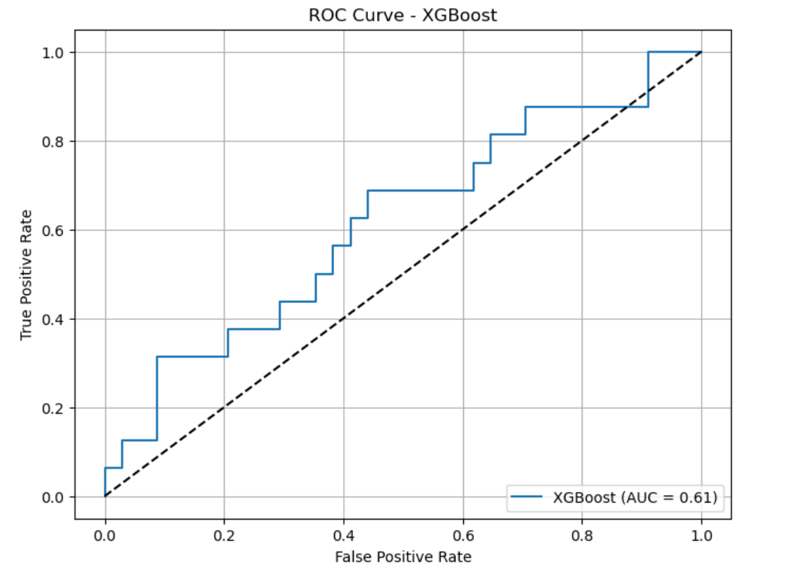

Slide 13
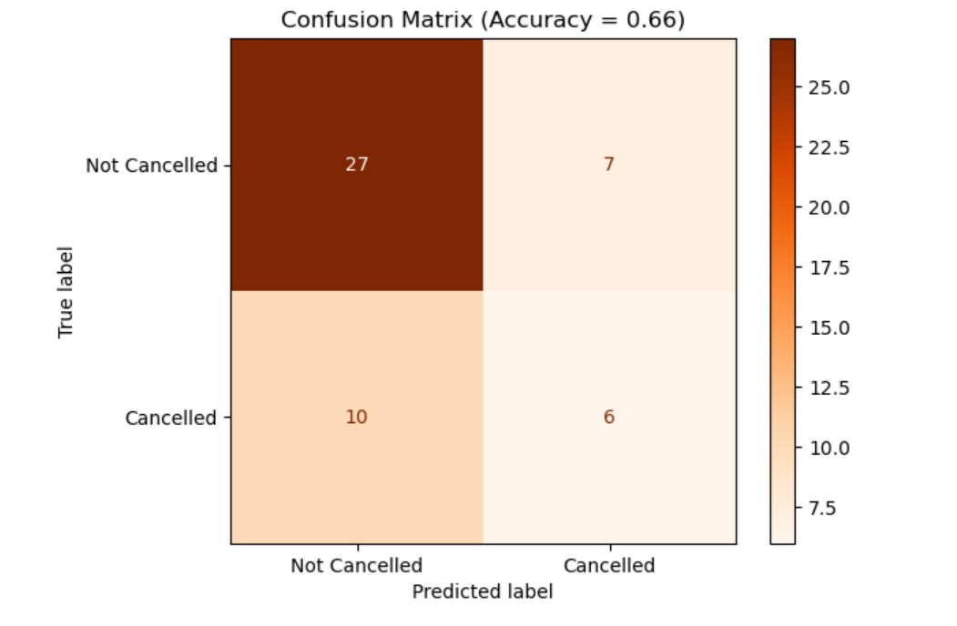

Slide 14
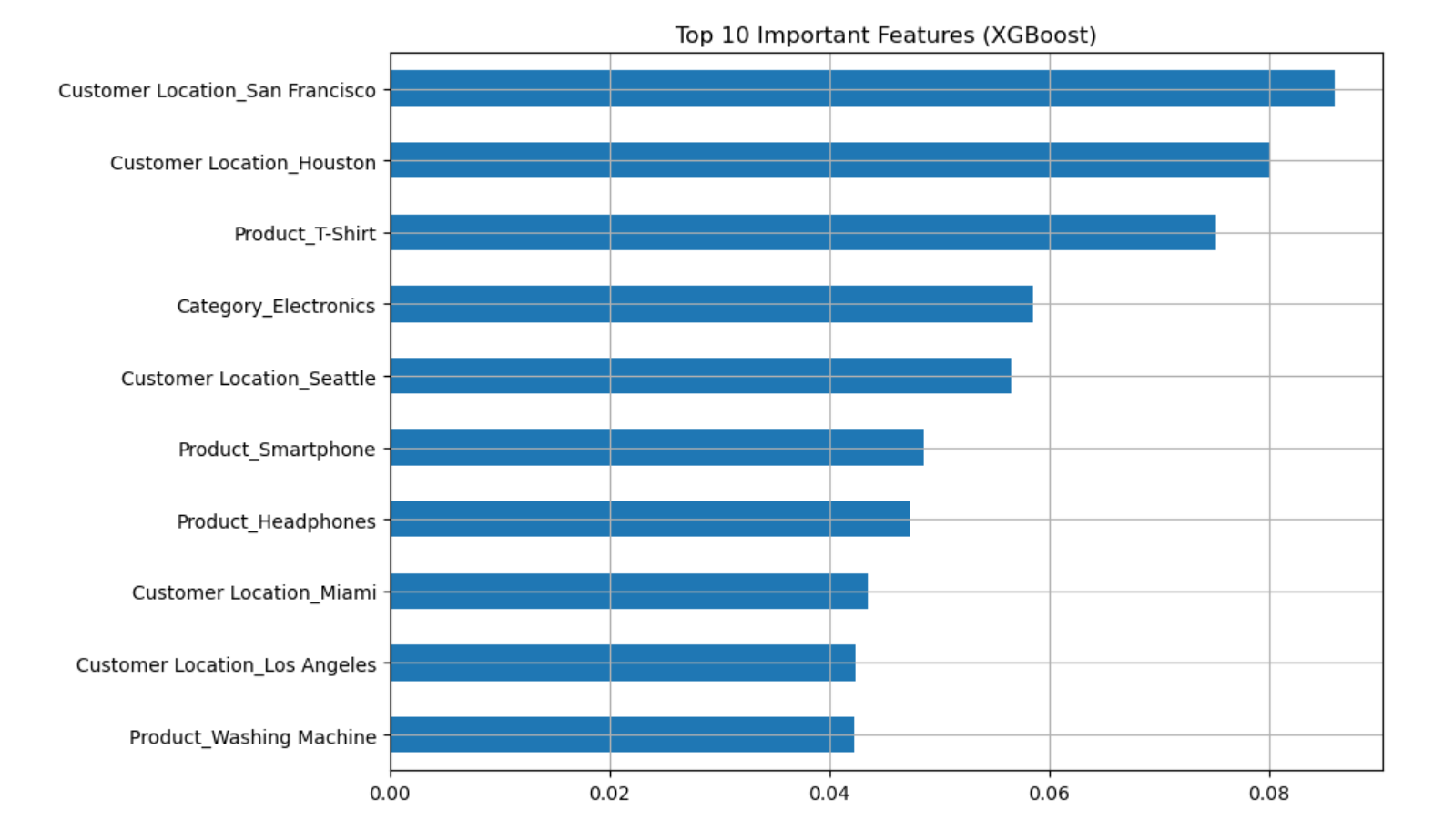

Slide 15
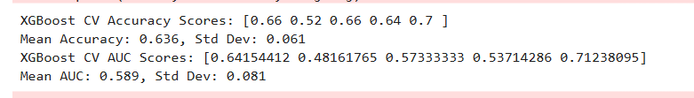
Cross Validation:

Slide 16
Overfitting Issues
When Overfitting Occurs: "Overfitting occurs when a model memorizes the training data instead of learning patterns that generalize to new data.
To address this:
we applied 5-fold cross-validation to both models to ensure consistent performance across different data splits.
I we controlled model complexity in XGBoost by limiting the tree depth to 4 and using fewer boosting rounds (50 estimators).
The close match between our test set accuracy and cross-validation results indicates that our models are not severely overfitting."

Slide 17
Ethical Considerations
To make sure no personally identifiable information was used for modeling, we removed the customer’s name.
The model should be used responsibly: prediction of cancellations should not bias customer service actions without justification.

Slide 18

Any Questions?

