Slide 1
Final Project Introduction to Web Programming Title: Online Computer Science Tutoring

Slide 2
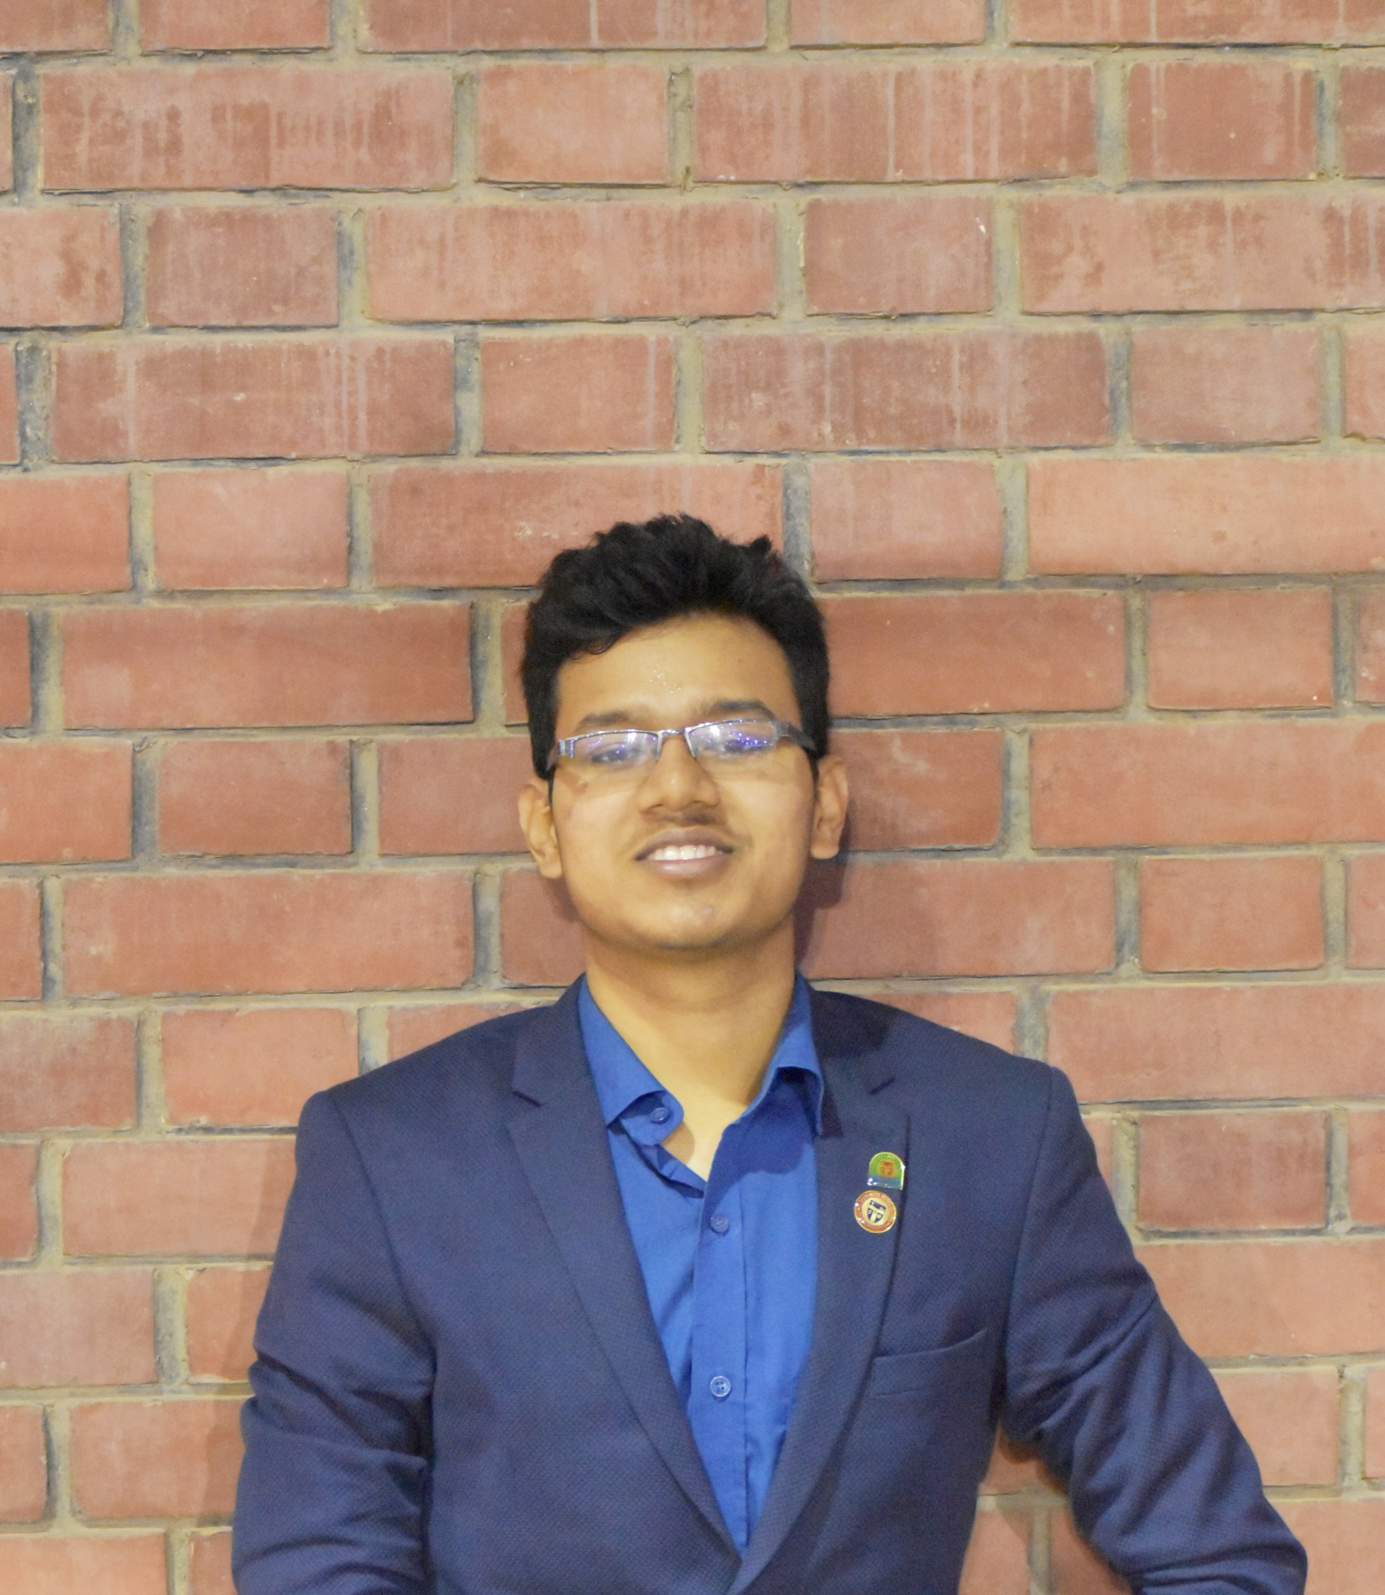
Prepared by Pronob Kumar
Major: Applied Computer Science & Data Science
Minor: Physics & Mathematics

Slide 3
Front End
index.html (Main Entry point to the web application)
script.js
(Control behavior of the application & Dynamic Navigation)
Style.css
(Design and color of the web application)

Slide 4
Key Features
Event-Driven Programming: Functions like login, register, fetchTutors, and postQuestion are triggered by user actions.
AJAX Communication: Uses fetch API to interact with the backend routes and dynamically update the content on the page.

Slide 5
Back End
server.js
Storage
questions.txt
users.txt
Handles all the server-side
tutors.txt
logic, including managing
user sessions, processing
data, and interacting with
text files for data storage

Slide 6
Key Features
In-Memory Sessions: Tracks user login states using a simple object (sessions).
File-Based Storing: Uses text files for storing data instead of a database for simplicity.

Slide 7
Let’s go to the website

Slide 8
Main Features:
Tutor Directory: A searchable and filterable list of tutors, including contact information, subject expertise, and availability.
Question Board: A forum-like section where students can post questions and receive hints or solutions.
Comments/Responses: This would allow registered users to leave comments, hints, or solutions.
User Accounts: Authentication system enabling students and tutors to register, log in, and manage their profiles.

Slide 9
Search & Filter: Let the users find tutors by subject or by what time they are available.
Comments/Responses: This would allow registered users to leave comments, hints, or solutions.
Ratings/Feedback: Allow students to rate tutors on helpfulness and other stuff.
Additional Functionalities:

Slide 10
Problems Encountered:
Adding SQL and running the same thing on other devices
1
Securing My SQL password
2

Slide 11
Future Plans
Have an Admin user feature to control the user and tutors
Real-life chatting with students and tutors
Share it with all the Universities in Minnesota State to get the students connected

Slide 12

Any Questions?

