Slide 1
算法分析与设计复习

Slide 2
课程成绩评价方式
平时成绩 占总成绩45%
PTA在线答题
在线作业（Sakai）
期末考试（闭卷）占总成绩55%

Slide 3
Chapter 1 The Role of Algorithms in Computing
(1) Definition of algorithm
Definition:
An algorithm is any well-defined computational procedure that
takes some value, or set of values, as input and
produces some value, or set of values, as output.
An algorithm is thus a sequence of computational steps that transform the input into the output.

Slide 4
(2) Algorithms as a technology
Algorithms as a technology
infinitely fast: Terminates, with the correct answer
not infinitely fast: Computing time is therefore a bounded resource, algorithms that are efficient in terms of time or space
Efficiency: algorithms-T, hardware-v, Software-c
Algorithms for sorting: Insertion sort, Merge sort
c₁=2, c₂=50; T_{A}=c₁n², T_{B}=c₂nlogn
Computer: A-v=1G, B-v=1M
n=1M: tA=2000s tB=1000s
n=100M: tA=23d tB=1.5d

Slide 5
Chapter 2 Getting Started: Analyzing Algorithms
(1) Analysis of algorithms
What are analysis of algorithms?
The theoretical study of computer-program performance and resource usage.
Criteria for analysis of algorithms
Correctness
Amount of work done
Amount of space used
Simplicity
Optimality

Slide 6
(2) Analyzing Algorithms
Run time formulation:
Input: What kind of input? I
Size of input: How many datum? n=|I|
Machine: CPU How fast is the machine? v1,…,vk
Computing model: RAM (random-access machine): How many machines? One only
Guarantee : Generally, we seek upper bounds on the running time, because everybody likes a guarantee max (i.e,. in the worst case)
Run time decided by: number of basic operations done and cpu speed
Run time: t = sum{n1/v1+…+nk/vk}

Slide 7
Time Complexity: simplified run time
T(n, I): may differ from I (Any input of size n)
Worst-case: (usually)
T(n) = maximum time of algorithm on any input of size n.
T(n)=max_{I} {T(n,I)}
Time Complexity (Default )
Average-case: (sometimes)
T(n) = expected time of algorithm over all inputs of size n.
Need assumption of statistical distribution of inputs.
Best-case: (bogus)
Cheat with a slow algorithm that works fast on some input.

Slide 8
Θ-notation
Asymptotic Analysis:
Asymptotic analysis: Look at growth of T(n) as n →∞.
Math:
Θ(g(n)) = { f (n): there exist positive constants c₁, c₂, and n₀ such that
0 ≤c₁ g(n) ≤ f (n) ≤ c₂ g(n) for all n ≥ n₀}
Engineering:
Drop low-order terms; ignore leading constants.
Example: 3n³ + 90n² –5n + 6046 = Θ(n³)

Slide 9
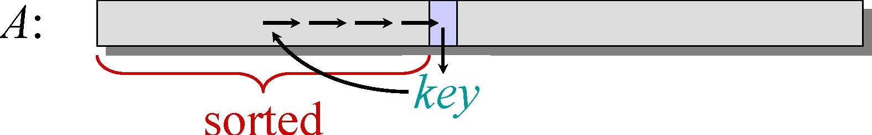
(3) Insertion sort:
INSERTION-SORT (A, n) // A[1 . . n]
“pseudocode”
for j ← 2 to n
do key ← A[ j]
// Insert A[j] into the sorted sequence A[1 j - 1].
i ← j – 1
while i > 0 and A[i] > key
do A[i+1] ← A[i]
i ← i – 1
A[i+1] = key
Worst case: T(n)=Θ(n²)
Average case: T(n)=Θ(n²)
Best case: T(n)=Θ(n)

Slide 10

(4) Designing Algorithms
Divide-and-Conquer Approach
Divide the problem into a number of subproblems.
Conquer the subproblems by solving them recursively. If the subproblem sizes are small enough, however, just solve the subproblems in a straightforward manner.
Combine the solutions to the subproblems into the solution for the original problem.

Slide 11
Merge Sort Algorithm: DC
MERGE-SORT A[1 . . n]
1. If n = 1, done.
2. Recursively sort A[ 1 . . ⎡n/2⎤ ]
and A[⎡n/2⎤+1 . . n ] .
3. “Merge” the 2 sorted lists.
… to be continued!
Key subroutine: MERGE

Slide 12
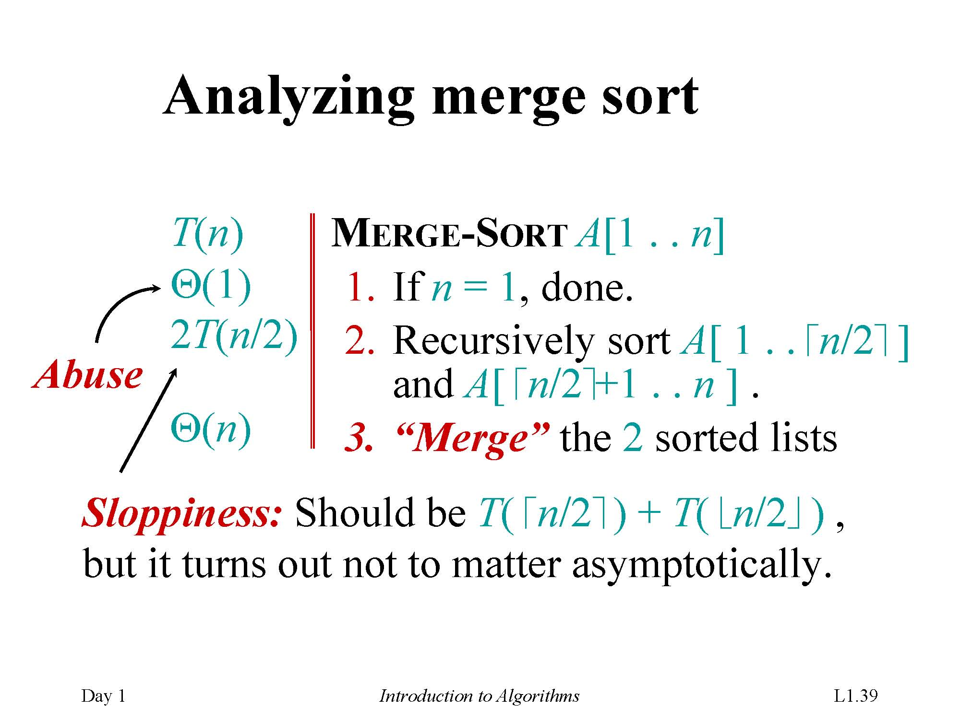

Slide 13
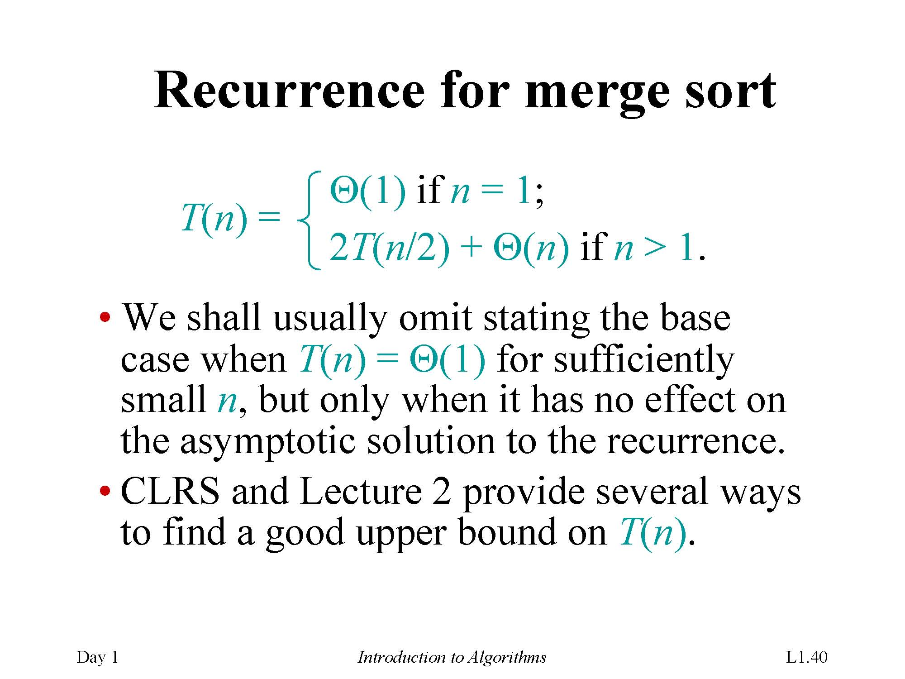

Slide 14
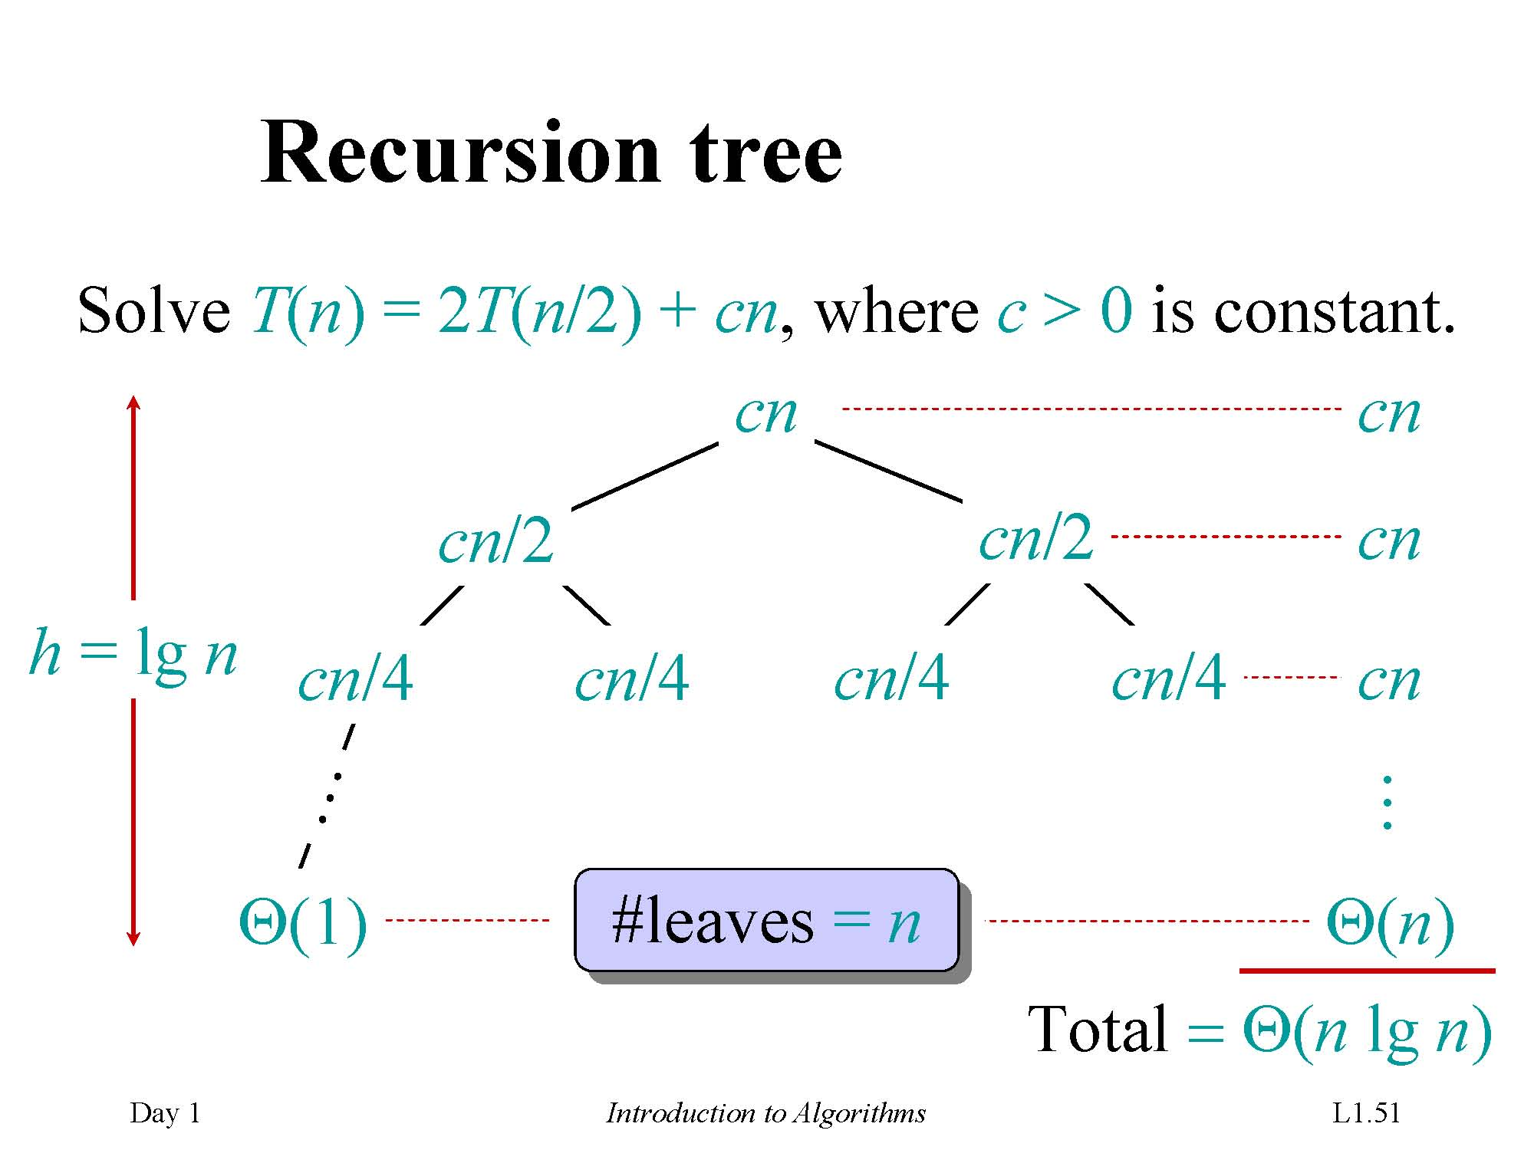

Slide 15
Chapter 3 Asymptotic Analysis for Algorithms
(1) Asymptotic Analysis
Big Idea
Ignore machine-dependent constants
Look at growth of T(n) as n → ∞ .
T(n): the Asymptotic Running Time
Neglects the fact that the time cost of each statement actually depends on the compiler, interpreter and the hardware platform
Stands for the worst case
T(n) can be denoted or approximated by a function f(n)

Slide 16
(2) Landau Symbols
Before we begin, however, we will make some assumptions:
Our functions will describe the time or memory required to solve a problem of size n
We conclude we are restricting ourselves to certain functions:
They are defined for n ≥ 0 and n→∞
They are strictly positive for all n
In fact, f(n) > c for some value c > 0
That is, any problem requires at least one instruction and byte
They are non-decreasing (monotonic non-decreasing)

Slide 17
Landau Symbols - Big Θ
f(n) = Θ(g(n)) , if there exist positive constants c₁, c₂, and n₀ such that 0 ≤ c₁ g(n) ≤ f (n) ≤ c₂ g(n) for all n ≥ n₀
If where , it follows that f(n) = Θ(g(n))
f(n) = Θ(g(n)) describes an equivalence relation:
1. f(n) = Θ (g(n)) if and only if g(n) = Θ (f(n))
2. f(n) = Θ (f(n))
3. If f(n) = Θ (g(n)) and g(n) = Θ (h(n)), it follows that f(n) = Θ (h(n))
Select one simplest element to represent the class of these functions

Slide 18
Big Θ as an Equivalence Relation
The most common classes are given names:
Θ (1) constant
Θ (log(n)) logarithmic
Θ (n) linear
Θ (n log(n)) “n log n”
Θ (n²) quadratic
Θ (n³) cubic
Θ (n!) factorial
2^{n}, e^{n}, 4^{n}, ... exponential

Slide 19
Landau Symbols - Big O
f (n) = O(g(n)) , if there exist positive constants c and n₀ such that 0 ≤ f (n) ≤ c·g(n) for all n ≥ n₀ }
If where , it follows that f(n) = O(g(n))

Slide 20
Big-O Operations
O(f(n))+O(g(n)) = O(max{f(n), g(n)})
O(f(n))+O(g(n)) = O(f(n)+g(n))
O(f(n)) ·O(g(n)) = O(f(n) ·g(n))
O(c·f(n)) = O(f(n))

Slide 21
Big-O
The most common classes are given names:
O (1) constant
O (log(n)) logarithmic
O (n) linear
O (n log(n)) “n log n”
O (n²) quadratic
O (n³) cubic
O (n!) factorial
2^{n}, e^{n}, 4^{n}, ... exponential

Slide 22
Landau Symbols - Big Ω
f(n) = Ω(g(n)) , if there exist positive constants c and n₀ such that 0 ≤ c·g(n) ≤ f(n) for all n ≥ n₀ }
If where , it follows that f(n) = Ω(g(n))

Slide 23
The Relationship between Θ, O and Ω
O - Upper bounds.
f(n) is O(g(n)) if there exist constants c > 0 and n₀ ≥ 0 such that for all n ≥ n₀ we have f(n) ≤ c · g(n).
Ω - Lower bounds.
f(n) is Ω(g(n)) if there exist constants c > 0 and n₀ ≥ 0 such that for all n ≥ n₀ we have f(n) ≥ c · g(n).
Θ - Tight bounds.
f(n) is Θ(g(n)) if f(n) is both O(g(n)) and Ω(g(n)).

Slide 24
Five Landau Symbols
We sometimes use these five possible descriptions:

Slide 25
(2) ANALYSIS of OPERATIONS
顺序程序块的渐进复杂度分析
具有控制结构的程序块复杂度分析
递归的程序块复杂度分析
递归的选择排序算法及复杂度分析

Slide 26
Recursive Functions
As an example, we could implement the factorial function recursively:
int factorial( int n ) {
if ( n <= 1 ) {
return 1;
} else {
return n * factorial( n – 1 );
}
}

Slide 27
We can examine the first few steps:
T!(n) = T!(n – 1) + 1
= T!(n – 2) + 1 + 1 = T!(n – 2) + 2
= T!(n – 3) + 3
From this, we see a pattern:
T!(n) = T!(n – k) + k
When k = n – 1, …
T!(n) =T!(n – (n – 1)) + n – 1
=T!(1) + n – 1
=1 + n – 1 = n
Thus, T!(n) = Θ(n)

Slide 28
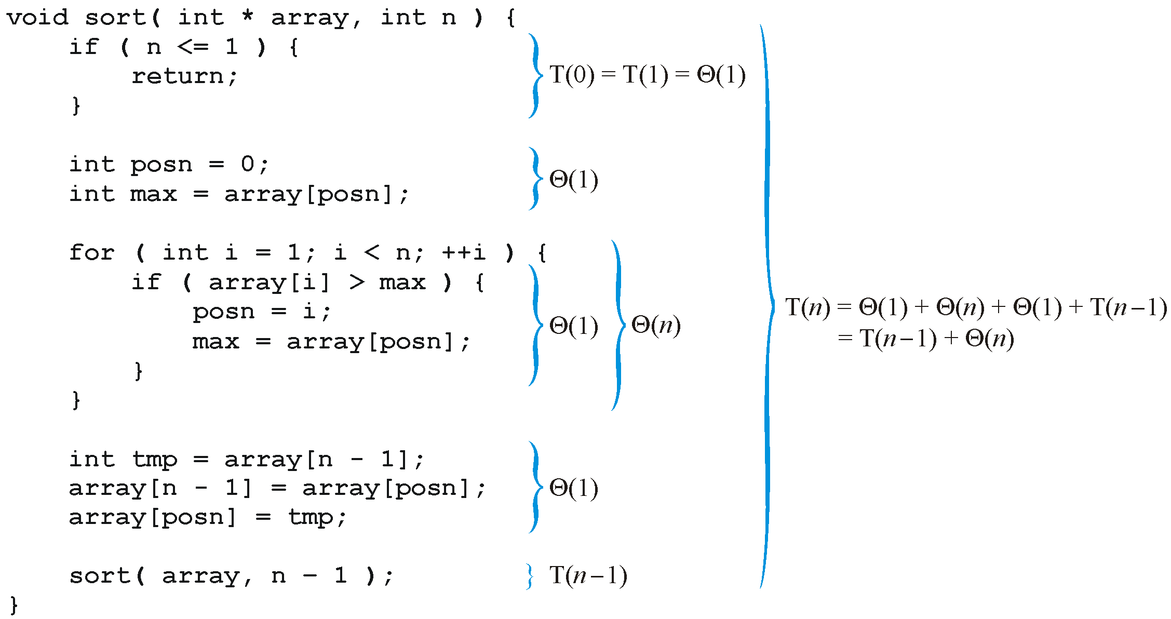
Recursive Functions： selection sort
Analyzing the function, we get:
T(n) = Θ(n²)

Slide 29
Recursive Functions: a binary search of a sorted list
Solving this can be difficult, in general, so we will consider only special values of n
Assume n = 2^{k} – 1 where k is an integer
Τ(n)=Θ (log(n))

Slide 30
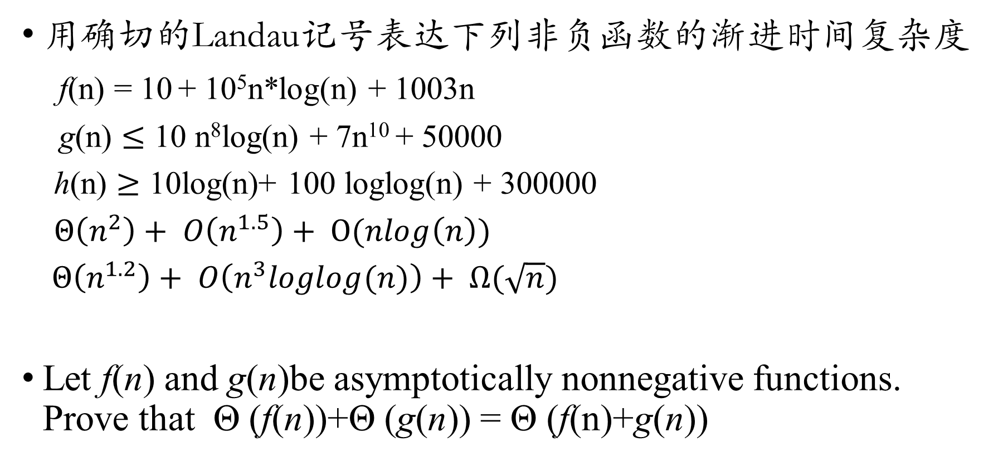
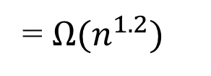
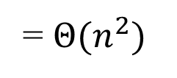
例题：
,
,
用确切的Landau记号表达下列非负函数的渐进时间复杂度
f(n) = 10 + 10⁵n*log(n) + 1003n
g(n) $≤$ 10 n⁸log(n) + 7n¹⁰ + 50000
h(n) $≥$ 10log(n)+ 100 loglog(n) + 300000
$Θ\left(n^{2}\right)+ O\left(n^{1.5}\right)+ O(nlog\left(n\right))$
$Θ\left(n^{1.2}\right)+ O\left(n^{3}loglog(n)\right)+ Ω(\sqrt{n})$
Let f(n) and g(n)be asymptotically nonnegative functions. Prove that Θ (f(n))+Θ (g(n)) = Θ (f(n)+g(n))
= $Θ(n^{2})$
= $Ω(n^{1.2})$

Slide 31
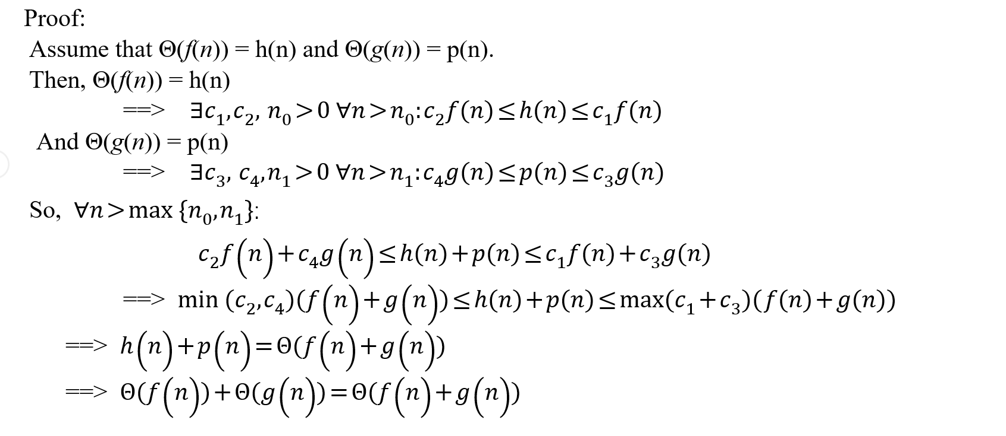
Let f(n) and g(n)be asymptotically nonnegative functions. Prove that Θ (f(n))+Θ (g(n)) = Θ (f(n)+g(n))

Slide 32
Chapter 4 Merge Sort and Recursion
Merge Sort and Insertion Sort
Recursion Analyzing
Expansion
Substitution
Recursion Tree

Slide 33
Expansion Method
E.g., given the following recurrence :
T(n) = T(n – 1) + Θ(n), T(1) = Θ(1)

Slide 34
Substitution method
The most general method.
1. Guess the form of the solution.
2. Verify by induction.
3. Solve for constants.

Slide 35
Example of substitution
Example: T(n) = 4T(n/2) + Θ(n), T(1) = Θ(1)
Guess Ο(n³) .
Assume that T(n) ≤ c₁n³ for n ≥ n₀ .
Prove T(n) ≤ c₁n³ by induction.

Slide 36
Example of substitution
This is not a tight bound: We cannot prove the tightness!

Slide 37
Example of substitution
T(n) = 4T(n/2) + Θ(n), T(1) = Θ(1)
How about we want to prove Θ(n²)?
We need to prove Ω(n²) and Ο(n²)
Prove T(n) ≤ c₁n² and T(n) ≥ c₃n² for n ≥ n₀ simultaneously?

Slide 38
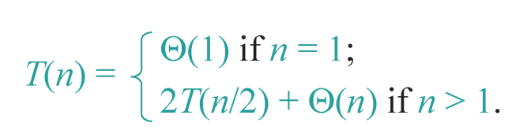
Apply Substitution to Merge Sort
Guess Θ(n log n) .
Assume that T(n) ≤ c₁ · n log n and T(n) ≥ c₂ · n log n for n ≥ n₀ .
Prove T(n) ≤ c₁ · n log n and T(n) ≥ c₂ · n log n by induction.

Slide 39
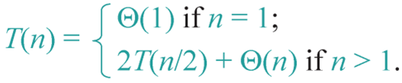
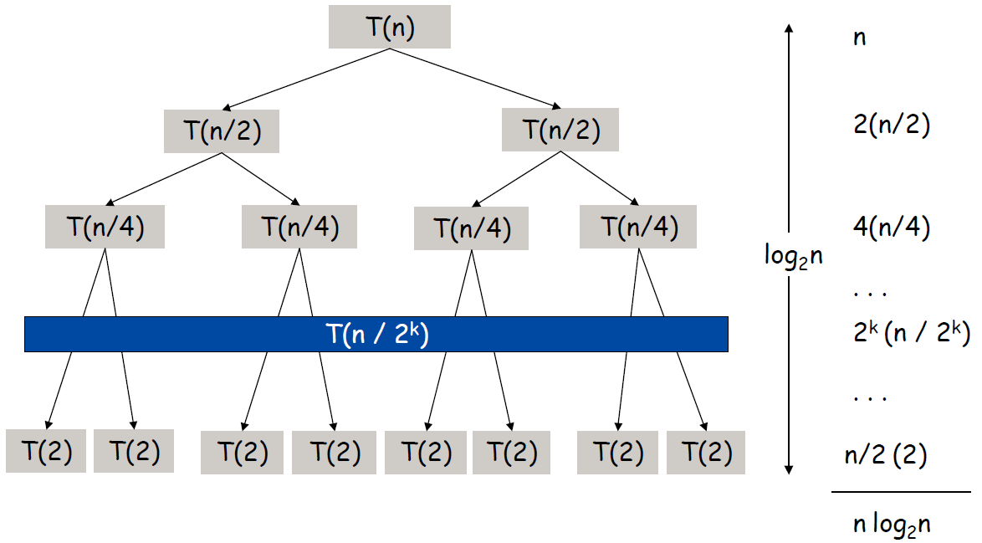
Apply Recursion-tree to Merge Sort

Slide 40
例题：
,
,
用展开法求T(n) = T(n-1) + n (n>1), T(1) = 1的渐进时间复杂度f(n)
合并排序过程中，对较长的数组按 2：1 比例划分，给出描述该排序算法时间复杂度的递推方程.
T(n) = T(2n/3)+T(n/3)+ θ(n)(或n)
Draw the recursion tree (递归树) of the recurrent function: T(n)=T(3n/4)+T(n/4)+ Θ(n), prove the tight bound (Θ) of your recurrence with substitution(替代法)

Slide 41
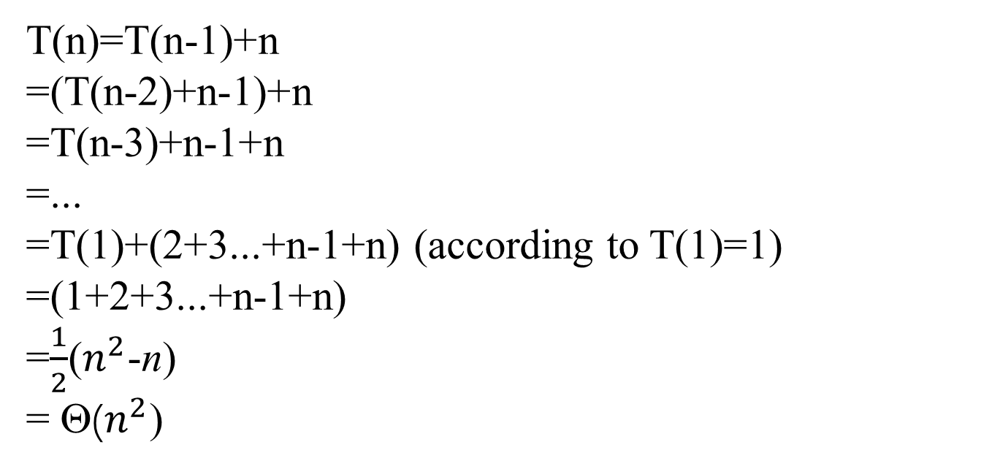
用展开法求T(n) = T(n-1) + n (n>1), T(1) = 1的渐进时间复杂度f(n)
T(n)=T(n-1)+n
=(T(n-2)+n-1)+n
=T(n-3)+n-1+n
=...
=T(1)+(2+3...+n-1+n) (according to T(1)=1)
=(1+2+3...+n-1+n)
=$\frac{1}{2}$($n^{2}$-n)
= Θ($n^{2}$)

Slide 42
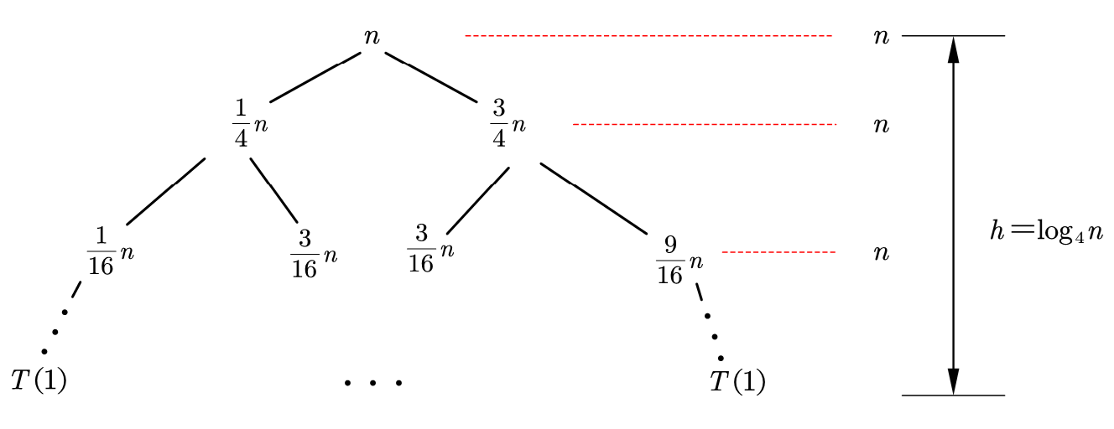
Draw the recursion tree (递归树) of the recurrent function: T(n)=T(3n/4)+T(n/4)+ Θ(n), prove the tight bound (Θ) of your recurrence with substitution(替代法)
递归树可得T(n)= Θ(nlogn)

Slide 43
Chapter 7 Quick Sort
Basic Quick Sort:
Average Run Time (Memory), Worst Run Time (Memory)
Improving Quick Sort with Medians
Choose the Median-of-Three as the pivot
search forward and backward

Slide 44
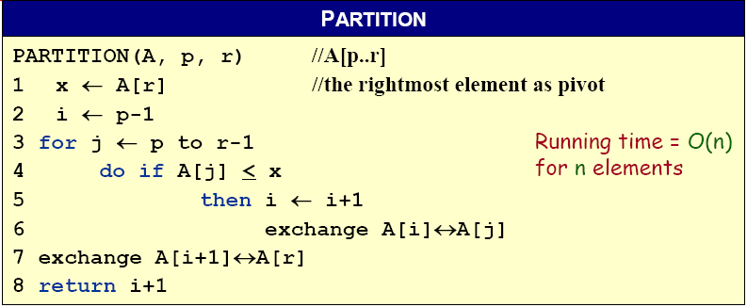
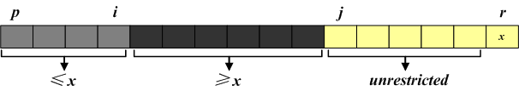
Basic Quick Sort – PARTITION
A[p, … , i]: known to be ≤ pivot
A[j … r-1]: not yet examined
A[i+1, … , j-1]: known to be > pivot
A[r]: pivot

Slide 45










A Simple Implementation – PARTITION
The operation of Partition on the sample array. Lightly shaded array elements are all with values no greater than x (the pivot). Heavily shaded array elements are all with values greater than x.

Slide 46
A Simple Implementation – QUICKSORT
QUICKSORT (A, p, r)
IF p < r
THEN q ← PARTITION (A, p, r)
QUICKSORT (A, p, q–1)
QUICKSORT (A, q+1, r)
Initial call: QUICKSORT(A, 1, n)

Slide 47
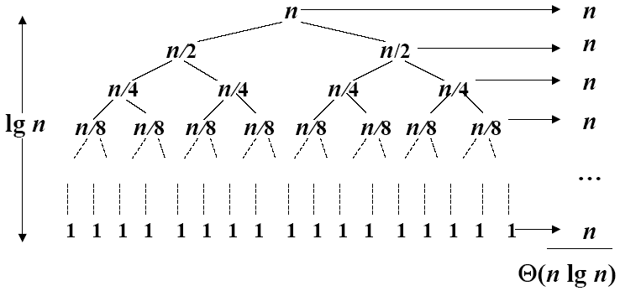
Recursive Tree of the Best Case
A recursion tree for quick sort in which the partition always balances the two sides of the partition equally. The resulting running time is Θ(n log n)
The question is: WHAT happens if we don’t get that lucky?

Slide 48
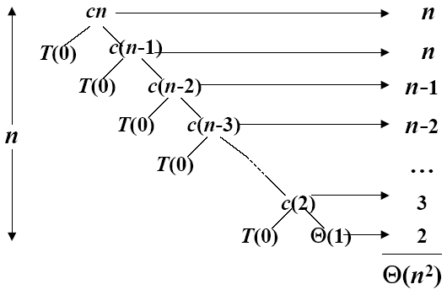
Recursive Tree of the Worst Case
A recursion tree for quick sort in which the partition always puts only a single element on one side of the partition. The resulting running time is Θ(n²)

Slide 49
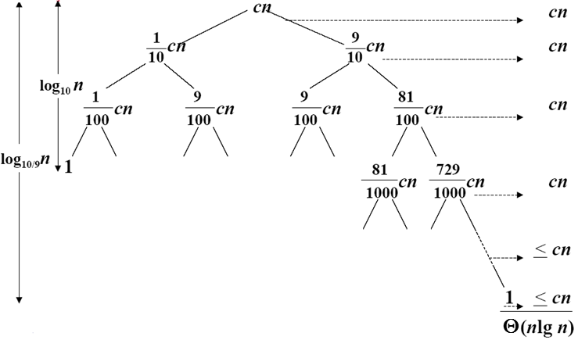
Recursive Tree of the Balanced Case
A recursion tree for quick sort in which partition always produces a 9-to-1 split, yielding a running time of Θ(n log n)

Slide 50
Summery
To summarize all three O(n log n) algorithms
 | Average Run Time | Worst-case Run Time | Average Memory | Worst-case Memory
Heap Sort | O(n log n) |  | O(1)
Merge Sort | O(n log n) |  | O(n)
Quick Sort | O(n log n) | O(n²) | O(log n) | O(n)

Slide 51
Chapter 15 Dynamic Programming
Elements of Dynamic Programming
Optimal substructure
the solutions to the subproblems used within the optimal solution must themselves be optimal. (Usually use cut-and-paste to prove)
Overlapping subproblems
The total number of distinct subproblems is a polynomial in the input size.

Slide 52
Elements of DP Algorithms
Sub-structure: decompose problem into smaller sub-problems. Express the solution of the original problem in terms of solutions for smaller problems.
Table-structure: Store the answers to the sub-problem in a table, because sub-problem solutions may be used many times.
Bottom-up computation: combine solutions on smaller sub-problems to solve larger sub-problems, and eventually arrive at a solution to the complete problem.

Slide 53
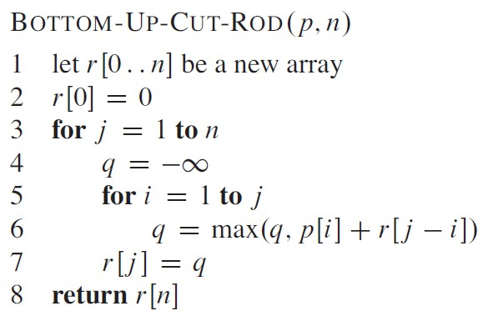


(2) Rod cutting
Given a rod of length n inches and a table of prices p_{i} for i = 1,2,3,…,n, determine the maximum revenue r(n) obtainable by cutting up the rod and selling the pieces.
r(n)= p_{i} + r(n-i)

Slide 54
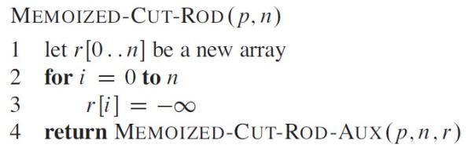
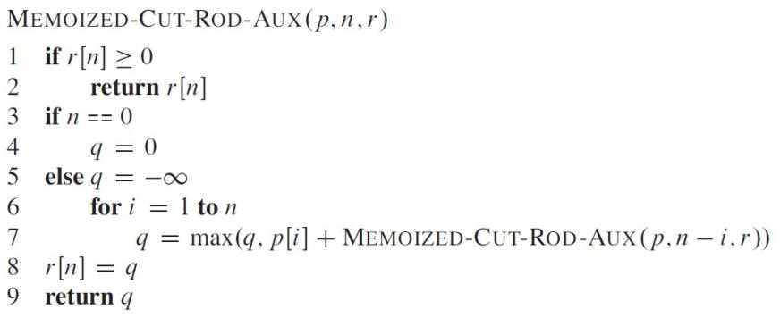
Dynamic Programming – top down memoization
Avoid resolving same sub-problem

Slide 55
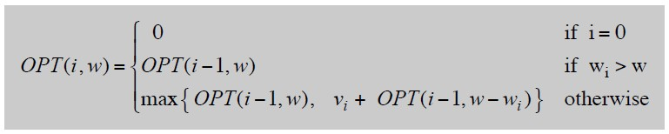
(3) Knapsack Problem
0-1 Knapsack problem
Formulation:
Recursive Solution Formulation
Def. OPT(i, w) = max profit subset of items 1, …, i with weight limit w.

Slide 56
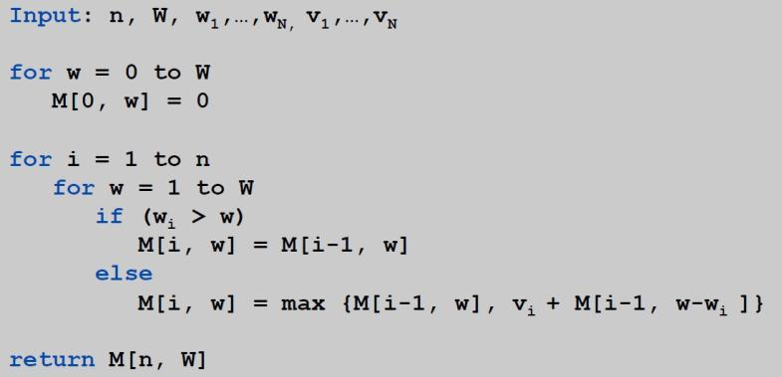
Knapsack Algorithm – Bottom-Up
Knapsack. Fill up an n-by-W array.
Θ(nW)

Slide 57
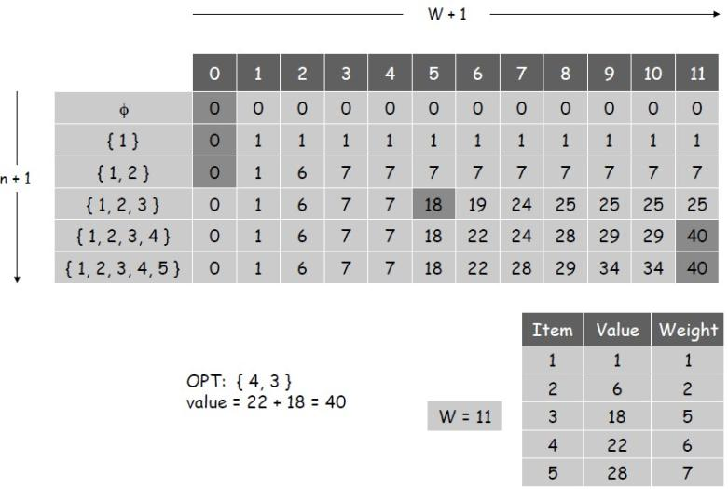
Exercise : 0-1 Knapsack Problem
Compute OPT(5,12)

Slide 58
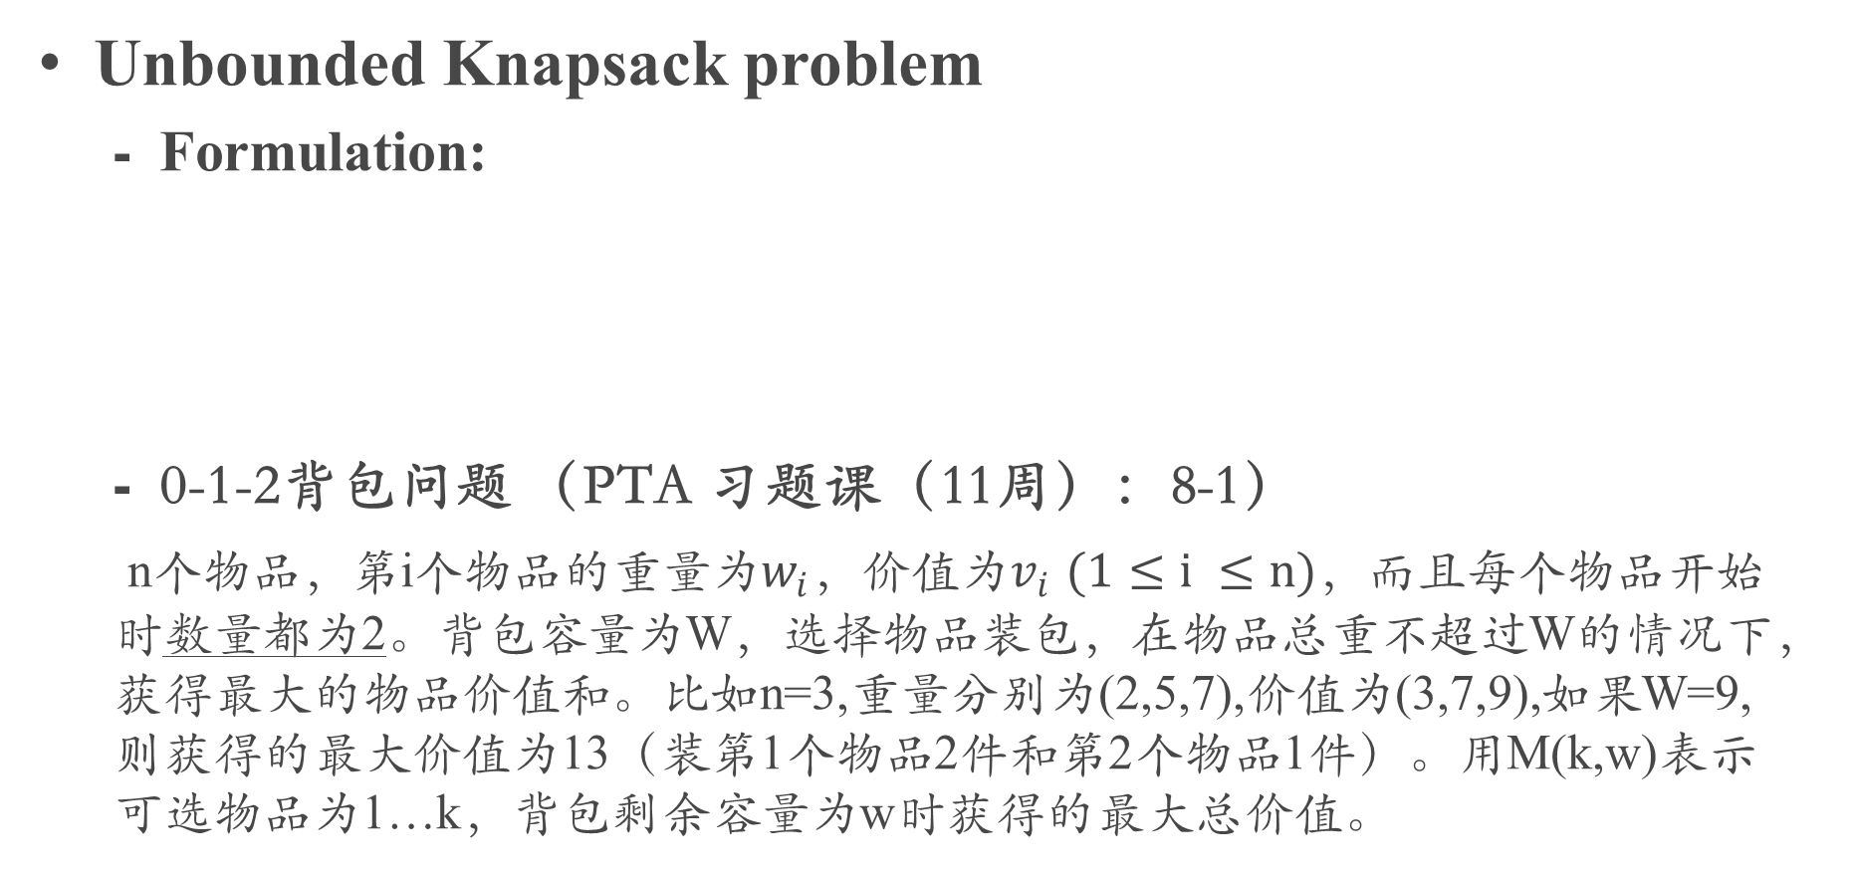
Unbounded Knapsack problem
Formulation:
0-1-2背包问题 （PTA 习题课（11周）：8-1）
n个物品，第i个物品的重量为$w_{i}$，价值为$v_{i}$ $(1≤i ≤n)$，而且每个物品开始时数量都为2。背包容量为W，选择物品装包，在物品总重不超过W的情况下，获得最大的物品价值和。比如n=3,重量分别为(2,5,7),价值为(3,7,9),如果W=9,则获得的最大价值为13（装第1个物品2件和第2个物品1件）。用M(k,w)表示可选物品为1…k，背包剩余容量为w时获得的最大总价值。

Slide 59
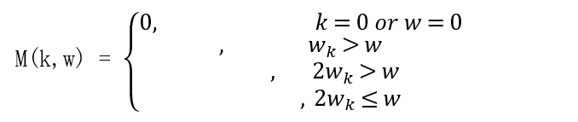
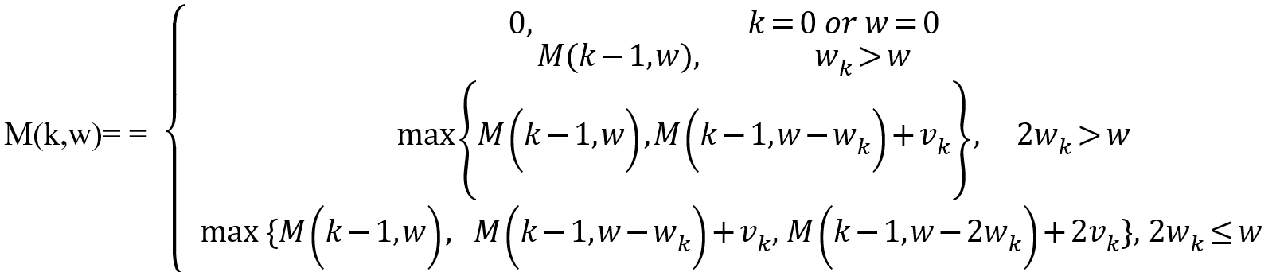
1）完成M(k,w)的递归方程。

Slide 60
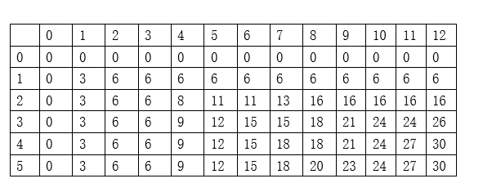
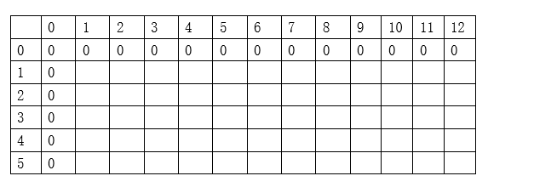
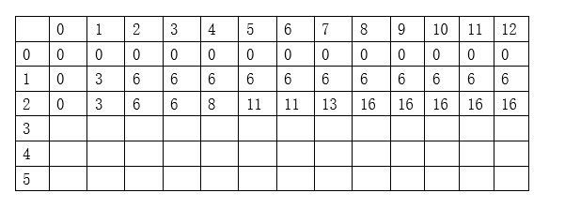
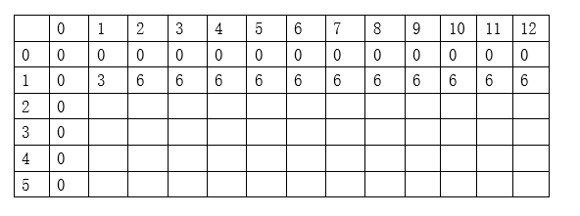
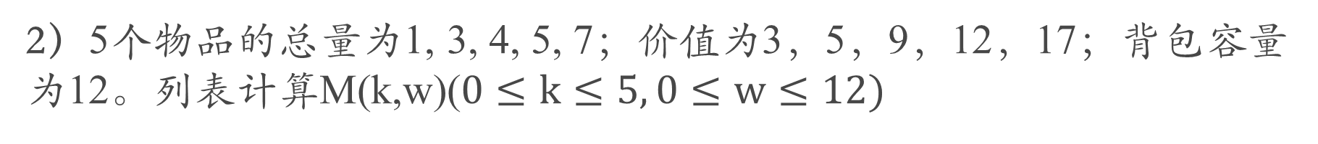
2）5个物品的总量为1, 3, 4, 5, 7；价值为3，5，9，12，17；背包容量为12。列表计算M(k,w)($0≤k≤5, 0≤w≤12)$

Slide 61
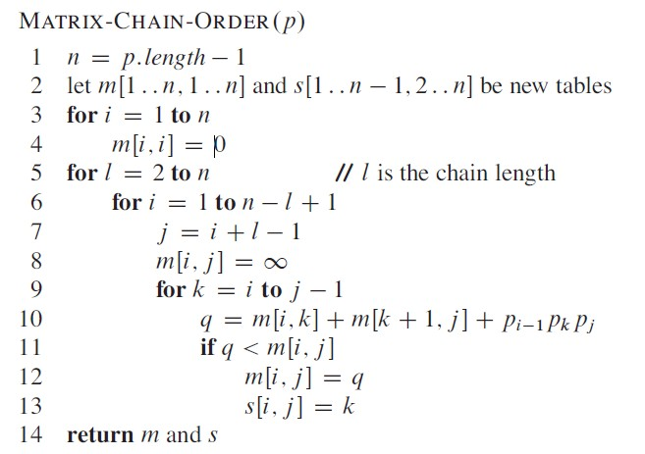
(4) Matrix chain multiplication
Given a sequence of matrices A₁ A₂…A_{n} , and dimensions p₀ p₁…p_{n} where A_{i} is of dimension p_{i-1} x p_{i} , determine multiplication sequence that minimizes the number of operations.
Θ(n³)

Slide 62

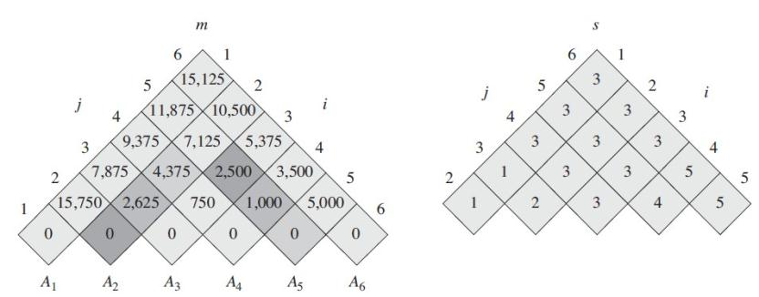
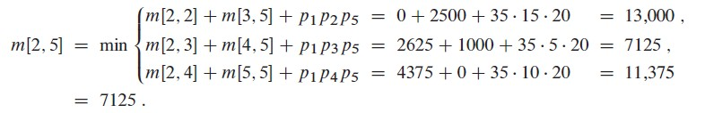
Applying dynamic programming
s[2,5] = 3

Slide 63
(5) Longest Common Subsequence (LCS)
Problem: Given 2 sequences, X = ⟨x₁,...,x_{m}⟩ and Y = ⟨y₁,...,y_{n}⟩, find a common subsequence whose length is maximum.
Recursive Solution Formulation
Theorem
Let Z = ⟨z₁, . . . , z_{k}⟩ be any LCS of X and Y .
1. If x_{m} = y_{n}, then z_{k} = x_{m} = y_{n} and Z_{k-1} is an LCS of X_{m-1} and Y_{n-1}.
2. If x_{m} ≠ y_{n}, then either z_{k} ≠ x_{m} and Z is an LCS of X_{m-1} and Y .
3. or z_{k} ≠ y_{n} and Z is an LCS of X and Y_{n-1}.
Define c[i, j] = length of LCS of X_{i} and Y_{j} .

Slide 64
LCS-LENGTH (X, Y)
m ← length[X]
n ← length[Y]
for i ← 1 to m
do c[i, 0] ← 0
for j ← 0 to n
do c[0, j ] ← 0
for i ← 1 to m
do for j ← 1 to n
do if x_{i} = y_{j}
then c[i, j ] ← c[i−1, j−1] + 1
b[i, j ] ← “ ”
else if c[i−1, j ] ≥ c[i, j−1]
then c[i, j ] ← c[i− 1, j ]
b[i, j ] ← “↑”
else c[i, j ] ← c[i, j−1]
b[i, j ] ← “←”
return c and b
PRINT-LCS (b, X, i, j)
if i = 0 or j = 0
then return
if b[i, j ] = “ ”
then PRINT-LCS(b, X, i−1, j−1)
print x_{i}
elseif b[i, j ] = “↑”
then PRINT-LCS(b, X, i−1, j)
else PRINT-LCS(b, X, i, j−1)
O(mn)
O(m+n)
b[i, j ] points to table entry whose subproblem we used in solving LCS of X_{i} and Y_{j}.
c[m,n] contains the length of an LCS of X and Y.

Slide 65
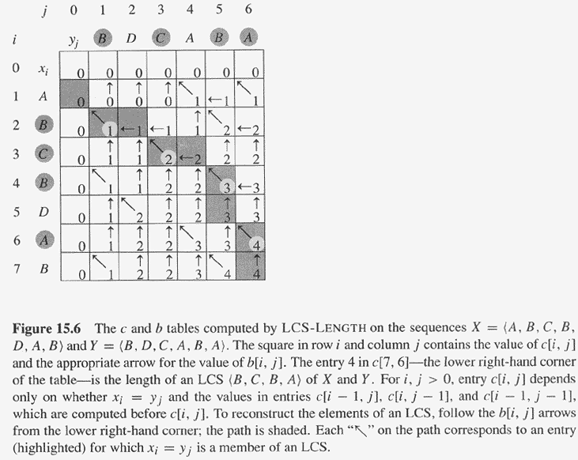
Copyright © The McGraw-Hill Companies, Inc. Permission required for reproduction or display.

Slide 66
(6) Optimal binary search trees (LCS)
Problem:
Given sequence K = k₁ < k₂ <··· < k_{n} of n sorted keys, with a search probability p_{i} for each key k_{i}.
Want to build a binary search tree (BST) with minimum expected search cost.
Actual cost = # of items examined.
For key k_{i}, cost = depth_{T}(k_{i})+1, where depth_{T}(k_{i}) = depth of k_{i} in BST T .
Recursive Solution Formulation
Define e[i, j ] = expected search cost of optimal BST for k_{i},...,k_{j}.

Slide 67
OPTIMAL-BST(p, q, n)
for i ← 1 to n + 1
do e[i, i− 1] ← 0
w[i, i− 1] ← 0
for l ← 1 to n
do for i ← 1 to n−l + 1
do j ←i + l−1
e[i, j ]←∞
w[i, j ] ← w[i, j−1] + p_{j}
for r ←i to j
do t ← e[i, r−1] + e[r + 1, j ] + w[i, j ]
if t < e[i, j ]
then e[i, j ] ← t
root[i, j ] ←r
return e and root
Consider all trees with l keys.
Fix the first key.
Fix the last key
Determine the root
of the optimal
(sub)tree
O(n³)

Slide 68
Chapter 16 Greedy Algorithm
Elements of Greedy Algorithm
Optimal substructure
the solutions to the subproblems used within the optimal solution must themselves be optimal.
Greedy-choice property
A globally optimal solution can be arrived at by making a locally optimal (greedy) choice.

Slide 69
(2) Typical Steps of Greedy Algorithm
Cast the optimization problem as one in which we make a choice and are left with one subproblem to solve.
Prove that there’s always an optimal solution that makes the greedy choice, so that the greedy choice is always safe.
Show that greedy choice and optimal solution to subproblem ⇒ optimal solution to the problem.
Make the greedy choice and solve top-down.
May have to preprocess input to put it into greedy order.

Slide 70
(3) Activity Selection Problem
Input: Set S of n activities, a₁, a₂, …, a_{n}.
s_{i} = start time of activity i.
f_{i} = finish time of activity i.
Output: Subset A of maximum number of compatible activities.
Two activities are compatible, if their intervals don’t overlap.
Recursive Solution
Assume activities are sorted by finishing times.
f₁ ≤ f₂ ≤ … ≤ f_{n}.
Let Sij = subset of activities in S that start after ai finishes and finish before aj starts.
Let c[i, j] = size of maximum-size subset of mutually compatible activities in Sij .
The problem also exhibits the greedy-choice property.
There is an optimal solution to the subproblem S_{ij}, that includes the activity with the smallest finish time in set S_{ij}.
Can be proved easily.

Slide 71
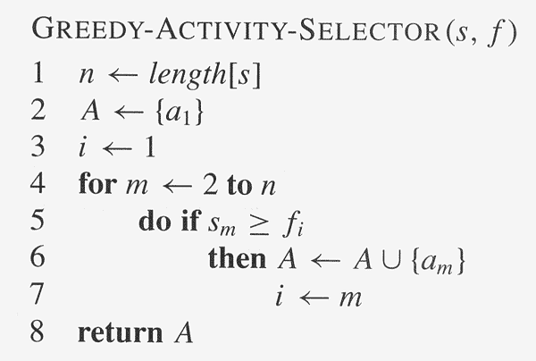
Recursive-Activity-Selector (s, f, i, j)
m ← i+1
while m < j and s_{m} < f_{i}
do m ← m+1
if m < j
then return {a_{m}} ∪
Recursive-Activity-Selector(s, f, m, j)
else return φ
Complexity: Θ(n)

Slide 72
(4) The Knapsack Problem: Greedy Vs. Dynamic
The fractional problem can be solved greedily
The 0-1 problem cannot be solved with a greedy approach
As you have seen, however, it can be solved with dynamic programming

Slide 73
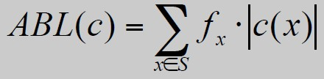
(5) Huffman Codes
Prefix codes :
Definition. A prefix code for a set S is a function c that maps each x∈S to 1s and 0s in such a way that for x,y∈S, x≠y, c(x) is not a prefix of c(y).
Optimal Prefix Codes
Definition. The average bits per letter of a prefix code c is the sum over all symbols of its frequency times the number of bits of its encoding:
Goal: the minimum ABL of any prefix code
Representing Prefix Codes using Binary Trees
Claim. The binary tree corresponding to the optimal prefix code is full.

Slide 74
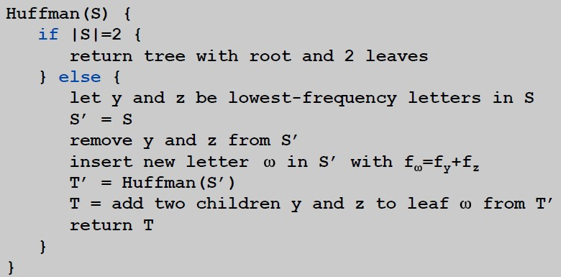
Optimal Prefix Codes: Huffman Encoding
Claim. There is an optimal prefix code with tree T* where the two lowest-frequency letters are assigned to leaves that are siblings in T*.
Greedy template. [Huffman, 1952] Create tree bottom-up.
Make two leaves for two lowest-frequency letters y and z.
Recursively build tree for the rest using a meta-letter for yz.
Q. What is the time complexity?
A. T(n) = T(n-1) + O(n) so O(n²)
Q. How to implement finding lowest-frequency letters efficiently?
A. Use priority queue for S: T(n) = T(n-1) + O(log n) so O(n log n)

Slide 75
例题：服务次序安排问题
设有 n 个顾客同时等待一项服务。顾客 i 需要的服务时间为 t_{i}，1≤i≤n。顾客必须排队依次接受服务，除排第一的顾客不用等待外，请他顾客需等到前面的所有顾客服务完，因此等待时间是前面顾客的服务时间之和。应该如何安排 n 个顾客的服务次序才能使总的时间达到最小？总的等待时间是每个顾客等待服务时间的总和，要求：
(1)给出算法描述（可用文字）
(2)分析算法的时间复杂性和空间复杂性
(3)证明算法的正确性（证明贪心选择性质即可）

Slide 76
解答：
（1）为了使所有顾客等待时间最小，需要安排服务时间长的顾客在队列的后面，安排服务时间短的在前面。计算就是按照服务时间从小到大排序。
（2）排序算法的复杂度，如果用合并排序，时间θ(n log(n)),空间θ(n)；插入排序时间O(n²),空间θ(1);堆排序时间θ(n log(n)),空间θ(1)… …
（3）证明服务时间最短的排在队列的前面，或者最长的排最后。如果最短的不在第1在第j(>1)位置，交换第1和第j的顾客，排在第j位后的顾客等待时间不受影响，而之前的顾客的总的等待时间只会减少不会增加，因此存在最优解服务时间最短的排在首位。

Slide 77
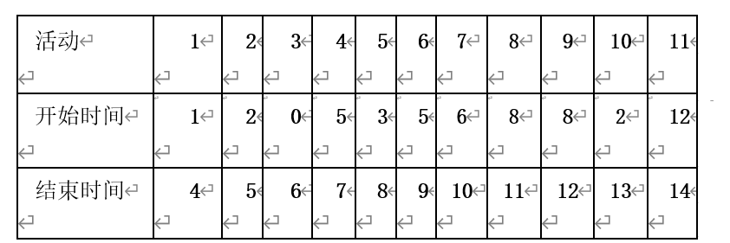
例题：活动选择问题
一组活动选出其中两两兼容（时间不重叠）的活动子集，子集中活动数量最多者为优。
(1)在可选活动中选择其中最先结束的活动，依次给出选出的活动
(2)在可选活动中选其中最晚开始的活动（时间相同的顺序任意），依次给出选择的活动
(3)在可选活动中选活动时间最短的活动，给出选的结果
(4)上述(1), (2)和(3)的选法，哪些可以得到最优解，哪些不能

Slide 78
解答：
（1）选择1、4、8、11活动。
（2）选择11、8、4、1活动
（3）选择4，11（顺序可换）1，8（顺序可换）
（4）（1）和（2）可得最优解，（3）一般不能得到最优解

Slide 79
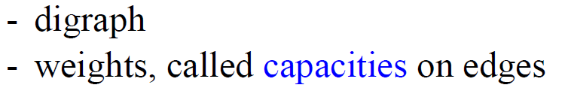




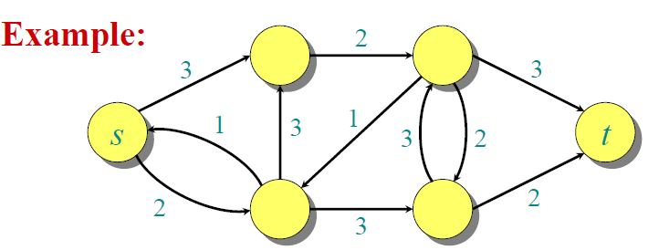
Chapter 26 Maximum Flow
Flow Network
Flow Network
- two distinct vertices
- each vertex on some path from source to sink

Slide 80
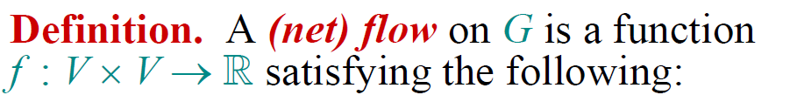
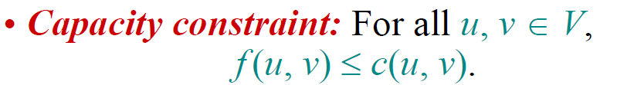
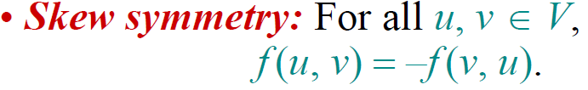
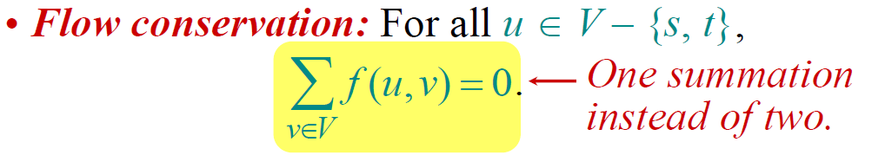
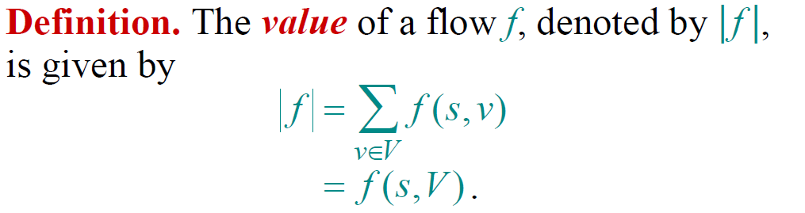
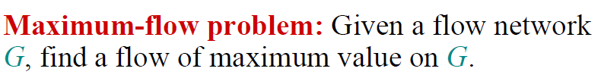
Net Flow

Slide 81








Simple Properties of Net Flow

Slide 82
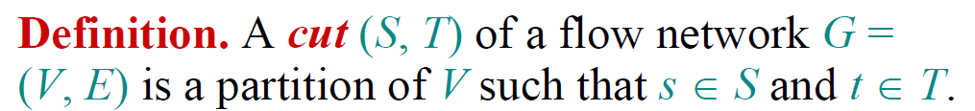



Cut

Slide 83




Residual Network
f(u,v) > 0
u
v
u
v
c(u,v)

Slide 84
Augmenting Path
An augmenting path p is a simple path from s to t in the residual network Gf of a flow network G.
residual capacity of p
the maximum flow | f | can increased by increasing the flow on each edge in p

Slide 85

Max-Flow, Min-Cut Theorem

Slide 86


（2）Ford-Fulkerson Algorithm
Rough Idea

Slide 87
（2）Edmonds & Karp Algorithm
Find the augmenting path using breadth-first search.
Breadth-first search gives the shortest path for graphs (Assuming the length of each edge is 1.)
Time complexity of Edmonds-Karp algorithm is O(|V||E|²).

Slide 88

例题
求下面的流量图的最大流。要求画出每次增流的剩余流量图（余网络）并标注增广路径。

Slide 89


