Slide 1

23/12/19
Trigyn Technologies
IoT Device simulator
A Project By – Manas Kabre
Trigyn Technologies Limited
Notes:
<number>

Slide 2
23/12/19
INTRODUCTION
This project is a cloud based Intelligent IoT device simulator.
It provides a custom made UI to interact with different IoT devices like AC,Smart Bulb, etc.
We also have a custom designed dashboard to get details about each of these IoT Devices.
The details include the history of all the changes made to each of the IoT devices.
It manages the visualization of this dataset with ultimate ease and flexibility.
<number>

Slide 3
23/12/19
TOOLS USED
Python-django
Materialise-CSS
Fiware – context broker
Docker (used to make fiware run)
Fiware- Quantum Leap
Grafana
Crate.io
<number>

Slide 4
Key Features
Unique Dashboard
Supports all platforms
Easy to use UI
Non-Intrusive
`
Easy To Deploy and manage
Real-Time Monitoring
Powerful Analytics
Grouping of multiple assests of same type

Slide 5
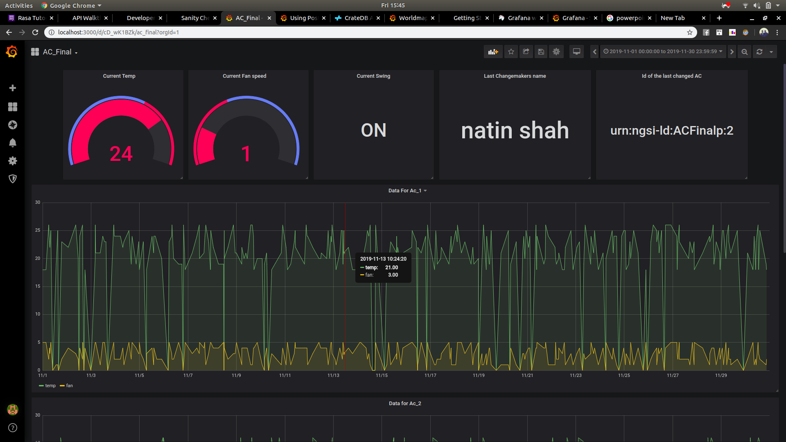
23/12/19
Dashboard : AC
<number>

Slide 6
Dashboard : AC
The Dashboard gives real-time details of the key parameters of the AC such as the temperature, fan speed, swing status and the last change-maker’s name.
The line graph gives the visualization of the temperature and fan speed data for the desired time range.
Every AC has an unique Id which allows us to track the performance and illustrate them using Gauge and Graphs.
All the AC’s can be grouped to get a powerful data graph for the desired time range vs Temperature.

Slide 7
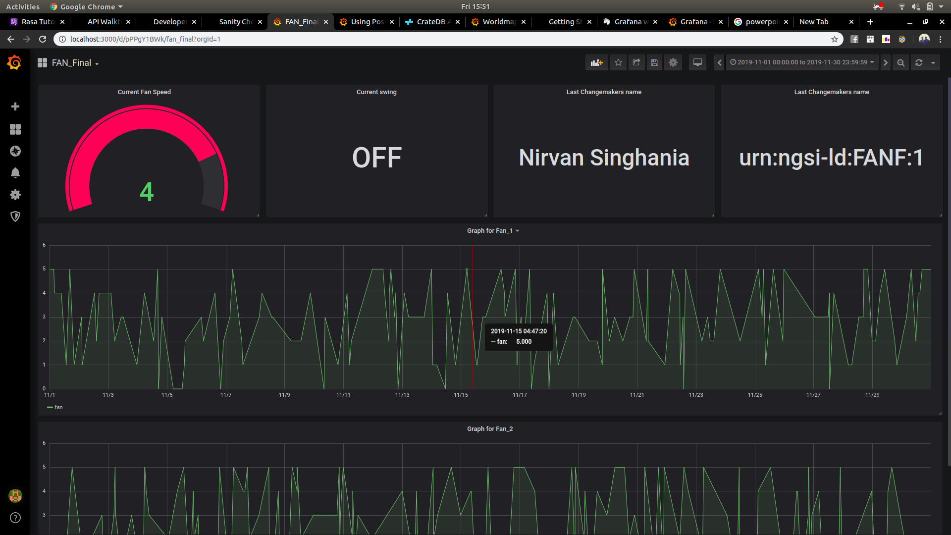
23/12/19
Dashboard : FAN
<number>

Slide 8
Dashboard : FAN
The Dashboard gives real-time details of the key parameters of the FAN such as the fan speed, swing status and the last change-maker’s name.
The line graph gives the visualization of the fan speed data for the desired time range.
Every Fan has an unique Id which allows us to track the performance and illustrate them using Gauge and Graphs.
All the Fan’s can be grouped to get a powerful data graph for the desired time range vs Temperature.

Slide 9
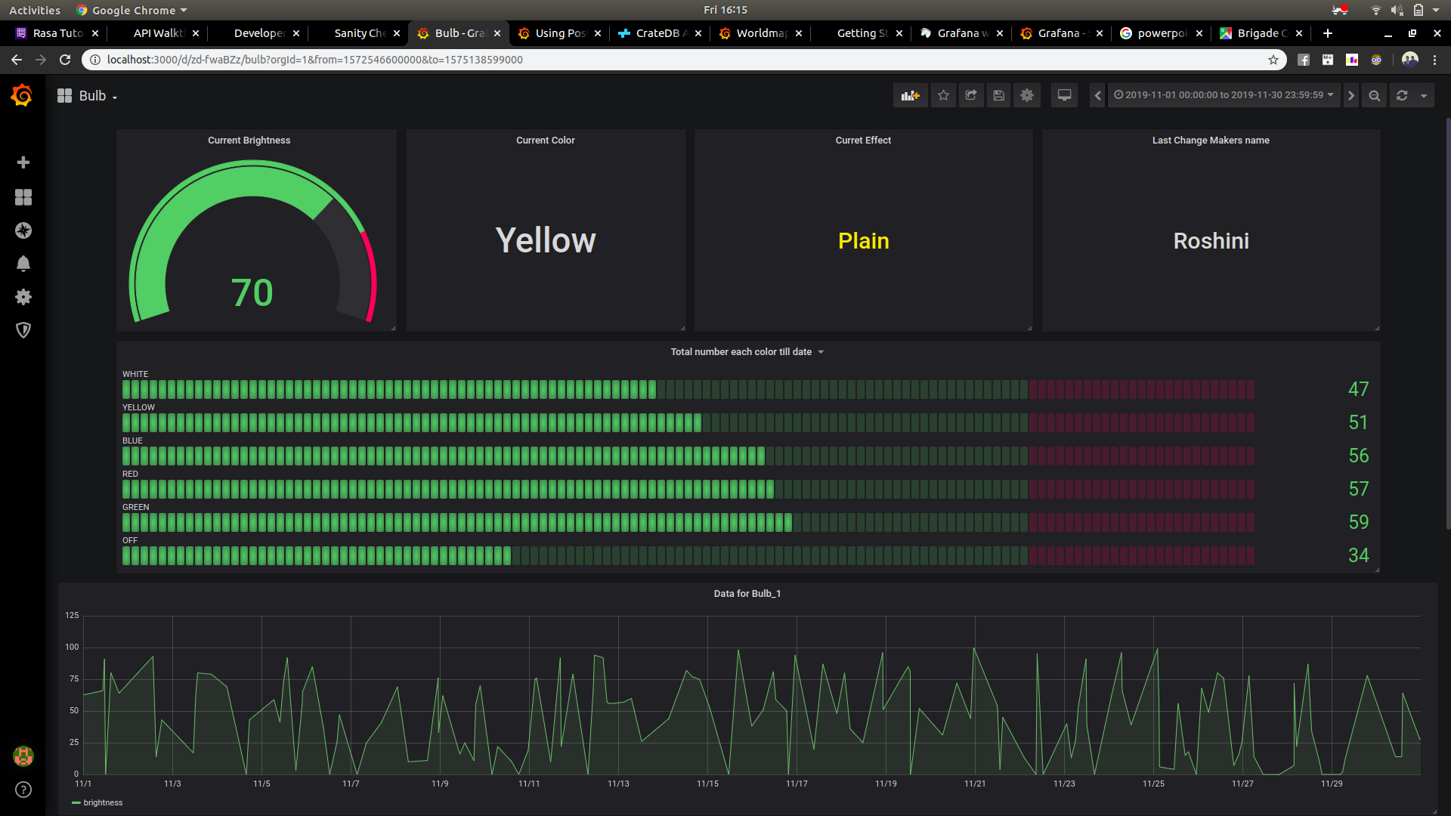
23/12/19
Dashboard : Bulb
<number>

Slide 10
Dashboard : Bulb
The Dashboard gives real-time details of the key parameters of the Bulb such as the Brightness, Color and the last change-maker’s name, and the effect being used.
The line graph gives the visualization of the brightness data for the desired time range.
Every Bulb has an unique Id which allows us to track the performance and illustrate them using Gauge and Graphs.
The bar graph gives a data visualization for all different colors which have been used by different users.

Slide 11
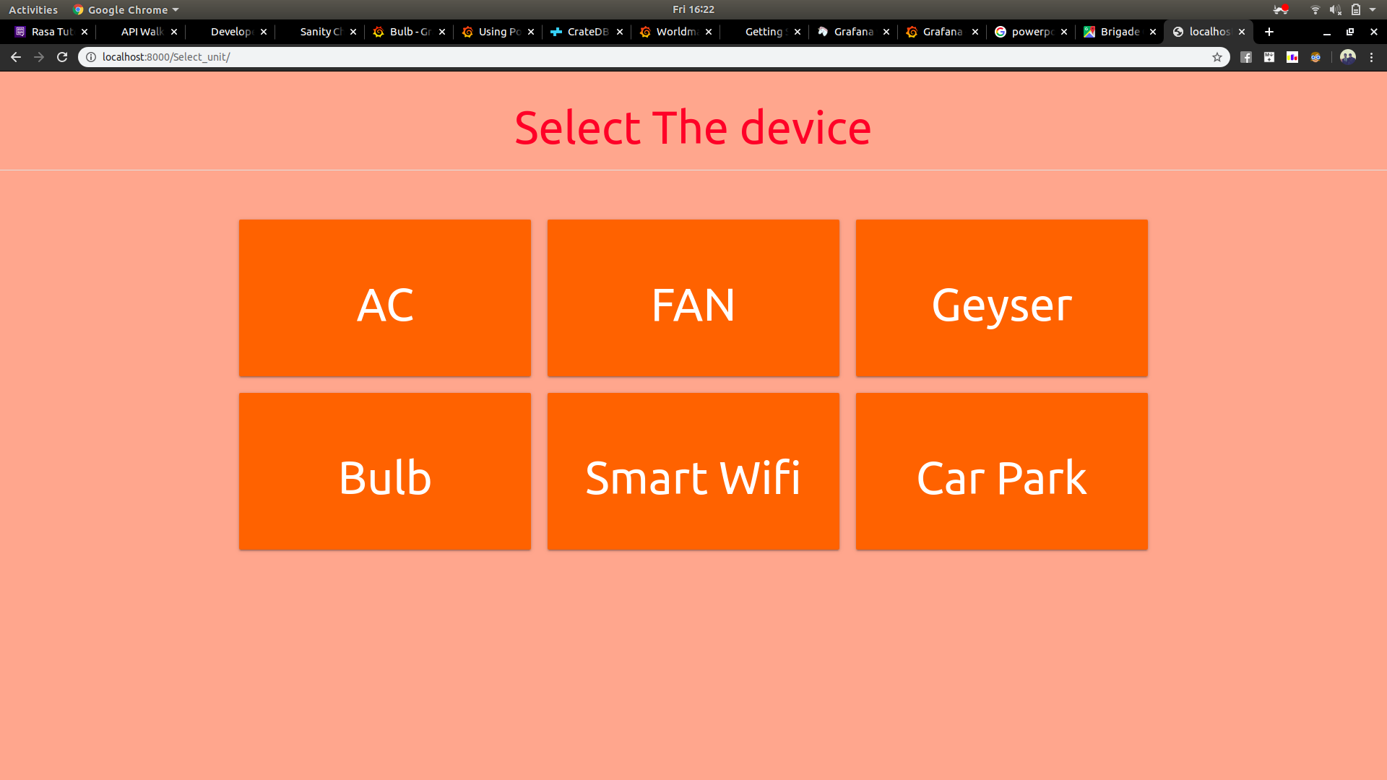
UI – Home Page

Slide 12
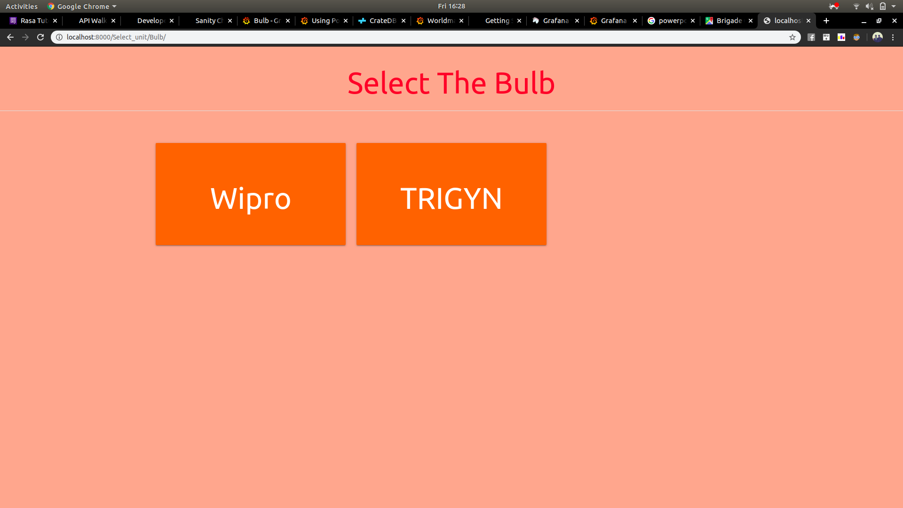
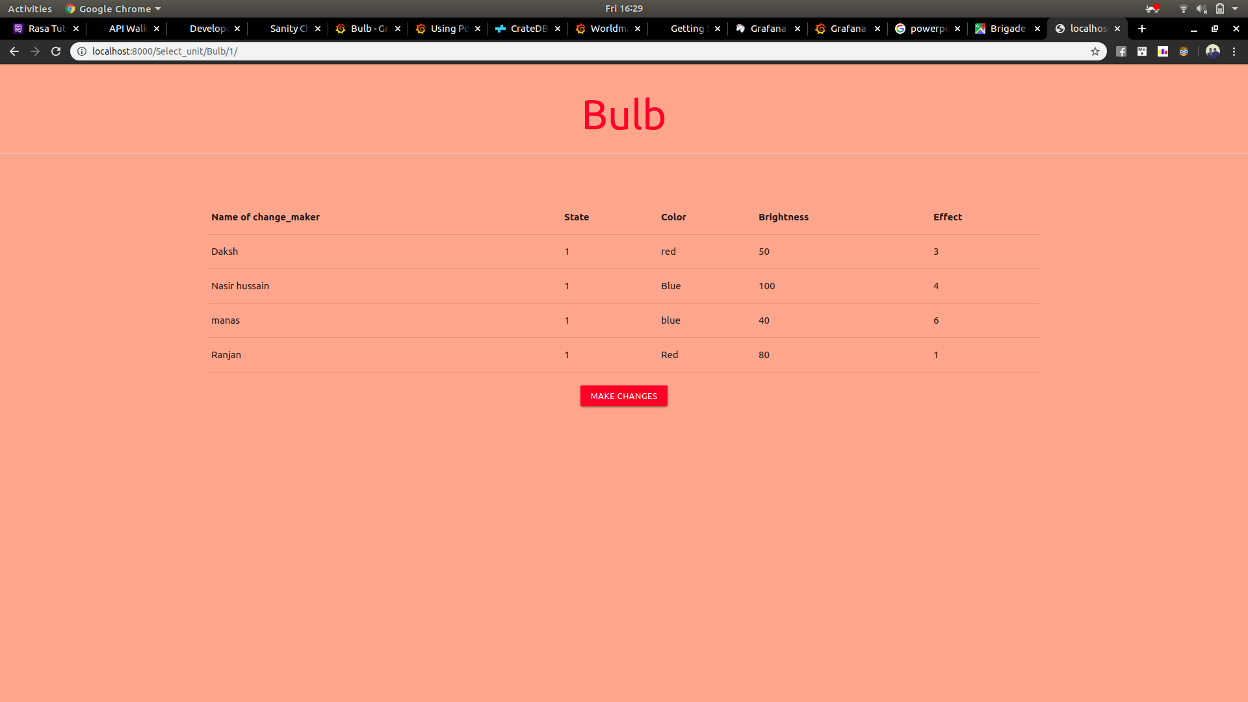
UI – Bulb(Example)

Slide 13
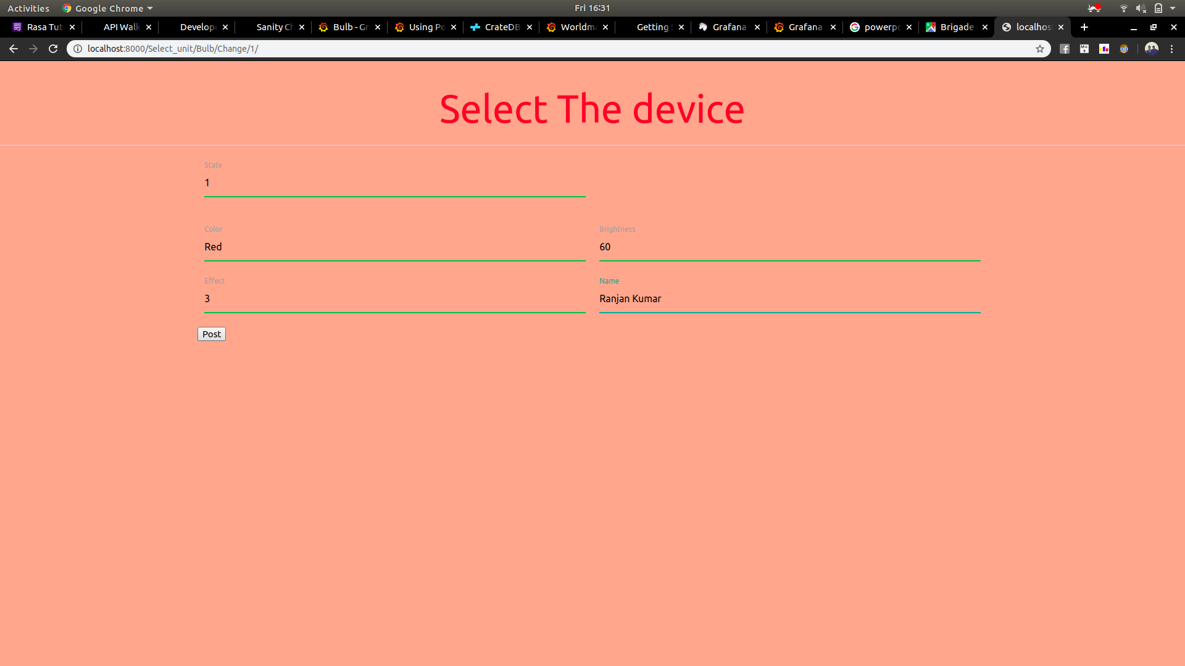
UI – Bulb(Example)
Once the post button is clicked the data is sent to bulb and the changes are reflected on the bulb.
The new changes are reflected on the dashboard in real time.

Slide 14
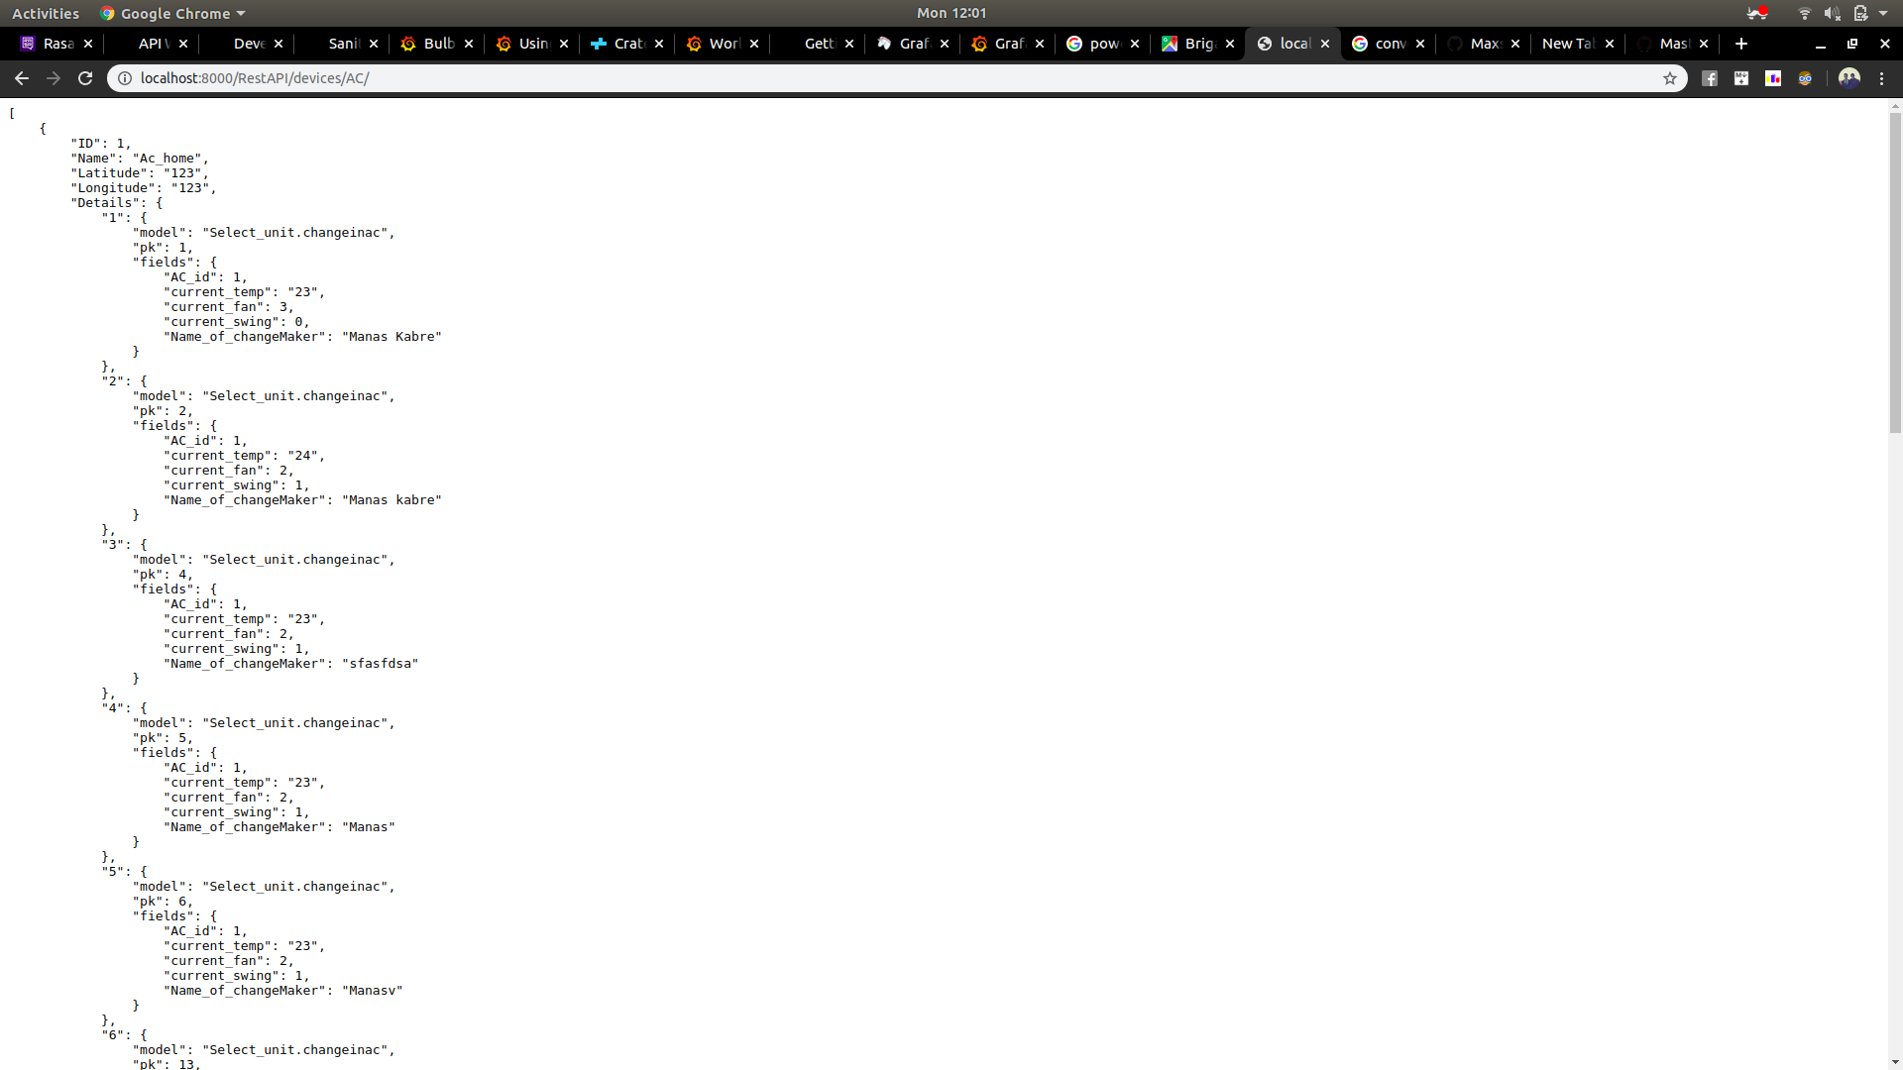
Rest-API’s
The webapp also offers certain RestAPI’s to see the details about different deiveces in json format
These details get us the raw data which can furthr be used for whatever the requirement may be

Slide 15

23/12/19
Thank You!
Trademarks, Registered Trademarks and Product Names used in this presentation are the
property of their respective owners and all rights to such remain with their owners.
<number>

