Slide 1
SLIDE 1: Cellular Respiration
Subtitle: This lecture explains how cells turn sugar and oxygen into usable energy.
Key themes: - Energy transformation in cells - Step-by-step pathways of respiration - How oxygen and lack of oxygen change the outcome

Slide 2
SLIDE 2: LEARNING OBJECTIVES
By the end of this lecture, students will be able to:
Describe the overall chemical equation for aerobic respiration and name its main products.
Outline the three major stages of aerobic respiration (glycolysis, citric-acid cycle, oxidative phosphorylation) and where each occurs in the cell.
Explain how ATP (adenosine triphosphate - the cell's "energy currency") is generated by substrate-level phosphorylation and by chemiosmosis.
Compare the ATP yield of aerobic respiration with that of anaerobic (fermentation) pathways and discuss why oxygen matters.

Slide 3
SLIDE 3: TOPIC INTRODUCTION & CONTEXT
All living cells need a constant supply of usable energy to grow, move, and maintain their structures.
Cellular respiration is a series of enzyme-catalyzed reactions that convert the chemical energy stored in glucose (a six-carbon sugar) into ATP.
The process can occur with oxygen (aerobic respiration) or without it (anaerobic fermentation), but the amount of ATP produced differs dramatically.
Understanding respiration helps explain everyday phenomena such as why we feel winded after running or why bread dough rises.
The pathways are highly organized: glycolysis happens in the cytosol, while the remaining steps take place inside mitochondria, the cell's "power plants."

Slide 4
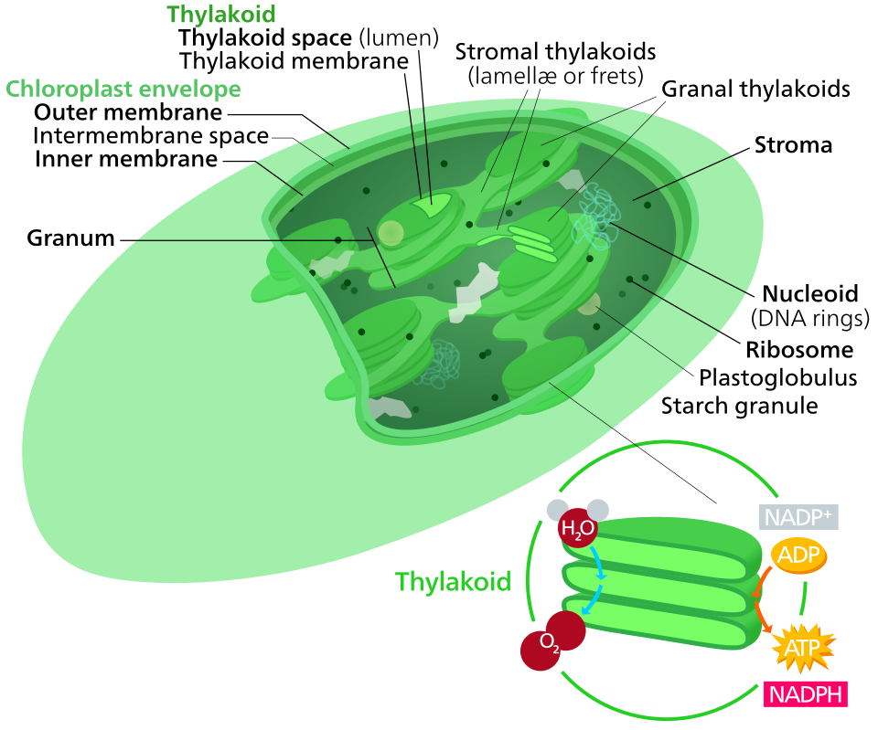
SLIDE 4: CORE CONCEPT 1 - GLYCOLYSIS: THE FIRST ENERGY HARVEST
Glycolysis is a ten-step pathway that splits one glucose molecule into two three-carbon pyruvate molecules in the cytosol.
The pathway uses two ATP molecules early on but later produces four, giving a net gain of two ATP (substrate-level phosphorylation).
Two NAD⁺ molecules are reduced to NADH, which later feed electrons into the electron transport chain.
Key regulatory enzymes are hexokinase (adds a phosphate to glucose) and phosphofructokinase-1 (PFK-1, a major "traffic-light" that responds to cellular energy levels).
If oxygen is unavailable, glycolysis can continue only if NAD⁺ is regenerated through fermentation.

Slide 5
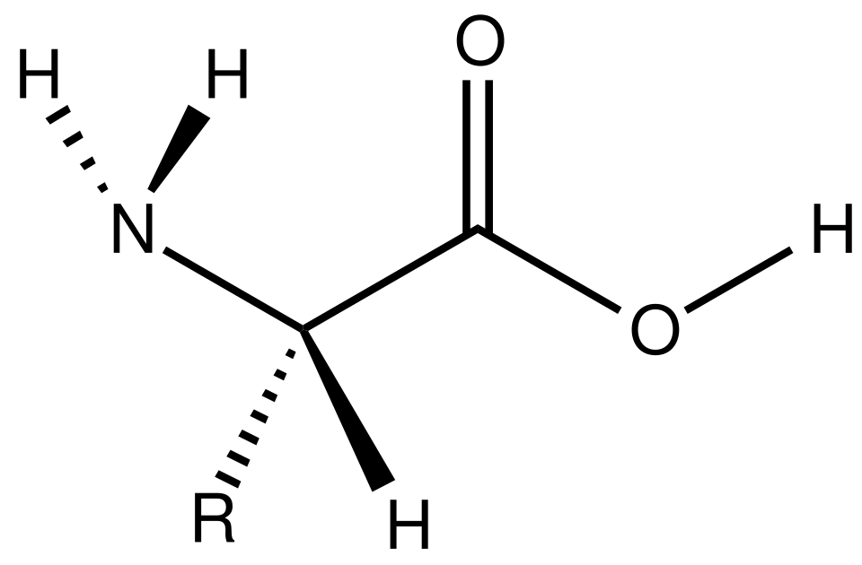
SLIDE 5: CORE CONCEPT 2 - PYRUVATE OXIDATION & THE CITRIC ACID CYCLE
Each pyruvate enters the mitochondrial matrix and is converted into acetyl-CoA by the pyruvate dehydrogenase complex, releasing one CO₂ and producing one NADH.
Acetyl-CoA then combines with oxaloacetate to start the citric-acid (Krebs) cycle, a series of eight reactions that fully oxidize the carbon atoms to CO₂.
For each turn of the cycle, three NADH, one FADH₂ (another electron carrier), and one GTP (converted to ATP) are generated.
Important control points include isocitrate dehydrogenase and α-ketoglutarate dehydrogenase, which are activated by low energy (high ADP/NAD⁺) and inhibited by high energy (high ATP/NADH).
The cycle's output-NADH and FADH₂-provides the electrons that power the electron transport chain.

Slide 6
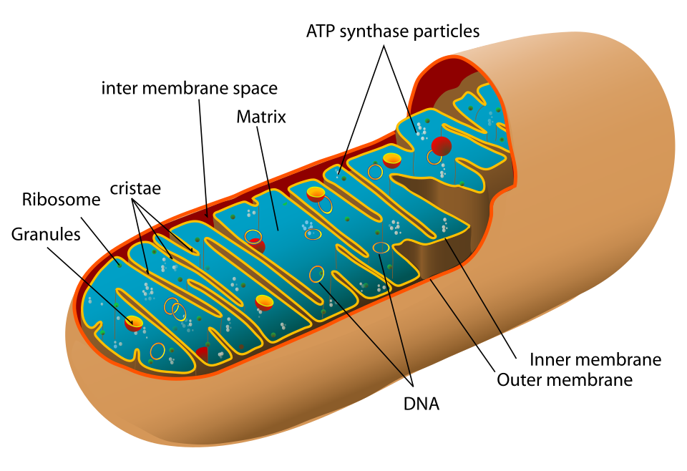
SLIDE 6: CORE CONCEPT 3 - OXIDATIVE PHOSPHORYLATION: ELECTRON TRANSPORT & CHEMIOSMOSIS
NADH and FADH₂ donate electrons to the electron transport chain (ETC), a series of protein complexes (I-IV) embedded in the inner mitochondrial membrane.
As electrons move through the complexes, protons (H⁺) are pumped from the matrix to the inter-membrane space, creating an electrochemical gradient called the proton-motive force.
Oxygen acts as the final electron acceptor, combining with electrons and protons to form water-without O₂ the chain backs up and stops.
The return flow of protons through ATP synthase (a rotary motor enzyme) drives the synthesis of ATP from ADP and inorganic phosphate (Pi) - this is chemiosmosis.
Approximately 28-30 ATP molecules are produced by oxidative phosphorylation for each glucose molecule, depending on the efficiency of the shuttle systems that move NADH into mitochondria.

Slide 7
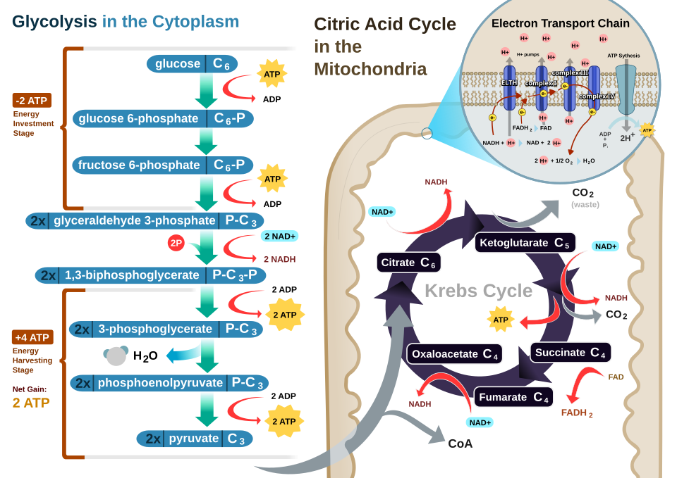
SLIDE 7: DEEP DIVE & MECHANISMS
Complex I (NADH dehydrogenase) accepts electrons from NADH and pumps four protons across the membrane.
Complex II (succinate dehydrogenase) receives electrons from FADH₂ but does not pump protons, contributing fewer protons to the gradient.
Ubiquinone (CoQ) shuttles electrons between Complexes I/II and Complex III, while cytochrome c carries them to Complex IV.
At Complex IV (cytochrome c oxidase), electrons reduce molecular oxygen to water, and four protons are pumped, completing the gradient.
The resulting proton-motive force drives ATP synthase, which can produce up to three ATP per full rotation of its central stalk.

Slide 8
SLIDE 8: REAL-WORLD APPLICATIONS & EXAMPLES
During intense exercise, muscles rely on glycolysis and lactic-acid fermentation, leading to the familiar "burn" and temporary muscle fatigue.
Yeast cells perform alcoholic fermentation (pyruvate → ethanol + CO₂) to regenerate NAD⁺, a process exploited in bread making and brewing.
Certain diseases, such as mitochondrial myopathies, arise from defects in the ETC, causing reduced ATP production and chronic fatigue.
Athletes use "oxygen-training" to increase the number of mitochondria in muscle cells, thereby boosting aerobic ATP yield.
Biotechnologists engineer microbes with altered respiration pathways to produce bio-fuels or high-value chemicals more efficiently.

Slide 9
SLIDE 9: CRITICAL THINKING & ANALYSIS
Why does the presence of oxygen allow cells to extract far more ATP from glucose than anaerobic fermentation alone?
How would a blockage at Complex I of the ETC affect the overall ATP yield and the cell's reliance on glycolysis?
Compare the regulatory roles of PFK-1 in glycolysis and isocitrate dehydrogenase in the citric-acid cycle; how do they help match energy production to demand?
Predict what would happen to blood pH if lactic-acid fermentation persisted for an extended period during a marathon.
Discuss how the concept of "substrate-level phosphorylation" differs from "oxidative phosphorylation" in terms of where and how ATP is made.

Slide 10
SLIDE 10: SUMMARY & CONCLUSION
Key points covered:
Cellular respiration transforms glucose and oxygen into CO₂, water, and up to ~32 ATP through glycolysis, the citric-acid cycle, and oxidative phosphorylation.
ATP is generated directly in glycolysis (substrate-level) and indirectly via the proton-gradient created by the electron transport chain (chemiosmosis).
Oxygen is essential for the high-yield aerobic pathway; without it, cells resort to low-yield fermentation, which has distinct physiological consequences.
Discussion question: If a cell could not import oxygen, how might it reorganize its metabolism to survive, and what trade-offs would it face?
Further reading: Explore an interactive animation of the mitochondrial electron transport chain (e.g., a reputable educational website or textbook supplement).

