Slide 1
EDUFORGE AI · CURRICULUM SUITE
Computer organization
This lecture explains how the parts inside a computer work together to run programs.
Target Audience: Secondary Education Curriculum
September 15, 2026 | 10 Learning Slides | Multi-Agent Pedagogical Pipeline

Slide 2
COMPUTER ORGANIZATION · SECONDARY LEVEL
SLIDE 1: Computer Organization
01
Key themes
- How the CPU processes instructions - How data is stored and accessed in memory - How hardware design choices affect speed and capacity
Computer organization | EduForge AI Curriculum Suite
01 / 10

Slide 3
COMPUTER ORGANIZATION · SECONDARY LEVEL
SLIDE 2: LEARNING OBJECTIVES
01
02
Describe the main components of a CPU and their roles.
Explain how the ALU performs arithmetic, logical, and two's-complement operations.
03
04
Identify why word alignment and structure padding matter for memory performance.
Outline the purpose of virtual memory and how pages are mapped to physical RAM.
Computer organization | EduForge AI Curriculum Suite
02 / 10

Slide 4
COMPUTER ORGANIZATION · SECONDARY LEVEL
SLIDE 3: TOPIC INTRODUCTION & CONTEXT
01
02
Modern computers are built from many tiny electronic switches that represent binary 0s and 1s.
The CPU (Central Processing Unit) fetches, decodes, and executes the binary instructions that make programs run.
03
04
Memory is organized into words, which are the natural data size the CPU can move in a single cycle.
Alignment means placing each word at an address that is a multiple of its size, which speeds up access.
05
Understanding these low-level details helps students see why some programs run faster than others.
Computer organization | EduForge AI Curriculum Suite
03 / 10

Slide 5
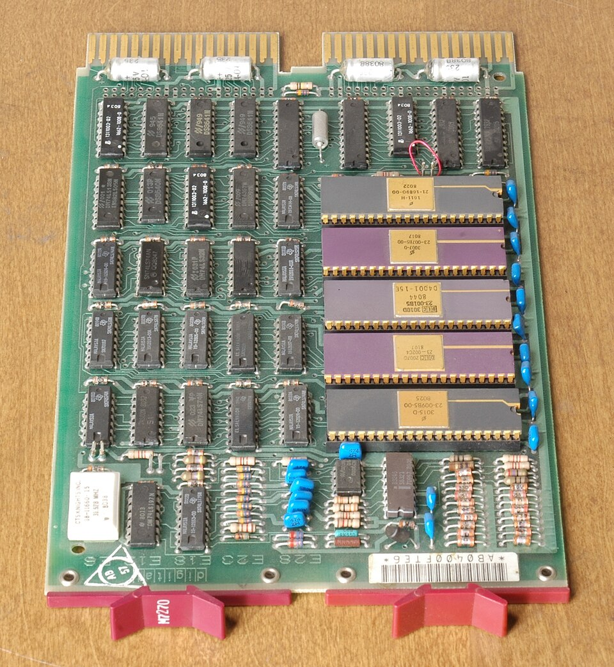
COMPUTER ORGANIZATION · SECONDARY LEVEL
SLIDE 4: CORE CONCEPT 1: CPU - The Brain of the Computer
01
The CPU contains a Control Unit that decides which operation to perform next.
02
Inside the CPU are General-Purpose Registers, tiny fast storage locations that hold data while it is being processed.
03
The Control Unit sends data to the ALU (Arithmetic-Logic Unit) for calculation or logical testing.
04
Each instruction is carried out in one or more clock cycles, a rhythmic "tick" that synchronizes the whole chip.
Visual Concept Diagram · EduForge AI
Computer organization | EduForge AI Curriculum Suite
04 / 10

Slide 6
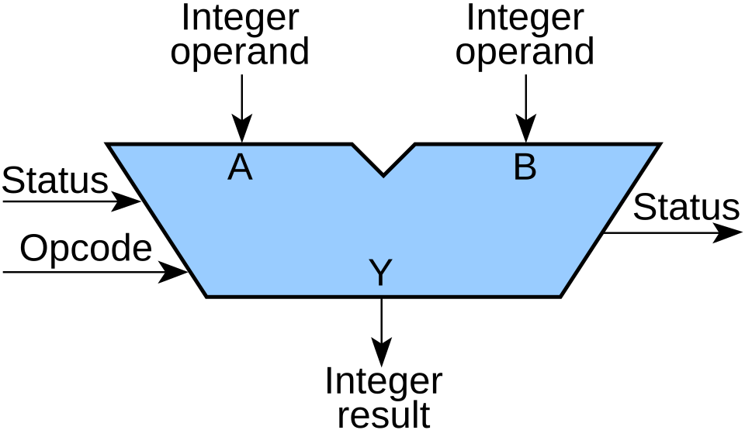
COMPUTER ORGANIZATION · SECONDARY LEVEL
SLIDE 5: CORE CONCEPT 2: ALU - Arithmetic-Logic Unit
01
The ALU is a combinational circuit that produces a result in a single clock cycle for most operations.
02
It can add, subtract, multiply, and perform logical functions such as AND, OR, XOR, and NOT on binary numbers.
03
Subtraction is performed by adding the two's-complement (invert-bits-and-add-1) of the number to be subtracted.
04
Bit-masking uses logical operations with a mask value to isolate, set, or clear particular bits in a word.
Visual Concept Diagram · EduForge AI
Computer organization | EduForge AI Curriculum Suite
05 / 10

Slide 7
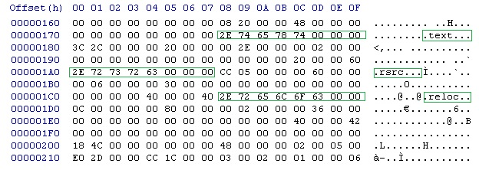
COMPUTER ORGANIZATION · SECONDARY LEVEL
SLIDE 6: CORE CONCEPT 3: MEMORY ORGANIZATION - WORDS, ALIGNMENT, AND PADDING
01
A memory word is the natural chunk of data the CPU handles; on many systems a word is 4 bytes (32 bits).
02
When a word's address is a multiple of 4, the CPU can fetch it in a single read cycle; misaligned accesses may need two cycles.
03
Structure padding inserts unused bytes so each field starts at its natural alignment boundary, creating an "unpacked" layout.
04
A packed structure removes the padding, saving space but sometimes causing slower or illegal accesses on certain CPUs.
Visual Concept Diagram · EduForge AI
Computer organization | EduForge AI Curriculum Suite
06 / 10

Slide 8
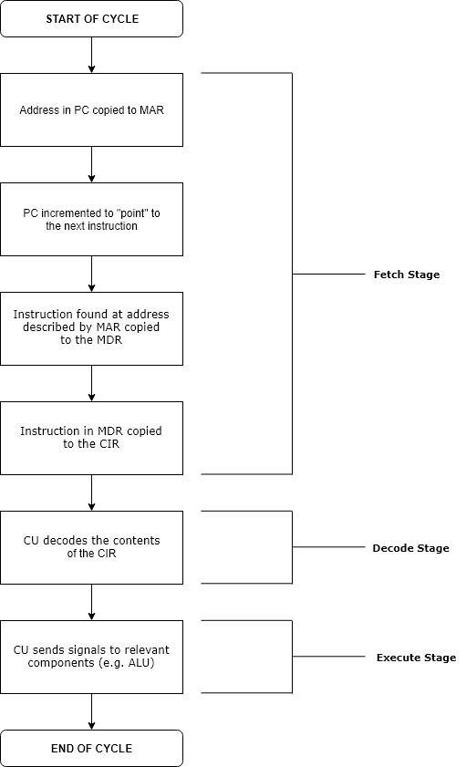
COMPUTER ORGANIZATION · SECONDARY LEVEL
SLIDE 7: DEEP DIVE & MECHANISMS - THE INSTRUCTION CYCLE
01
The fetch stage reads the next instruction word from memory using the program counter (PC).
02
The decode stage interprets the binary opcode and determines which registers and ALU operation are needed.
03
The execute stage sends the required operands to the ALU, which produces a result in one clock cycle.
04
The write-back stage stores the result into a destination register or memory location.
Visual Concept Diagram · EduForge AI
Computer organization | EduForge AI Curriculum Suite
07 / 10

Slide 9
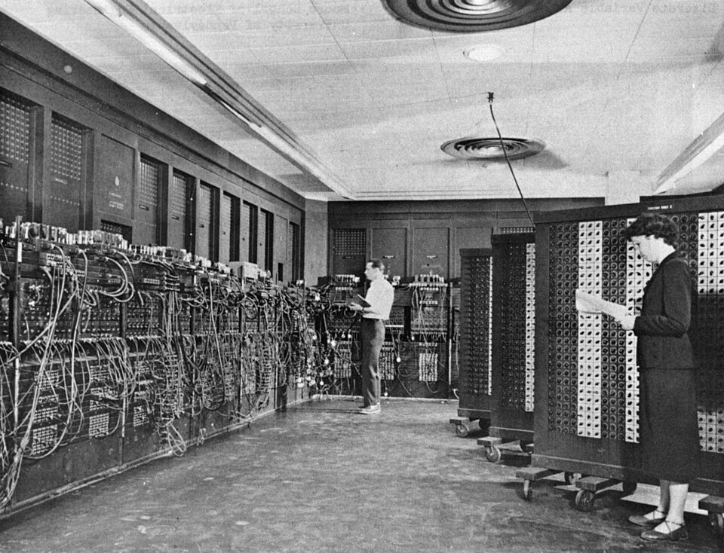
COMPUTER ORGANIZATION · SECONDARY LEVEL
SLIDE 8: REAL-WORLD APPLICATIONS & EXAMPLES
01
Game developers rely on the VFP coprocessor's 32 single-precision registers to perform fast 3-D graphics calculations.
02
Embedded systems often use packed structures to conserve memory, but must ensure the processor supports unaligned accesses.
03
Operating systems implement virtual memory so each program thinks it has a large, private address space, improving security and multitasking.
04
Page tables map 4 KB virtual pages to physical RAM pages, allowing the OS to swap rarely used pages to disk without the program noticing.
Visual Concept Diagram · EduForge AI
Computer organization | EduForge AI Curriculum Suite
08 / 10

Slide 10
COMPUTER ORGANIZATION · SECONDARY LEVEL
SLIDE 9: CRITICAL THINKING & ANALYSIS
01
02
Why might a programmer choose a packed structure even though it can cause slower memory accesses on some CPUs?
How does two's-complement representation simplify the hardware design of the ALU compared to separate subtraction circuitry?
03
04
In what situations could misaligned memory accesses lead to program crashes rather than just slower performance?
Consider the trade-off between having many registers (e.g., VFP's 32 single-precision registers) and the silicon area they occupy on a chip.
05
How does virtual memory enable a computer with 4 GB of RAM to run a program that appears to need 8 GB of address space?
Computer organization | EduForge AI Curriculum Suite
09 / 10

Slide 11
COMPUTER ORGANIZATION · SECONDARY LEVEL
SLIDE 10: SUMMARY & CONCLUSION
01
02
The CPU's Control Unit, registers, and ALU work together to execute instructions in clock-synchronized steps.
Alignment, word size, and structure padding directly affect how quickly data can be fetched and how much memory a program uses.
03
04
Discussion question
Virtual memory abstracts physical RAM, providing isolation, flexibility, and the illusion of larger memory.
*If you were designing a new smartphone processor, which memory-alignment rule would you prioritize and why?*
05
Further reading
Explore an introductory textbook chapter on "Computer Architecture" or a reputable online tutorial that explains binary arithmetic and memory hierarchy.
Computer organization | EduForge AI Curriculum Suite
10 / 10

Slide 12
End of Lecture
Computer organization

