Slide 1
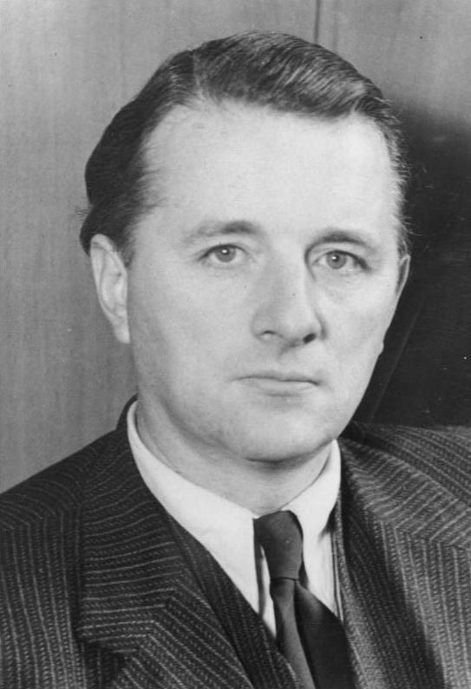
SLIDE 1: Title - Photosynthesis Fundamentals
Subtitle: How plants convert solar radiation into biological chemical energy.
Key themes: Solar energy capture, Chloroplast ultrastructure, Calvin cycle biochemical pathways.

Slide 2
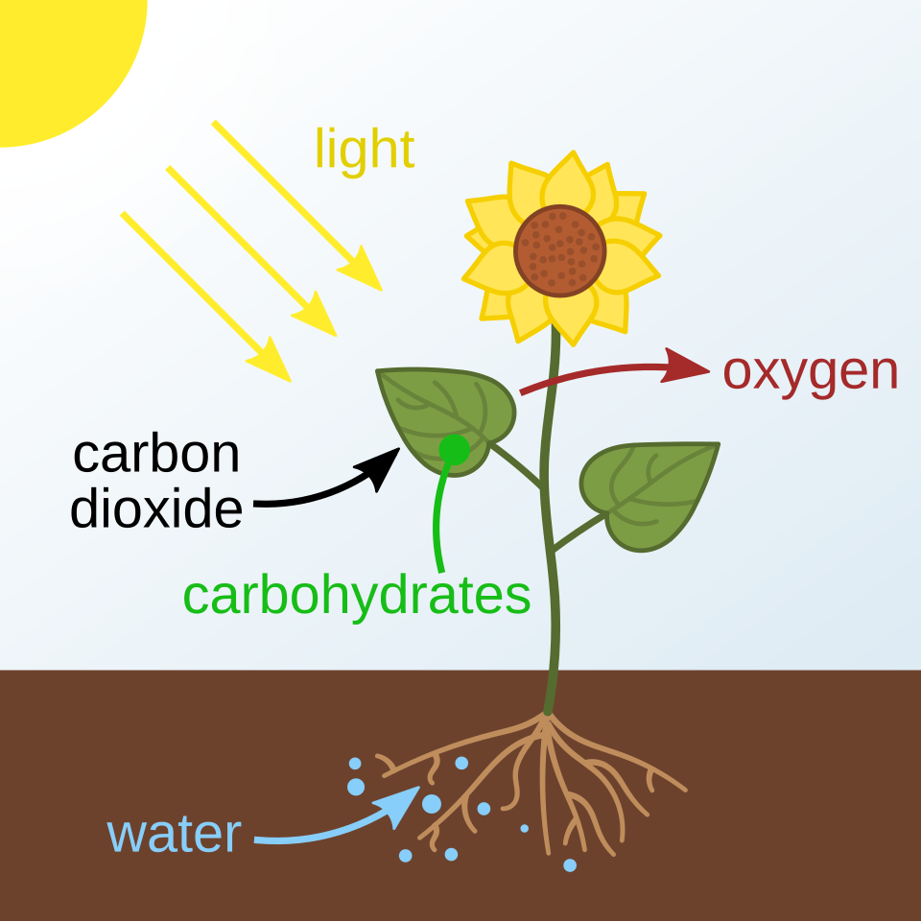
SLIDE 2: LEARNING OBJECTIVES
By the end of this lecture, students will be able to:
Formulate and explain the balanced chemical equation for oxygenic photosynthesis.
Identify and describe the structural functions of thylakoid membranes, grana, and stroma.
Trace the sequence of electron flow through photosystem II and photosystem I in the Z-scheme.
Summarize the three major phases of the Calvin cycle occurring in the stroma.

Slide 3
SLIDE 3: TOPIC INTRODUCTION & CONTEXT
Photosynthesis is the fundamental biological reaction sustaining nearly all life on Earth.
Autotrophic organisms capture electromagnetic radiation and convert it into chemical bond energy.
The overall balanced reaction consumes 6 carbon dioxide and 6 water molecules to yield glucose and oxygen.
Terrestrial plants, aquatic algae, and cyanobacteria act as the primary photosynthetic producers.
The released oxygen gas maintains Earth's atmospheric composition necessary for aerobic respiration.

Slide 4
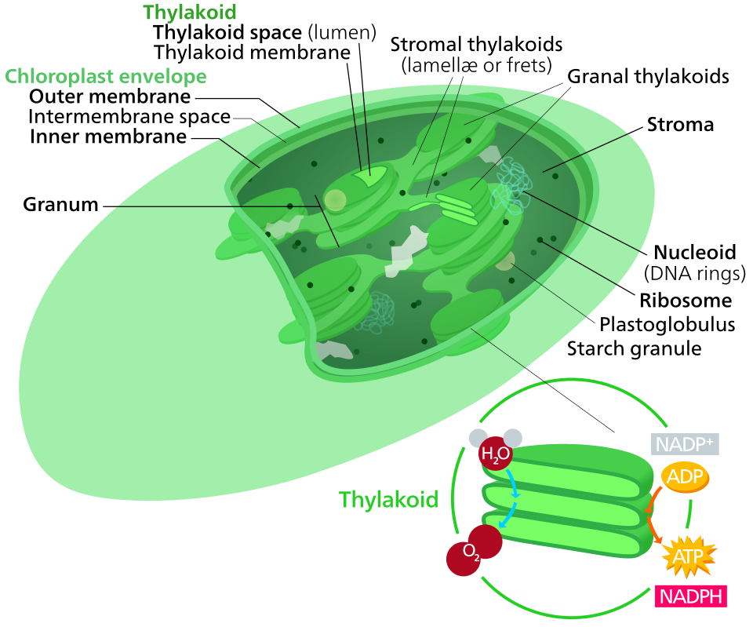
SLIDE 4: CORE CONCEPT 1: CHLOROPLAST STRUCTURE & THYLAKOIDS
Photosynthesis takes place inside specialized double-membrane organelles termed chloroplasts.
The stroma is a dense, protein-rich fluid matrix containing enzymes required for carbohydrate synthesis.
Thylakoids are flattened, disc-shaped membranous sacs organized into stacks known as grana.
Chlorophyll a and accessory pigments are embedded directly into the thylakoid lipid bilayer.
The lumen inside thylakoids maintains a concentrated proton gradient during photochemical activity.

