Slide 1
SLIDE 1: Photosynthesis in Plants - Introduction
Subtitle: An overview of solar energy conversion in flora

Slide 2
SLIDE 2: Learning Objectives
Understand light-dependent reactions
Identify chloroplast structures

Slide 3
SLIDE 3: Topic Introduction & Context
Plants harness solar energy
Base of terrestrial food webs

Slide 4
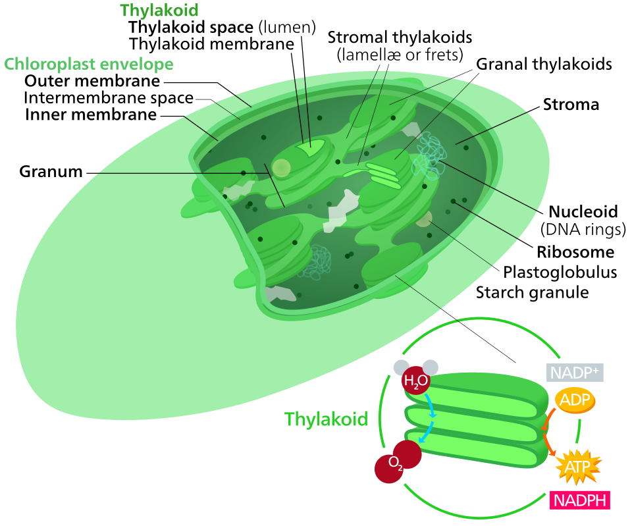
SLIDE 4: Chloroplast Structure & Thylakoid Membrane
Double membrane organelle
Thylakoids house chlorophyll pigments

Slide 5
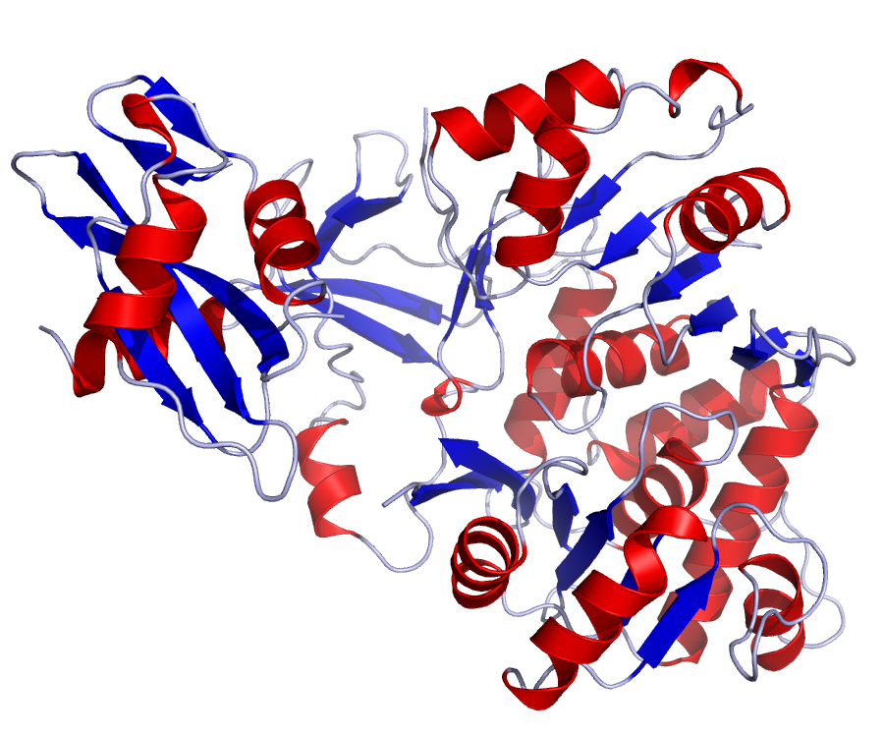
SLIDE 5: Light-Dependent Reaction Mechanisms
Photons excite electrons in Photosystem II
ATP and NADPH synthesized

Slide 6
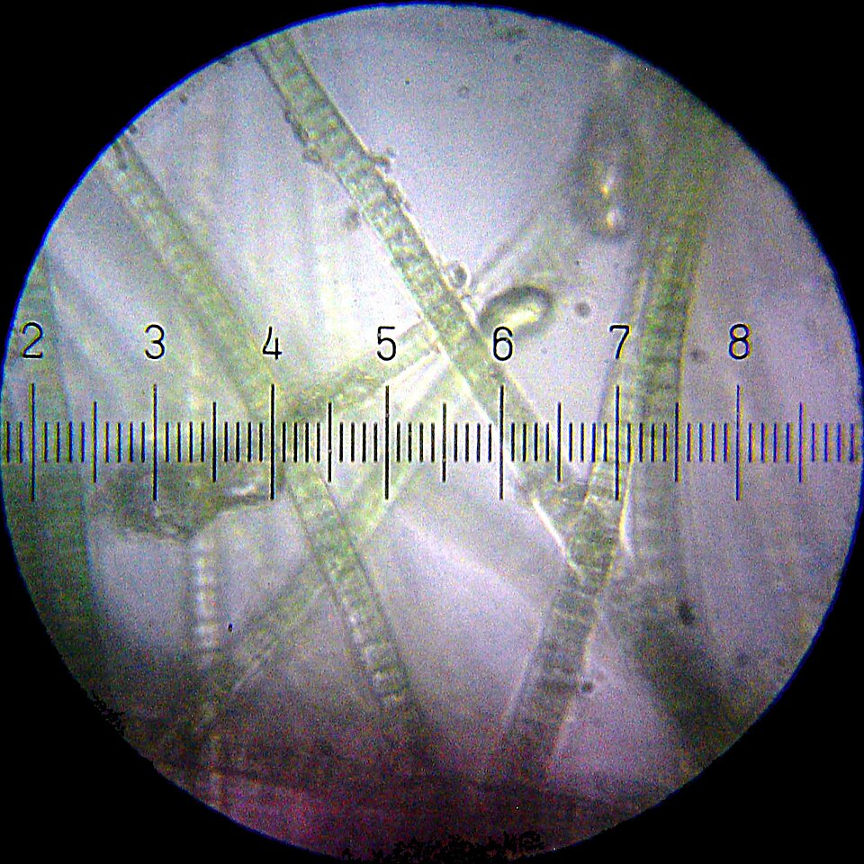
SLIDE 6: Calvin Cycle & Carbon Fixation
RuBisCO enzyme fixes carbon dioxide
G3P sugar produced

Slide 7
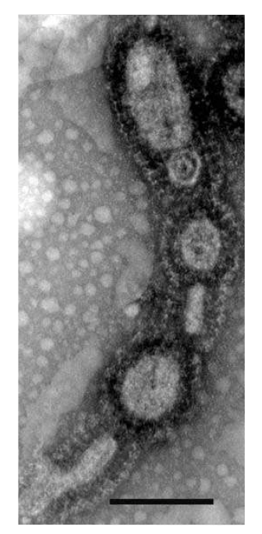
SLIDE 7: Deep Dive: Electron Transport Chain
Cytochrome b6f complex
Proton gradient drives ATP synthase

Slide 8
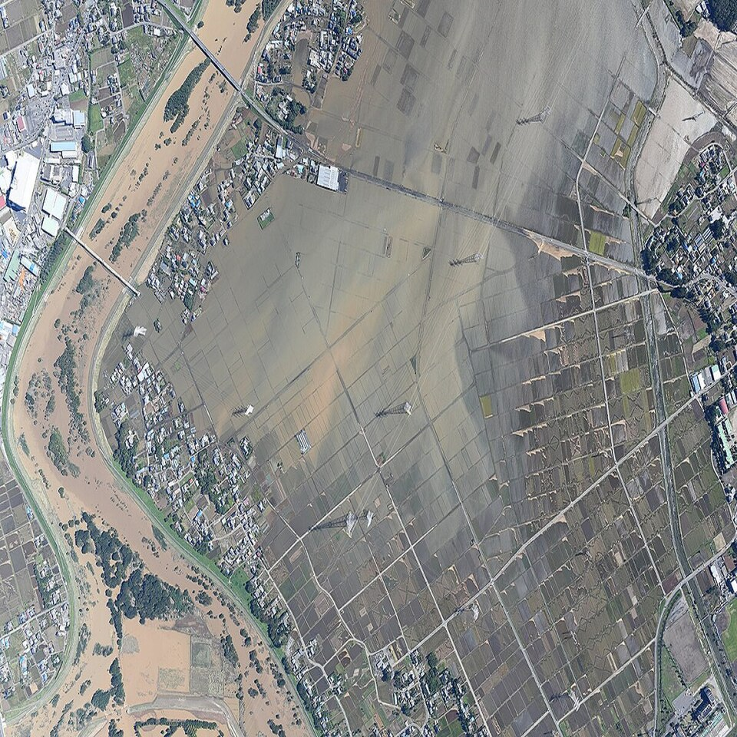
SLIDE 8: Real-World Applications & Agricultural Crop Yields
Artificial photosynthesis research
Optimizing greenhouse lighting

Slide 9
SLIDE 9: Critical Thinking & Ecological Impact
Impact of deforestation on global carbon cycle

Slide 10
SLIDE 10: Summary & Conclusion
Key points recap
Discussion questions

