Slide 1
SLIDE 1 - DATABASE SECURITY
Subtitle: This lecture surveys the foundational principles, technical controls, and contemporary challenges of protecting relational and NoSQL data stores.
Key themes
The CIA triad as a security framework for databases.
Authentication, authorization, and access-control architectures.
Encryption, monitoring, and compliance mechanisms in modern deployments.

Slide 2
SLIDE 2 - LEARNING OBJECTIVES
By the end of this lecture, students will be able to:
1. Articulate precise definitions of confidentiality, integrity, and availability as they apply to database systems.
2. Compare discretionary, mandatory, and role-based access-control models and justify the selection of each in a given scenario.
3. Design a layered protection strategy that incorporates authentication, encryption (at rest & in transit), and audit logging.
4. Evaluate a real-world breach case study using threat-modeling techniques such as STRIDE to identify mitigations.

Slide 3

SLIDE 3 - CONTEXT & RELEVANCE
Databases hold the majority of mission-critical and personally identifiable information in enterprise applications.
The concentration of high-value data makes databases a frequent target; 19 % of breaches involved database compromise (Verizon DBIR 2023).
Perimeter-only defenses are insufficient-insider threats and credential theft can bypass network-level controls.
A systematic security posture requires preventive controls (e.g., encryption) and detective controls (e.g., activity monitoring).
Cloud-native architectures add new attack surfaces: mis-configured storage buckets, exposed management APIs, etc.
Speaker note: Emphasise that database security is multidimensional and extends far beyond the classic "firewall-only" mindset.

Slide 4
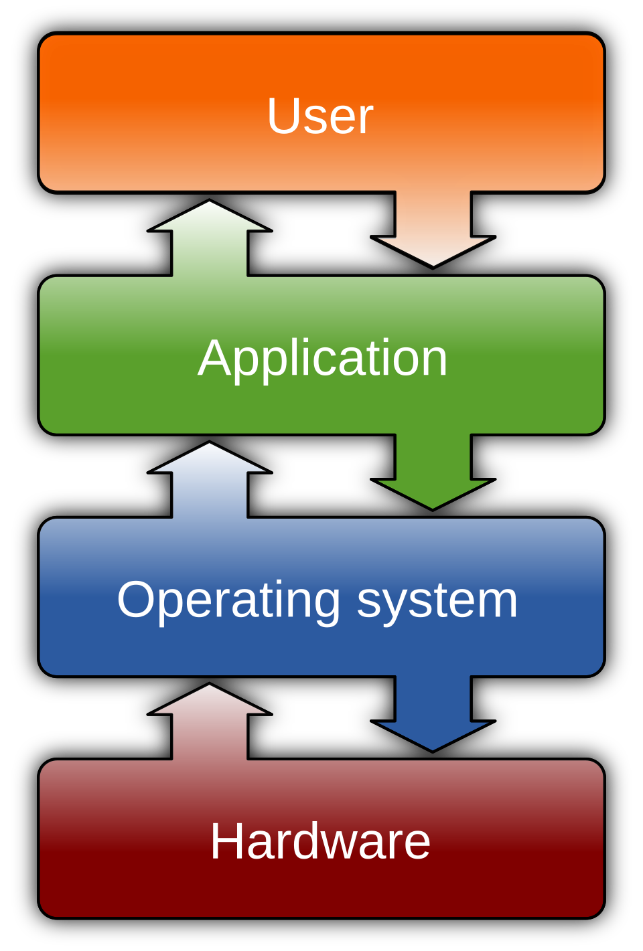
SLIDE 4 - CORE CONCEPT 1: THE CIA TRIAD IN DATABASES
Confidentiality - Only subjects with appropriate credentials may read or export data; enforced via encryption, masking, and column-level controls.
Integrity - Data must remain accurate and unaltered except by authorized transactions; upheld by constraints, checksums, and immutable transaction logs.
Availability - The system must deliver data to legitimate users within defined performance thresholds; achieved through replication, fail-over clusters, and rigorous backup strategies.
The three properties are inter-dependent; e.g., excessive encryption without proper key-management can degrade availability by causing latency or service-outage during key rotation.
Quantitative metrics (RPO, RTO, false-positive rates) enable continuous improvement of the security program.
Visual cue: Insert a Venn-diagram showing overlap of CIA elements and example controls for each.
Speaker note: Highlight the need to balance the three pillars rather than optimise one at the expense of the others.

Slide 5

SLIDE 5 - CORE CONCEPT 2: AUTHENTICATION & AUTHORIZATION
Authentication validates identity of users, services, or devices before any DB interaction (passwords, MFA tokens, X.509 certificates, Kerberos tickets).
Authorization determines which operations (SELECT, INSERT, ALTER, ...) an authenticated principal may perform (GRANT statements, role memberships).
Role-Based Access Control (RBAC) abstracts individual privileges into roles → simplifies administration & supports least-privilege.
Mandatory Access Control (MAC) enforces system-wide policies based on security labels → stronger isolation for highly classified data.
Continuous re-evaluation of session context (IP, device posture, risk score) is a core tenet of zero-trust database access.
Visual cue: Show a flowchart from authentication → session creation → authorization check.
Speaker note: Stress that strong authentication is a prerequisite for any meaningful authorization policy.

Slide 6
SLIDE 6 - CORE CONCEPT 3: ACCESS-CONTROL MODELS & PRIVILEGE MANAGEMENT
Discretionary Access Control (DAC) - Object owners grant rights directly; can lead to privilege creep if not audited.
Mandatory Access Control (MAC) - Immutable policies supersede owner discretion; reduces risk of inadvertent over-granting.
RBAC - Aligns permissions with business functions, enables separation of duties (SoD), and simplifies compliance reporting.
Fine-grained delegation - Grant EXECUTE on specific stored procedures rather than broad table rights → limits impact of compromised accounts.
Automated privilege-audit tools detect anomalous grant patterns and recommend revocation to enforce least-privilege.
Visual cue: Use a comparative matrix (rows = DAC, MAC, RBAC; columns = owner control, policy rigidity, typical use-case).
Speaker note: Use a diagram to contrast DAC, MAC, and RBAC, illustrating where each model is most appropriate.

Slide 7
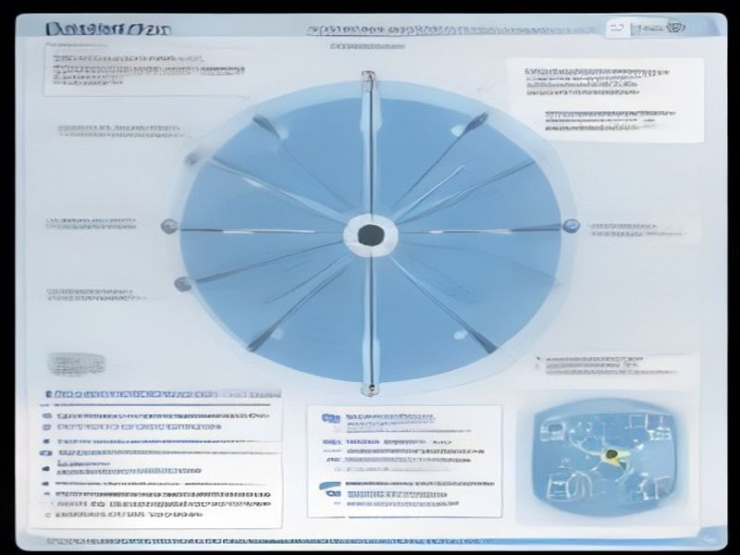
SLIDE 7 - DEEP DIVE: TECHNICAL MECHANISMS
Transparent Data Encryption (TDE) - AES-256 applied to data files & backups; < 5 % performance overhead on modern hardware.
TLS 1.2/1.3 - Encrypts client-to-server traffic, protecting credentials & query payloads from network-level eavesdropping.
Database Activity Monitoring (DAM) - Captures every DDL/DML event, correlates patterns against baselines, alerts on anomalous queries (e.g., tautological predicates).
Immutable auditing - Logs stored in WORM repositories provide forensic evidence for regulatory investigations.
Patch management - Timely application of vendor security advisories eliminates known exploitable vulnerabilities (e.g., CVE-2022-XXXX).
Visual cue: Layered "defence-in-depth" diagram with TDE, TLS, DAM, Auditing, Patch Management stacked.
Speaker note: Illustrate how these mechanisms form a layered defence-in-depth architecture.

Slide 8
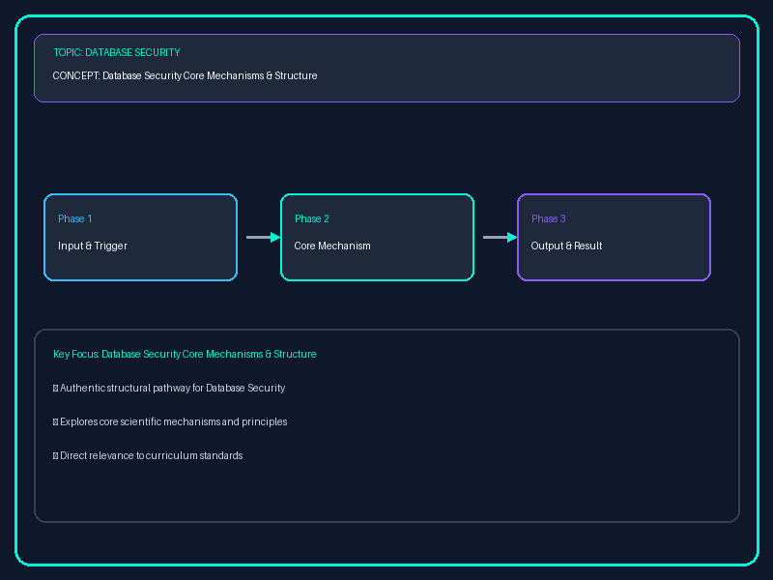
SLIDE 8 - REAL-WORLD APPLICATIONS & EXAMPLES
2022 Capital One breach - Mis-configured WAF allowed SQL-injection payload; underscores need for input sanitisation & DAM.
RBAC with strict SoD - Reduced average breach cost by 27 % (Ponemon 2023).
Cloud-native encryption - AWS RDS with TDE shows < 2 % latency increase, proving practicality at scale.
Homomorphic encryption prototypes - Enable secure analytics on encrypted health records, satisfying HIPAA while preserving utility.
Zero-trust database gateways - Per-query authentication blocked 94 % of lateral-movement attempts in recent red-team exercises.
Speaker note: Connect each example back to confidentiality, integrity, or availability controls discussed earlier.

Slide 9
SLIDE 9 - CRITICAL THINKING & ANALYSIS
1. Least-privilege vs. performance - How might strict privilege limits conflict with high-throughput OLTP workloads? Propose mitigation strategies (e.g., role-hierarchies, caching of privilege checks).
2. Full-disk vs. column-level encryption - Evaluate trade-offs when compliance mandates selective data protection.
3. Signature-based DAM vs. ML-based anomaly detection - Critically assess effectiveness for novel SQLi techniques.
4. STRIDE for databases - Adapt threat-modeling to enumerate DB-specific attack surfaces (e.g., privilege escalation via stored procedures).
5. Ethics of homomorphic encryption - Discuss implications for data ownership & accountability in outsourced analytics.
Speaker note: Prompt small-group debates; require evidence-based arguments and citation of at least one scholarly source per argument.

Slide 10
SLIDE 10 - SUMMARY & DISCUSSION
Key take-aways
The CIA triad provides a conceptual scaffold for evaluating confidentiality, integrity, and availability in database environments.
Robust authentication, granular authorization, and appropriate access-control models are essential to enforce least-privilege.
Encryption, activity monitoring, and disciplined patch management constitute the technical backbone of a resilient database security program.
Discussion question
In a multi-cloud architecture where data resides across heterogeneous DBMS platforms, how would you design a unified security policy that satisfies both technical constraints and diverse compliance mandates?
Further reading
NIST SP 800-53 Revision 5 - "Database Security" controls (https://csrc.nist.gov/publications/detail/sp/800-53/rev-5/final)
Verizon Data Breach Investigations Report 2023 (Verizon 2023, Data Breach Investigations Report, https://www.verizon.com/business/resources/reports/dbir/)

