Slide 1
EDUFORGE AI · CURRICULUM SUITE
human respiratory system
This lecture explains how we breathe, how oxygen and carbon-dioxide move between air and blood, and how the body controls breathing.
Target Audience: Secondary Education Curriculum
September 14, 2026 | 10 Learning Slides | Multi-Agent Pedagogical Pipeline

Slide 2
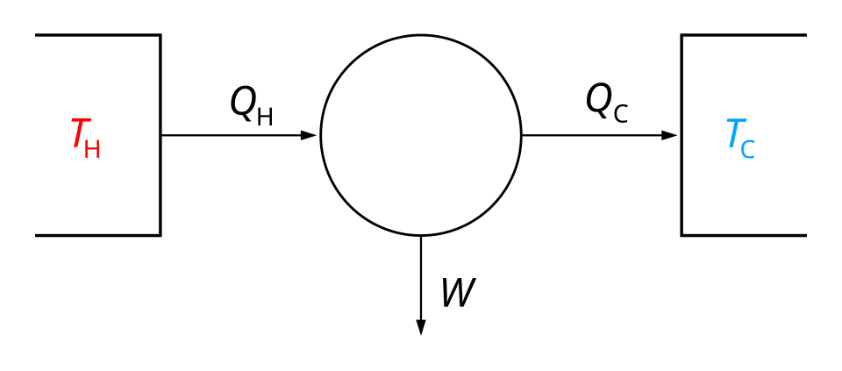
HUMAN RESPIRATORY SYSTEM · SECONDARY LEVEL
SLIDE 1: Human Respiratory System
01
Structure and function of the respiratory tract
02
Mechanics of ventilation and gas exchange
03
Regulation and transport of respiratory gases
Visual Concept Diagram · EduForge AI
human respiratory system | EduForge AI Curriculum Suite
01 / 10

Slide 3
HUMAN RESPIRATORY SYSTEM · SECONDARY LEVEL
SLIDE 2: LEARNING OBJECTIVES
01
02
Define respiration, ventilation, and gas exchange using clear, everyday language.
Describe the main anatomical parts of the upper and lower airways and their roles.
03
04
Explain how the diaphragm and intercostal muscles create the pressure changes needed for breathing.
Summarize how oxygen and carbon-dioxide are carried in the blood and how breathing is automatically regulated.
human respiratory system | EduForge AI Curriculum Suite
02 / 10

Slide 4
HUMAN RESPIRATORY SYSTEM · SECONDARY LEVEL
SLIDE 3: TOPIC INTRODUCTION & CONTEXT
01
02
The respiratory system supplies every cell in the body with oxygen, the fuel needed for energy production, and removes carbon-dioxide, a waste gas.
Respiration includes two linked processes: external respiration (gas exchange between air and blood) and cellular respiration (use of O2 inside cells to make ATP).
03
04
Humans have a highly branched airway network called the bronchial tree, which ends in millions of tiny air sacs called alveoli where gas exchange occurs.
The total surface area of all alveoli together is about 70 m2-roughly the size of a tennis court-providing ample space for diffusion.
05
Breathing is controlled automatically by the brainstem, but we can also change it voluntarily, such as when singing or exercising.
human respiratory system | EduForge AI Curriculum Suite
03 / 10

Slide 5
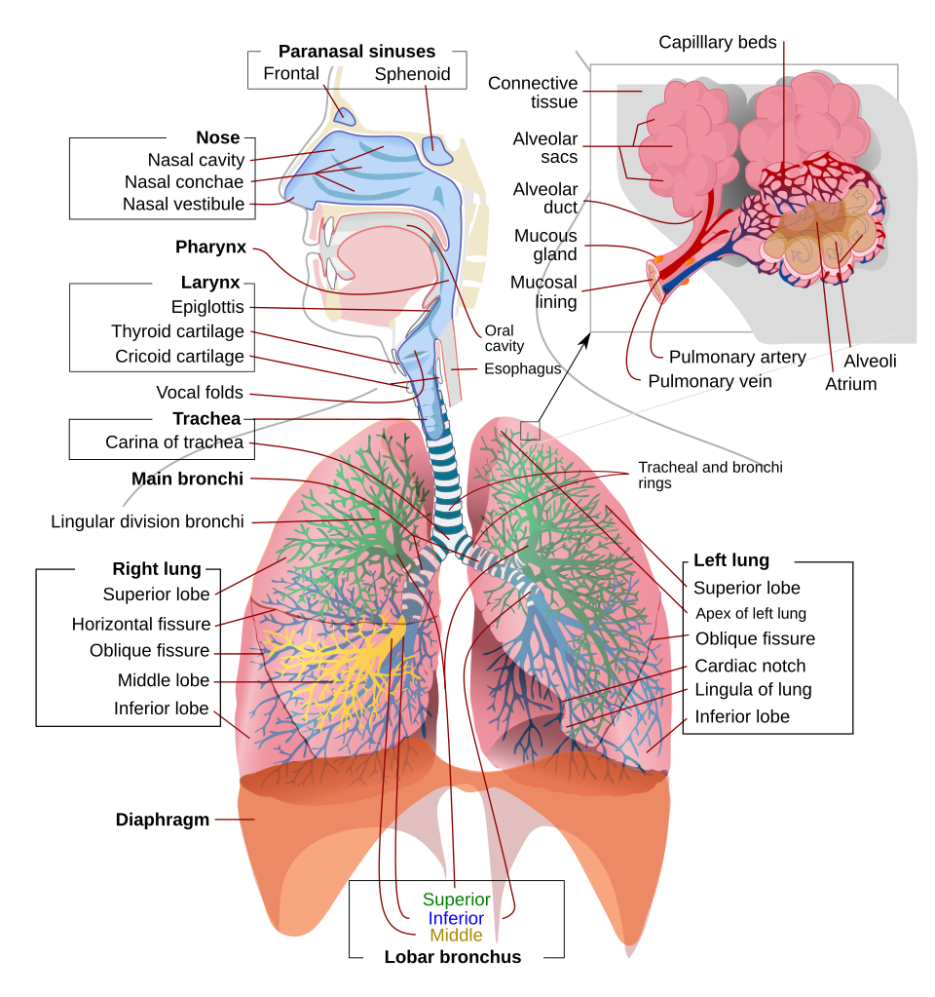
HUMAN RESPIRATORY SYSTEM · SECONDARY LEVEL
SLIDE 4: CORE CONCEPT 1: RESPIRATION & VENTILATION
01
Respiration (the overall process of taking in O2 and releasing CO2) is divided into external and cellular components.
02
Ventilation, also called pulmonary ventilation, is the mechanical movement of air in and out of the lungs through inhalation and exhalation.
03
During quiet inhalation, the diaphragm contracts and flattens while the external intercostal muscles lift the ribs, increasing thoracic volume and lowering lung pressure.
04
Quiet exhalation occurs when these muscles relax, allowing the elastic recoil of the lungs and chest wall to push air out.
Visual Concept Diagram · EduForge AI
human respiratory system | EduForge AI Curriculum Suite
04 / 10

Slide 6
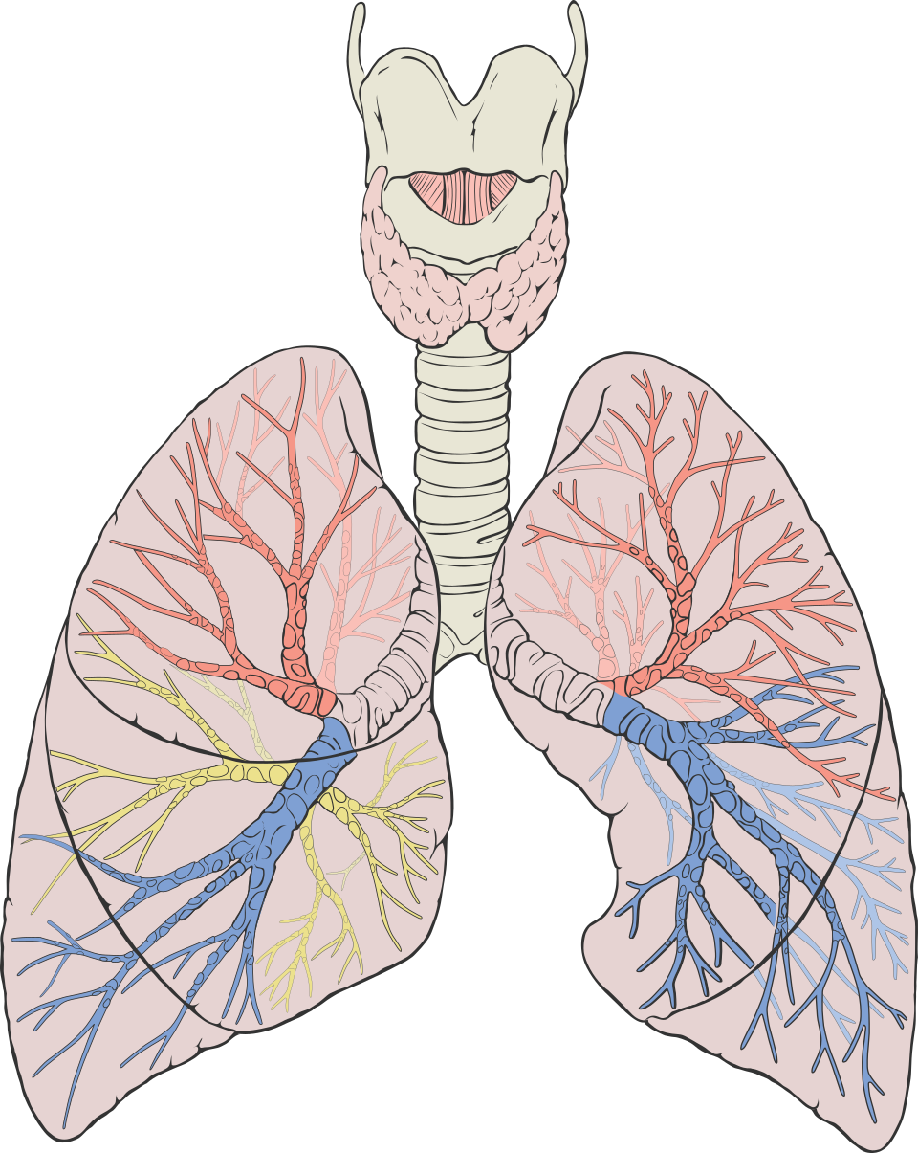
HUMAN RESPIRATORY SYSTEM · SECONDARY LEVEL
SLIDE 5: CORE CONCEPT 2: ANATOMY OF THE RESPIRATORY TRACT
01
The upper airway starts at the nasal cavity, continues through the pharynx and larynx, and ends at the trachea, which serves as the main air conduit.
02
The lower airway branches from the trachea into the right and left primary bronchi (three on the right, two on the left) and then repeatedly subdivides into lobar, segmental bronchi, bronchioles, and finally the respiratory bronchioles.
03
Terminal bronchioles lead to alveolar ducts that end in clusters of alveoli, each surrounded by a dense network of pulmonary capillaries.
04
The pleura consists of two thin layers-the visceral pleura covering the lungs and the parietal pleura lining the chest cavity-that secrete fluid to reduce friction during breathing.
Visual Concept Diagram · EduForge AI
human respiratory system | EduForge AI Curriculum Suite
05 / 10

Slide 7
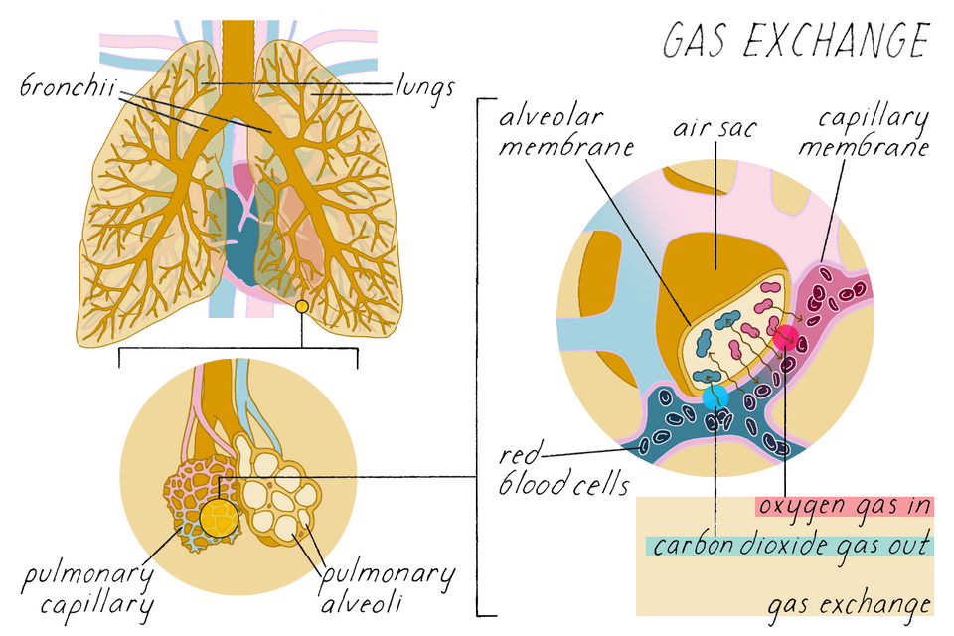
HUMAN RESPIRATORY SYSTEM · SECONDARY LEVEL
SLIDE 6: CORE CONCEPT 3: GAS EXCHANGE & TRANSPORT
01
External (pulmonary) gas exchange occurs by diffusion: O2 moves from the high-pressure alveolar air (~100 mmHg) into lower-pressure blood (~40 mmHg), while CO2 moves in the opposite direction.
02
Fick's law states that the rate of diffusion is proportional to surface area and the diffusion coefficient, and inversely proportional to membrane thickness; thickening (as in fibrosis) slows gas exchange.
03
About 98 % of oxygen is carried bound to hemoglobin (Hb) in red blood cells, forming oxyhemoglobin, while the remaining 2 % dissolves directly in plasma.
04
Carbon-dioxide is transported mainly as bicarbonate ions (~70 %), with smaller amounts dissolved in plasma (~7 %) and bound to proteins as carbamino compounds (~23 %).
Visual Concept Diagram · EduForge AI
human respiratory system | EduForge AI Curriculum Suite
06 / 10

Slide 8
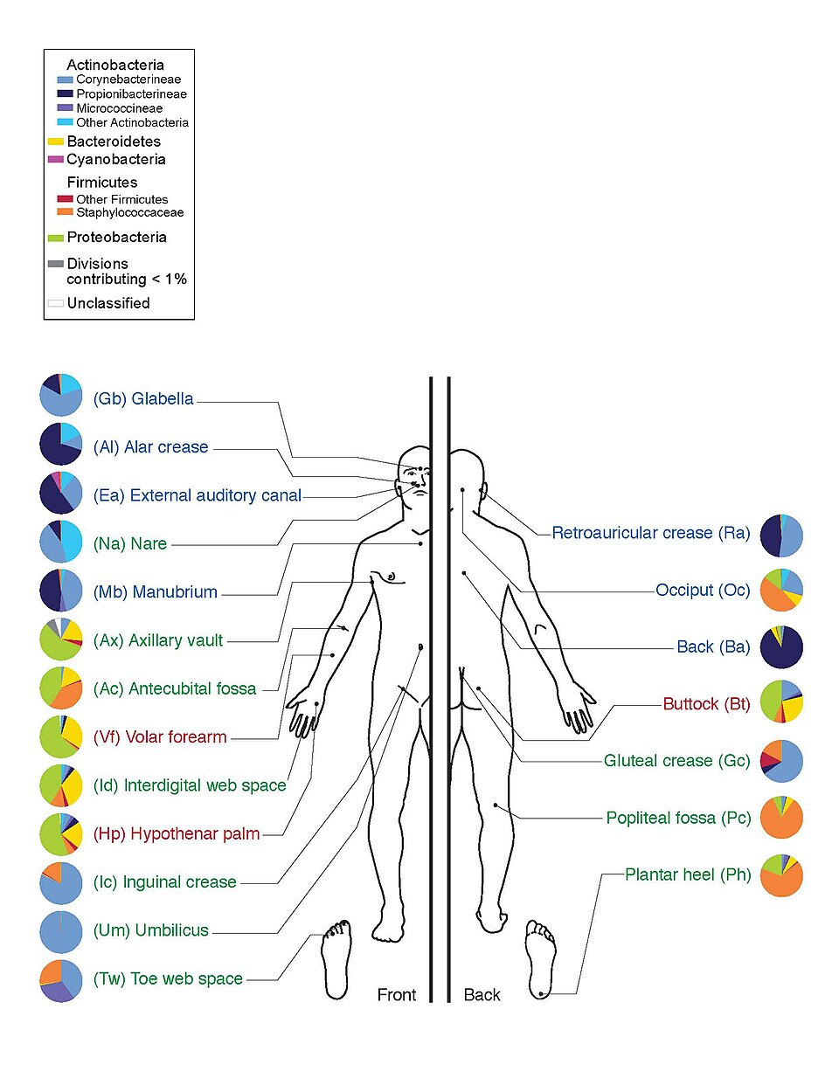
HUMAN RESPIRATORY SYSTEM · SECONDARY LEVEL
SLIDE 7: DEEP DIVE & MECHANISMS
01
Inhalation reduces intrapulmonary pressure below atmospheric pressure, creating a pressure gradient that pulls air into the lungs.
02
The diaphragm's contraction lowers the pressure in the thoracic cavity by about 2-3 mmHg, while rib elevation adds another 1-2 mmHg of pressure drop.
03
During forced exhalation, the internal intercostal muscles contract to pull the ribs downward, and abdominal muscles push the diaphragm upward, raising intrapulmonary pressure to expel air rapidly.
04
The volume of air moved in a normal breath (tidal volume) is about 500 mL, whereas the maximal amount that can be exhaled after a deep inhalation (vital capacity) ranges from 3 to 5 L in adolescents.
Visual Concept Diagram · EduForge AI
human respiratory system | EduForge AI Curriculum Suite
07 / 10

Slide 9
HUMAN RESPIRATORY SYSTEM · SECONDARY LEVEL
SLIDE 8: REAL-WORLD APPLICATIONS & EXAMPLES
01
Athletes train to increase tidal volume and vital capacity, allowing more oxygen to reach muscles during intense exercise.
02
At high altitude, lower atmospheric pO2 triggers peripheral chemoreceptors, causing deeper and faster breathing to maintain oxygen delivery.
03
Smoking damages the alveolar walls, reducing surface area and thickening the diffusion barrier, which impairs gas exchange and leads to chronic obstructive pulmonary disease (COPD).
04
Respiratory infections such as pneumonia fill alveoli with fluid, dramatically decreasing the effective surface area for diffusion and causing shortness of breath.
Visual Concept Diagram · EduForge AI
human respiratory system | EduForge AI Curriculum Suite
08 / 10

Slide 10
HUMAN RESPIRATORY SYSTEM · SECONDARY LEVEL
SLIDE 9: CRITICAL THINKING & ANALYSIS
01
02
How would a decrease in hemoglobin concentration (as in anemia) affect the amount of oxygen delivered to tissues, even if lung function is normal?
If the diaphragm were paralyzed, which other muscles could partially compensate for breathing, and what limitations would they have?
03
04
Why does carbon-dioxide, rather than oxygen, serve as the primary driver of the respiratory control center's response to metabolic changes?
Consider a scenario where alveolar walls become thickened by fibrosis; predict how this would alter the partial pressures of O2 and CO2 in arterial blood.
05
Evaluate the trade-offs between rapid, shallow breathing and slow, deep breathing during a sprint versus a long-distance run.
human respiratory system | EduForge AI Curriculum Suite
09 / 10

Slide 11
HUMAN RESPIRATORY SYSTEM · SECONDARY LEVEL
SLIDE 10: SUMMARY & CONCLUSION
01
02
The respiratory system's structure-from nasal cavity to alveoli-creates a large, thin-walled surface for gas exchange.
Breathing is driven by coordinated muscle actions that change thoracic pressure, while the brainstem automatically regulates rate and depth.
03
04
Discussion question
Oxygen is mainly transported bound to hemoglobin, and carbon-dioxide is carried in three forms, with the control center responding chiefly to CO2-induced pH changes.
*If you could design a new technology to improve gas exchange in diseased lungs, what biological principle would you base it on and why?*
05
Further reading
Explore a reputable science textbook chapter or a short documentary on pulmonary physiology (e.g., "The Lungs: Anatomy and Function" from a trusted educational series).
human respiratory system | EduForge AI Curriculum Suite
10 / 10

Slide 12
End of Lecture
human respiratory system

