Slide 1


Slide 2


Slide 3





IoT CONTAINER
WATCH YOUR CONTAINERS ANYWHERE!
GET YOUR STATISTICS!
TEMPERATURE
HUMIDITY
EXPIRING DATE
FULL CHECK
CAP
STATE OF THE BOX (READ THE LIGHTS!)

Slide 4
HOW IT WORKS

Slide 5


Slide 6
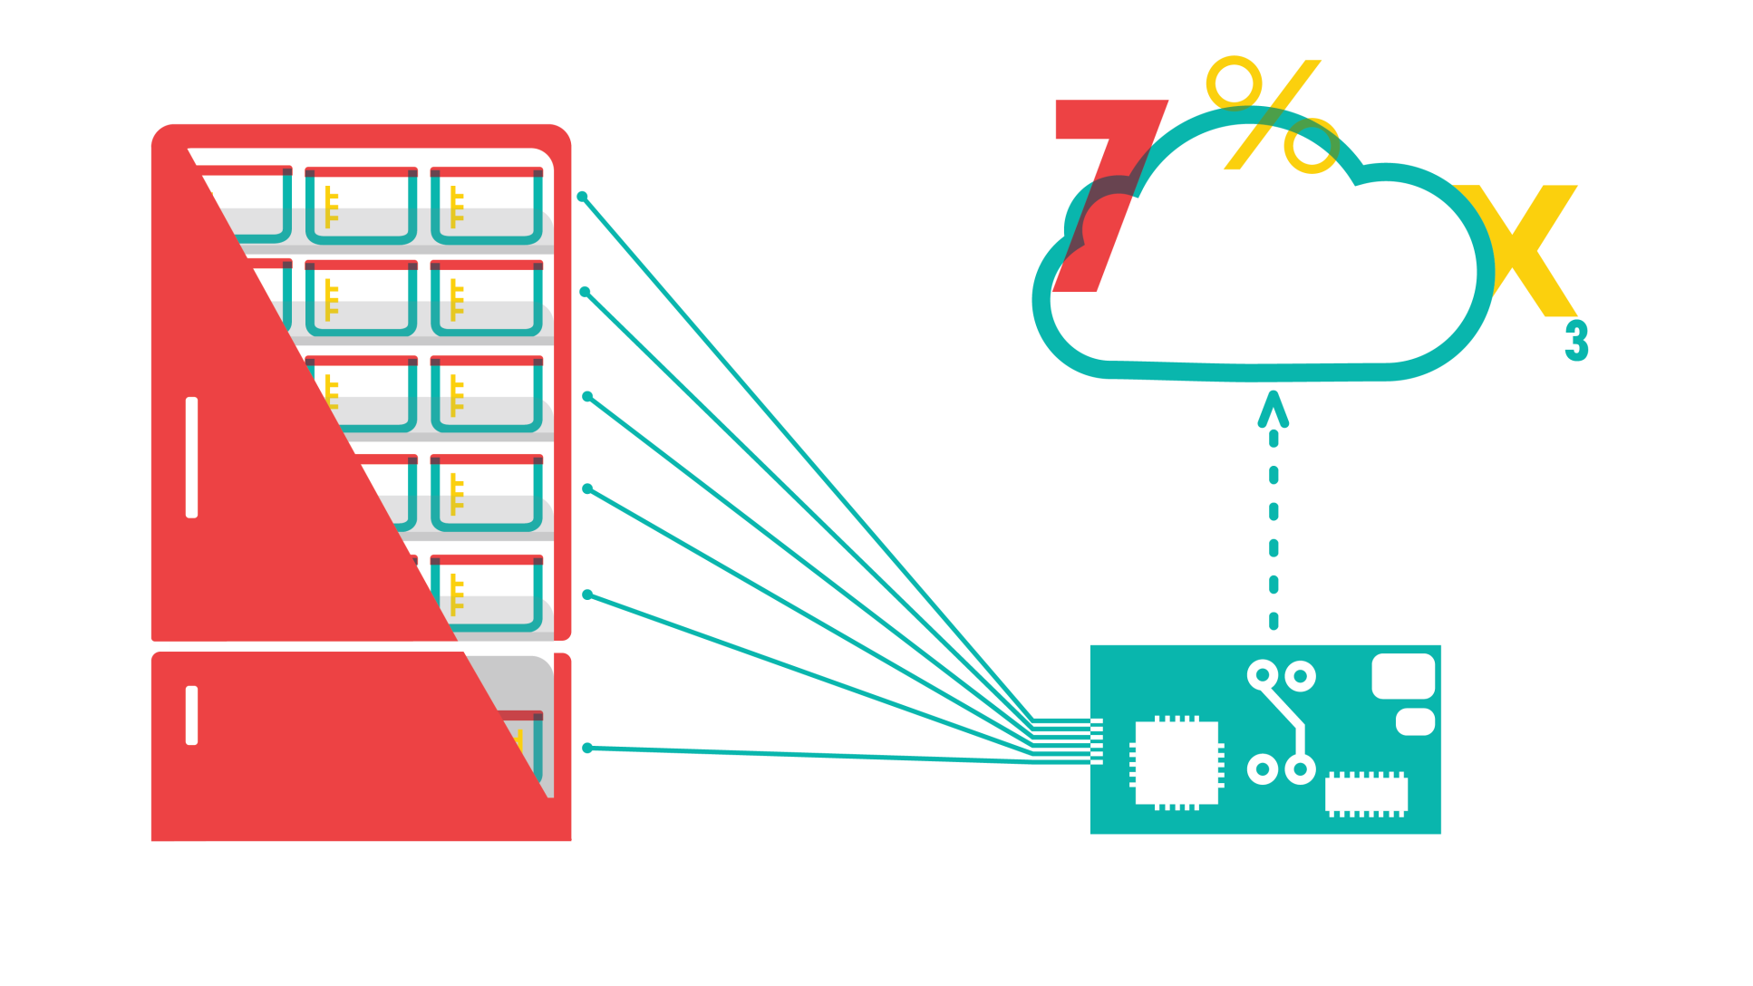

Slide 7
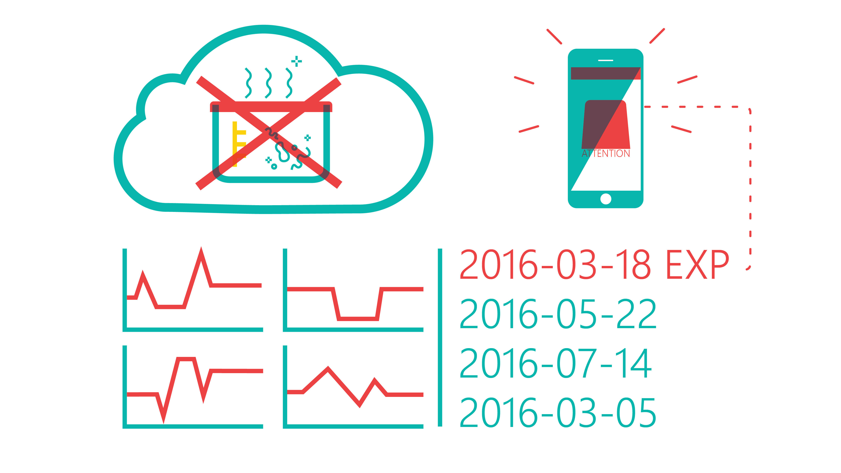

Slide 8
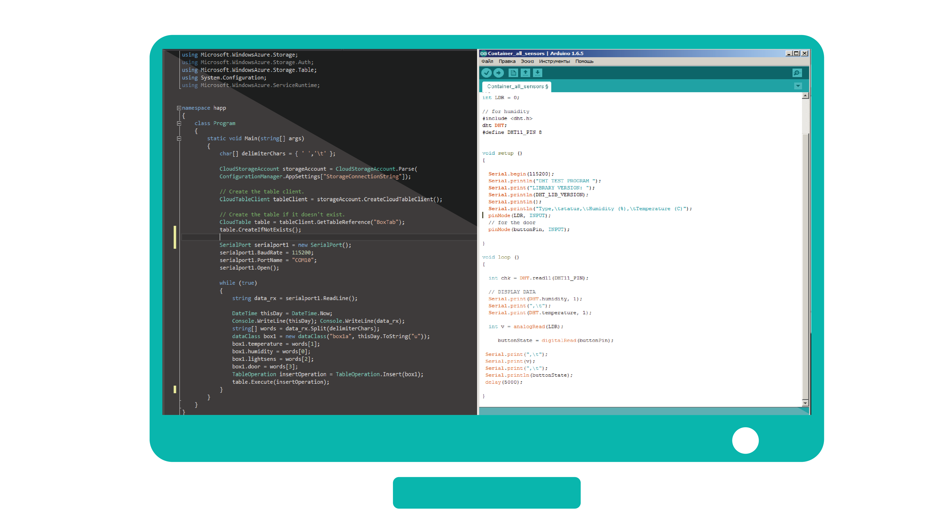

Slide 9
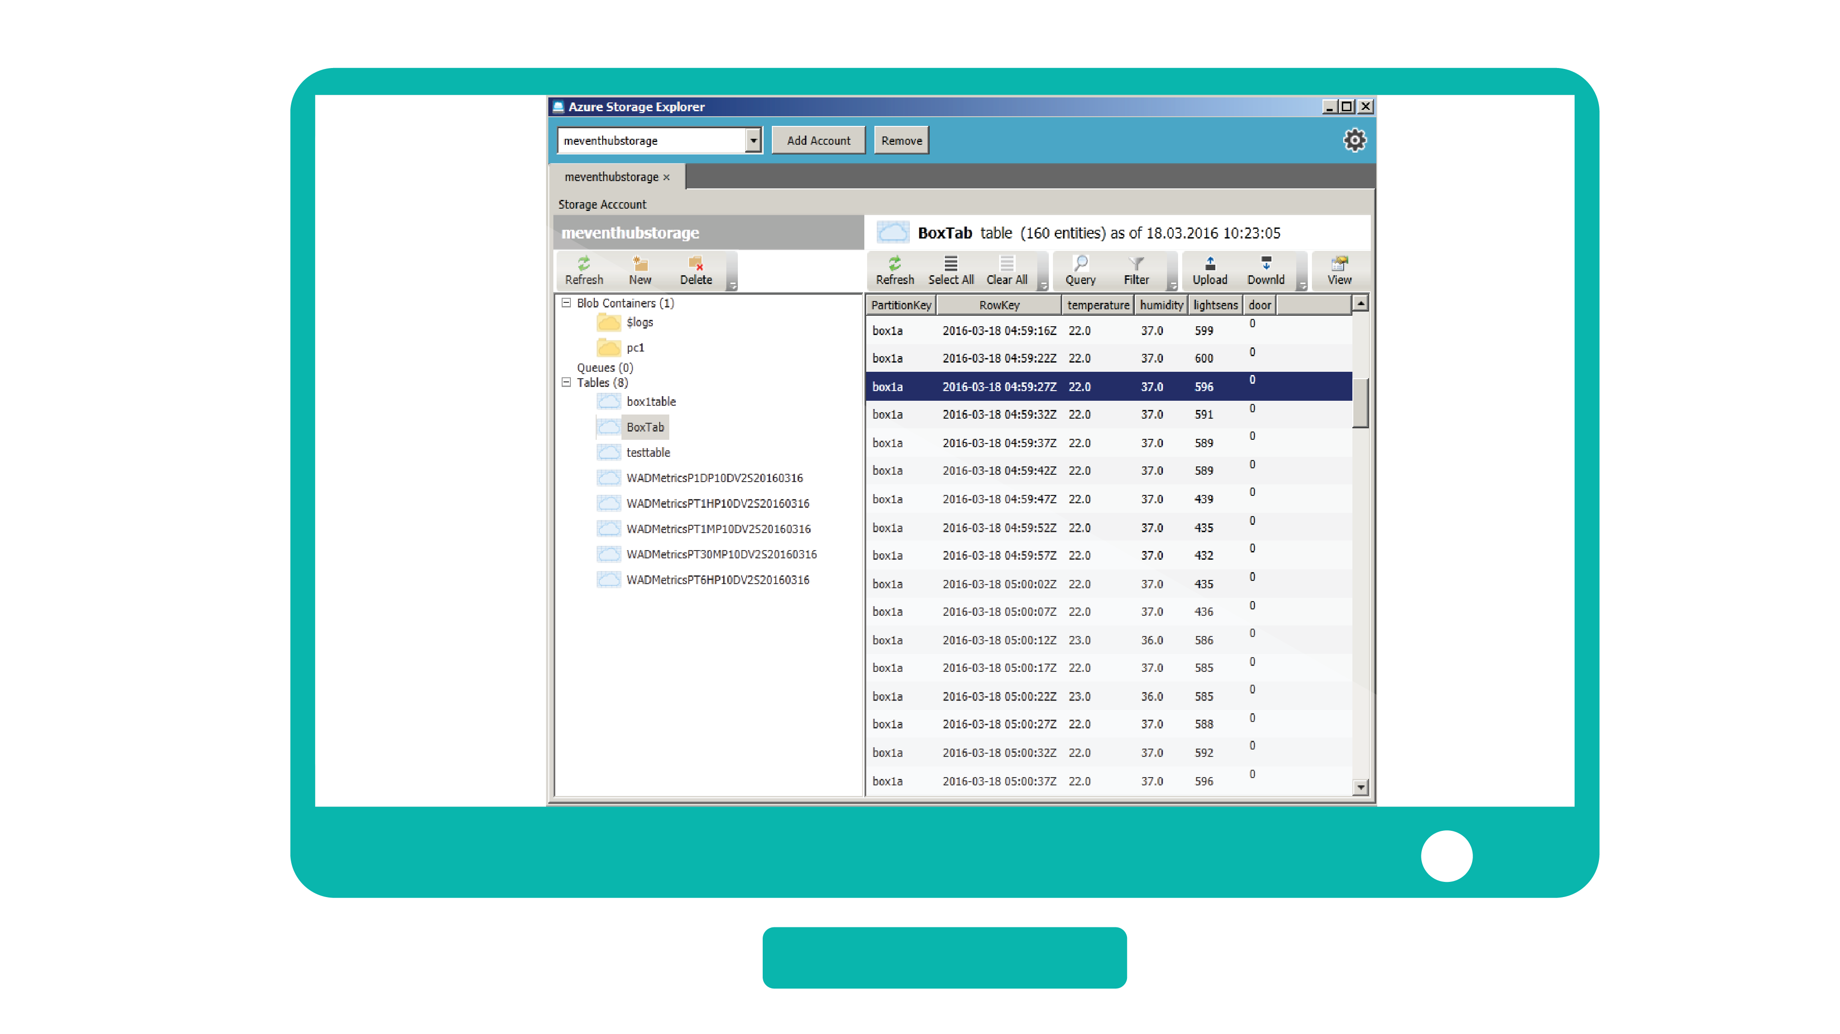

Slide 10
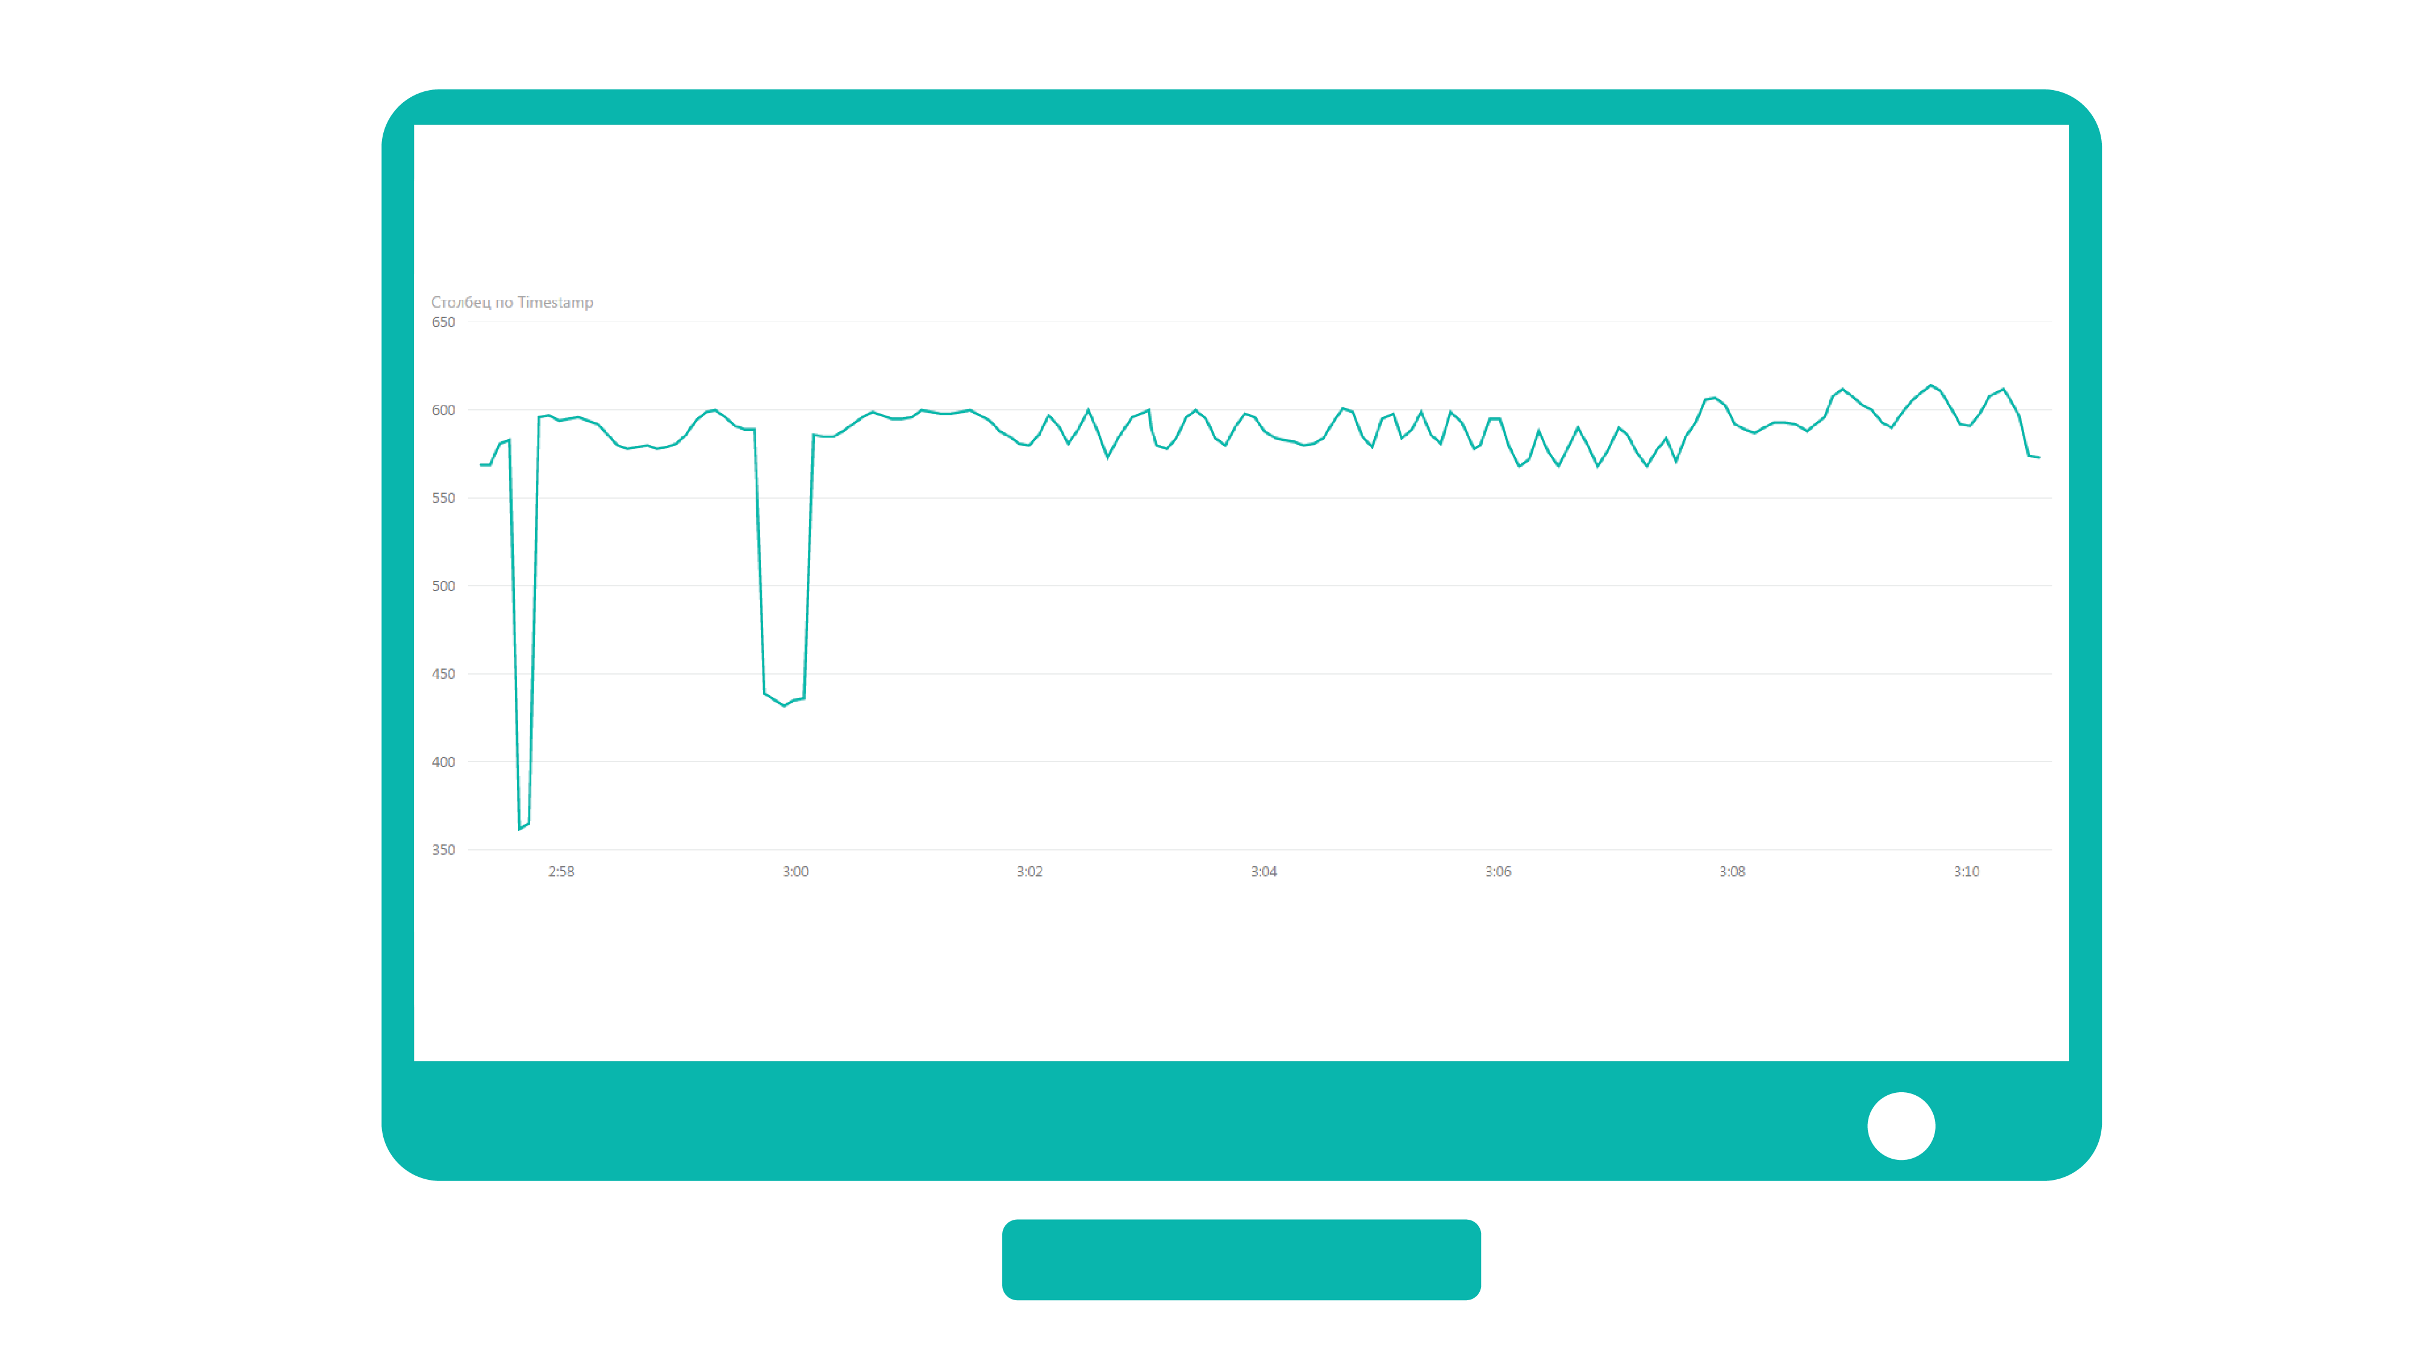

Slide 11


