Slide 1
SMM Mode
Kernel Mode
User Mode
SMRAM
ashmd Module
Ulibaurora
SMVisor
Secure Session
Enclave
Tlibaurora
User logic
Drivers
Kernel
Drivers
Hardware
Keyboard
Printer
Disk
Clock
...

Slide 2
App Enclave
App Enclave
App Enclave
App Enclave
Launch
Enclave
ashmd
Launch
Enclave
Launch
Enclave
TPM PCR
SMVisor
TPM PCR
SMVisor
TPM PCR

Slide 3
Enclave
Enclave
Tlibaurora
Tlibaurora
User
Mode
App
App
Ulibaurora
Ulibaurora
Kernel
Kernel
Kernel
Mode
ashmd
ashmd
SMVisor
SMVisor
SMM
Mode
Drivers
Drivers
HW.
Devices
Devices

Slide 4
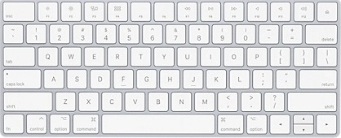
Aurora-OpenSSH Client
TLS
Operating System
Secure Session
SMVisor
OpenSSH Server
Keyboard

Slide 5

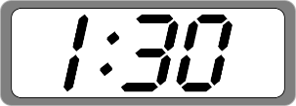

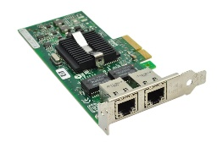


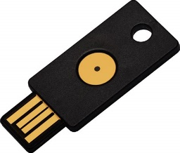
Client
Server
Client
Server
TLS
TLS
Enclave
OpenSSL
OpenSSL
SMRAM
Supervisor
Supervisor
Supervisor
Service Provider
HW Clock
NIC
Aurora-Key
Aurora-Bank

