Slide 1
SMM Mode
Kernel Mode
User Mode
SMRAM
Ulibaurora
ashmd Module
Enclave
SMVisor
Secure Session
Tlibaurora
User logic
Drivers
Kernel
Drivers
Hardware
KBD
COM
USB
CLK
App Enc.
App Enc.
Launch
Enc.
ashmd
TPM PCR
SMM
Supervisor

Slide 2
Enclave
Tlibaurora
User Mode
App
Ulibaurora
Kernel
Enclave
Enclave
Kernel Mode
ashmd
Tlibaurora
Tlibaurora
User Mode
SMVisor
App
App
Ulibaurora
Ulibaurora
SMM Mode
Drivers
Kernel
Kernel
Kernel Mode
ashmd
ashmd
Hardware
Devices
SMVisor
SMVisor
SMM Mode
Drivers
Drivers
Hardware
Devices
Devices

Slide 3

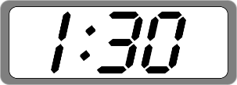

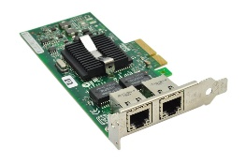
Client
Server
Client
Server
TLS
TLS
Enclave
OpenSSL
OpenSSL
SMRAM
Supervisor
Supervisor
Supervisor
Service Provider
HW Clock
NIC

Slide 4
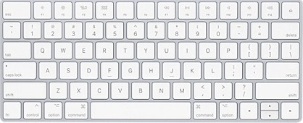


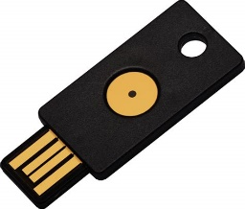
Aurora-OpenSSH Client
TLS
Operating System
Secure Session
SMVisor
OpenSSH Server
Keyboard
Aurora-Key
Aurora-Bank

