Slide 1

Практичне завдання “Work-case 2”
The presentation was prepared by students group БІКС-13
Savustian Maksym and Yemets Valeriia

Slide 2

In our situation, we installed Virtual Box. We found it on the Internet, downloaded it, and installed it
1. Встановіть на своїй домашній робочій станції гіпервізор ІІ типу – Virtual Box, VMWare Workstation, Hyper-V (або інший на Ваш вибір).
2

Slide 3
2. Опишіть набір базових дій в встановленому Вами гіпервізорі:
- Creating a new virtual machine; To create a new virtual machine, you need to click "Create" and configure the machine
- Selecting/adding hardware available for the virtual machine; You can add memory to the machine, select the number of processor cores, video card memory, audio, etc.
- Setting up a network and connecting to Wi-Fi points; To connect the machine to the Internet, I needed a wifi adapter, as I could not use the built-in one on my laptop.
- Ability to work with external media (flash memory). The memory can be expanded and external media can be connected
-Ability to make slices to "roll back" the system to an earlier stage
- The ability to create a shared folder between the main and the created OS
3
1
2
3
4
5
6

Slide 4
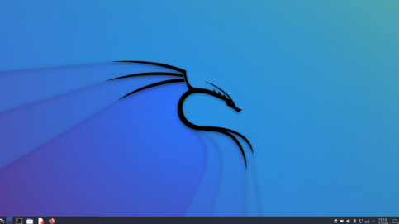
3. Встановіть в вашому гіпервізорі операційну систему GNU/Linux CentOS (або інший зручний Вам дистрибутив) у базовій конфігурації з графічною оболонкою.
4

Slide 5
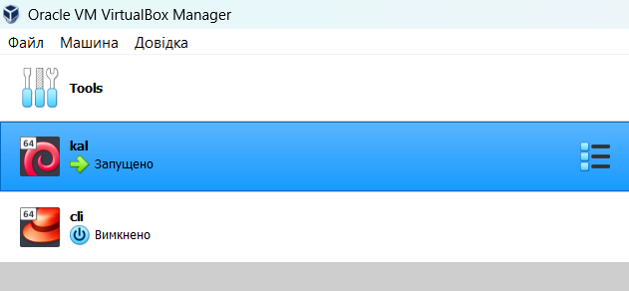
4. Створіть другу віртуальну машину та виконайте для неї наступні дії:
5

Slide 6
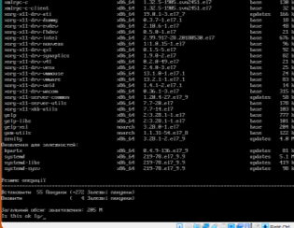
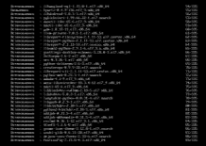
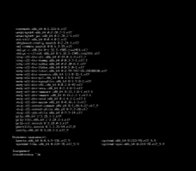
- Встановіть у мінімальній конфігурації з термінальним вводом-виводом без графічного інтерфейсу операційну систему GNU/Linux CentOS ;
6
1
2
3

Slide 7
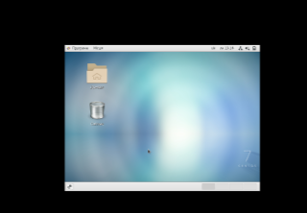
- Встановіть графічну оболонку GNOME поверх встановленої в попередньому пункті ОС;
7

Slide 8
- Встановіть додатково ще другу графічну оболонку (їх можливий перелік можна знайти в лабораторній роботі №1) та порівняйте її можливості з GNOME.
GNOME and KDE GNOME: It has a clean and simple design that focuses on ergonomics and ease of use. The interface has fewer controls by default. KDE: Aims to be more customisable and has different themes and styles for personalisation. The interface can look more colourful and varied. GNOME: Generally considered to be less resource intensive, which can be important for older or less powerful computers. KDE: Historically seen as more resource intensive, but has been optimised over the years to run more efficiently. GNOME: Has limited customisation options compared to KDE, but tries to make it easy to use. KDE: The word "customisation" is the key word for KDE. It has many options and personalisation possibilities. GNOME: Uses applications such as Nautilus (file manager), GNOME Terminal, GNOME Software, etc. KDE: Applications include Dolphin (file manager), Konsole (terminal), KDE Connect for mobile device integration, etc. GNOME: Part of the GNOME Project, it is the standard desktop environment for some Linux distributions. KDE: Also has its own large ecosystem, but is less commonly used than GNOME. GNOME: Usually simplistic and built-in, but can be extended with extensions. KDE: Known for its extensibility and large selection of applications to work with.
8

Slide 9
Conclusion
9
In this work, we installed a hypervisor and virtual machines, and did basic things there. We also installed 2 different graphical shells and found out what the difference between them was.

