Slide 1
Work-case№1
Github, creating repository, team work
The presentation was prepared by students group БІКС-13
Savustian Maksym and Yemets Valeriia

Slide 2
Git is a distributed version control system widely used in software development to track changes in source code during the development of a project. It enables collaboration among multiple developers, facilitates code management, and allows for efficient handling of different versions of the codebase

Slide 3

Here are the main use cases, actions, and commands in Git:
Action | Command
Initialize a new Git repository | git init
Clone a repository | git clone <URL>
Add files to staging area | git add <file>
Add all changed files to staging area | git add .
Commit changes | git commit -m "Commit message"
List available branches | git branch
Create a new branch | git branch <branch_name>
Switch to an existing branch | git checkout <branch_name>
Merge changes from different branches | git merge <branch_name>
Add a remote repository | git remote add origin <URL>
Push commits to a remote repository | git push origin <branch_name>
Fetch and merge changes from a remote | git pull origin <branch_name>
Show the status of the working directory | git status
Display the commit history | git log
Unstage a file | git reset <file>
Reset the repository to a specific commit | git reset --hard <commit>
Specify files or directories to ignore | Utilize .gitignore file

Slide 4




Git facilitates collaborative software development by tracking changes, managing branches, and ensuring a stable and organized version history. It enhances the efficiency of development workflows and provides mechanisms for team collaboration.

Slide 5
Що таке "комміт", як він дозволяє відслідковувати зміни у файлах?
Git’s main power comes from the ability to keep a record of every single change made to the files in your project by taking snapshots called commits. When you commit, Git only stores a summary of the changes, rather than storing entire copies of every changed file. This keeps things fast and stops a repository from getting unreasonably large.

Slide 6
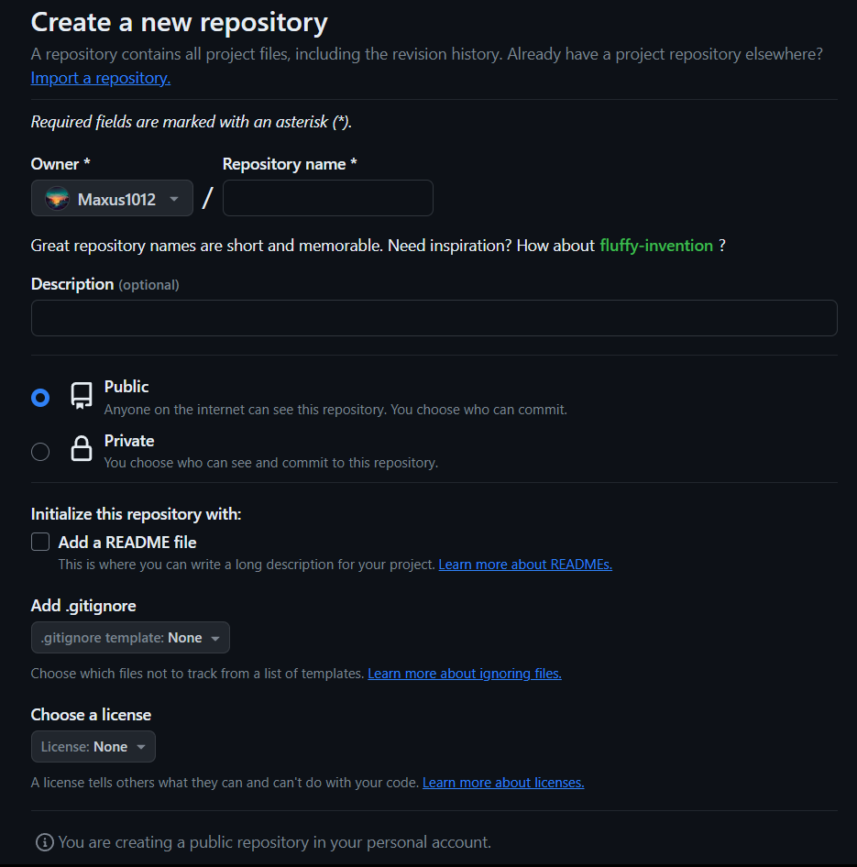
Даємо назву репозиторію
Публічне для особистого користування Приватне - для компанії
Для початку нам не потрібне

Slide 7

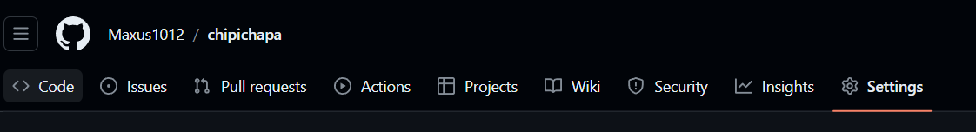
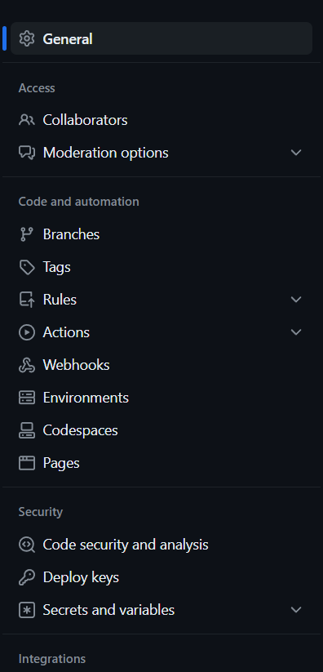
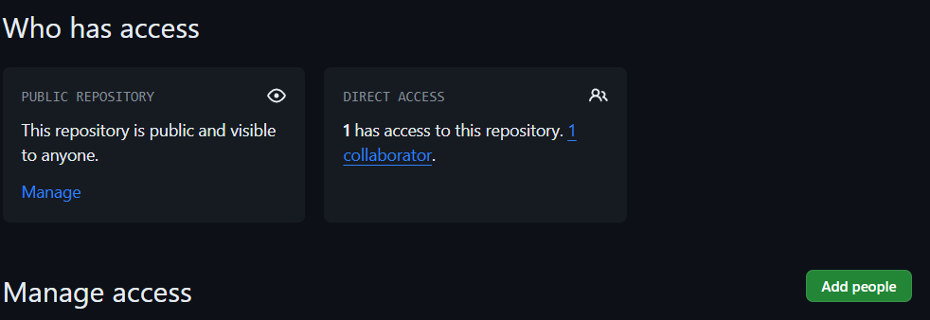

Заходимо в налаштування репозиторію
Завершуємо створення
1
2

Slide 8

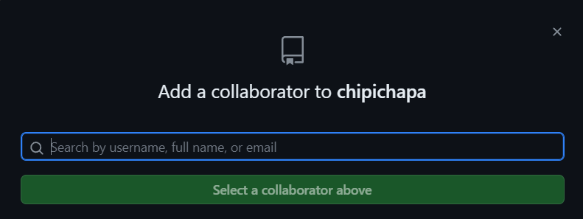
Знаходимо товаришів за їхнім username
Обираємо та доєднуємо акаунт до колег-редакторів-колабораторів

Slide 9
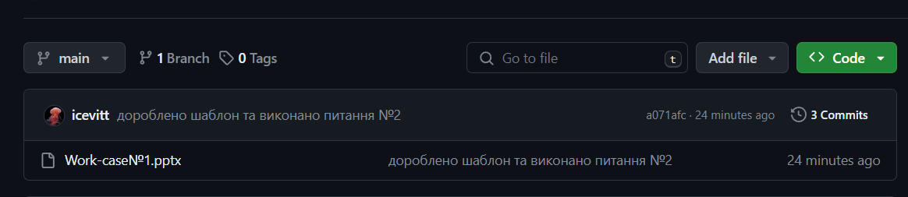
Вітаю!!! Ви можете насолоджуватись спільними роботами
Щоб добавити роботу потрібно зайти в головну строрінку репозиторію та загрузити файл для подальшої роботи з ним

Slide 10
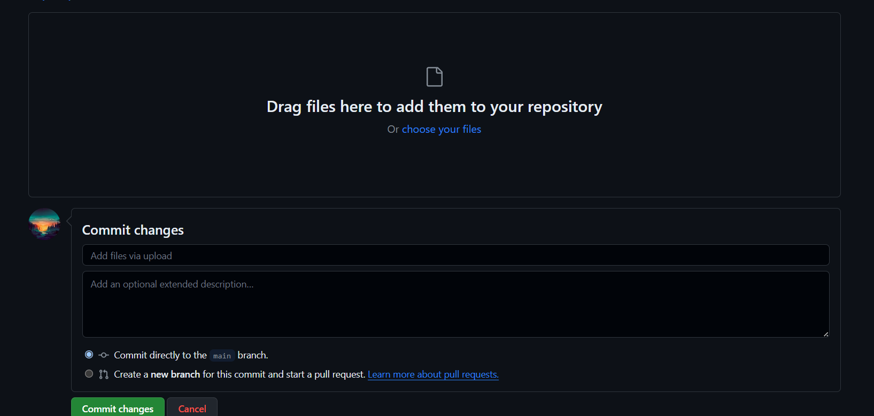
Для опису виправлень можна добавити commit

Slide 11
Conclusion
GitHub is a web service designed for working not only alone but also in a team. It makes work easier by distributing tasks amongst each other. It helps to develop the skills of being in a well-coordinated team, finding a common language with your colleagues. It also allows you to work online and make adjustments at any time

